Slide 1
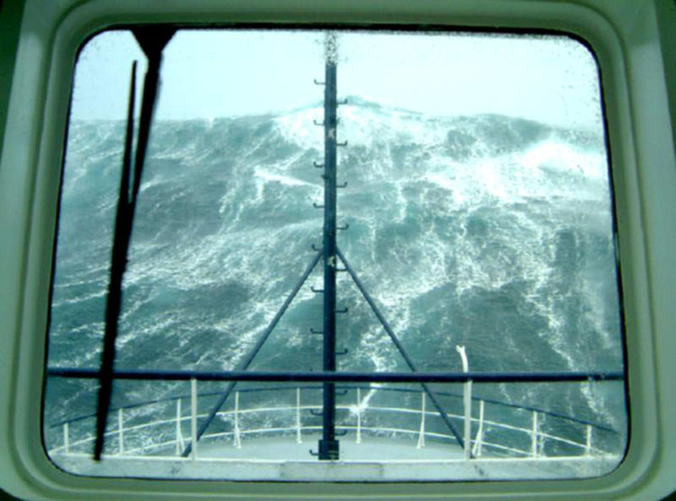
LECTURE 5 Ch 15 WAVES
What is a wave?
A disturbance that propagates
Examples
Waves on the surface of water
Sound waves in air
Electromagnetic waves
Seismic waves through the earth
Electromagnetic waves can propagate through a vacuum
All other waves propagate through a material medium (mechanical waves). It is the disturbance that propagates - not the medium - e.g. Mexican wave
CP 478

Slide 2
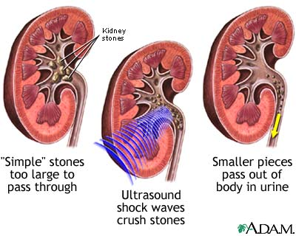
SHOCK WAVES CAN SHATTER KIDNEY STONES
Extracorporeal shock wave lithotripsy

Slide 3
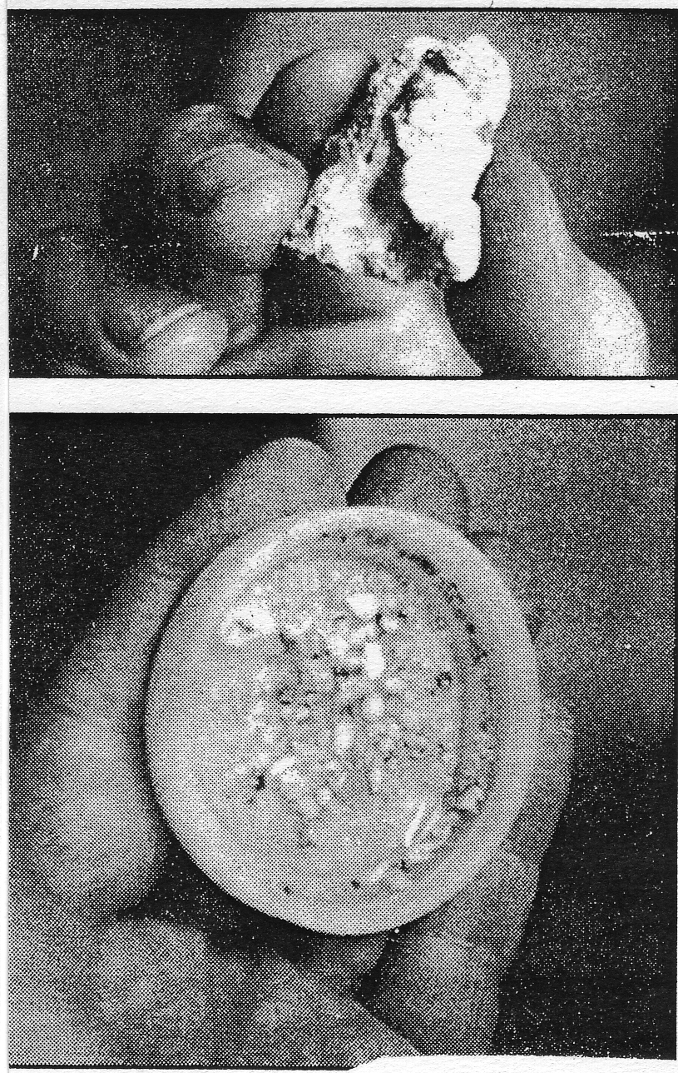

Slide 4
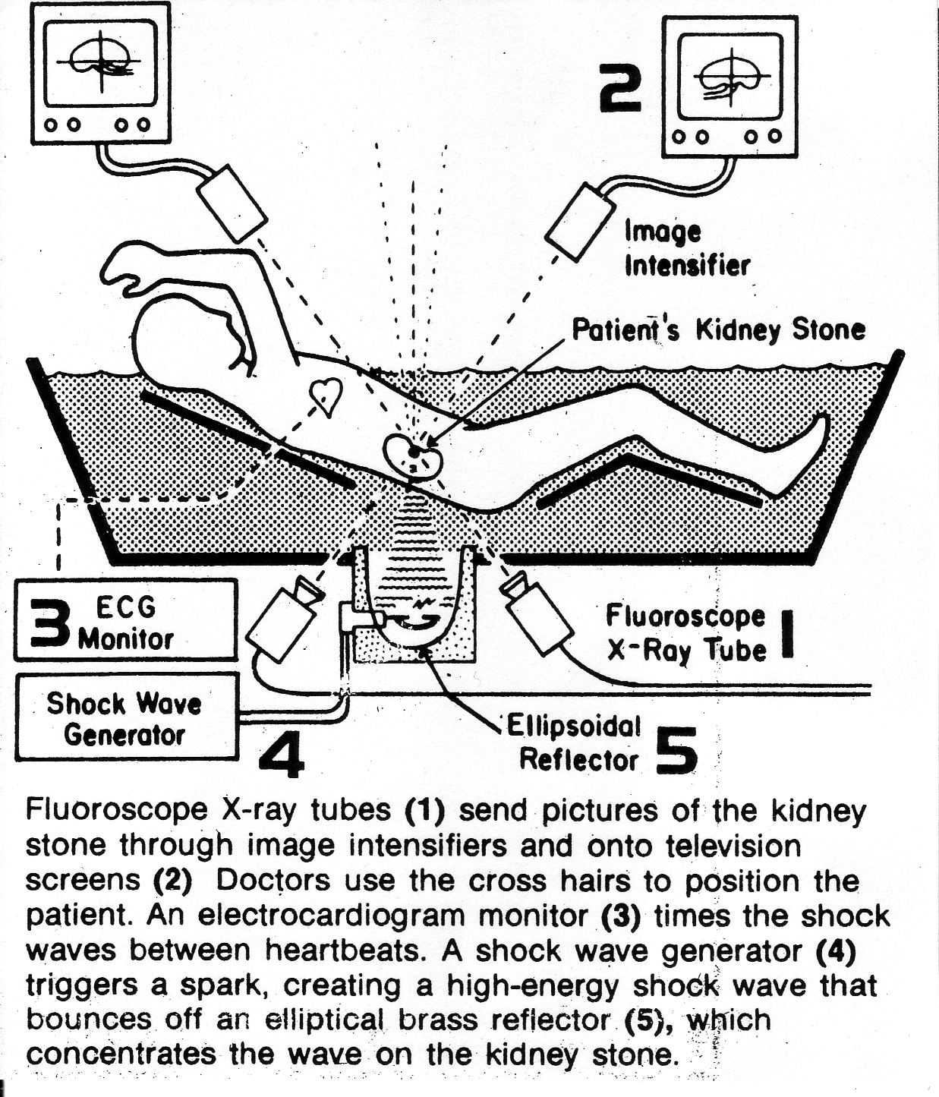

Slide 5

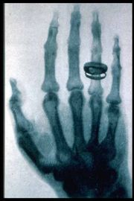


Slide 6
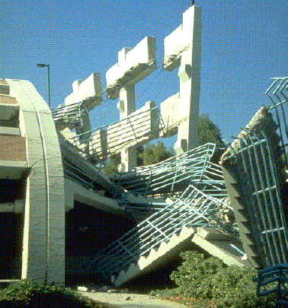
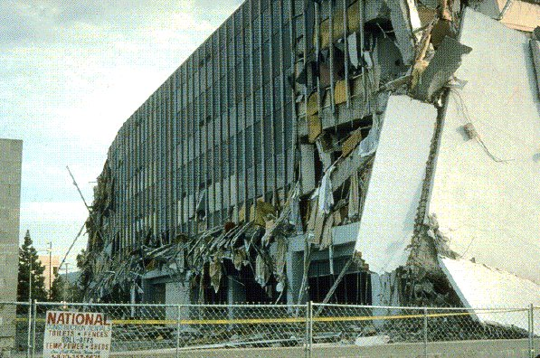
SEISMIC WAVES (EARTHQUAKES)
S waves (shear waves) – transverse waves that travel through the body of the Earth. However they can not pass through the liquid core of the Earth. Only longitudinal waves can travel through a fluid – no restoring force for a transverse wave. v ~ 5 km.s⁻¹.
P waves (pressure waves) – longitudinal waves that travel through the body of the Earth. v ~ 9 km.s⁻¹.
L waves (surface waves) – travel along the Earth’s surface. The motion is essentially elliptical (transverse + longitudinal). These waves are mainly responsible for the damage caused by earthquakes.

Slide 7
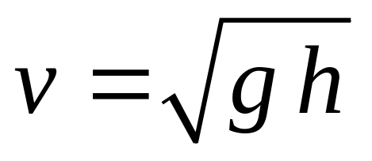
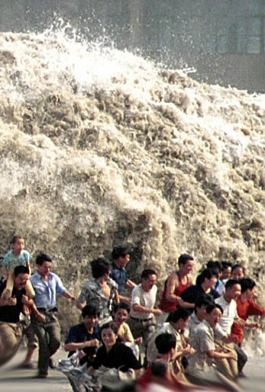

Tsunami
If an earthquakes occurs under the ocean it can produce a tsunami (tidal wave).
Sea bottom shifts ⇒ ocean water displaced ⇒ water waves spreading out from disturbance very rapidly v ~ 500 km.h⁻¹, λ ~ (100 to 600) km, height of wave ~ 1m ⇒ waves slow down as depth of water decreases near coastal regions ⇒ waves pile up ⇒ gigantic breaking waves ~30+ m in height.
1883 Kratatoa - explosion devastated coast of Java and Sumatra

Slide 8
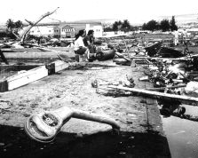
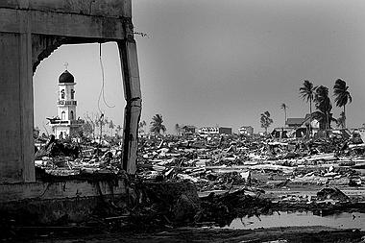
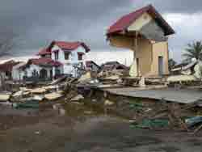
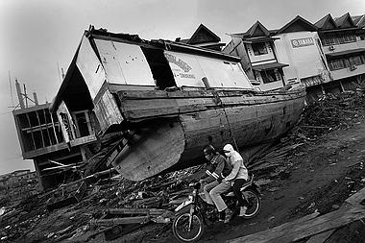
11:59 am Dec, 26 2005: “The moment that changed the world:
Following a 9.0 magnitude earthquake off the coast of Sumatra, a massive tsunami and tremors struck Indonesia and southern Thailand - killing over 104,000 people in Indonesia and over 5,000 in Thailand.

Slide 9
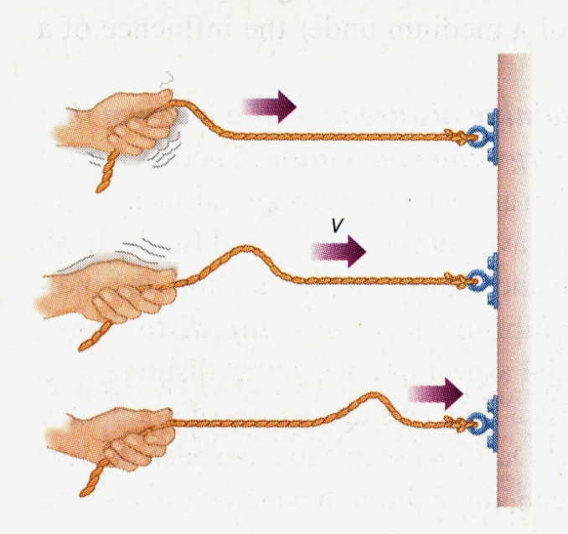
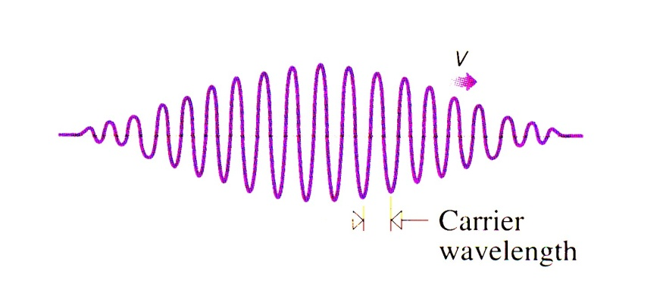
Waveforms
Wavepulse
An isolated disturbance
Wavetrain
e.g. musical note of short duration
Harmonic wave: a sinusoidal disturbance of constant amplitude and long duration

Slide 10
A progressive or traveling wave is a self-sustaining disturbance of a medium that propagates from one region to another, carrying energy and momentum. The disturbance advances, but not the medium.
The period T (s) of the wave is the time it takes for one wavelength of the wave to pass a point in space or the time for one cycle to occur.
The frequency f (Hz) is the number of wavelengths that pass a point in space in one second.
The wavelength λ (m) is the distance in space between two nearest points that are oscillating in phase (in step) or the spatial distance over which the wave makes one complete oscillation.
The wave speed v (m.s⁻¹) is the speed at which the wave advances
v = Δx / Δt = λ / T = λ f

Slide 11
Longitudinal & transverse waves
Longitudinal (compressional) waves
Displacement is parallel to the direction of propagation
Examples:
waves in a slinky; sound; earthquake waves P
Transverse waves
Displacement is perpendicular to the direction of propagation
Examples: electromagnetic waves; earthquake waves S
Water waves: combination of longitudinal & transverse

Slide 12
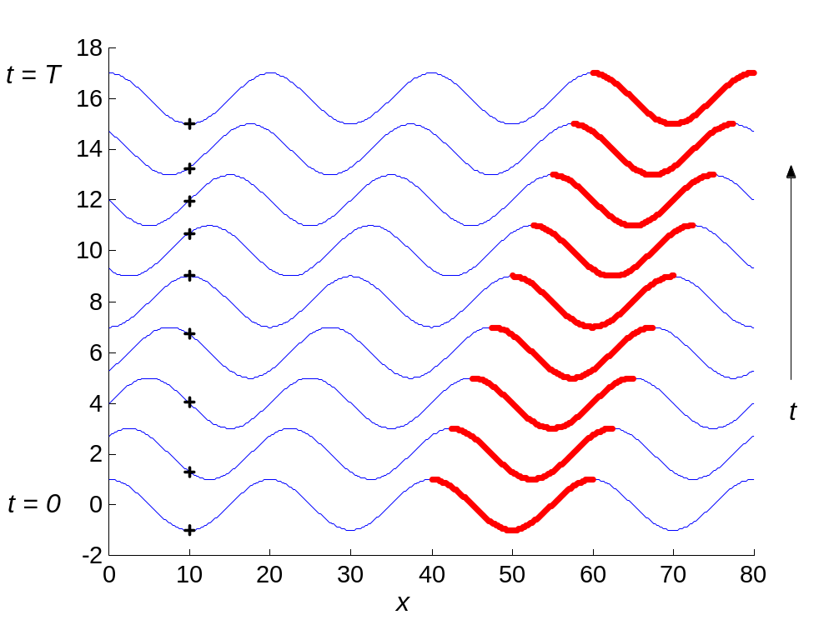
Transverse waves - electromagnetic, waves on strings, seismic - vibration at right angles to direction of propagation of energy

Slide 13
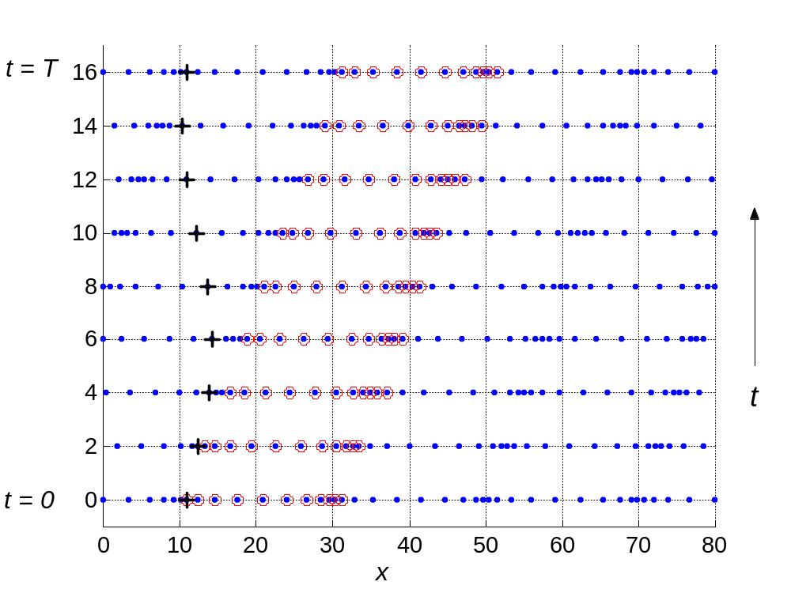
Longitudinal (compressional) - sound, seismic - vibrations along or parallel to the direction of propagation. The wave is characterised by a series of alternate condensations (compressions) and rarefractions (expansion

Slide 14
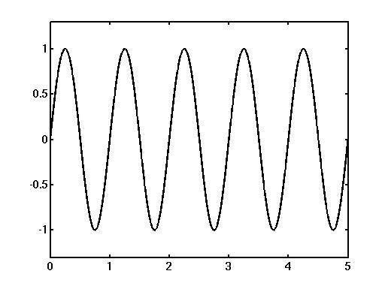
Harmonic wave - period
At any position, the disturbance is a sinusoidal function of time
The time corresponding to one cycle is called the period T
T
amplitude
displacement
time

Slide 15
Harmonic wave - wavelength
At any instant of time, the disturbance is a sinusoidal function of distance
The distance corresponding to one cycle is called the wavelength λ
λ
amplitude
displacement
distance

Slide 16
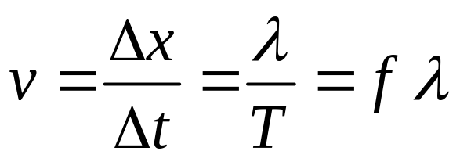








Wave velocity - phase velocity
distance
Propagation velocity (phase velocity)

Slide 17
Problem 5.1
For a sound wave of frequency 440 Hz, what is the wavelength ?
(a) in air (propagation speed, v = 3.3 x 10² m.s⁻¹)
(b) in water (propagation speed, v = 1.5 x 10³ m.s⁻¹)
[Ans: 0.75 m, 3.4 m]
I S E E

Slide 18
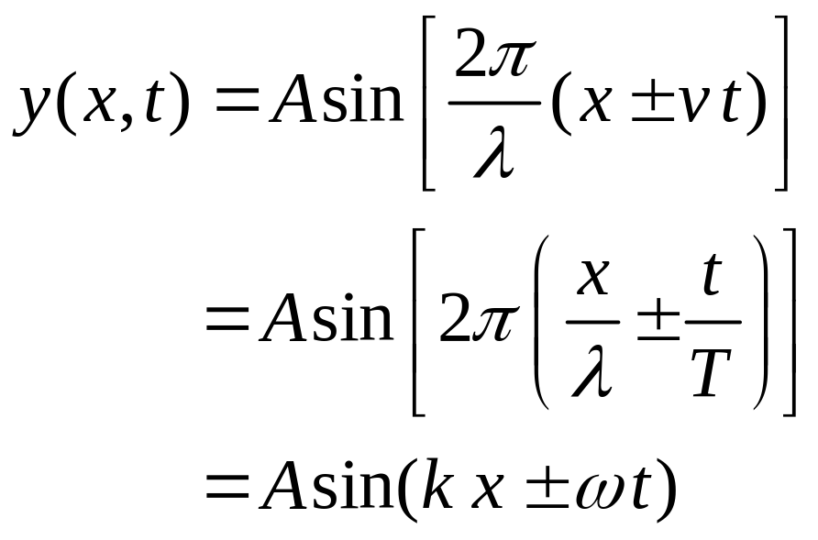
Wave function (disturbance)
e.g. for displacement y is a function of distance and time
+ wave travelling to the left - wave travelling to the right
Note: could use cos instead of sin
CP 484

Slide 19
Amplitude, A of the disturbance (max value measured from equilibrium position y = 0). The amplitude is always taken as a positive number. The energy associated with a wave is proportional to the square of wave’s amplitude. The intensity I of a wave is defined as the average power divided by the perpendicular area which it is transported. I = P_{avg} / Area
angular wave number (wave number) or propagation constant or spatial frequency,) k (rad.m⁻¹)
angular frequency, ω (rad.s⁻¹)
Phase, (k x ± ω t) (rad)
CP 484

Slide 20
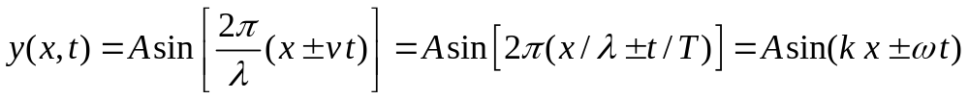
wavelength, λ (m)
y(0,0) = y(λ,0) = A sin(k λ) = 0
k λ = 2 π λ = 2π / k
Period, T (s)
y(0,0) = y(0,T) = A sin(-ω T) = 0
ω T = 2π T = 2π / ω f = 2π / ω
phase speed, v (m.s⁻¹)
v = Δx / Δt = λ / T = λ f = ω / k
CP 484

Slide 21
As the wave travels it retains its shape and therefore, its value of the wave function does not change i.e. (k x - ω t) = constant ⇔ t increases then x increases, hence wave must travel to the right (in direction of increasing x). Differentiating w.r.t time t
k dx/dt - ω = 0 dx/dt = v = ω / k
As the wave travels it retains its shape and therefore, its value of the wave function does not change i.e. (k x + ω t) = constant ⇔ t increases then x decreases, hence wave must travel to the left (in direction of decreasing x). Differentiating w.r.t time t
k dx/dt + ω = 0 dx/dt = v = - ω / k
CP 492

Slide 22
Each “particle / point” of the wave oscillates with SHM
particle displacement: y(x,t) = A sin(k x - ω t)
particle velocity: ∂y(x,t)/∂t = -ω A cos(k x - ω t)
velocity amplitude: v_{max} = ω A
particle acceleration: a = ∂²y(x,t)/∂t²
= -ω² A sin(k x - ω t)
= -ω² y(x,t)
acceleration amplitude: a_{max} = ω² A
CP 492

Slide 23
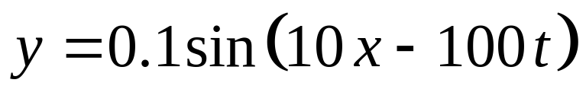
Problem 5.2 (PHYS 1002, Q11(a) 2004 exam)
A wave travelling in the +x direction is described by the equation
where x and y are in metres and t is in seconds.
Calculate
the wavelength,
the period,
the wave velocity, and
the amplitude of the wave
[Ans: 0.63 m, 0.063 s, 10 m.s⁻¹, 0.1 m]
I S E E

Slide 24
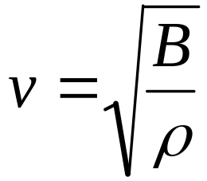
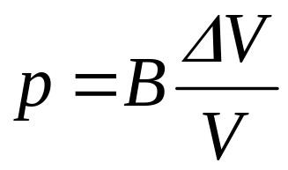
Compression waves
Longitudinal waves in a medium (water, rock, air)
Atom displacement is parallel to propagation direction
Speed depends upon
the stiffness of the medium - how easily it responds to a compressive force (bulk modulus, B)
the density of the medium ρ
If pressure p compresses a volume V, then change in volume ΔV is given by

Slide 25

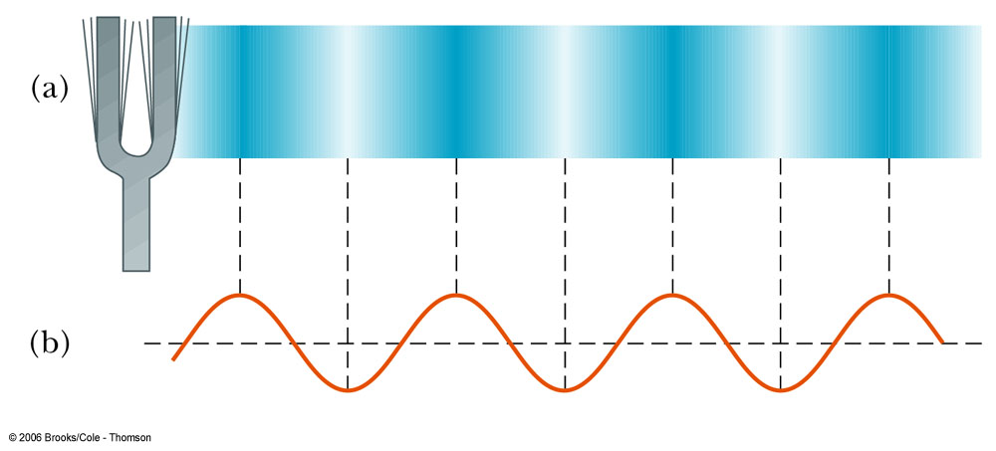

Slide 26
Problem 5.3
A travelling wave is described by the equation
y(x,t) = (0.003) cos( 20 x + 200 t )
where y and x are measured in metres and t in seconds
What is the direction in which the wave is travelling?
Calculate the following physical quantities:
1 angular wave number
2 wavelength
3 angular frequency
4 frequency
5 period
6 wave speed
7 amplitude
8 particle velocity when x = 0.3 m and t = 0.02 s
9 particle acceleration when x = 0.3 m and t = 0.02 s

Slide 27
Solution I S E E
y(x,t) = (0.003) cos(20x + 200t)
The general equation for a wave travelling to the left is y(x,t) = A.sin(kx + ωt + φ)
1 k = 20 m⁻¹
2 λ = 2π / k = 2π / 20 = 0.31 m
3 ω = 200 rad.s⁻¹
4 ω = 2 π f f = ω / 2π = 200 / 2π = 32 Hz
5 T = 1 / f = 1 / 32 = 0.031 s
6 v = λ f = (0.31)(32) m.s⁻¹ = 10 m.s⁻¹
7 amplitude A = 0.003 m
x = 0.3 m t = 0.02 s
8 v_{p} = ∂y/∂t = -(0.003)(200) sin(20x + 200t) = -0.6 sin(10) m.s⁻¹ = + 0.33 m.s⁻¹
9 a_{p} = ∂vp/∂t = -(0.6)(200) cos(20x + 200t) = -120 cos(10) m.s⁻² = +101 m.s⁻²

