Slide 1
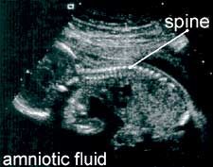
SOUND WAVES IN AIR
LECTURE 6 Ch 15 & 16
Longitudinal wave through any medium which can be compressed: gas, liquid, solid
Frequency range 20 Hz - 20 kHz (human hearing range)
Ultrasound: f > 20 kHz
Infrasound: f < 20 Hz
Atoms/molecules are displaced in the direction of propagation about there equilibrium positions
For medical imaging f = 1-10 MHz
Why so large?

Slide 2
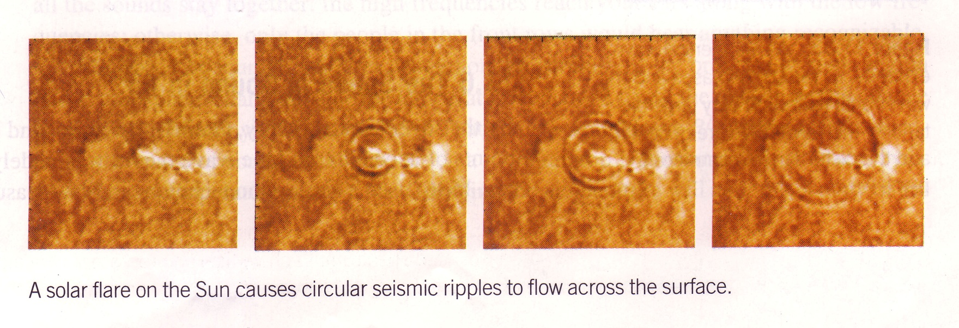
WAVEFRONTS
A wavefront is a line or surface that joins points of same phase
For water waves travelling from a point source, wavefronts are circles (e.g. a line following the same maximum)
For sound waves emanating from a point source the wave fronts are spherical surfaces
wavefront

Slide 3
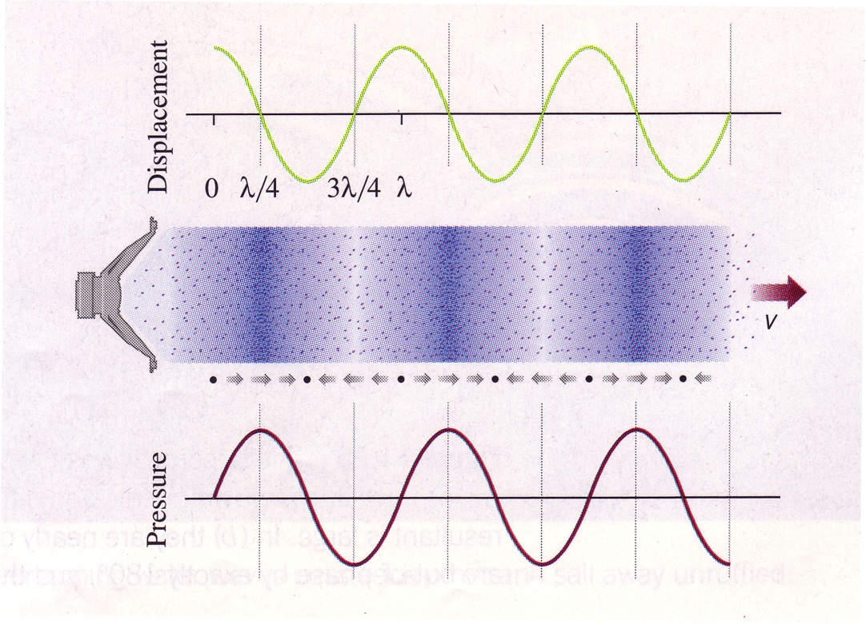
SOUND WAVES IN AIR
disp 0 max→ 0 max← 0
P min 0 max 0 min
Displacement of molecules
Pressure variation

Slide 4
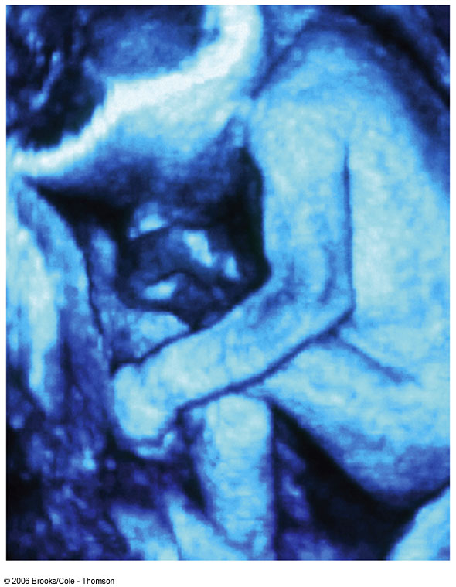
ULTRASOUND
Ultrasonic sound waves have frequencies greater than 20 kHz and,
as the speed of sound is constant for given temperature and medium,
they have shorter wavelength. Shorter wavelengths allow them to
image smaller objects and ultrasonic waves are, therefore, used as a diagnostic tool and in certain treatments.
Internal organs can be examined via the images produced by the reflection and absorption of ultrasonic waves. Use of ultrasonic waves is safer than x-rays but
images show less details. Certain organs such as the liver and the spleen are invisible to x-rays but visible to ultrasonic waves.
Physicians commonly use ultrasonic waves to
observe fetuses. This technique presents far less
risk than do x-rays, which deposit more energy in
cells and can produce birth defects.

Slide 5
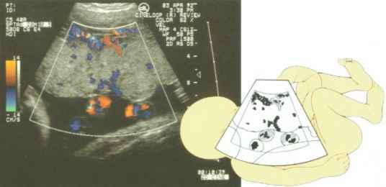
ULTRASOUND
Flow of blood through the placenta

Slide 6
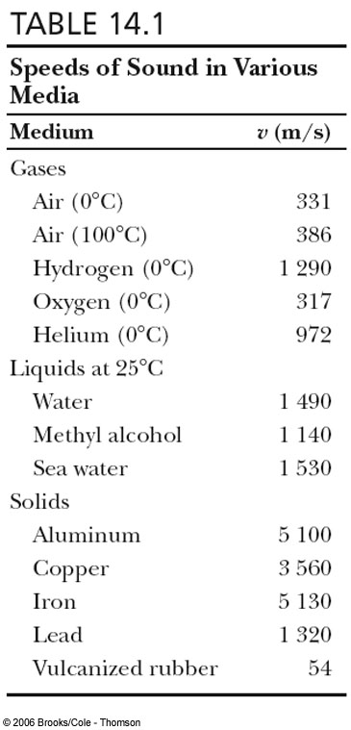
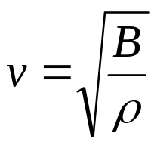
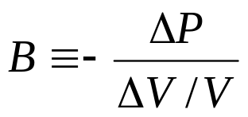
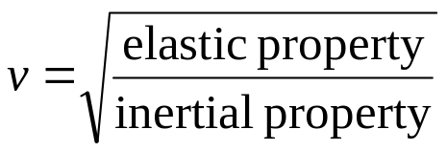
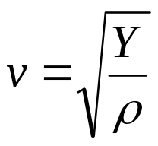
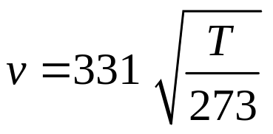
Speed of sound wave in a fluid
The speed of a sound wave in a fluid depends
on the fluid’s compressibility and inertia.
B : bulk modulus of the fluid
ρ : equilibrium density of the fluid
Speed of sound wave in a solid rod
Y : Young’s modulus of the rod
ρ : density of the fluid
Speed of sound wave in air
v = 343 m.s⁻¹ at T = 20ºC
Above formulae not examinable

Slide 7
BEHAVIOUR OF WAVES
* Propagation of energy
* Reflection
* Refraction
* Superposition: diffraction & interference (wave not particle behaviour)
* Polarisation (wave not particle behaviour
only transverse waves can be polarized)

Slide 8
BEHAVIOUR OF WAVES
Pulse on a rope - reflection
When pulse reaches the attachment point at the wall the pulse is reflected
If attachment is fixed the pulse inverts on reflection ( π rad phase change)
If attachment point can slide freely of a rod, the pulse reflects without inversion (0 rad phase change)
If wave encounters a discontinuity, there will be some reflection and some transmission
Example: two joined strings, different μ. What changes across the discontinuity - frequency, wavelength, wave speed?

Slide 9
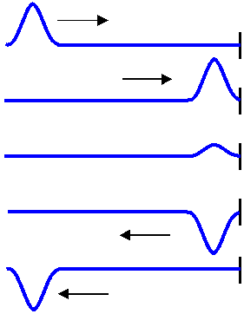
Reflection of waves at a fixed end
Reflection of waves at a free end
Reflected wave is inverted
π rad PHASE CHANGE
Reflected wave is not inverted
0 rad PHASE CHANGE

Slide 10
Refection of a pulse - string with boundary condition at the junction like a fixed end
Incident pulse
Transmitted pulse
Reflected pulse
Heavy string exerts
Reflected wave
π
rad
a downward force on
(180°) out of phase
light string when pulse
with incident wave
arrives
CP 510

Slide 11
Refection of a pulse - string with boundary condition at the junction like a free end
Incident pulse
Reflected pulse
Transmitted pulse
Reflected wave: in phase
Heavy string pulls light
with incident wave, 0
rad
string up when pulse arrives,
phase difference
string stretches then recovers
producing reflected pulse
CP 510

Slide 12
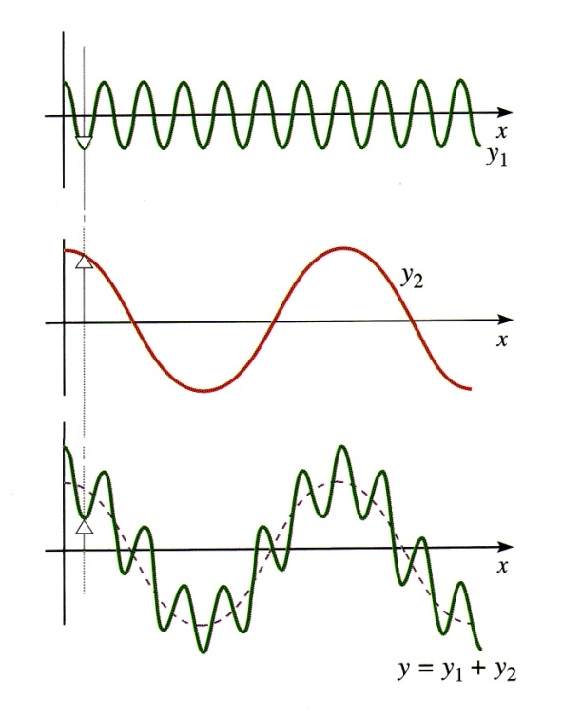
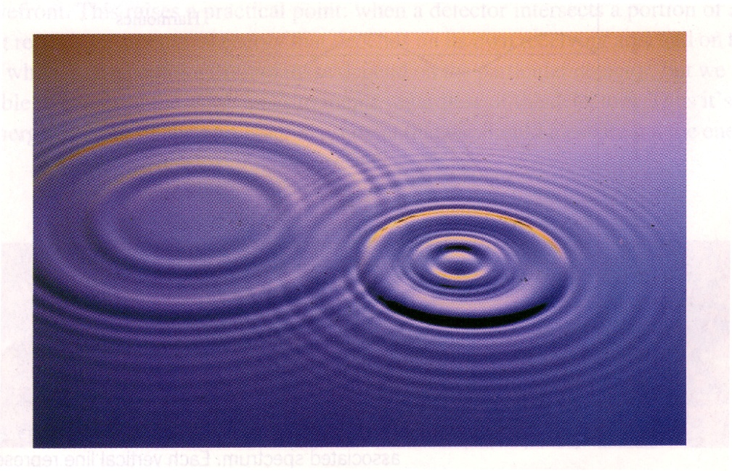
SUPERPOSITION OF WAVES
Two waves passing through the same region will superimpose - e.g. the displacements simply add
Two pulses travelling in opposite directions will pass through each other unaffected, while passing, through each other, the resultant displacement is simply the sum of the individual displacements
CP 514

Slide 13
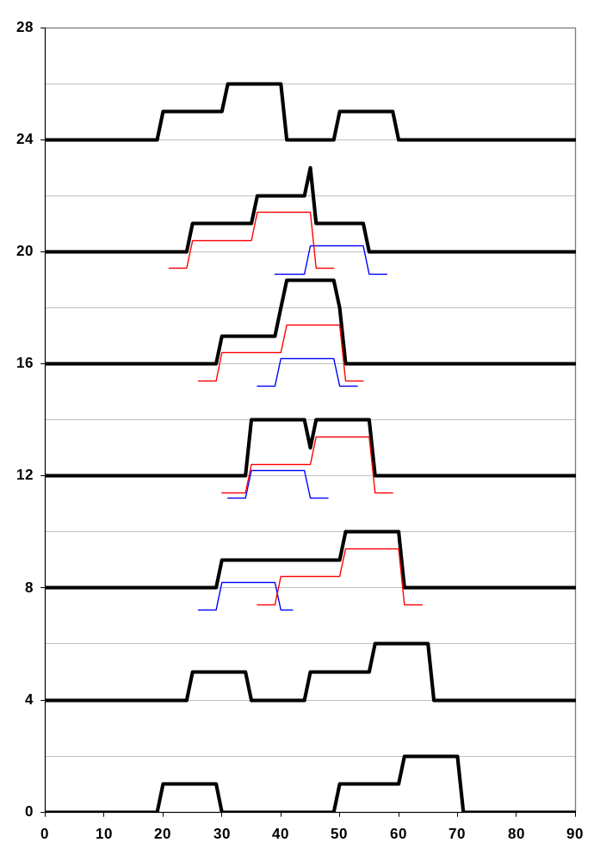
Superposition Principle
CP 510

Slide 14
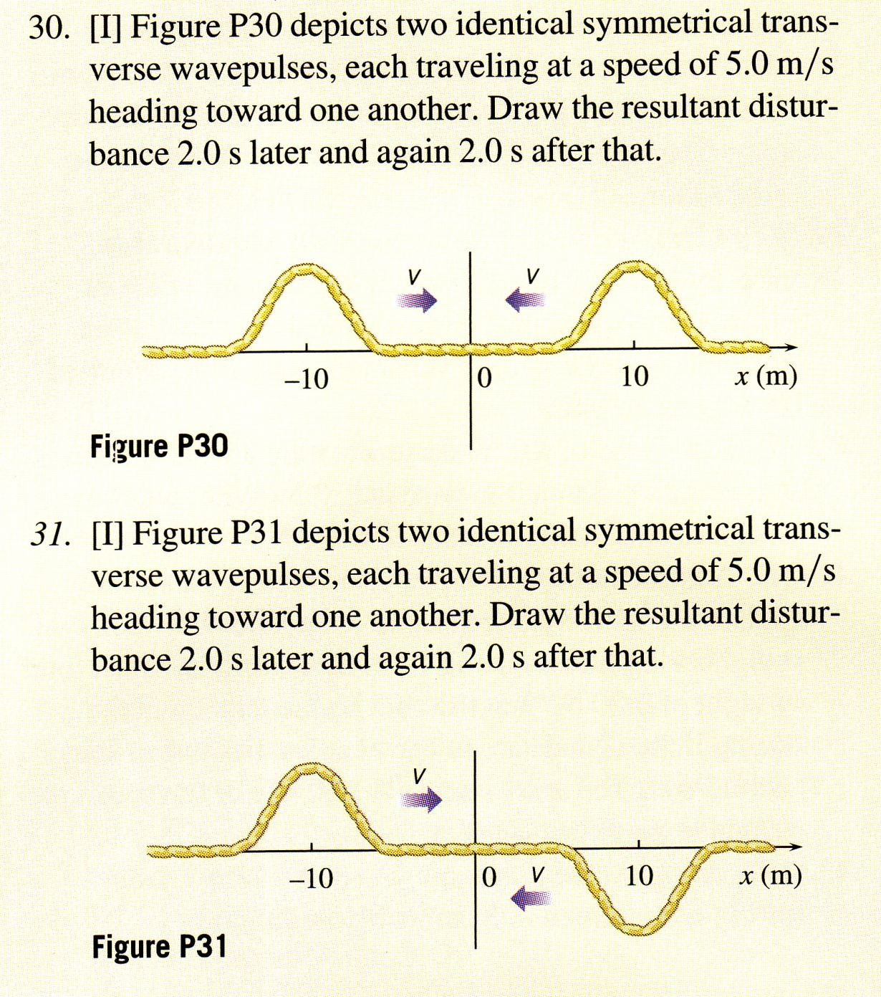
Problem 6.1

Slide 15
SUPERPOSITION ⇒ INTERFERENCE
Interference of two overlapping travelling waves depends on:
* relative phases of the two waves
* relative amplitudes of the two waves
fully constructive interference: if each wave reaches a max at the same time,
waves are in phase (phase difference between waves two waves Δφ = 0 rad)
greatest possible amplitude ( y_{max1} + y_{max2})
fully destructive interference: one wave reaches a max and the other a min at the same time, waves are out phase (phase difference between two waves
Δφ = π rad), lowest possible amplitude |y_{max1} - y_{max2}|
intermediate interference: 0 rad < phase difference Δφ < π rad
or π rad < phase difference Δφ < 2π rad
⇒

Slide 16
A phase difference of 2π rad corresponds to a shift of one wavelength ( λ) between two waves.
For m = 0, 1, 2, 3
fully constructive interference ⇒ phase difference = m λ
fully destructive interference ⇒ phase difference = (m + ½) λ

Slide 17
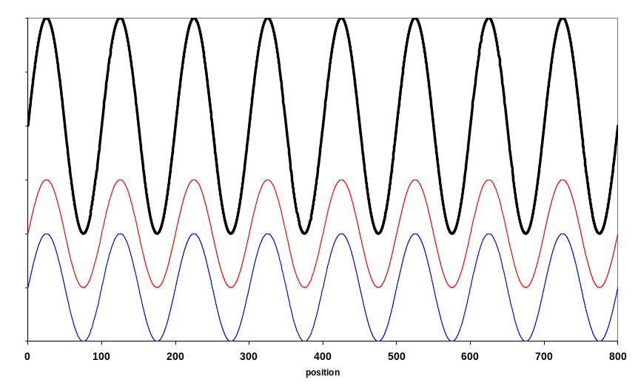
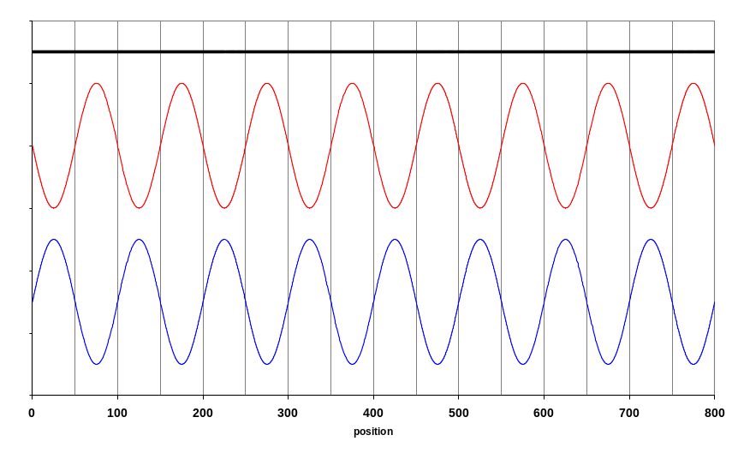
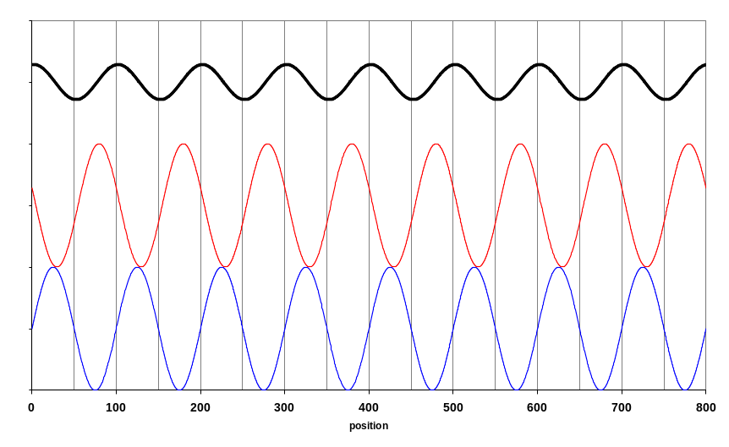
A
B
Which graph corresponds to constructive, destructive and intermediate interference ?
C

Slide 18
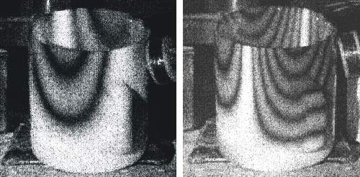
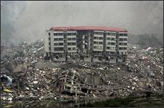
What do these pictures tell you ?

Slide 19
λ
s
2
Audio
s
oscillator
1
λ
Path difference
Δ
= |
s
-
s
|
2
1
Phase difference
Δφ
= 2
π
(
Δ
/
λ
)
CP 523

Slide 20
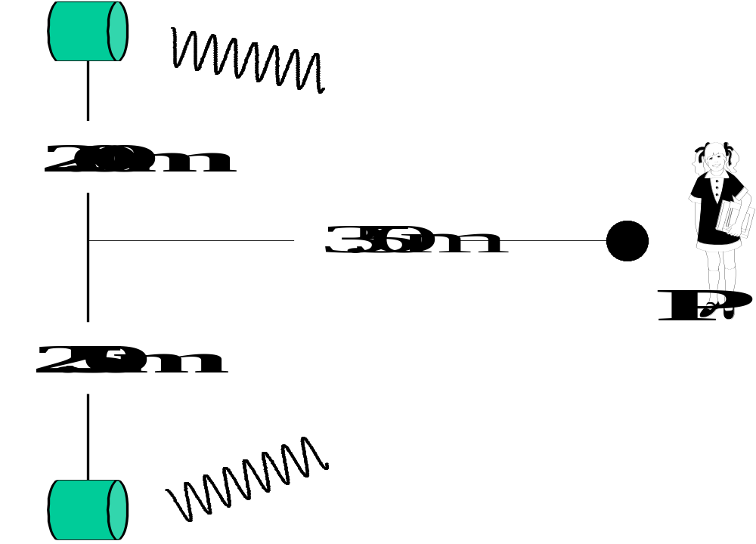
Problem 6.2
Two small loudspeakers emit pure sinusoidal waves that are in phase.
(a) What frequencies does a loud sound occur at a point P?
(b) What frequencies will the sound be very soft?
(v_{sound} = 344 m.s⁻¹).
Answers
(a) 1.27 kHz, 2.55 kHz, 3.82 kHz, … , 19.1 kHz
(b) 0.63 kHz, 1.91 kHz, 3.19 kHz,… , 19.7 kHz
CP 523

Slide 21
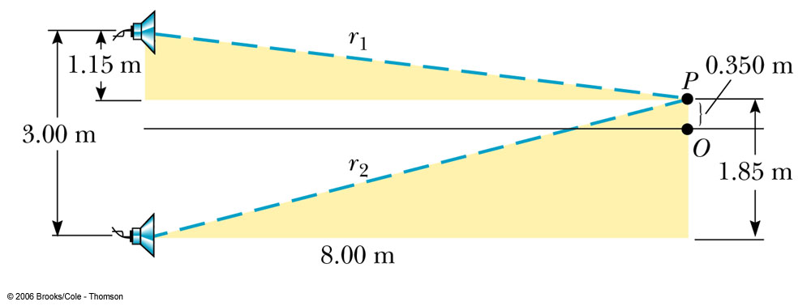
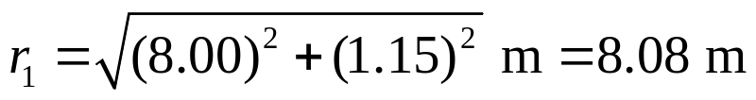
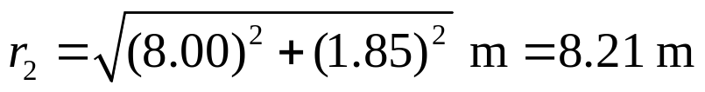
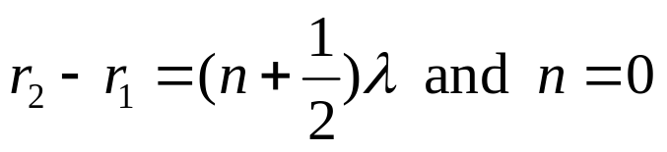
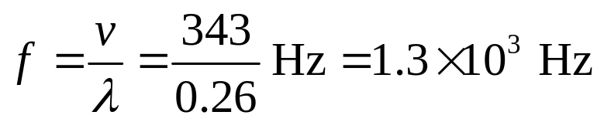

Problem 6.3
Two speakers placed 3.00 m apart are driven by the same oscillator.
A listener is originally at Point O, which is located 8.00 m from the
center of the line connecting the two speakers. The listener then walks
to point P, which is a perpendicular distance 0.350 m from O, before
reaching the first minimum in sound intensity. What is the frequency
of the oscillator? Take speed of sound in air to be 343 m.s⁻¹.

Slide 22
FOURIER ANALYSIS
A sinusoidal sound wave of frequency f is a pure tone.
A note played by an instrument is not a pure tone - its wavefunction is not of sinusoidal form. Its wavefunction is a superposition (sum) of a sinusoidal wavefunction at f (fundamental or 1st harmonic), plus one at 2f (second harmonic or 1st overtone) plus one at 3f (third harmonic or second overtone) etc, with progressively decreasing amplitudes.
The harmonic waves with different frequencies which sum to the final wave are called a Fourier series. Breaking up the original wave into its sinusoidal components is called Fourier analysis.
CP 521

Slide 23
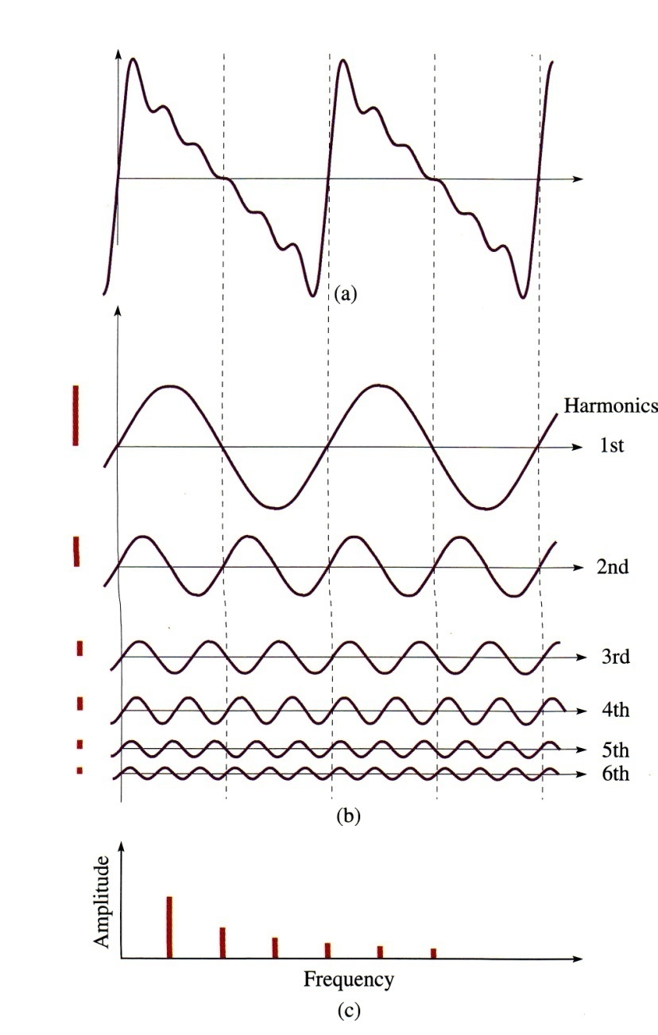
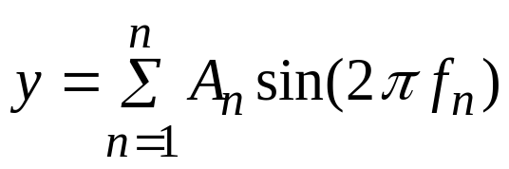
FOURIER ANALYSIS ⇒ any wave pattern can be decomposed into a superposition of appropriate sinusoidal waves.
FOURIER SYNTHESIS ⇒ any wave pattern can be constructed as a superposition of appropriate sinusoidal waves
Waveform
Fundamental
1st overtone
2nd overtone
1st harmonic
2nd harmonic
3rd harmonic
Superimpose → resultant (add) waveform
Electronic music ?
CP 521

Slide 24
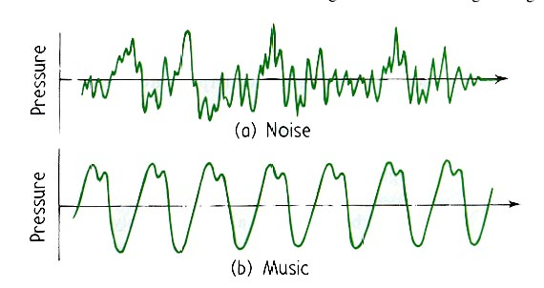
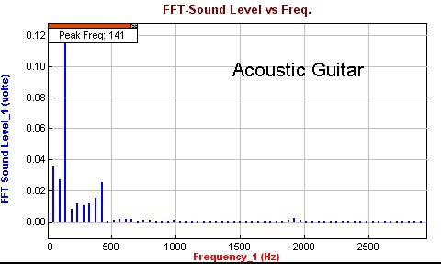

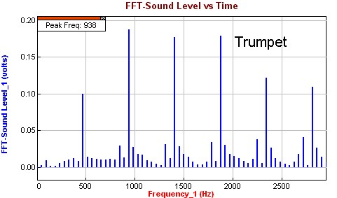
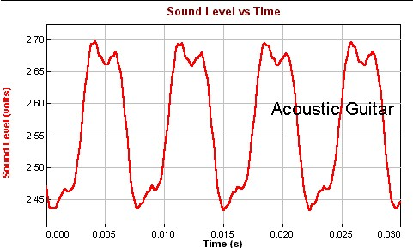
Quality of Sound Timbre or tone color or tone quality
Frequency spectrum
noise
music
piano
Harmonics
Harmonics

Slide 25
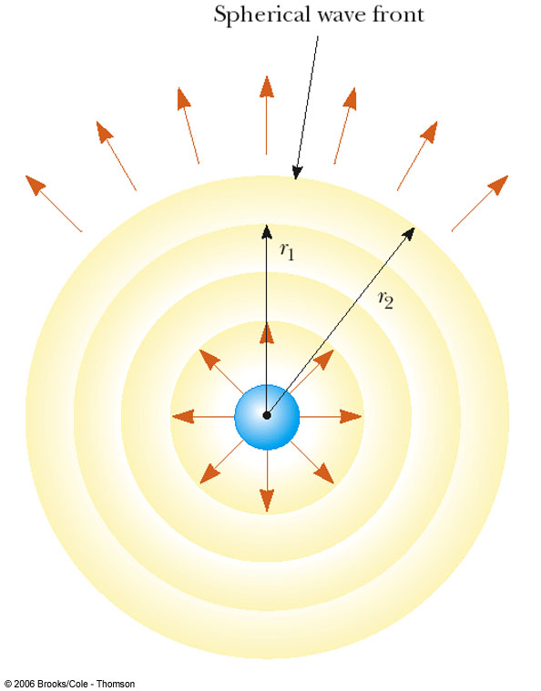
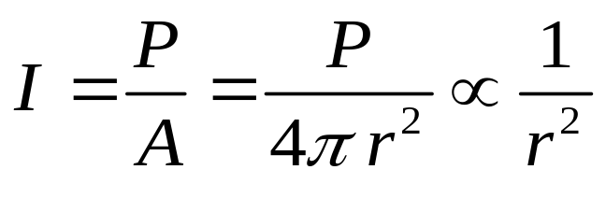
INTENSITY
Energy propagates with a wave - examples?
If sound radiates from a source, the power per unit area (called intensity) will decrease as you move away from the source
For example if the sound radiates uniformly in all directions, the intensity decreases as the inverse square of the distance from the source.
units: W.m⁻²
Wave energy: ultrasound for blasting gall stones, warming tissue (physiotherapy); sound of volcano eruptions travels long distances
CP 491

Slide 26
The faintest sounds the human ear can detect at a frequency of
1 kHz have an intensity of about 1x10⁻¹² W.m⁻² – Threshold of hearing
The loudest sounds the human ear can tolerate have an intensity
of about 1 W.m⁻² – Threshold of pain

Slide 27
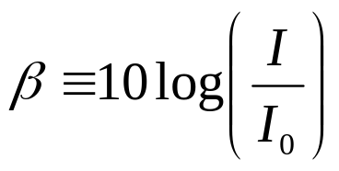
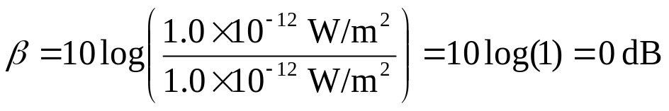
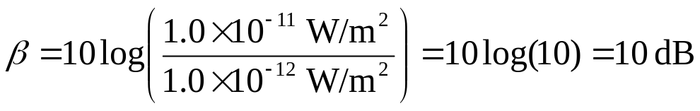
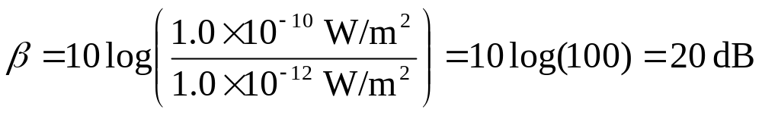
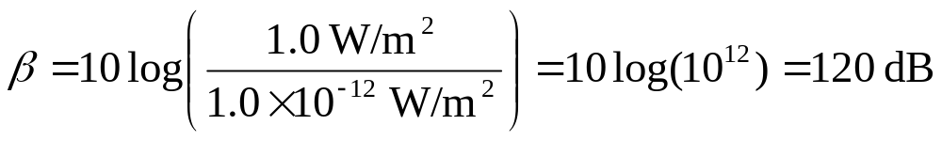
Energy and Intensity of Sound waves
Intensity level in decibel
The loudest tolerable sounds have intensities about 1.0x10¹² times
greater than the faintest detectable sounds.
The sensation of loudness is approximately logarithmic in the human
ear. Because of that, the relative intensity of a sound is called the
intensity level or decibel level, defined by:
I₀ = 1.0x10⁻¹² W.m⁻² : the reference intensity
the sound intensity at the threshold of hearing
Threshold of hearing
Threshold of pain

Slide 28
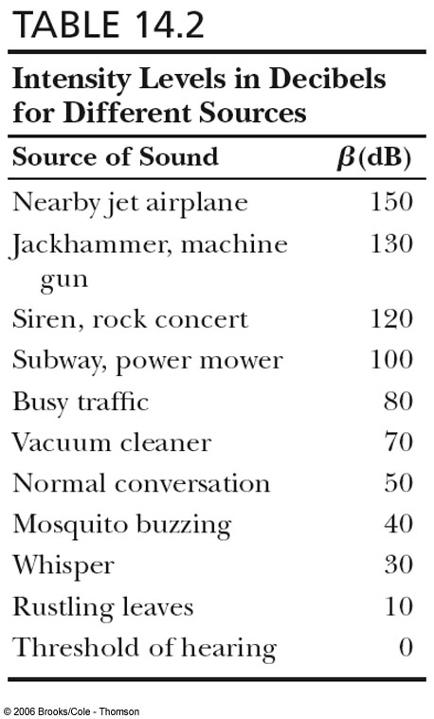
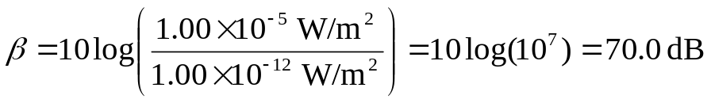
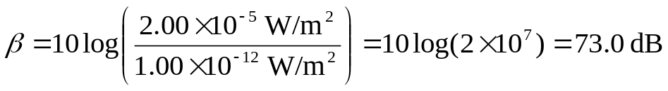
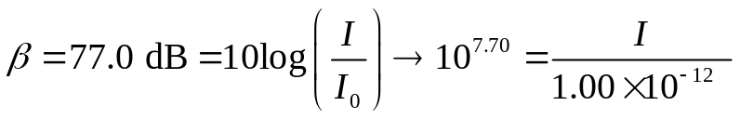

Problem 6.4
A noisy grinding machine in a factory
produces a sound intensity of 1.00x10⁻⁵ W.m⁻².
(a) Calculate the intensity level of the single grinder.
(b) If a second machine is added, then:
(c) Find the intensity corresponding to an
intensity level of 77.0 dB.

Slide 29
Problem 6.5
A point source of sound waves emits a disturbance with a power of 50 W into a surrounding homogeneous medium. Determine the intensity of the radiation at a distance of 10 m from the source. How much energy arrives on a little detector with an area of 1.0 cm² held perpendicular to the flow each second? Assume no losses.
[Ans: 4.0×10⁻² W.m⁻² 4.0×10⁻⁶ J]

Slide 30
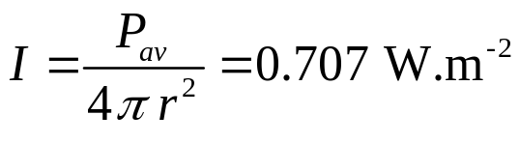
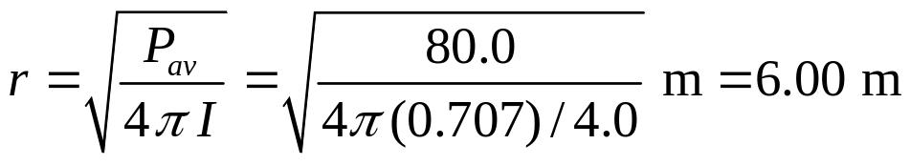
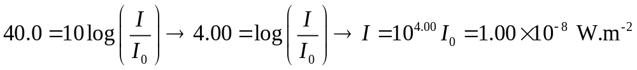
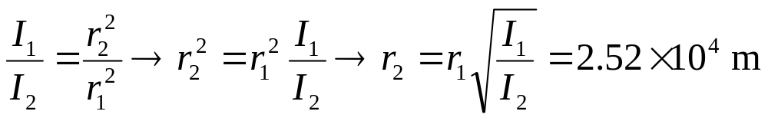
Problem 6.6
A small source emits sound waves with a power output of 80.0 W.
(a) Find the intensity 3.00 m from the source.
(b) At what distance would the intensity be one-fourth as much as it
is at r = 3.00 m?
(c) Find the distance at which the sound level is 40.0 dB?

