Slide 1
Standing waves
Lecture 7 Ch 16
If we try to produce a traveling harmonic wave on a rope, repeated reflections from the end produces a wave traveling in the opposite direction - with subsequent reflections we have waves travelling in both directions
The result is the superposition (sum) of two waves traveling in opposite directions
The superposition of two waves of the same amplitude travelling in opposite directions is called a standing wave
Examples: transverse standing waves on a string with both ends fixed (e.g. stringed musical instruments); longitudinal standing waves in an air column (e.g. organ pipes and wind instruments)

Slide 2
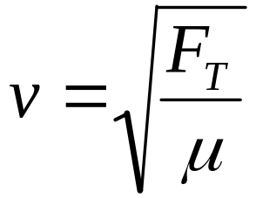
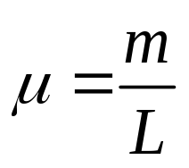
Transverse waves - waves on a string
The string must be under tension for wave to propagate
The wave speed
Waves speed
increases with increasing tension F_{T}
decreases with increasing mass per unit length μ
independent of amplitude or frequency

Slide 3
Problem 7.1
A string has a mass per unit length of 2.50 g.m⁻¹ and is put under a tension of 25.0 N as it is stretched taut along the x-axis. The free end is attached to a tuning fork that vibrates at 50.0 Hz, setting up a transverse wave on the string having an amplitude of 5.00 mm. Determine the speed, angular frequency, period, and wavelength of the disturbance.
[Ans: 100 m.s⁻¹, 3.14x10² rad.s⁻¹, 2.00x10⁻² s, 2.00 m]
I S E E

Slide 4
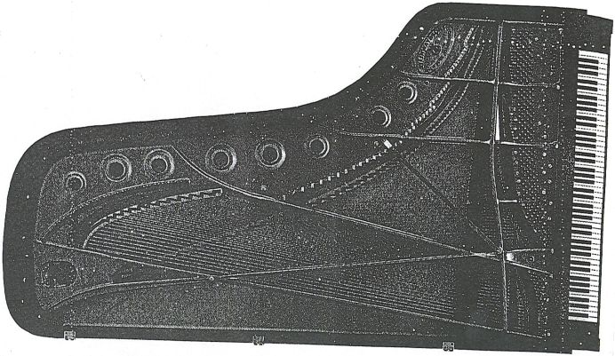
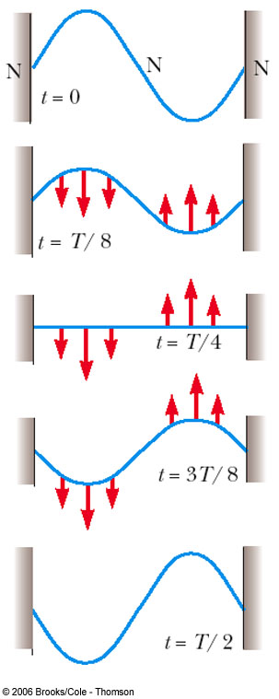
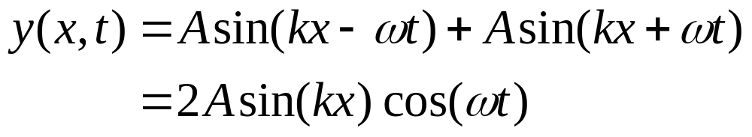
Standing waves on strings
Two waves travelling in opposite directions with equal displacement amplitudes and with identical periods and wavelengths interfere with each other to give a standing (stationary) wave (not a travelling wave - positions of nodes and antinodes are fixed with time)
amplitude
oscillation
each point oscillates
with SHM, period T = 2π / ω
CP 511

Slide 5
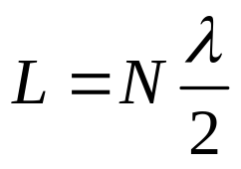
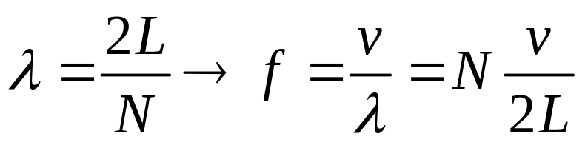
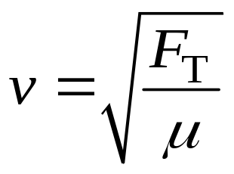
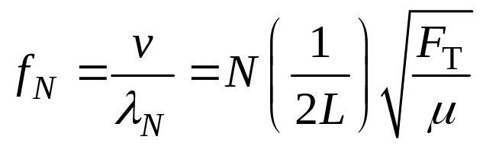
Standing waves on a string
NATURAL FREQUNCIES OF VIBRATION
String fixed at both ends
A steady pattern of vibration will result if the length corresponds to an integer number of half wavelengths
In this case the wave reflected at an end will be exactly in phase with the incoming wave
This situations occurs for a discrete set of frequencies
Boundary conditions →
Speed transverse wave along string
Natural frequencies of vibration
CP 511

Slide 6
Why do musicians have to tune their string instruments before a concert?
different string
-
μ
Finger
-
board
bridges
-
change
L
tuning knobs (pegs)
Body of instrument (belly)
-
adjust
F
T
resonant chamber
-
amplifier
F
N
F
λ
=
2L / N
v
=
T
f
=
T
μ
2L
μ
1
F
f
=
T
f_{N} = N f₁
1,2,3,...
1
2
L
μ
CP 518

Slide 7
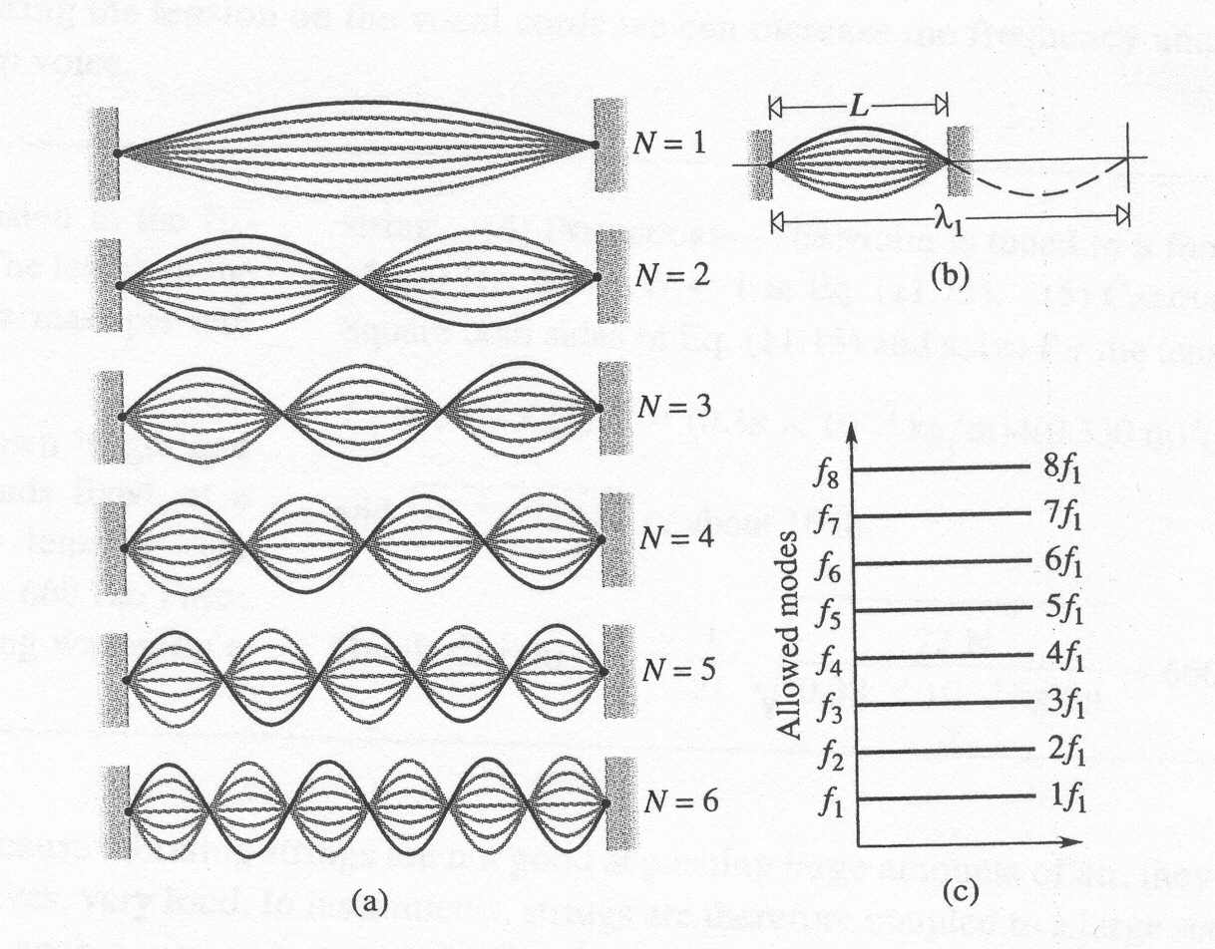
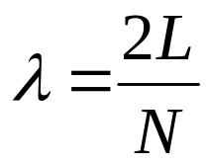
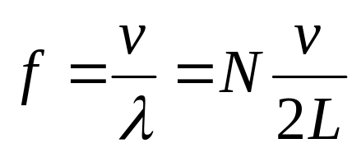
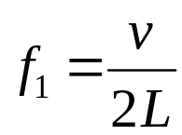
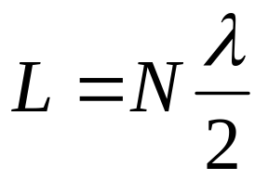

Modes of vibrations of a vibrating string fixed at both ends
Natural frequencies of vibration
Fundamental
node
antinode
CP 518

Slide 8
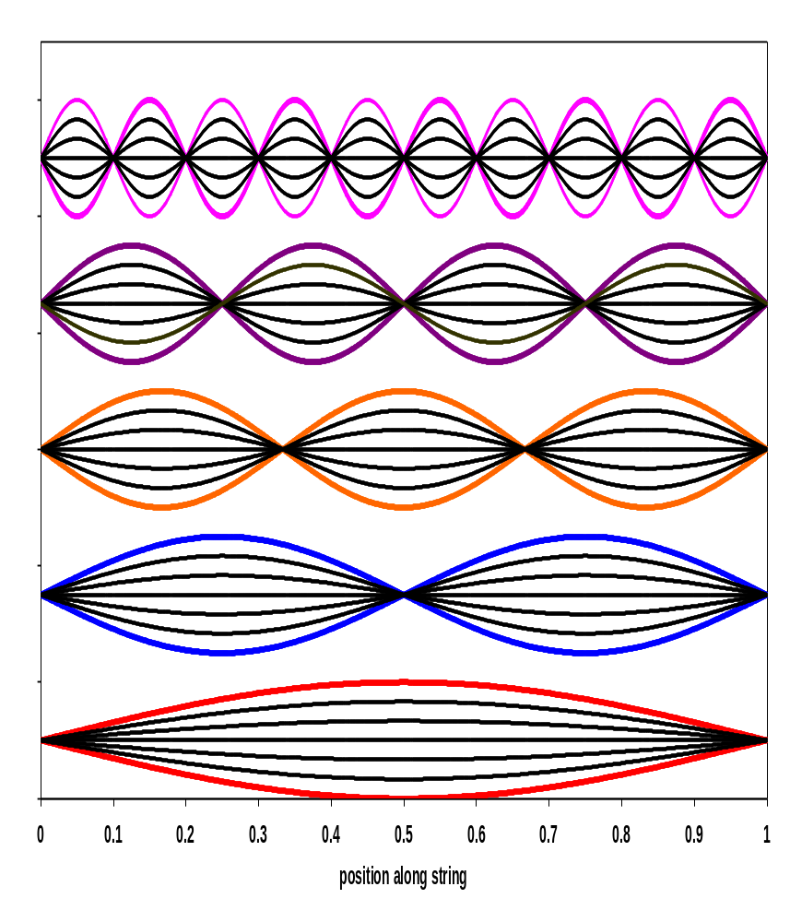
Harmonic series
N^{th} harmonic or (N-1)^{th} overtone
λ_{N} = 2L / N = λ₁ / N f_{N} = N f₁
N = 3 3nd harmonic (2nd overtone)
λ₃ = L = λ₃ / 2 f₃ = 2 f₁
N = 2 2nd harmonic (1st overtone)
λ₂ = L = λ₁ / 2 f₂ = 2 f₁
N = 1 fundamental or first harmonic
λ₁ = 2L f₁ = (1/2L).√(FT / μ)
Resonance (“large” amplitude oscillations) occurs when the string is excited or driven at one of its natural frequencies.
CP 518

Slide 9
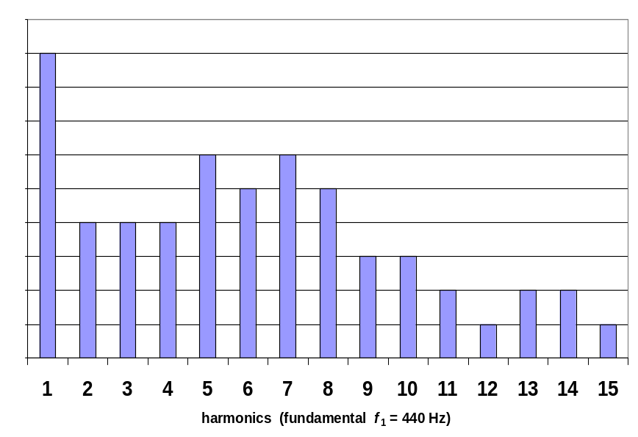
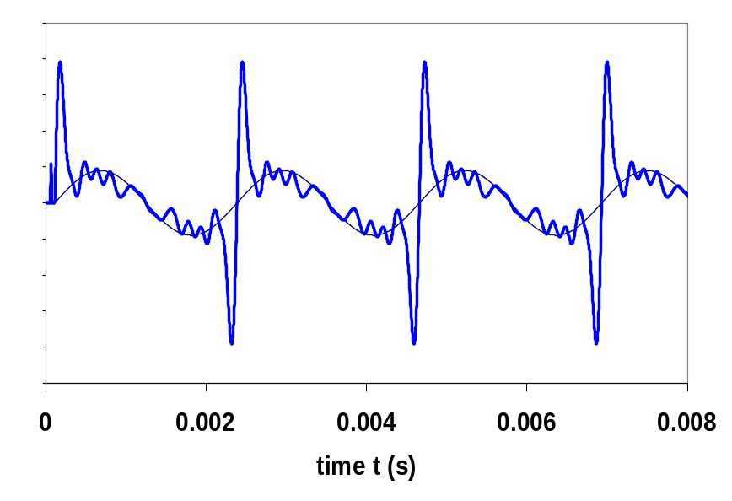
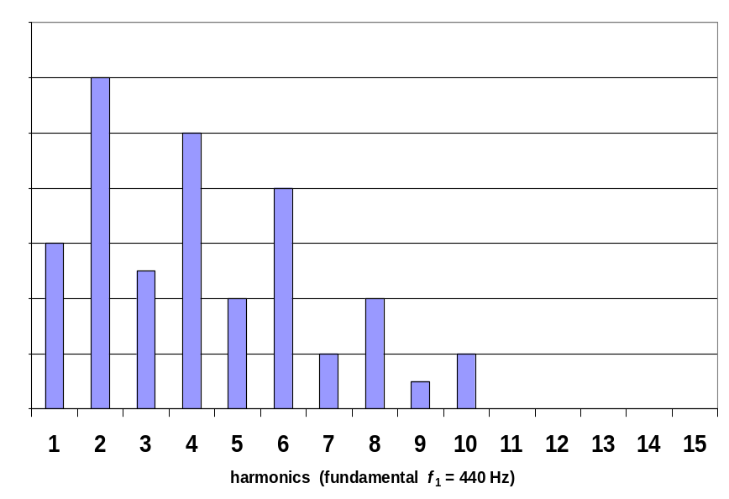
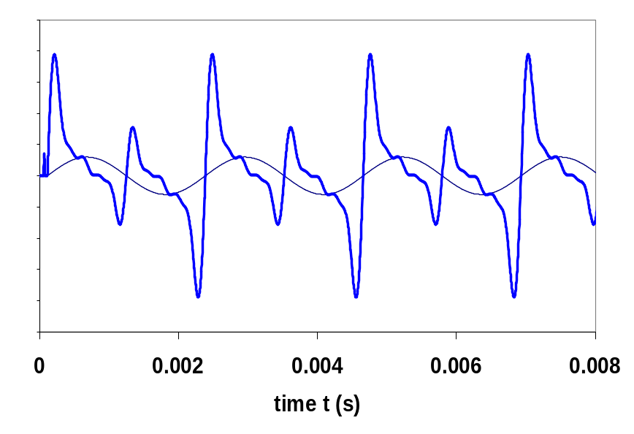
violin – spectrum
viola – spectrum
CP 518

Slide 10
Problem 7.2
A guitar string is 900 mm long and has a mass of 3.6 g. The distance from the bridge to the support post is 600 mm and the string is under a tension of 520 N.
1 Sketch the shape of the wave for the fundamental
mode of vibration.
2 Calculate the frequency of the fundamental.
3 Sketch the shape of the string for the sixth harmonic and
calculate its frequency.
4 Sketch the shape of the string for the third overtone and
calculate its frequency.
Ans: f₁ = 300 Hz f₆ = 1.8×10³ Hz f₄ = 1.2×10³ Hz

Slide 11
Problem 7.3
A particular violin string plays at a frequency of 440 Hz.
If the tension is increased by 8.0%, what is the new frequency?
Ans: f = 457 Hz

