Slide 1
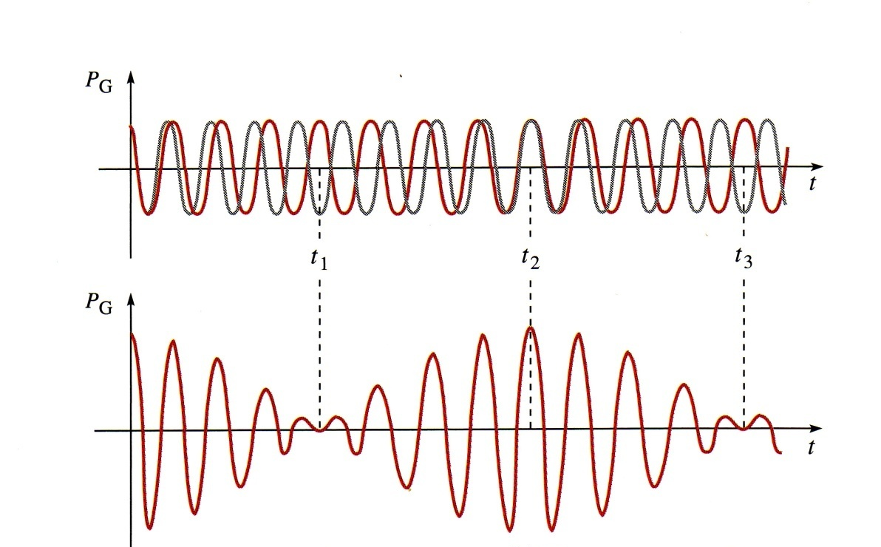
LECTURE 9 Ch 16.7 BEATS Ch 115.7 Doppler Effect
BEATS
Loud-soft-loud modulations of intensity are produced when waves of slightly different frequencies are superimposed.
The beat frequency is equal to the difference frequency f_{beat} = | f₁ - f₂|
1 beat
Used to tune musical instruments to same pitch
CP 52

Slide 2
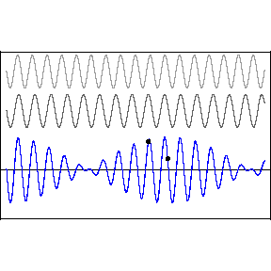
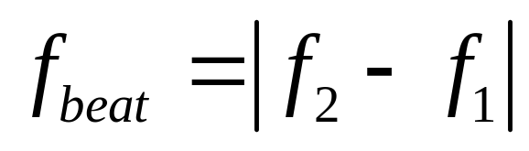
Beats two interfering sound waves can make beat
Two waves with different frequency create a beat because of interference between them. The beat frequency is the difference
of the two frequencies.

Slide 3
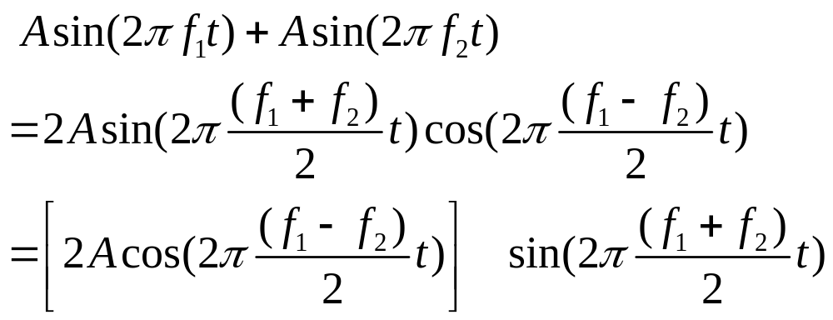

BEATS
Superimpose oscillations of equal amplitude, but different frequencies
Modulation of amplitude
Oscillation at the average frequency
frequency of pulses is | f₁-f₂ |
CP 527

Slide 4
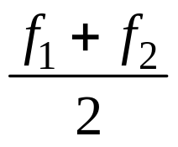
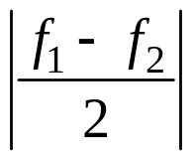
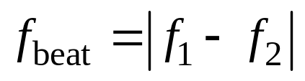
BEATS – interference in time
Consider two sound sources producing audible sinusoidal waves at slightly different frequencies f₁ and f₂. What will a person hear? How can a piano tuner use beats in tuning a piano? If the two waves at first are in phase they will interfere constructively and a large amplitude resultant wave occurs which will give a loud sound. As time passes, the two waves become progressively out of phase until they interfere destructively and it will be very quite. The waves then gradually become in phase again and the pattern repeats itself. The resultant waveform shows rapid fluctuations but with an envelope that various slowly.
The frequency of the rapid fluctuations is the average frequencies =
The frequency of the slowly varying envelope =
Since the envelope has two extreme values in a cycle, we hear a loud sound twice in one cycle since the ear is sensitive to the square of the wave amplitude.
The beat frequency is
CP 527

Slide 5
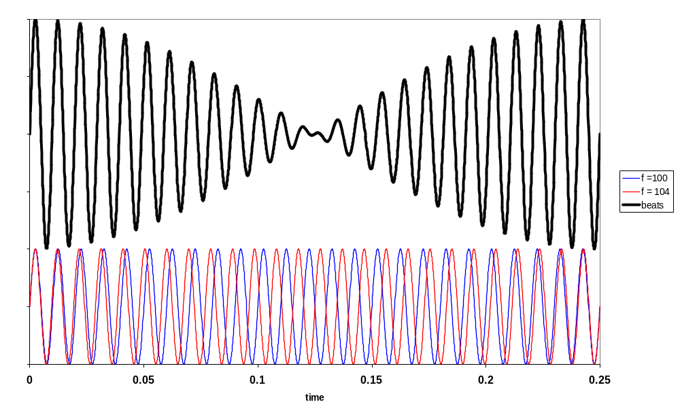
f₁ = 100 Hz f₂ = 104 Hz f_{rapid} = 102 Hz T_{rapid} = 9.8 ms
f_{beat} = 4 Hz T_{beat} = 0.25 s (loud pulsation every 0.25 s)
CP 527

Slide 6
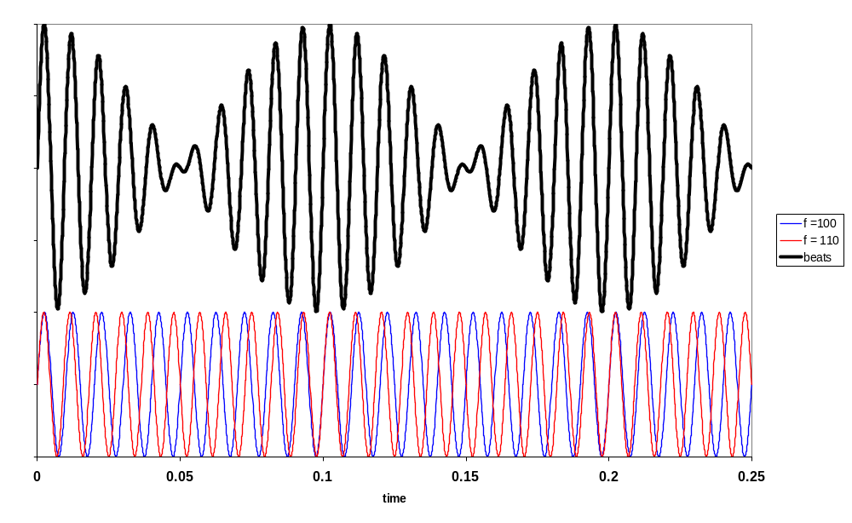
f₁ = 100 Hz f₂ = 110 Hz f_{rapid} = 105 Hz T_{rapid} = 9.5 ms
f_{beat} = 10 Hz T_{beat} = 0.1 s (loud pulsation every 0.1 s)
CP 527

Slide 7
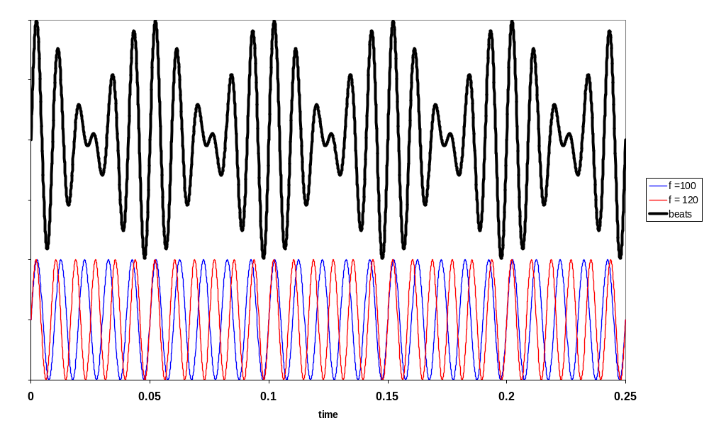
f₁ = 100 Hz f₂ = 120 Hz f_{rapid} = 110 Hz T_{rapid} = 9.1 ms
f_{beat} = 20 Hz T_{beat} = 0.05 s (loud pulsation every 0.05 s)
CP 527

Slide 8
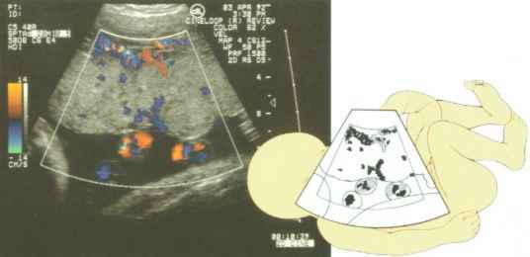
What is the physics of this image?
CP 495

Slide 9

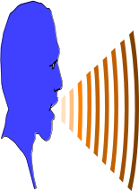
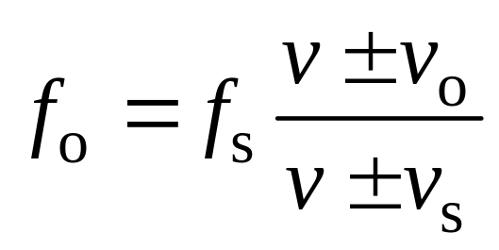

DOPPLER EFFECT - motion related frequency changes
Doppler 1842, Buys Ballot 1845 - trumpeters on railway carriage
Source (s) Observer (o)
formula different to textbook
Applications: police microwave speed units, speed of a tennis ball, speed of blood flowing through an artery, heart beat of a developing fetous, burglar alarms, sonar – ships & submarines to detect submerged objects, detecting distance planets, observing the motion of oscillating stars.
note: formula is very different to textbook
CP 495

Slide 10
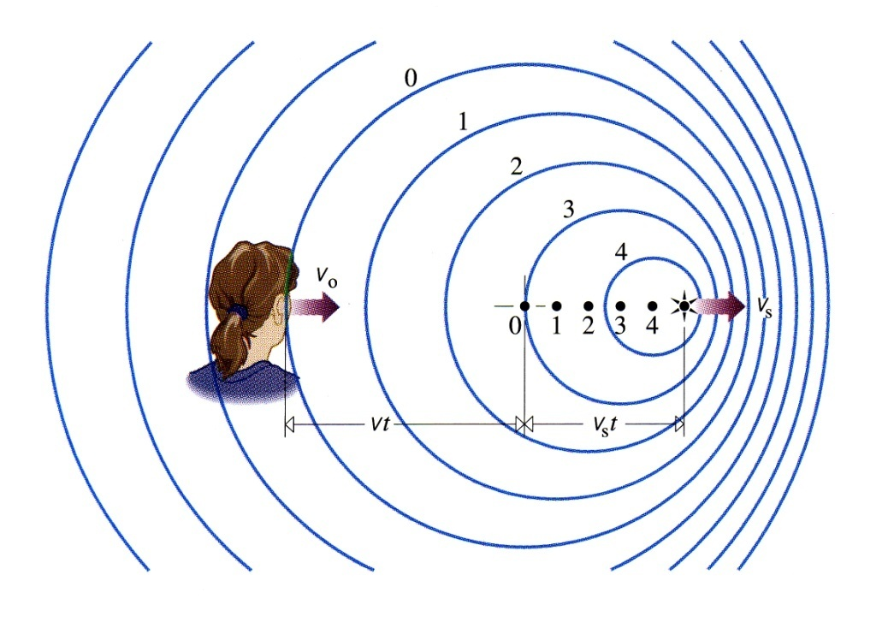
Doppler Effect
v = λ f
Consider source of sound at frequency f_{s}, moving speed v_{s}, observer at rest (v_{o} = 0)
Speed of sound v
What is frequency f_{o} heard by observer?
On right - source approaching
source catching up on waves
wavelength reduced
frequency increased
On left - source receding
source moving away from waves
wavelength increased
frequency reduced
CP 495

Slide 11
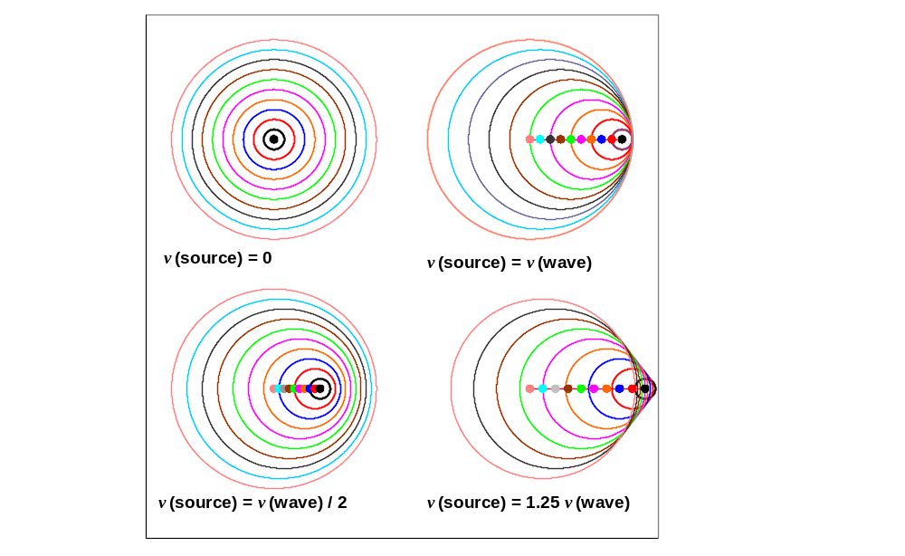
CP 495

Slide 12
source v_{s} | observer v_{o} | observed frequency f_{o}
stationary | stationary | = f_{s}
stationary | receding | < f_{s}
stationary | approaching | > f_{s}
receding | stationary | < f_{s}
approaching | stationary | > f_{s}
receding | receding | < f_{s}
approaching | approaching | > f_{s}
approaching | receding | ?
receding | approaching | ?
CP 595

Slide 13
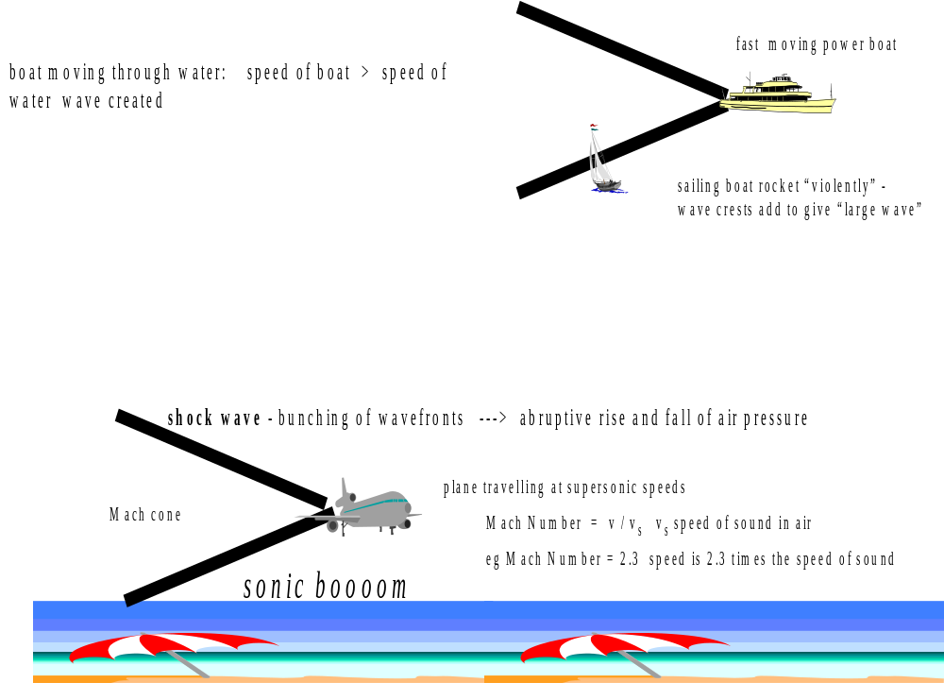
Shock Waves – supersonic waves
CP 506

Slide 14
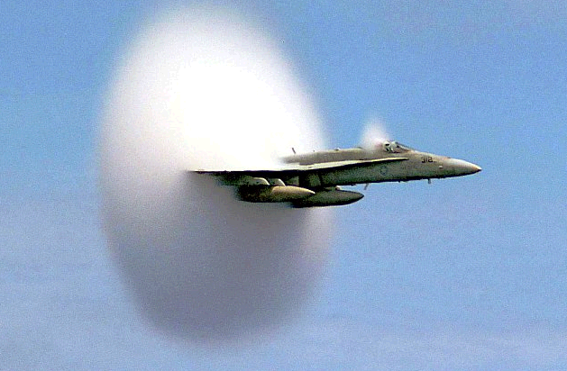
Shock Waves – supersonic waves
CP 506

Slide 15
Problem 9.1
A train whistle is blown by the driver who hears the sound at 650 Hz. If the train is heading towards a station at 20.0 m.s⁻¹, what will the whistle sound like to a waiting commuter? Take the speed of sound to be 340 m.s⁻¹.
[Ans: 691 Hz]

Slide 16
Problem 9.2
The speed of blood in the aorta is normally about 0.3000 m.s⁻¹.
What beat frequency would you expect if 4.000 MHz ultrasound waves were directed along the blood flow and reflected from the end of red blood cells?
Assume that the sound waves travel through the blood with a velocity of 1540 m.s⁻¹.

Slide 17
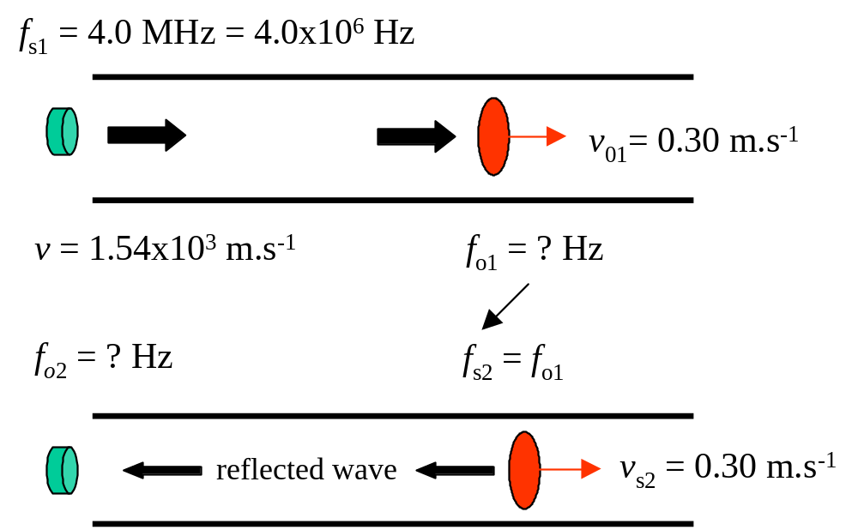
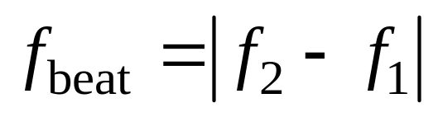
Solution 9.2 I S E E
Doppler Effect Beats

Slide 18
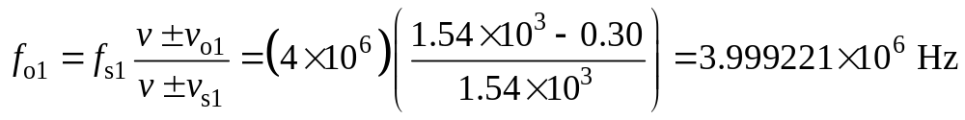
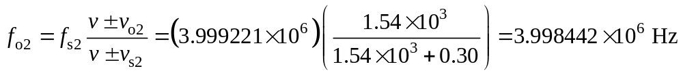
Blood is moving away from source ⇒ observer moving away from source ⇒ f_{o} < f_{s}
Wave reflected off red blood cells ⇒ source moving away from observer ⇒ f_{o} < f_{s}
Beat frequency = | 4.00 – 3.998442| ×10⁶ Hz = 1558 Hz
In this type of calculation you must keep extra significant figures.

Slide 19
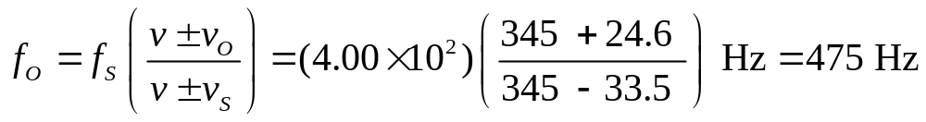
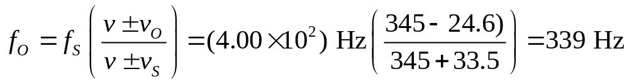
Problem 8.3
An ambulance travels down a highway at a speed of 33.5 m.s⁻¹, its
siren emitting sound at a frequency of 4.00x10² Hz. What frequency
is heard by a passenger in a car traveling at 24.6 m.s⁻¹ in the opposite
direction as the car and ambulance: (a) approach each other and
(b) pass and move away from each others?
Speed of sound in air is 345 m.s⁻¹.
Solution
(a)
(b)

