Slide 1
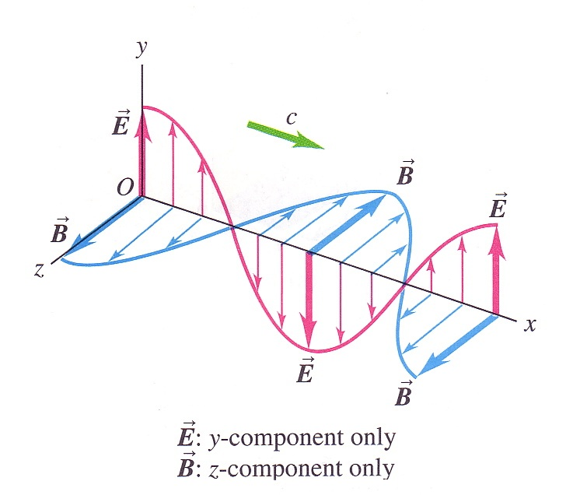
Electromagnetic waves
LECTURE 10 Ch 17 & Ch 18
Transverse wave
Oscillating quantities: electric and magnetic fields, in phase, perpendicular to each other and direction of propagation
Can travel through vacuum, speed is c = 3.0 x 10⁸ m.s⁻¹
In transparent medium, speed is v = c / n where n is a property of the medium called refractive index
When electromagnetic waves are emitted or absorbed by an atom, done so in quanta of energy: E = h f
CP 551

Slide 2


Electromagnetic spectrum
VISIBLE SPECTRUM
700 nm
400 nm
c = λ f
E = h f
Gamma rays
X-rays
Ultraviolet
Visible
Infrared
Microwaves
Radio
Red orange yellow green blue indigo violet
Increasing frequency
Increasing wavelength
CP 588

Slide 3
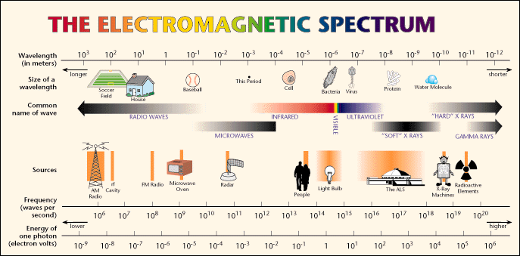

Slide 4
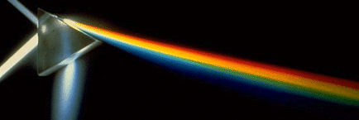
REFRACTION
How can we see?
What produces an image in an optical microscope?
What happens when light passes through a transparent material?
dispersion
CP 588

Slide 5
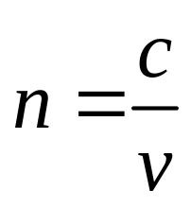
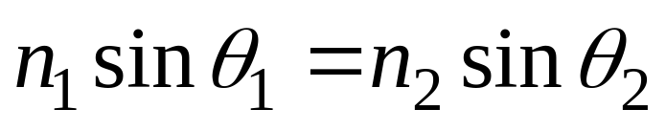
The ratio of the speed of an electromagnetic wave, c in vacuum to that in the medium, v is defined as the refractive index, n
When a wave enters a new medium (different wave speed) at an angle the wavefront must bend. This bending is called refraction. The amount of bending is described by Snell's Law (Law of Refaction)
CP 588

Slide 6
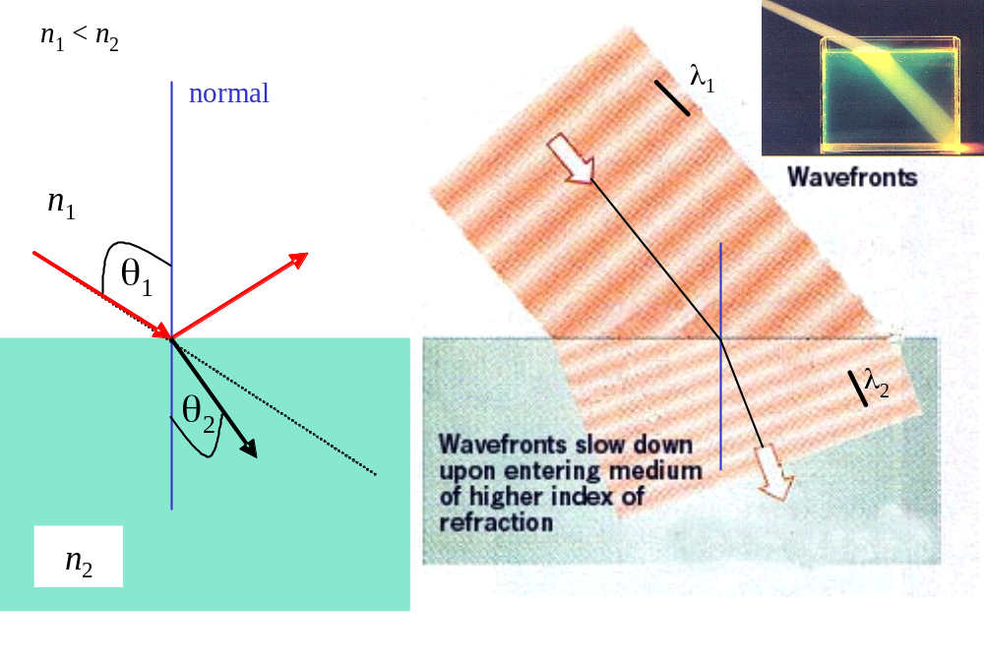
CP 588

Slide 7
n₁
normal
n₁
normal
θ₁
reflection
reflection
θ₁
n₂
n₂
refraction
θ₂
θ₂
refraction
n₁ < n₂
sinθ₁ > sinθ₂
refracted ray bent towards normal
n₁ > n₂
sinθ₁ < sinθ₂
refracted ray bent away from normal
Critical angle sinθ₂ = 1
sinθ₁ = sinθ_{C} = n₂ / n₁
total internal
reflection
CP 588

Slide 8
REFRACTION
How can we see?
What produces an image in an optical microscope?
What happens when light passes through a transparent material?
dispersion
CP 588

Slide 9
Refraction
When light enters the eye, most of the light is bent at the cornea and fine adjusts by the lens to focus the light onto the retina. Glasses correct for eye defects to produce a focussed image.
In a transmission optical microscope light passes through a sample and the path of the light is bend by the various lens. The image gives a "map" of the refractive index variation throughout the sample.
Fiberoptics – bending of light through a glass fibre (total internal reflection).
CP 588

Slide 10
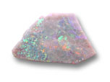
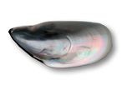
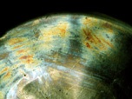
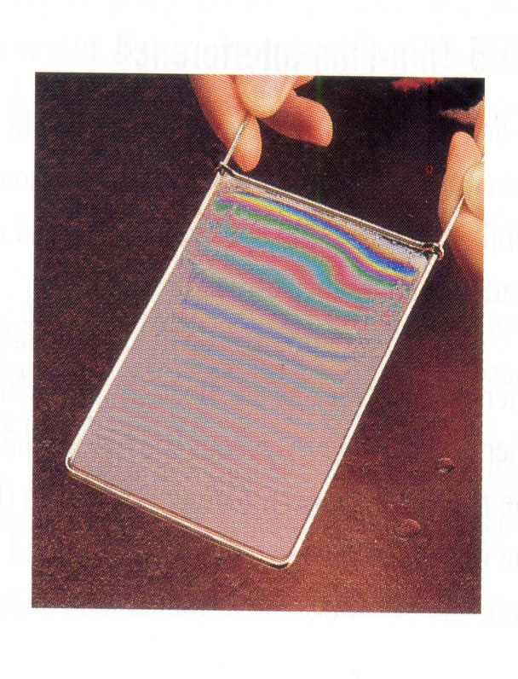
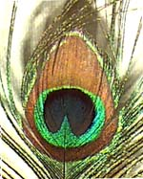
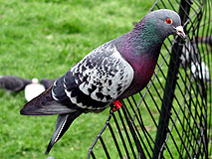
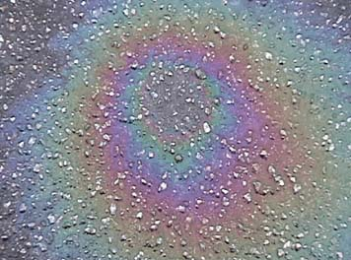
THIN FILM INTERFERENCE
CP 563

Slide 11
THIN FILM INTERFERENCE
Thin films are responsible for colours of soap bubbles, oil sticks, iridescence of peacock feathers, blooming of camera lenses … .
When light impinges on the first surface of a transparent film, a portion of the incident wave is partially reflected and partially transmitted. The transmitted portion is then reflected from a second surface and emerges back out of the film. Thus, emerging from the thin film are two waves (1) wave reflected from front surface and (2) wave reflected from rear surface. The two waves have different path optical lengths that is determined by the width of the film. The two waves will eventually interfere and the interference pattern observed will depend upon the thickness of the film.
Consider a thin oil film with varying thickness. Whenever the film is exactly the right thickness for the two waves of emerging red light to undergo constructive interference, the film will appear red at this location and the same for the other colours for different thicknesses in different locations. Thus, the oil film will show its characteristic with multi-coloured fringe pattern when viewed under white light.
CP 563

Slide 12
Review: Interference
We have seen examples already: beats and standing waves
When superimposing (adding) waves we sometimes get constructive interference (max amplitude), destructive interference (zero amplitude), and in between situations.
Consider two sources which are in phase (coherent), emitting waves of the same amplitude
At any location the resultant disturbance is the sum of the individual waves at that point.
In some places there will be maxima (constructive interference)
In other places there will be zeros (destructive interference)
CP 555

Slide 13
Review: Interference
What determines the type of interference?
Constructive interference - why?
Two sources, in phase (coherent)
For every wavelength path difference there is 2π phase difference
CP 555

Slide 14
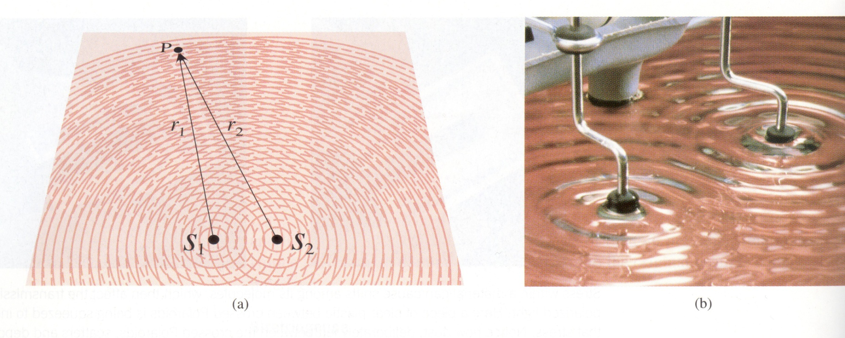
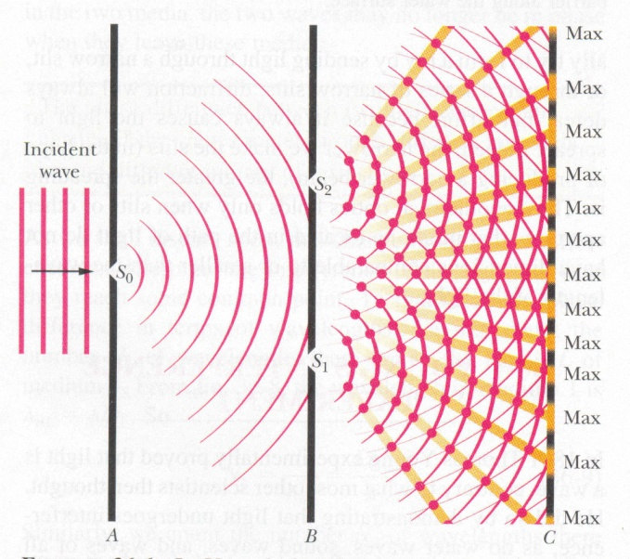
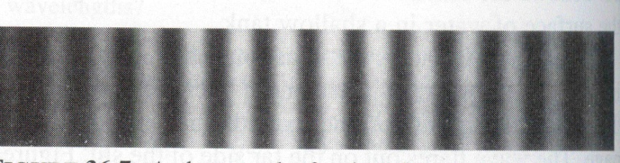
Interference of waves - water waves
Interference of waves - light
fringes
CP 555

Slide 15
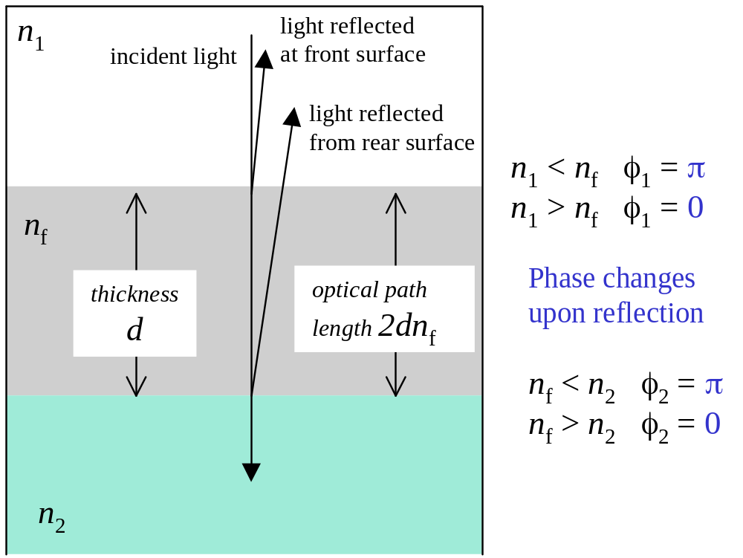

THIN FILM INTERFERENCE
v = c / n_{f}
CP 563

Slide 16
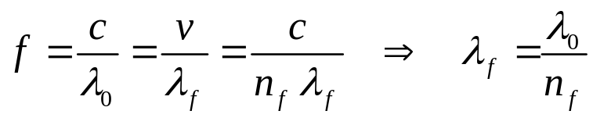
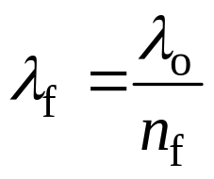
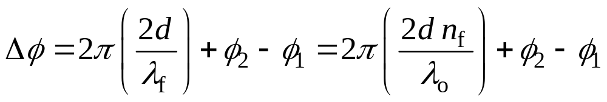
The reflected wave from the rear surface travels an extra distance 2d (path difference) before it is superimposed and interferes with the wave reflected from the front surface. The wavelength λ_{f} of the wave in the film is different from that in a vacuum λ_{o}
The optical path length is (2d) n_{f}
The phase difference between the two waves is
The φ's are determined from the reflections at the interfaces. Remember a pulse travelling down a thin string is reflected with a phase shift of π rad (inverted) at the interface with a heavy string. So a reflected light wave has a π change of phase when it is incident upon a material that has a greater refractive index (optically more dense).
CP 563

Slide 17
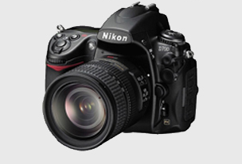
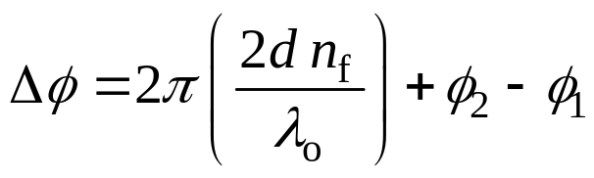
m = 0, 1, 2, 3 , ….
For constructive interference Δφ = m (2π) rad
For destructive interference Δφ = (2m+1)(π) rad
Thin film destructive interference is the principle behind coating optical surfaces such as lenses to reduce reflections so more light then can be transmitted. An uncoated air-glass interface reflects ~ 4% of the incident light. In a multiple lens system, the loss of transmitted light can be significant. Often lens are coated with magnetism fluoride to reduce reflections to produce a gain in the transmission of the lens system.
For thick films it becomes possible for many different colours to have their maxima at the same locations. Where many wavelengths can interfere constructively at the same time, the reflected colour becomes increasing unsaturated and the fringe contrast disappears.
CP 563

Slide 18
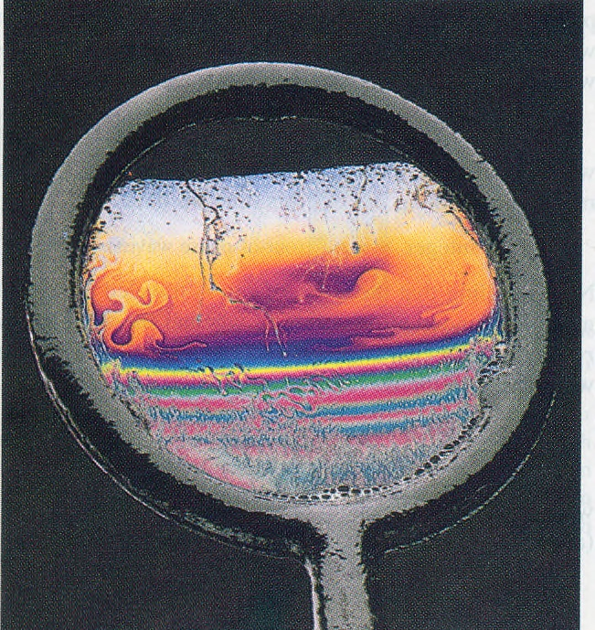


Soap film fringes illuminated by white light
Why does the film look dark at the top (where it is thinnest)?
air | water | air
CP 563

Slide 19
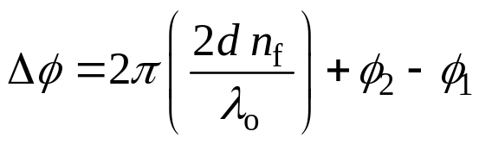
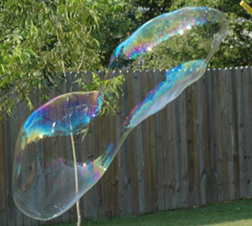
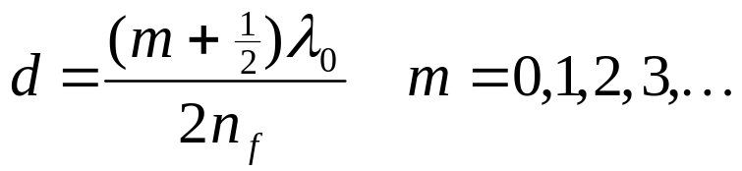
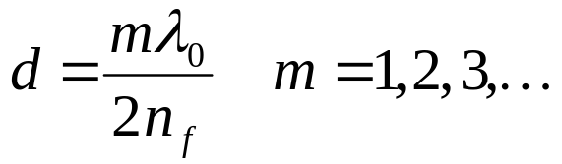
Reflection from soap films
Film has higher refractive index than medium on either side (air)
At first interface refractive index increases, at second refractive index decreases
In this case there is π (180°) phase difference between the reflected beams, in addition to phase difference due to path difference.
φ₁ = π φ₂ = 0
What is the thickness of the soap film ?
constructive interference m(2π) = 2π (2d n_{f} / λ_{o}) - π
destructive interference π(2m+1) = 2π (2d nf / λ_{o}) - π :
CP 563

Slide 20
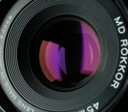
Anti-reflection coating
Thin film of material with refractive index between that of air and glass on a lens.
Choose thickness so there is destructive interference between light reflected from each interface
Why do such lens look ‘purple’?
Anti-reflection coating: destructive interference
The film thickness d is equal to an odd number of quarter wavelengths λ_{f}
Waves reflected from the two interfaces are π (180)° out of phase
CP 563

Slide 21

Anti-reflective coating
φ₂ - φ₁ = 0
φ₁= π
φ₂= π
Destructive interference
thinnest film
π = 2π (2d n_{f} / λ_{o}) + 0
d = λ_{o} / (4 n_{f}) = λ_{f} / 4
air
n₁ = 1
n_{f}
d
film
glass
n₂
n₁ < n_{f} < n₂

Slide 22

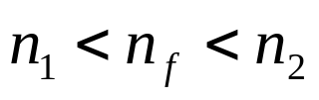
Problem 10.1 PHYS 1002 Exam, 2002
In air (n = 1.00) light is incident normally on a thin film with an index of refraction n = 1.25. The film covers a glass lens of refractive index 1.45. What is the minimum thickness of the film to minimise reflection of blue light (400 nm)?
n₁ =1
thin film
d
[Ans: d =80 nm]

Slide 23
Problem 10.2
Light is incident normally on a thin film with an index of reflection n =1.35. The film covers a glass lens of refractive index 1.5. What is the thickness of the film to maximise the reflection of red light (633 nm)?

Slide 24
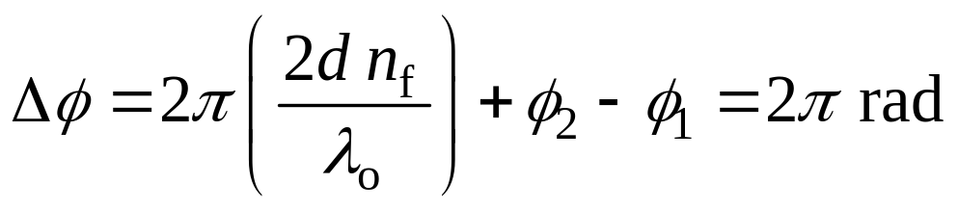
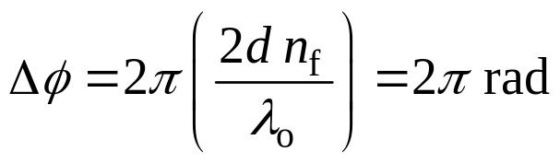
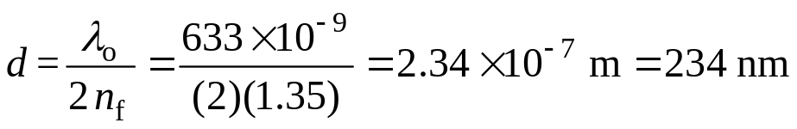
Solution 10.2 I S E E
n₁ = 1 n_{f} = 1.35 n₂ = 1.5 λ_{o} = 633 nm = 633×10⁻⁹ m
To maximise reflections we need the reflected waves to interfere constructively.
you need to add diagram
reflection at front interface n₁ < n_{f} ⇒ φ₁ = π
reflection at rear interface n_{f} < n₂ ⇒ φ₂ = π
φ₂ - φ₁ = 0 ⇒ can ignore the total phase change due to interface reflections

Slide 25
Problem 10.3 PHYS 1002 Exam, 2004 - Question 12
(a) Explain the meaning of the concepts of constructive and destructive interference when applied to two monochromatic waves. You can draw diagrams showing the waves produced by two sources as part of your answer.
(b) When light reflects off a surface it can have zero change in phase or a π change in phase. What is the significance of the refractive index in determining this change upon reflection?
(c) A fused silica lens of refractive index 1.46 is surrounded by air. Explain why a ‘quarter wavelength’ thick magnesium fluoride (refractive index of 1.38) coating over the front surface of the lens can reduce reflections and hence increase the amount of light transmitted through the lens.
(d) Light from a helium neon laser (wavelength 633 nm) is normally incident upon the coated lens described in part (c). What is the minimum thickness of the film that will result in minimum reflected intensity [Ans: d = 115 nm]

Slide 26
Problem 10.4
Oil (n = 1.20) leaking from a damaged tanker creates a large oil slick on the harbour (n = 1.33). In order to determine the thickness of the oil slick, a plane is flown when the Sun is overhead. The sunlight reflected directly below the plane is found to have intensity maxima at 450 nm and 600 nm, and no wavelengths in between. What is the thickness of the oil slick?
[Ans 750 nm]

