Slide 1
LECTURE 11 Ch17
A progressive electromagnetic wave is a self-supporting, energy-carrying disturbance that travels free of its source. The light from the Sun travels through space (no medium) for only 8.3 minutes before arriving at Earth. Each form of electromagnetic radiation (radiowaves, microwaves, infrared, light, ultraviolet, x-rays and γ rays) is a web of oscillating electric and magnetic fields inducing one another. A fluctuating electric field (electric charges experience forces) creates a magnetic field (moving charges experience forces) perpendicular too itself, surrounding and extending beyond it. That magnetic field sweeping off to a point further in space is varying there, and so generates a perpendicular electric fields that spreads out … . Nothing is actually displaced in space like a water wave where the water oscillates up and down and side-ways.

Slide 2
All electromagnetic waves propagate in vacuum at exactly
speed of light c = 2.997 924 85 m.s⁻¹
This is a tremendous speed, light travels 1m in only 3.3×10⁻¹⁰ s.
"There are only two fundamental mechanisms for transporting energy and momentum: a streaming of particles and a flowing of waves. And even these two seemingly opposite conceptions are subtly intertwined – there are no waves without particles and no particles without waves … " from Hecht.
The particles associated with electromagnetic waves are called photons. The energy of a single photon is
E = h f
E energy of photon (J) electron volt 1 eV = 1.6×10⁻¹⁹ J
f frequency of electromagnetic wave (Hz)
h = 6.62606876×10⁻³⁴ J.s Planck's constant (J.s)

Slide 3
Absorption and emission of light
The emission and absorption of light (transfer of energy & momentum) takes place in a particle manner. All forms of electromagnetic radiation, interact with matter in the process of emission and absorption. The radiation propagates in a wavelike fashion but in an interaction the radiation behaves as a concentration of energy (photons) moving at the speed of light.
Each photon carries very little energy. However, even an ordinary torch beam is a torrent of ~10¹⁷ photons.s⁻¹. When we “see” light what we observe by eye or on film is the average energy per unit area per time arriving at some surface.

Slide 4
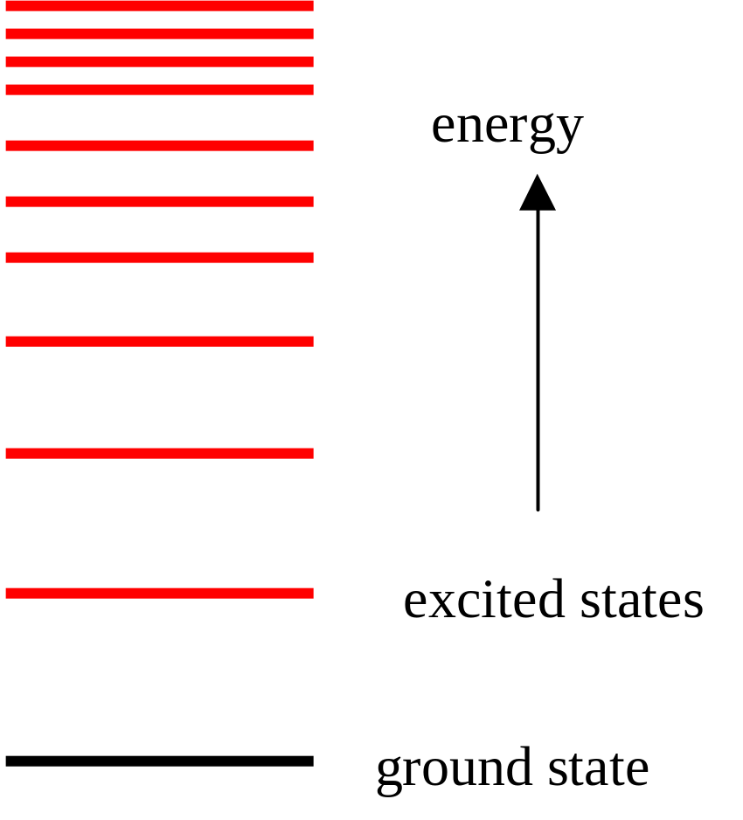
Most of the chemical and optical properties of a substance are dependent upon the outer most bound electrons in atoms. Each electron is usually in its ground state – the lowest energy state. Only when an atom absorbs specific and sufficient energy can the atom move to a well-defined higher energy state (excited state).

Slide 5
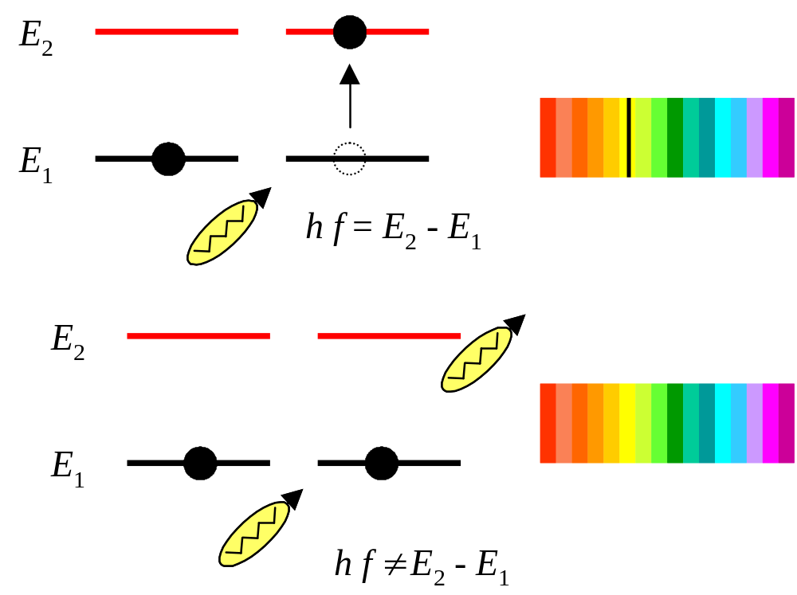
Resonant Absorption

Slide 6
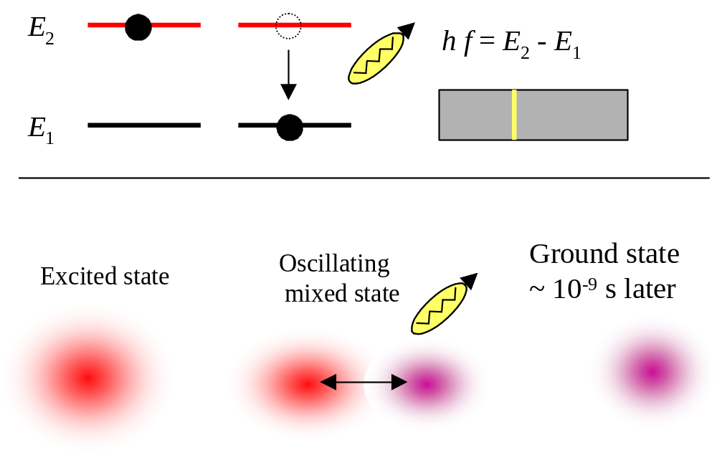
Spontaneous emission

Slide 7
Radiation | f (Hz) | λ (m) | Photon Energy (eV) | Comments
power lines | 50 | 6×10⁶ | 2×10⁻¹³ | Currents. Radiation emitted from 50 Hz power lines – are they dangerous?
radio AM FM TV | < 10⁹ | > 0.3 | < 4×10⁻⁶ | Currents, electronic circuits. AM FM radio, TV.
microwaves | 10⁹ 3×10¹¹ | 0.3 1×10⁻³ | 4×10⁻⁶ 1×10⁻³ | Magnetron. λ ~ 10 mm to 30 m can penetrate atmosphere – satellite communications, mobile phones, police radar, microwave cooking (polar water molecule), medical – diathermy.

Slide 8
Radiation | f (Hz) | λ (m) | Photon Energy (eV) | Comments
infrared | 3×10¹¹ 4×10¹⁴ | 1×10⁻³ 8×10⁻⁷ | 1×10⁻³ 2 | Molecular vibrations & rotations, all objects. Why do you get warm standing in the sun? Thermography, IR satellite images, detecting tumors & cancers.
light | 3.9×10¹⁴ 7.7×10¹⁴ | 7.8×10⁻⁷ 3.9×10⁻⁷ | 2 3 | Outer electrons, incandescent lamps, lasers, arcs. Eye sensitive to this narrow band. White light mixture of all colours of visible spectrum. TV (red blue green). If a an uranium atom enlarged to a size of a pea , λ_{red} ~ 20 m long. Sunlight ~ 10¹⁷ photons.s⁻¹.m⁻². Blue light photons sufficient energy to disrupt chemical bonds.
ultraviolet | 8×10⁻¹⁴ 3×10¹⁶ | 4×10⁻⁷ 1×10⁻⁸ | 3 1×10² | Inner & outer electrons. Ionising (4 eV photons break C-C bonds). Skin cancers, tans the skin, vitamin D synthesis, damage to eyes. O₃ layer absorbs UV – protection layer. Can kill micro-organisms.

Slide 9
Radiation | f (Hz) | λ (m) | Photon Energy (eV) | Comments
x-rays | 3×10¹⁶ 10²⁰ | 1×10⁻⁸ 3×10⁻¹² | 1×10² 4×10⁵ | Inner electrons, x-ray tubes. Diagnostic medical-rays. Computed tomography CT scan. Crystal & molecular structures.
γ-rays | > 10¹⁸ | 3×10⁻¹⁰ ↓ | > 4×10³ | Nuclei, accelerators. Sterlisation, food preservation, cancer treatment, medical diagnosis, flaw detection. Very penetrating – can pass through large thickness of concrete.

