Slide 1
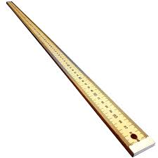
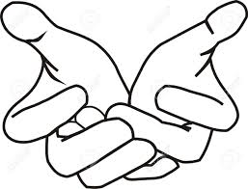

Slide 2
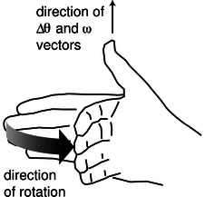
direction of cross product
direction of rotation of fingers

Slide 3

54 N
50º
45 N
r = 0.74 m
90º
75º
75 N

Slide 4
point of application of force
axis of rotation
r₁
r₂
r₃
out of page
anticlockwise rotation
out of page
anticlockwise rotation
into page
clockwise rotation

Slide 5
Y
X

Slide 6
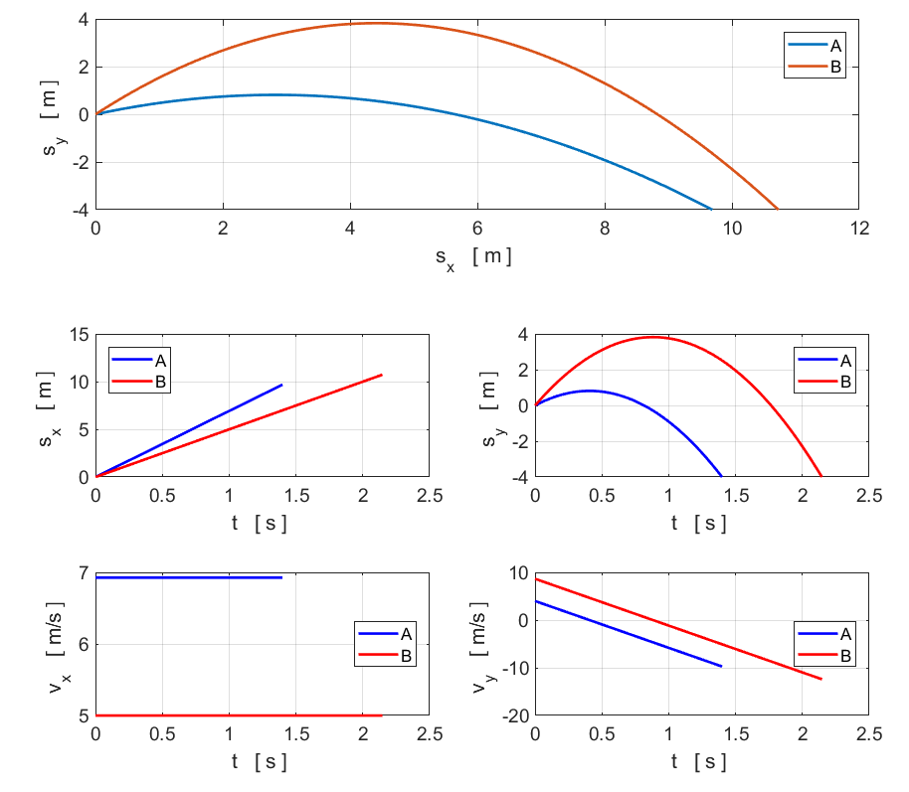

Slide 7

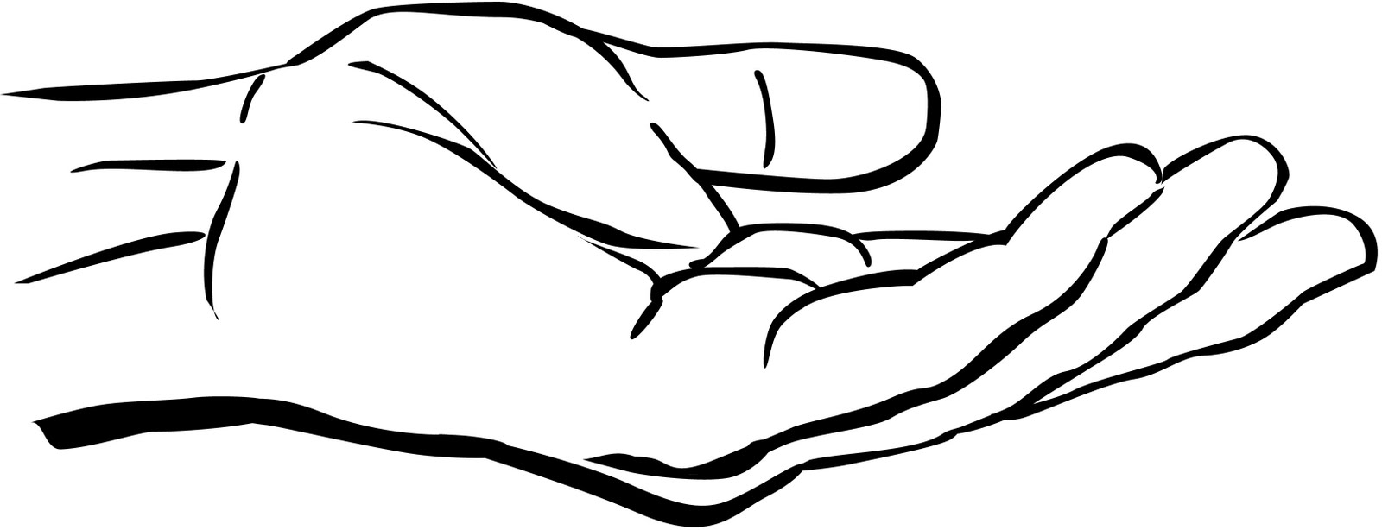
F₁ is the force of hand on ball
F₂ is the force of ball on hand
F₃ is the force of the ball on the Earth
F₄ is the force of the Earth on the ball

Slide 8
Systems
Y
Ball
m a > 0
Hand
Earth
X
F₁
F₃
F₄
F₂
F₁ is the force of hand on ball
F₂ is the force of ball on hand
F₃ is the force of the ball on the Earth
F₄ is the force of the Earth on the ball
Newton’s 3rd Law: action / reaction forces
Ball / Earth F₄ = F₃
Ball / Hand F₁ = F₂
The ball accelerates upward F₁ > F₄

Slide 9
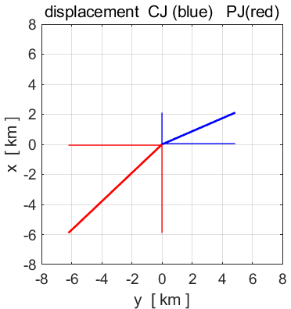
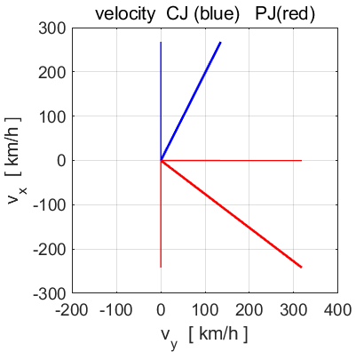
N
Y
We need to specify the vectors for displacement and velocity in terms of their X and Y components. Let the frame of reference be the XY plane with the Origin at the location of Joe. All angles are measured w.r.t the X axis from -180º to +180º.
X
The displacements and velocities of Chris w.r.t Joe and Pat w.r.t are:

