Slide 1
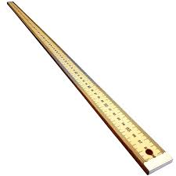
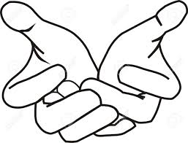

Slide 2
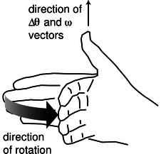
direction of cross product
direction of rotation of fingers

Slide 3

54 N
50º
45 N
r = 0.74 m
90º
75º
75 N

Slide 4
point of application of force
axis of rotation
r₁
r₂
r₃
out of page
anticlockwise rotation
out of page
anticlockwise rotation
into page
clockwise rotation

Slide 5
+Z direction
anticlockwise rotation
axis of rotation
Z
Z axis
Y
X
pivot point
lever arm vector
point of application
of force
XY plane

Slide 6
tangential applied force
torque
m
linear acceleration
angular acceleration

Slide 7
tangential velocity v
m
centripetal force
centripetal acceleration

Slide 8


Slide 9
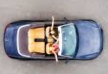
tendency for passenger to move in a straight line
system: car
system: passenger
force on car: net frictional force between road and tyres
force on passenger: friction with seat / door

Slide 10
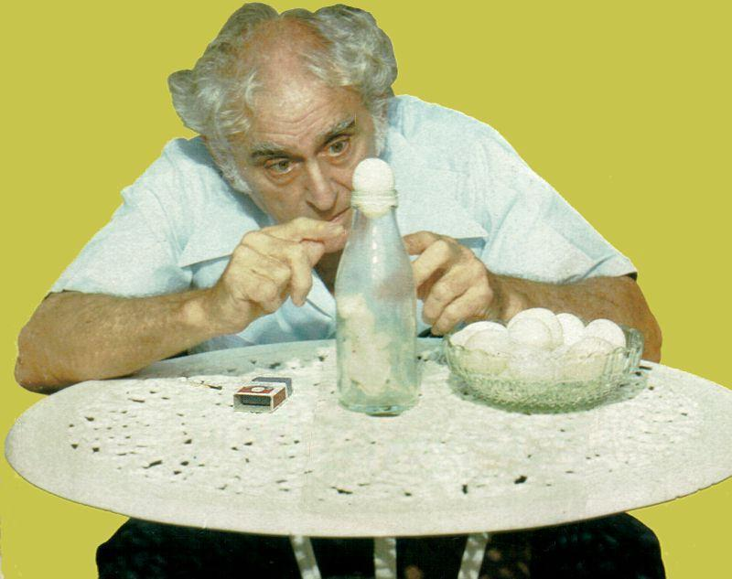
why is it so ???

Slide 11
G = 6.673x10^{‐11} N.m².kg^{‐2}
m_{A}= 0.500 kg
m_{B}= 0.010 kg
+X
R = 0.75 kg

Slide 12
m
m
m
2m
F
2F
d
d
m
m
m
9m
F/16
F
4d
3d

