Slide 1
A stone of mass m is connected to the end of a string and held at position A. The stone is released and then it swings freely in a vertical circular arc passing the points A, B and C. After the stone is released, the string tension F at points A, B and C are such that:
A F_{A} = F_{B} = F_{C}
B F_{A} < F_{B} < F_{C}
C F_{A} > F_{B} > F_{C}
D F_{A} = F_{B} F_{C} = 0
A
B
C

Slide 2
At x = 2.0 m, the direction of the force acting on the ball is
A B C D E
F = 0

Slide 3
Near the surface of a planet the gravitational field lines are approximately uniformly spaced hence we can assume a uniform gravitational field strength.
Gravitational field surrounding the planet increases towards the surface as shown by the increase in the density of the field lines.

Slide 4
normal F_{N}
spring F_{S}
F_{G} = F_{N}
1.23 kg
F_{G} = F_{S}
weight F_{G}
weight F_{G}

Slide 5

hand F_{H}
Object raised through a vertical displacement h at a constant velocity
a = 0 ⇒ F_{H} = F_{G}
m
weight F_{G}

Slide 6
R_{E}
M_{E}
r

Slide 7
1: initial event – ball released from rest
h₁ = 134 m E_{P1} = m g h₁ E_{K1} = 0 J v₁ = 0 m.s⁻¹
+
g = 9.8 m.s⁻²
g is only a number, can’t be negative
h₂ = 0 E_{P2} = 0 E_{K2} = ½ m v₂² = ? J v₂ = ? m.s⁻¹
2: final event – just before impact with ground

Slide 8
t = 0
Δt
2Δt
3Δt
4Δt
5Δt

Slide 9
+Y
a_{y} = g = -9.81 m.s⁻²
+ X direction: to the right
+ Y direction: up
+X
+Y
+X

Slide 10
vertical motion
going up
vertical motion
going down
highest point: v_{y} = 0
v_{y}
v_{x} = u_{x}
v_{x} = u_{x}
v_{x} = u_{x}
v_{y}
v_{x} = u_{x}
+Y
v_{y}
v_{x} = u_{x}
+X
at all times the net force on the object is downwards
v_{y}
horizontal: equal distance travelled in equal time intervals v_{x} = u_{x} a_{x} = 0

Slide 11
75º
60º
30º
45º
15º

Slide 12
u [m.s⁻¹]
30
40
50
60
70
80
90
100

Slide 13
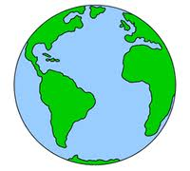

Slide 14
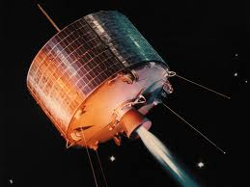
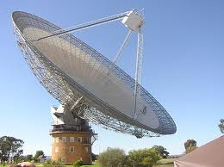
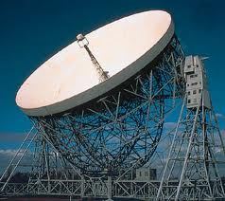
Satellites are used for communications and GPS (global positioning system). Microwaves and radio waves are used for the contact between radio telescopes and satellites.
uplink
downlink
Parks, NSW
Jodrell Bank, U.K.

Slide 15
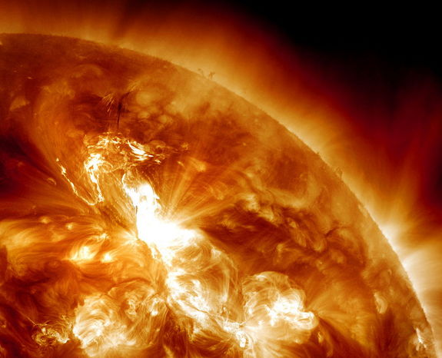
Solar Flare, January 23, 2012 which was proceed by auroras around the world on the 22nd.

Slide 16
rotation towards the east
NASA’s Cape Canaveral
Rotational speed ~ 400 m.s⁻¹ due to the Earth spinning around its rotation axis
Rotation axis

Slide 17
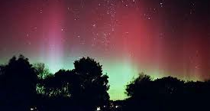
inner belt:
positively charged protons
outer belt:
negatively charged electrons
solar
wind
N
B-field
Auroras – bright light shows produced by the excitation of molecules in the air. The molecules are excited by collisions with high speed charged particles.

Slide 18
Earth’s orbital velocity around the Sun ~ 30 km.s⁻¹
Sun
Earth
Earth’s orbit around the Sun

Slide 19
Cannon ball fired with increasing velocities
A
B
ball fired at escape velocity
E
D
C
ball orbits around the Earth

Slide 20
momentum of rocket
p_{rocket}
F_{RG} force on rocket by gas
F_{GR} force on gas by rocket
momentum of exhaust gases
p_{gases}

Slide 21



angle too step → large heating effect → spacecraft burns out
angle too shallow → spacecraft bounces off atmosphere
Correct entry angle → spacecraft can land safely

Slide 22
start of a
steep dive
blood
pulling out of
a steep dive
body
Newton’s 1st law: blood keeps moving
Newton’s 1st law: blood stays put

Slide 23
LIFT OFF
v increasing
RE-ENTRY
v decreasing
It is must safer for an astronaut to lie in a crouching position rather than standing up because the body can tolerate larger g-forces. In the crouching position g-force(max) ~ 20g
Alan Shepard – first man in space
g-force (lift off) ~ 6 g
g-force (re-entry) ~ 12 g

Slide 24
Newton’s 2nd law applied to astronaut
mass of astronaut m
F_{N}
+
Scaling reading F_{N}
m
a
Weight F_{G} = m g
F_{G}
g is a positive number
v = constant → a = 0 → F_{N} = m g
v increasing → a > 0 → F_{N} = m g + m a > m g apparent weight > weight
v decreasing → a < 0 → F_{N} = m g – m|a| < m g apparent weight < weight
Free fall a = - g → F_{N} = 0 → apparent weight = 0 weightless

Slide 25
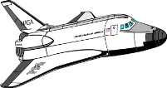
In 1952, Harry Allen proposed the best shape for the nose-cone of a spacecraft re-entering through atmosphere
sharp nose-cone → extreme heating effect :
temperatures > ~ 7500 ºC
blunt nose → shock wave → heating of air in front of nose-cone
space shuttle – nose well up
re-entry vehicle detached, backward entry → blunter nose → less heating
nose covered with ceramic tiles which are abated (vaporised) dissipating energy to reduce heating the shuttle
flat underbelly to atmosphere → blunt shape → shock wave → less heating of shuttle

Slide 26
orbital velocity v
string tension F_{T}
string breaks – object moves off in a straight line

Slide 27
100% transmission
100
80
% transmission
through atmosphere
60
40
20
0
10⁻¹⁰
10⁻⁸
10⁻⁶
10⁻⁴
10⁻²
10⁰
10²
wavelength λ (m)
100% absorption

Slide 28
orbital velocity v
gravitational force F_{G}
acting on satellite

Slide 29
change in velocity Δv directed towards the centre of the circle → acceleration a_{c} directed towards the centre of the circle

Slide 30
path of a planet around the Sun is an ellipse
r
Sun at one focus of ellipse
b semi-minor radius
2b
perihelion
aphelion
2a
a semi-major radius

Slide 31
elliptical path of planet around Sun
in equal time intervals A₁ = A₂
Sun
r
planet
A₁
A₂
equal areas
perihelion – closest point to the Sun – max speed of planet
aphelion – furthest point from the Sun – min speed of planet

Slide 32
perihelion
(large speed)
aphelion
(slow speed)

Slide 33
cart moves with a constant velocity v
ball is throw vertical up by the boy in the cart
BOY states the ball travels in a straight line – it goes up then down
GIRL states the ball travels along a parabolic arc

Slide 34
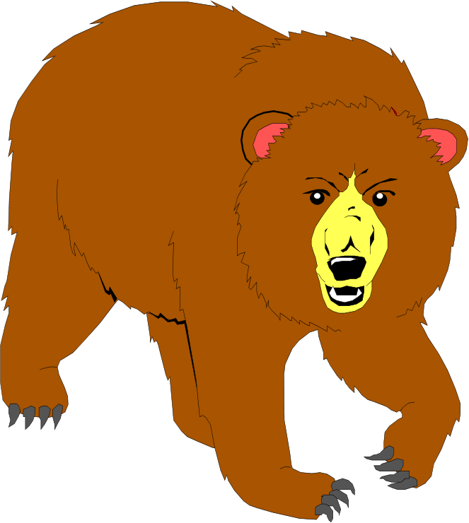

Slide 35
Flat Earth model – vertical direction was absolute
Earth is a sphere – vertical is a relative concept
is the arrow pointing up or down?

Slide 36
light beam
speed c
light beam
speed c
walking speed v
walking speed v
speed of light w.r.t to walker
c + v
speed of light w.r.t to walker
c - v

Slide 37

speed of aether w.r.t. the Earth v
aether
speed of earth w.r.t. the aether v
speed of light w.r.t. Earth
c - v
speed of light w.r.t. Earth
c + v

Slide 38
mirror M1
mirror M2
light source S
half-silver mirror
K
M1
M1
O
observer O
O
M2
M2
partial constructive interference of the waves from the two mirrors
partial destructive interference of the waves from the two mirrors

Slide 39
electromagnetic wave travelling at c
plane approaching radio transmitter at speed c/2
Measured speed of electromagnetic wave v w.r.t observer in jet aircraft
Newtonian physics v = c + c/ 2 = 3c/2
Einstein: special relativity v = c

Slide 40
F1
F1
A1
O1
B1
A1
O1
B1
v
v
A2
O2
B2
A2
O2
B2
F2
F2
Lightning strikes the points A and B
The light reaches O2

Slide 41
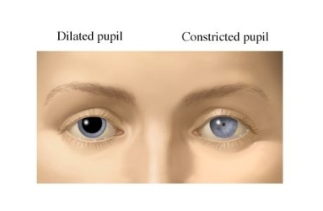
pupil - normal
pupil - dilated

Slide 42
stationary clock
beep 2
beep 4
beep 6
beep 10
beep 1
beep 3
beep 13
beep 8
beep 12
beep 5
beep 7
beep 9
beep 11
beep 1
beep 2
beep 3
beep 4
beep 5
beep 6
beep 7
beep 8
beep 9
beep 10
beep 11
beep 12
beep 13
moving clock
stationary clock: 8 beeps have occurred
moving clock: 6 beeps have occurred
⇒ moving clocks run slow

Slide 43
Cosmic rays from the Sun and outer space
high speed protons
Collisions between high speed protons and atmospheric molecules produce muons.
Most muons able to reach the Earth’s surface
L₀
v = 0.99c

Slide 44
v/ c = 0.994
Newtonian physics ok

Slide 45
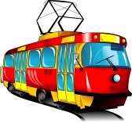
train at rest w.r.t. observer
train in motion w.r.t. observer
v
train is shorter in direction in motion but just as high and wide as it was at rest

Slide 47
Earth observer: time t for spacecraft travelling at speed v to travel a distance L₀ to red planet
red planet at rest w.r.t. Earth
L₀
v
v
L₀ = v t
t
Spaceship observer: time t₀ for spacecraft travelling at speed v to travel a distance L to red planet
v
red planet moving at speed v w.r.t. spacecraft
L
L = v t₀
t₀
length contraction

Slide 48
time t = 0 a.u.
planets
1 2 3 4
star

Slide 49
planet moves with
constant velocity
speed of spacecraft increased due to interaction with moving planet

Slide 51
KE of spacecraft
total energy of system
GPE of system

Slide 52
approach speed v₁
max speed at point of closest approach
v₁ = v₂
recede speed v₂

Slide 54
KE of spacecraft
total energy of system
GPE of system

Slide 56
spacecraft
planet

Slide 57
+X
a = - 2.5 m.s⁻²
t = 0
s = 0
u = 30 m.s⁻¹
v = 0
s = ? m
t = ? s

