Slide 1
Millikan’s Oil Drop Experiment
Charge of electron – very important application of uniform electric field between two plate – Robert Millikan (1868-1953)
  Purpose: to find charge of an electron

Slide 2
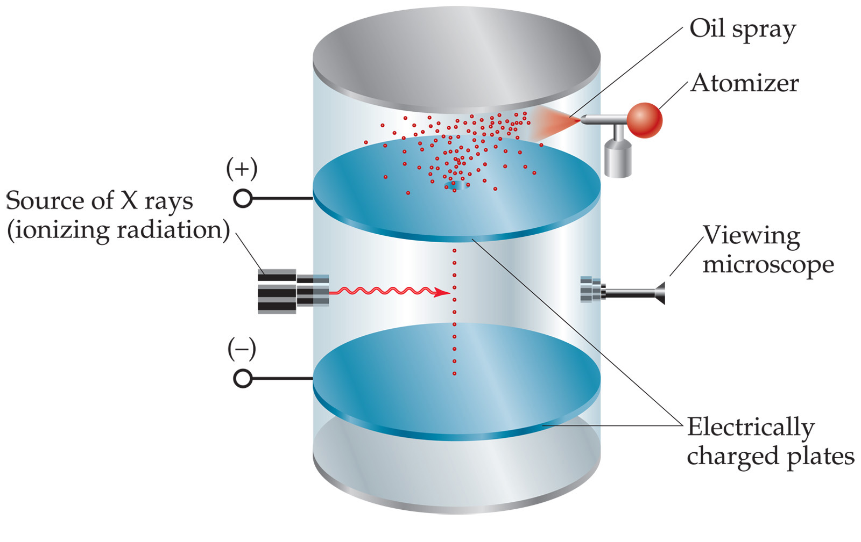
1. Fine oil sprayed into air in top – gravity causes them to fall
John D. Bookstaver
St. Charles Community College
St. Peters, MO
© 2006, Prentice Hall, Inc.

Slide 3
2. A few enter the hole
John D. Bookstaver
St. Charles Community College
St. Peters, MO
© 2006, Prentice Hall, Inc.

Slide 4
Potential difference between plates is applied – exerts a force
on the charged drops
John D. Bookstaver
St. Charles Community College
St. Peters, MO
© 2006, Prentice Hall, Inc.

Slide 5
Top plate is positive enough that negative drops will rise
-
John D. Bookstaver
St. Charles Community College
St. Peters, MO
© 2006, Prentice Hall, Inc.

Slide 6
Potential difference adjusted to suspend (float) particle
-
E*q = m*g
John D. Bookstaver
St. Charles Community College
St. Peters, MO
© 2006, Prentice Hall, Inc.

Slide 7
Electric field was determined from potential difference between two plates (E = V/d)
-
John D. Bookstaver
St. Charles Community College
St. Peters, MO
© 2006, Prentice Hall, Inc.

Slide 8
Found velocity of charge when field was turned off. Using velocity, mg was found. Using E & mg, the charge could be calculated.
-
John D. Bookstaver
St. Charles Community College
St. Peters, MO
© 2006, Prentice Hall, Inc.

Slide 9
The drops had a variety of charges. So, he ionized the air, added or removed electrons. The change in charge was always a multiple of -1.6 x 10⁻¹⁹ C. Thus, the charge on one electron.
-
John D. Bookstaver
St. Charles Community College
St. Peters, MO
© 2006, Prentice Hall, Inc.

Slide 10
Showed that charge is quantized – an object can only have charge with a magnitude that is some integral of the charge of an electron.
-
John D. Bookstaver
St. Charles Community College
St. Peters, MO
© 2006, Prentice Hall, Inc.

Slide 11
Sharing of Charge
Read pg. 438 & 439

Slide 12

Grounding
Grounding – touching an object to Earth to eliminate excess charge is called grounding
-
-
-
-
-

Slide 13
Chapter 21
Grounding – touching an object to Earth to eliminate excess charge is called grounding
-
-
-
-
-

Slide 14
Electric Field Near Conductors
Electric field near conductors – charges on conductors are spread as far as possible to keep energy of system low. Result – all charges are on surface of conductor
-
-
-
-
-
-
-
-
-
-
-
-
-
-
-
-
-
-

Slide 15
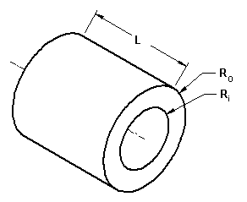
Electric Field Near Conductors
Electric field near conductors –
Hollow? Excess charges move to outer surface
-
-
-
-
Shielding
-
-
-
-
-
-
-
-
-
-
A closed, metal container will have no charge on the inside surface
http://www.engineersedge.com/motors/images/hollow11.gif

Slide 16
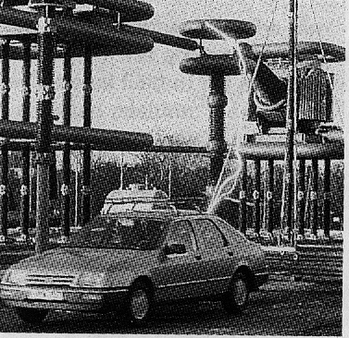
Electrons from the lightning bolt mutually repel and spread over the outer metal surface. Although the electric field set up may be great outside the car, the overall electric field inside the car practically cancels to zero.
http://webphysics.ph.msstate.edu/

Slide 17
Electric Field Outside Conductors
III. Electric field outside conductors – depends on shape of body and its potential
A. Charges are close together at sharp points, so field lines are close together, thus, the field is stronger here.
-
-
-
-
-
-
-
-
-
-
-
-
-
-
-
-
-
-

Slide 18
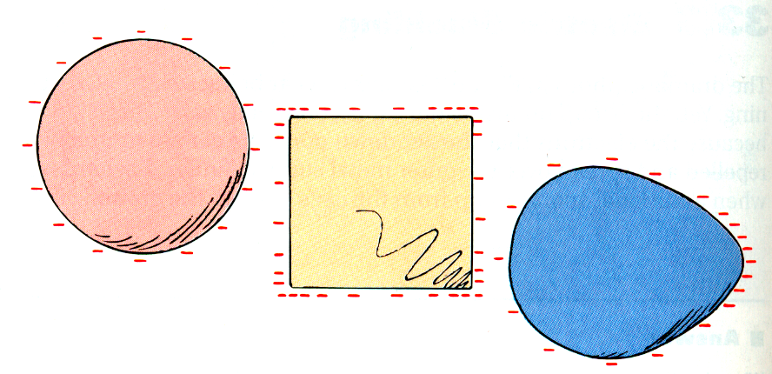
Even if the objects are not spherical the charge is on the outside. Note that where there are corners the charge tends to bunch up. The charge inside is still zero.
http://webphysics.ph.msstate.edu/

Slide 19
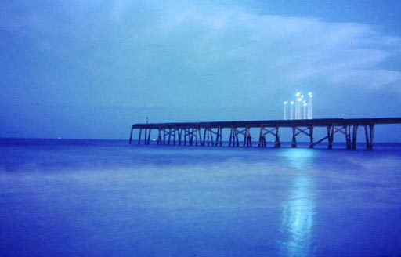
Electric Field Outside Conductors
III. Electric field outside conductors – depends on shape of body and its potential
B. The can actually cause nearby air molecules to be separated into electrons and positive ions
-
-
-
-
-
-
-
-
-
-
-
-
-
-
-
-
-
-
-
-
-
+
+
+
1. As they recombine, energy is released and blue corona can form (St. Elmo’s fire)
http://www.commissionseast.org.uk/library/lowestoft/lowestoft_5.jpg

Slide 20
Electric Field Outside Conductors
III. Electric field outside conductors – depends on shape of body and its potential
C. To reduce this effect in conductors that are highly charged or operate at high potentials, the conductors are made smooth in shape

Slide 21
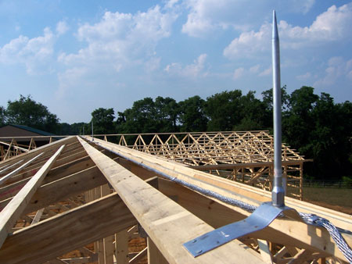
Electric Field Outside Conductors
III. Electric field outside conductors – depends on shape of body and its potential
D. Lightning rods – made pointed so electric field is strong near end of rod; charges spark to a rod rather than the roof of a building
http://wblightningrods.com/images/gallery_concealed.jpg

Slide 22
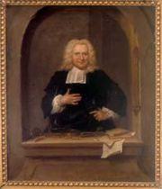
Storing Electric Energy
IV. Storing Electric Energy – The Capacitor
A. 1746 – Peter Van Musschenbroek – Dutch Physicist invented a device to store electric charge (Leyden jar)
http://upload.wikimedia.org/wikipedia/commons/thumb/c/c9/Pieter_van_Musschenbroek.jpeg/180px-Pieter_van_Musschenbroek.jpeg

Slide 23
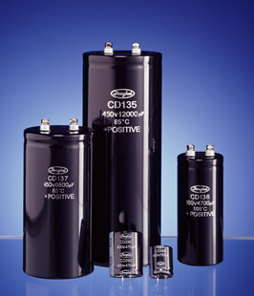
Storing Electric Energy
IV. Storing Electric Energy – The Capacitor
B. Capacitance (C) – ratio of charge to potential difference
C
=
q
[=]
Coulomb (C)
=
Farad (F)
V
Voltage
C. Capacitor – device used to have a specific capacitance (large capacitance in small device)
http://www.jianghai.com/image/da2.jpg

Slide 24
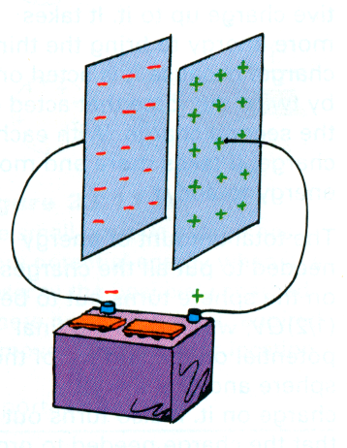
You can store electrical energy in a device called a capacitor. Capacitors are found in almost all electronic circuits.
A capacitor is simply a device that has two conducting materials separated by an insulating material.
Capacitors are usually between 10 pF (1 x 10 ⁻¹² F) and 500 μF (500 x 10⁻⁶ F)
http://webphysics.ph.msstate.edu/

