Slide 1
Millikan’s Oil Drop Experiment
To Determine The Charge Of The Electron

Slide 2
Success Criteria
Be able to state and explain Stokes Law for bodies moving through fluids
Be able to identify the forces acting on a stationary charged object in an electric field
Recall and explain how Millikan was experimentally able to determine the charge on the electron

Slide 3
Falling through a fluid
Give a detailed description of the forces acting on an object moving in a fluid
How could the drag force on the object be calculated?

Slide 4
Measuring the viscosity of water
Measurements:
  Mass of ball bearing
  Radius of ball bearing
  Terminal velocity of ball bearing

Slide 5
Stoke’s Law
When an object is dropped through a fluid, it experiences a force called viscous drag.
This force acts in the opposite direction to the velocity of the object, and is due to the viscosity of the fluid.
The force on a spherical object can be calculated using Stoke’s Law:
F=6πηrv
η=coeff of viscosity of fluid, r=radius of object
v=velocity of object, π=Pi

Slide 6
Assumptions
Small Reynolds number (small particles satisfy this)
Laminar flow
Smooth, spherical particles
Homogeneous fluid
Particles do not interfere with each other

Slide 7
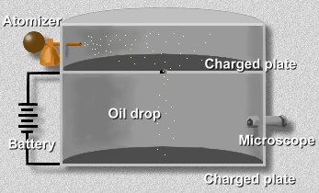
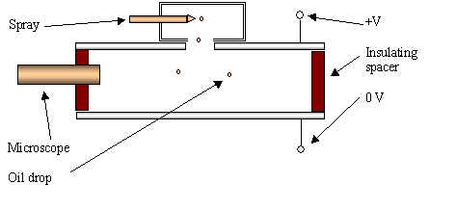
Millikan’s Apparatus
Atomiser created a fine mist of oil droplets, charged by friction (Later experiments used x-rays).
Some droplets fell through hole and could be viewed through the microscope with a scale to measure distances and hence velocities.
Millikan applied an electric field between the plates which would exert a force on the droplets. He could adjust the p.d. and hence field strength to get the oil droplets to hover.

Slide 8
Forces without a field
Before the electric field is turned on, the forces on the droplets are:
a) the weight of the drop;
b) the viscous force from the air.
The drop will reach terminal velocity when the two forces are equal.
mg=6πηrv
The mass of the drop is the volume multiplied by the density of the oil, ρ , so the equation can be written:
4/3πr³ρg = 6πηrv => r² = 9ηv/2ρg
Millikan in earlier experiments measured η and ρ, and now can calculate r.
Viscous Force
Weight

Slide 9
With An Electric Field
Millikan adjusted p.d. till the drop was stationary. Since for viscous force to act the drop needed to be moving, this for is now not there.
Two forces now are:
Weight of droplet;
Force due to uniform electric field.

Slide 10
For a charged oil droplet
The electric force is given by:
F = QV/d
Where
Q=charge on oil drop
V=p.d. between plates
d=distance between plates

Slide 11
If drop is stationary then electric force must be equal to the weight.
QV/d = 4/3πr³ρg
Earlier, r was calculated so the only unknown is Q.
Millikan could calculate the charge on the droplet. He repeated his experiment many times and found that the smallest value calculated was -1.6X10⁻¹⁹ C and all other values were a multiple of it.
He concluded that charge could never exist in smaller quantities than this, and this was the charge carried by a single electron.

Slide 12
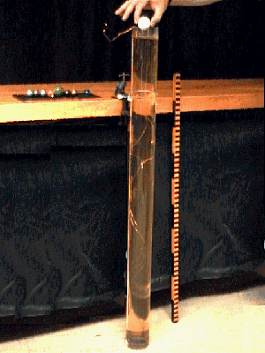
Practical Task
Find the coefficient of viscosity of glycerine

