Slide 1
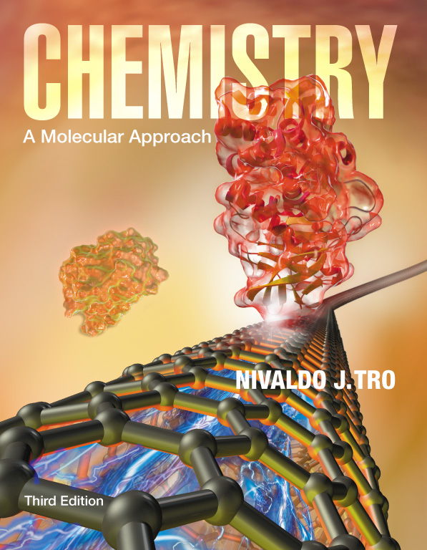
Lecture Presentation
Chapter 2-2 Atoms and Elements
Christian Madu, Ph.D.
Collin College

Slide 2
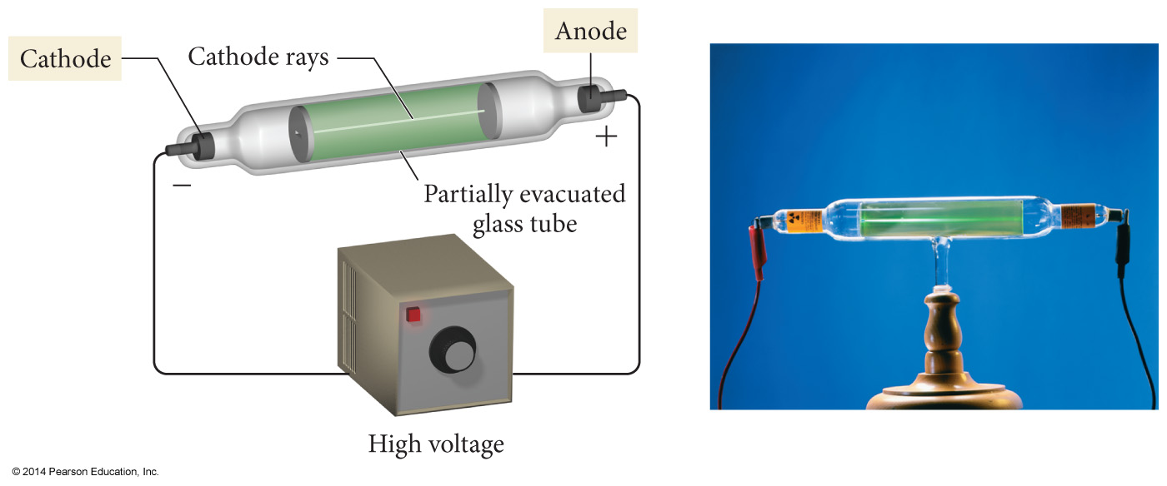
The Discovery of the Electron

Slide 3
The Discovery of the Electron
Thomson found that the particles that compose the cathode ray have the following properties:
They travel in straight lines.
They are independent of the composition of the material from which they originate (the cathode).
They carry a negative electrical charge.

Slide 4
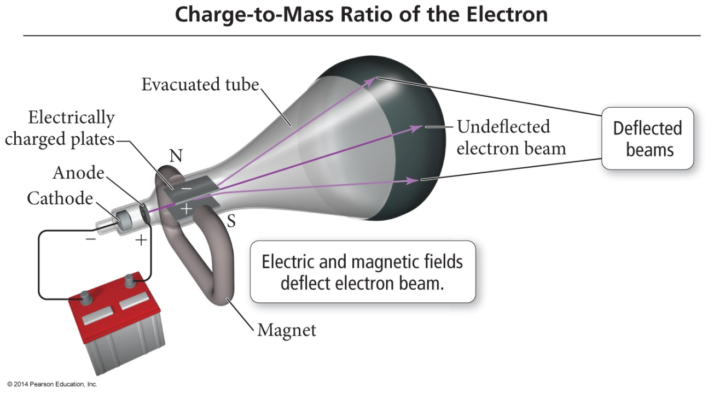
The Discovery of the Electron
J. J. Thomson measured the charge-to-mass ratio of the cathode ray particles by deflecting them using electric and magnetic fields, as shown in the figure.
The value he measured was –1.76 × 10³ coulombs (C) per gram.

Slide 5
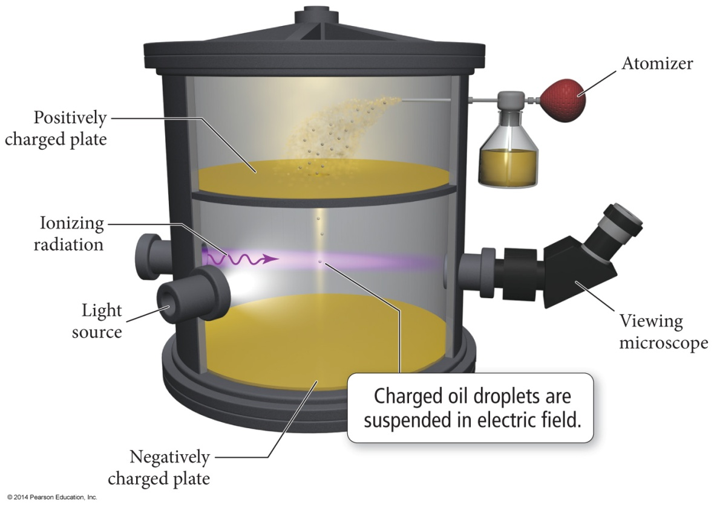
Millikan’s Oil Drop Experiment: The Charge of the Electron
American physicist Robert Millikan (1868–1953), performed his now famous oil drop experiment in which he deduced the charge of a single electron.

Slide 6
Millikan’s Oil Drop Experiment
By measuring the strength of the electric field required to halt the free fall of the drops, and by figuring out the masses of the drops themselves (determined from their radii and density), Millikan calculated the charge of each drop.
The measured charge on any drop was always a whole-number multiple of –1.96 × 10^{–19}, the fundamental charge of a single electron.

Slide 7
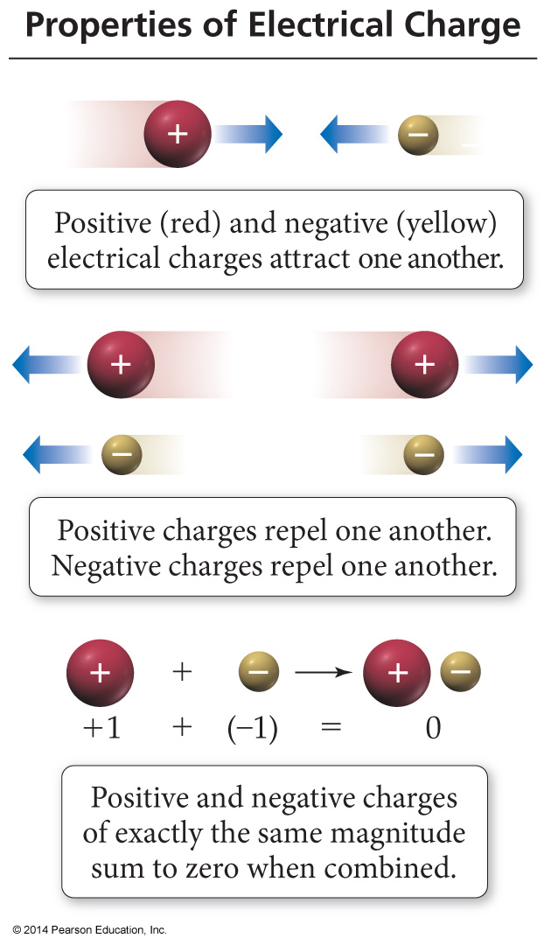
The Discovery of the Electron
J. J. Thomson had discovered the electron, a negatively charged, low mass particle present within all atoms.

Slide 8
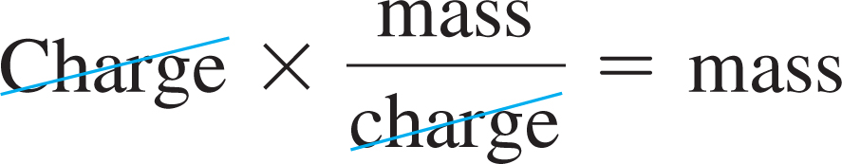
Millikan’s Oil Drop Experiment
With this number in hand, and knowing Thomson’s mass-to-charge ratio for electrons, we can deduce the mass of an electron:

Slide 9
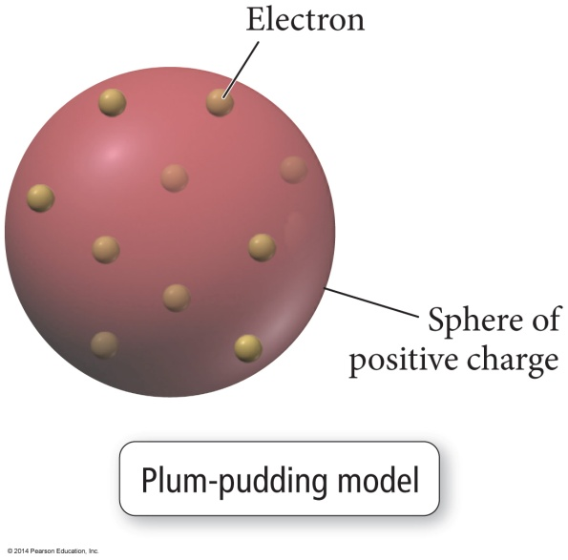
The Structure of the Atom
J. J. Thomson proposed that the negatively charged electrons were small particles held within a positively charged sphere.
This model, the most popular of the time, became known as the plum-pudding model.

Slide 10
Rutherford’s Gold Foil Experiment
In 1909, Ernest Rutherford (1871–1937), who had worked under Thomson and subscribed to his plum-pudding model, performed an experiment in an attempt to confirm Thomson’s model.
In the experiment, Rutherford directed the positively charged particles at an ultra thin sheet of gold foil.

Slide 11
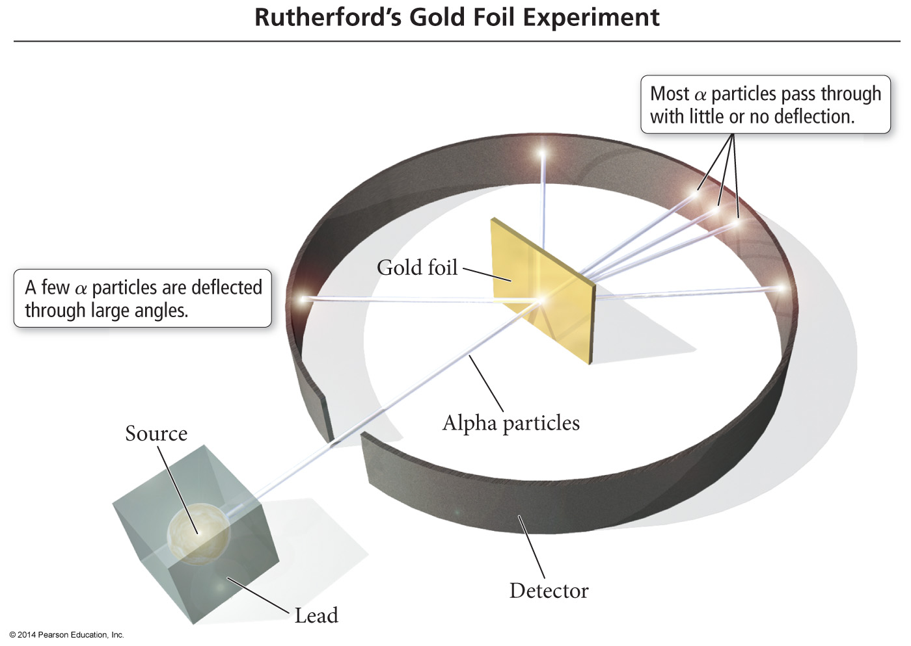
Rutherford’s Gold Foil Experiment

Slide 12
Rutherford’s Gold Foil Experiment
The Rutherford experiment gave an unexpected result. A majority of the particles did pass directly through the foil, but some particles were deflected, and some (approximately 1 in 20,000) even bounced back.
Rutherford created a new model—a modern version of which is shown in Figure 2.7 alongside the plum-pudding model—to explain his results.

Slide 13
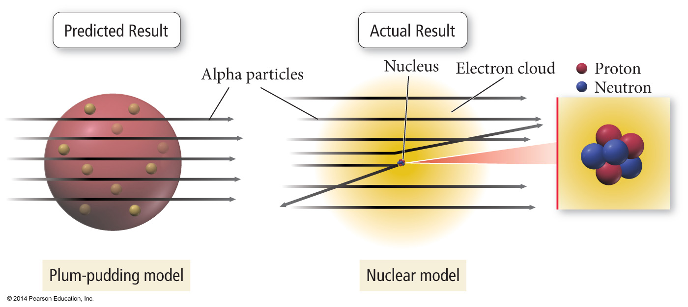
Rutherford’s Gold Foil Experiment
He concluded that matter must not be as uniform as it appears. It must contain large regions of empty space dotted with small regions of very dense matter.

Slide 14
Rutherford’s Gold Foil Experiment
Building on this idea, he proposed the nuclear theory of the atom, with three basic parts:
1. Most of the atom’s mass and all of its positive charge are contained in a small core called a nucleus.
2. Most of the volume of the atom is empty space, throughout which tiny, negatively charged electrons are dispersed.
3. There are as many negatively charged electrons outside the nucleus as there are positively charged particles (named protons) within the nucleus, so that the atom is electrically neutral.

Slide 15
The Neutrons
Although Rutherford’s model was highly successful, scientists realized that it was incomplete.
Later work by Rutherford and one of his students, British scientist James Chadwick (1891–1974), demonstrated that the previously unaccounted for mass was due to neutrons, neutral particles within the nucleus.

Slide 16
The Neutrons
The mass of a neutron is similar to that of a proton.
However, a neutron has no electrical charge.
The helium atom is four times as massive as the hydrogen atom because
it contains two protons
and two neutrons.
Hydrogen, on the other hand, contains only one proton and no neutrons.

Slide 17
Subatomic Particles
All atoms are composed of the same subatomic particles:
Protons
Neutrons
Electrons
Protons and neutrons, as we saw earlier, have nearly identical masses.
The mass of the proton is 1.67262 × 10^{–27} kg.
The mass of the neutron is 1.67493 × 10^{–27} kg.
The mass of the electron is 9.1 × 10^{–31} kg.

Slide 18
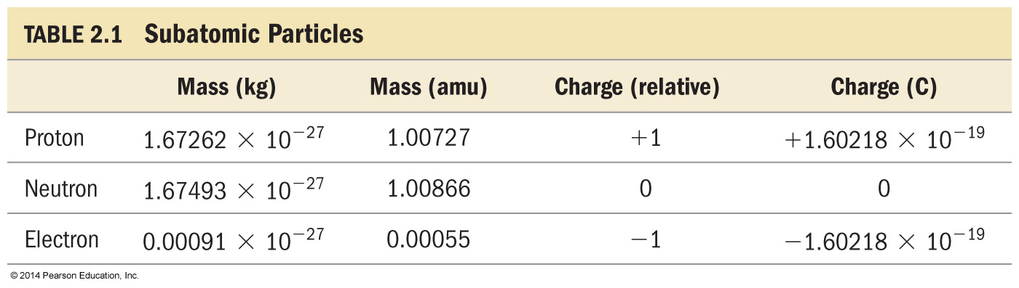
Subatomic Particles
The charge of the proton and the electron are equal in magnitude but opposite in sign. The neutron has no charge.

