Slide 1
variable power supply
fixed resistor
mA
V
milliammeter
voltmeter

Slide 2
mA
V

Slide 3
I_{A}
R₁ V₁ I₁
ε
I_{B}
I_{C}
R1
V
mA

Slide 4
I
R₁ V₁ I₁
ε
R₂ V₂ I₂

Slide 5
V
mA

Slide 6
1500 Ω
4700 Ω
ε
mA
V

Slide 7
I
R₁ V₁ I₁
R₂ V₂ I₂
ε
I₁
I₂
I
R
V
ε

Slide 8
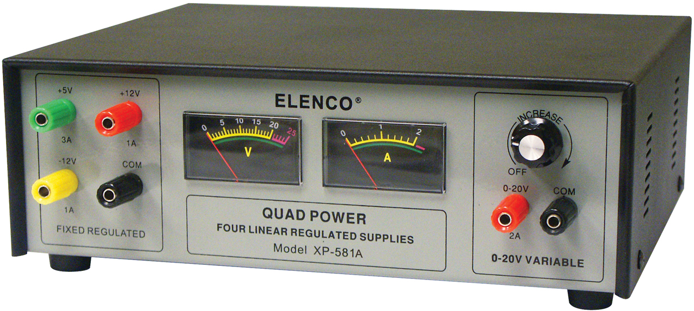
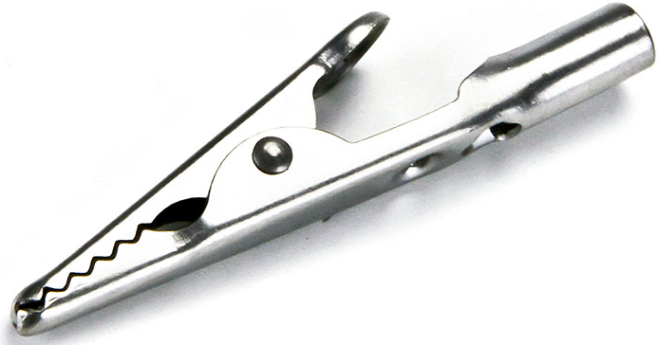
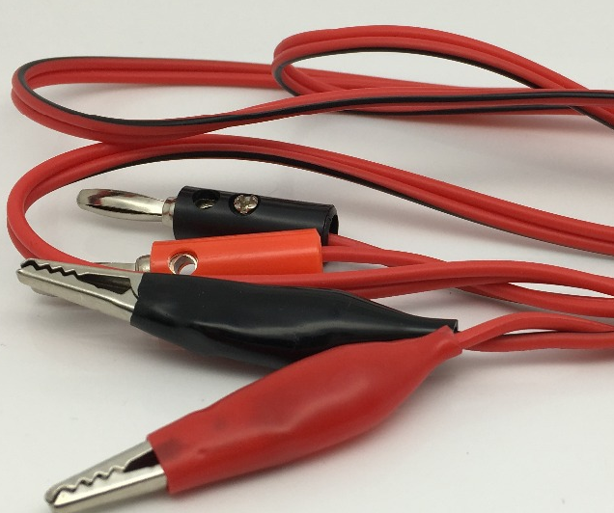
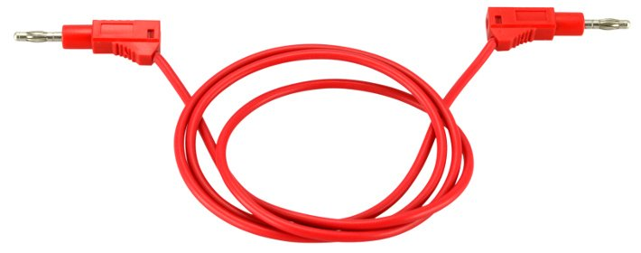
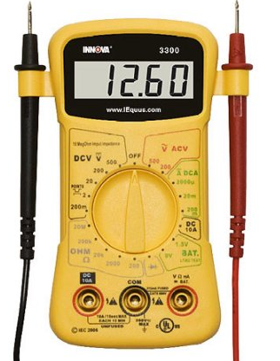
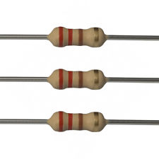
alligator clip
220 Ω red/red/black
1000 Ω brown/black/red
1500 Ω brown/green/red
4700 Ω yellow/violet/red

Slide 9
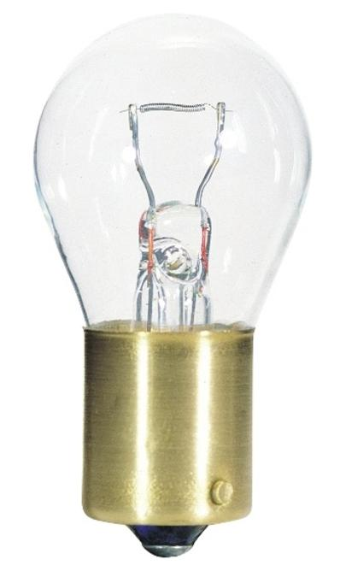
to circuit

Slide 10
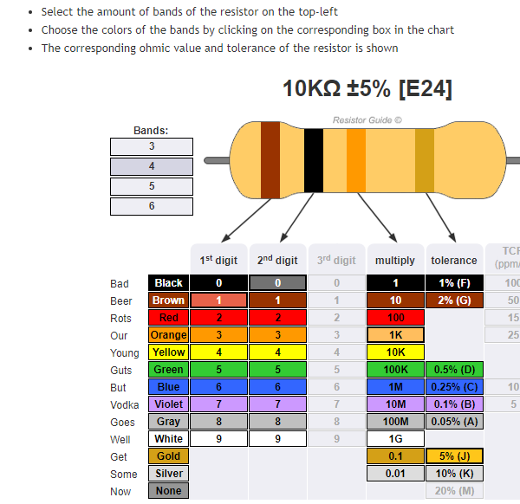

Slide 11
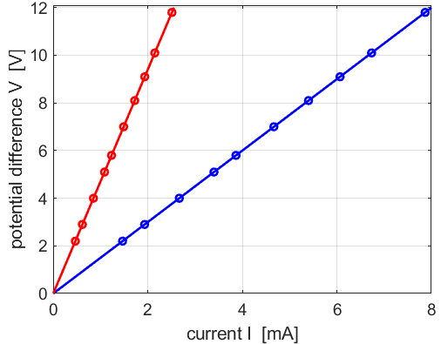
(2.0, 9.4)
(2.0, 3.0)

