Slide 1

CreditCard Fraudulent
Detection in Python

Slide 2
Team
Vishnu
Junaid
Rohith
Pawan
And
Chaturved

Slide 3


Agenda
Abstract
Fraud Detection Classifier
Dataset
GitHub Commits

Slide 4



Abstract
An average business loses not less than 5% of its annual profits to fraud, according to a survey of Certified Fraud Examiners (CFEs), and this number is likely to keep growing if companies don’t take precautions.
Luckily, these days IT specialists can detect fraudulent transactions with the help of various techniques, such as fraud detection in Python, applying Machine Learning (ML) to analyze huge datasets, and other tools.
​

Slide 5
Fraud Detection Classifier
Importing the dataset: The first step is to import the credit card fraud dataset and load it into a Pandas Data Frame.
Exploratory Data Analysis (EDA): Next, performs EDA on the dataset to gain insights into the data and identify any issues with it.
Data preprocessing: Then preprocesses the data by scaling the features and creating a balanced sample of the data to account for the class imbalance problem in the dataset.
Model selection: Tries out different Machine Learning models, including Logistic Regression, Decision Tree, to see which one performs best on the dataset.

Slide 6
Context
Tools
It is important that credit card companies are able to recognize fraudulent credit card transactions so that customers are not charged for items that they did not purchase
->Google Collab

Slide 7
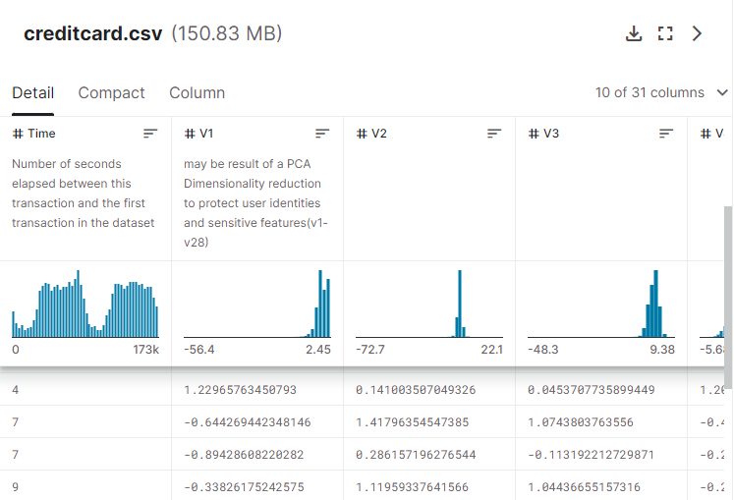
Dataset
The dataset contains transactions made by credit cards in September 2013 by European cardholders. This dataset presents transactions that occurred in two days, where we have 492 frauds out of 284,807 transactions

Slide 8
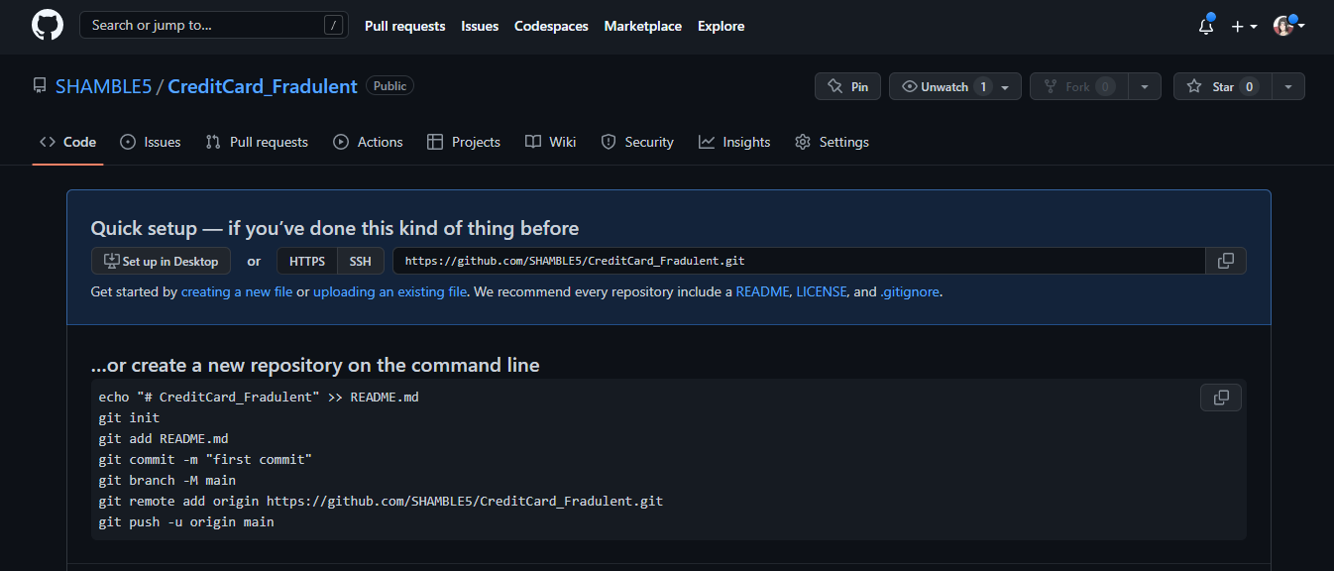

Slide 9

Thank you

