Slide 1

http://flic.kr/p/6oP7x7
Version Control with Git

Slide 2
Why track/manage revisions?

Slide 3
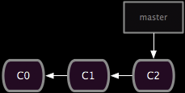
Backup: Undo or refer to old stuff
http://git-scm.com/book/en/Git-Branching-Basic-Branching-and-Merging

Slide 4
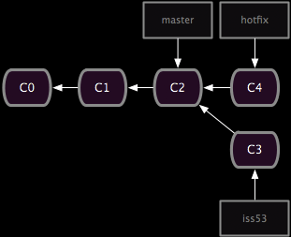
Branch: Maintain old release while working on new
http://git-scm.com/book/en/Git-Branching-Basic-Branching-and-Merging

Slide 5
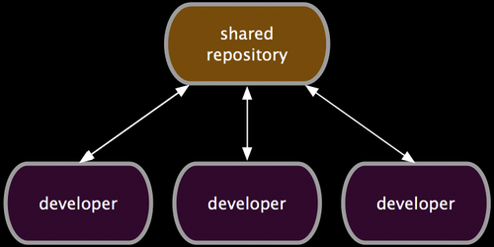
Collaborate: Work in parallel with teammates
http://git-scm.com/book/en/Distributed-Git-Distributed-Workflows

Slide 6
Version Control Systems (VCSs)
Help you track/manage/distribute revisions
Standard in modern development
Examples:
  Revision Control System (RCS)
  Concurrent Versions System (CVS)
  Subversion (SVN)
  Git
older
newer
Our focus

Slide 7
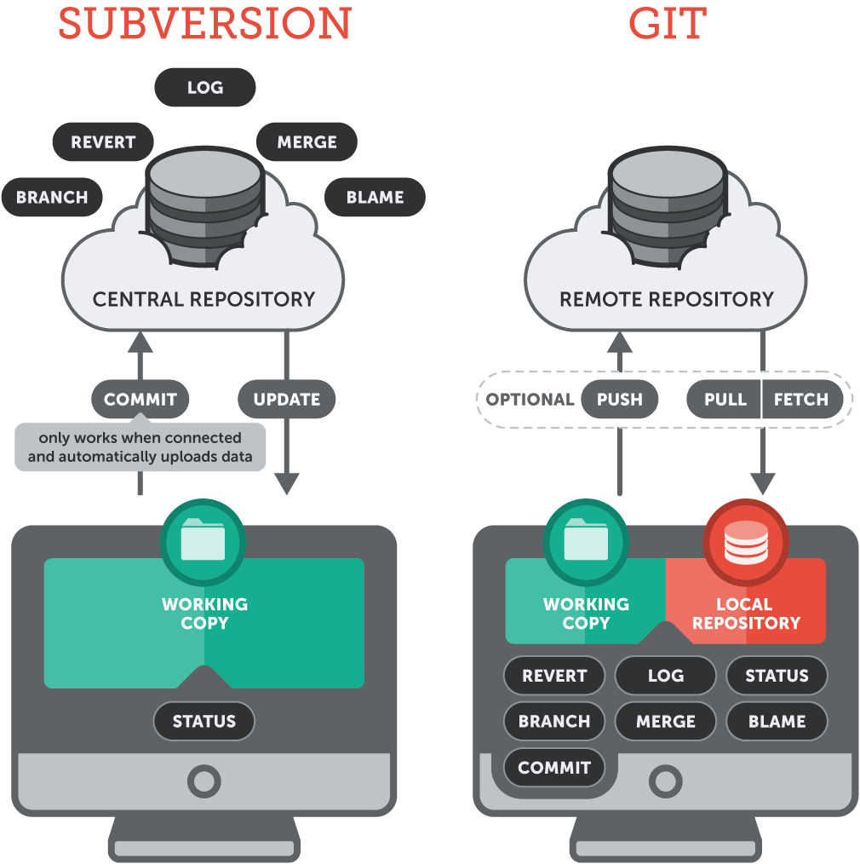

Slide 8
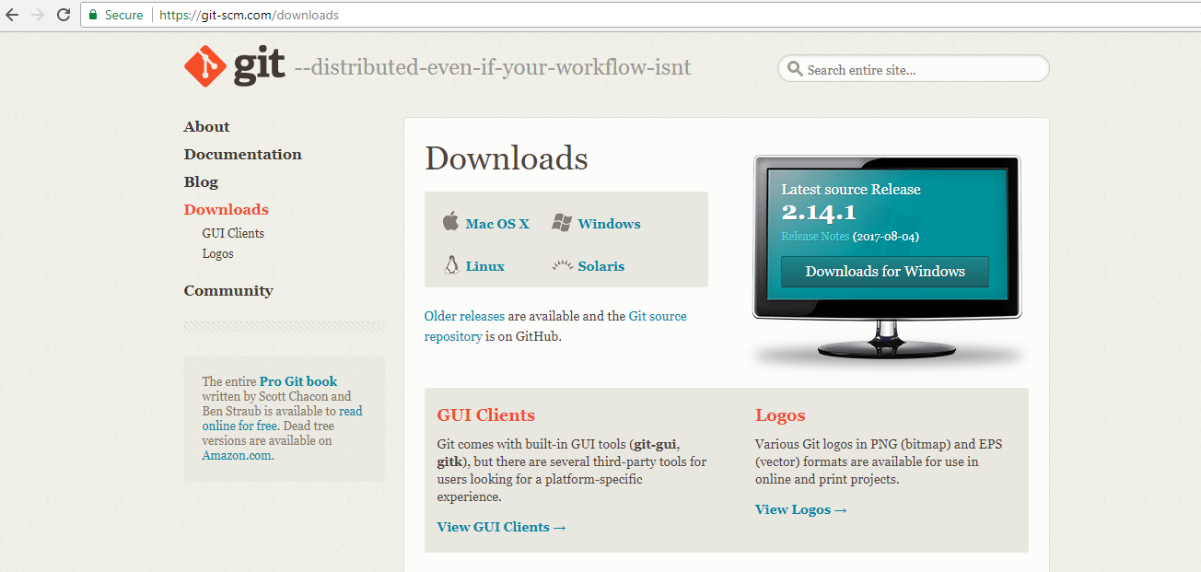
https://git-scm.com

Slide 9

https://github.com

Slide 10
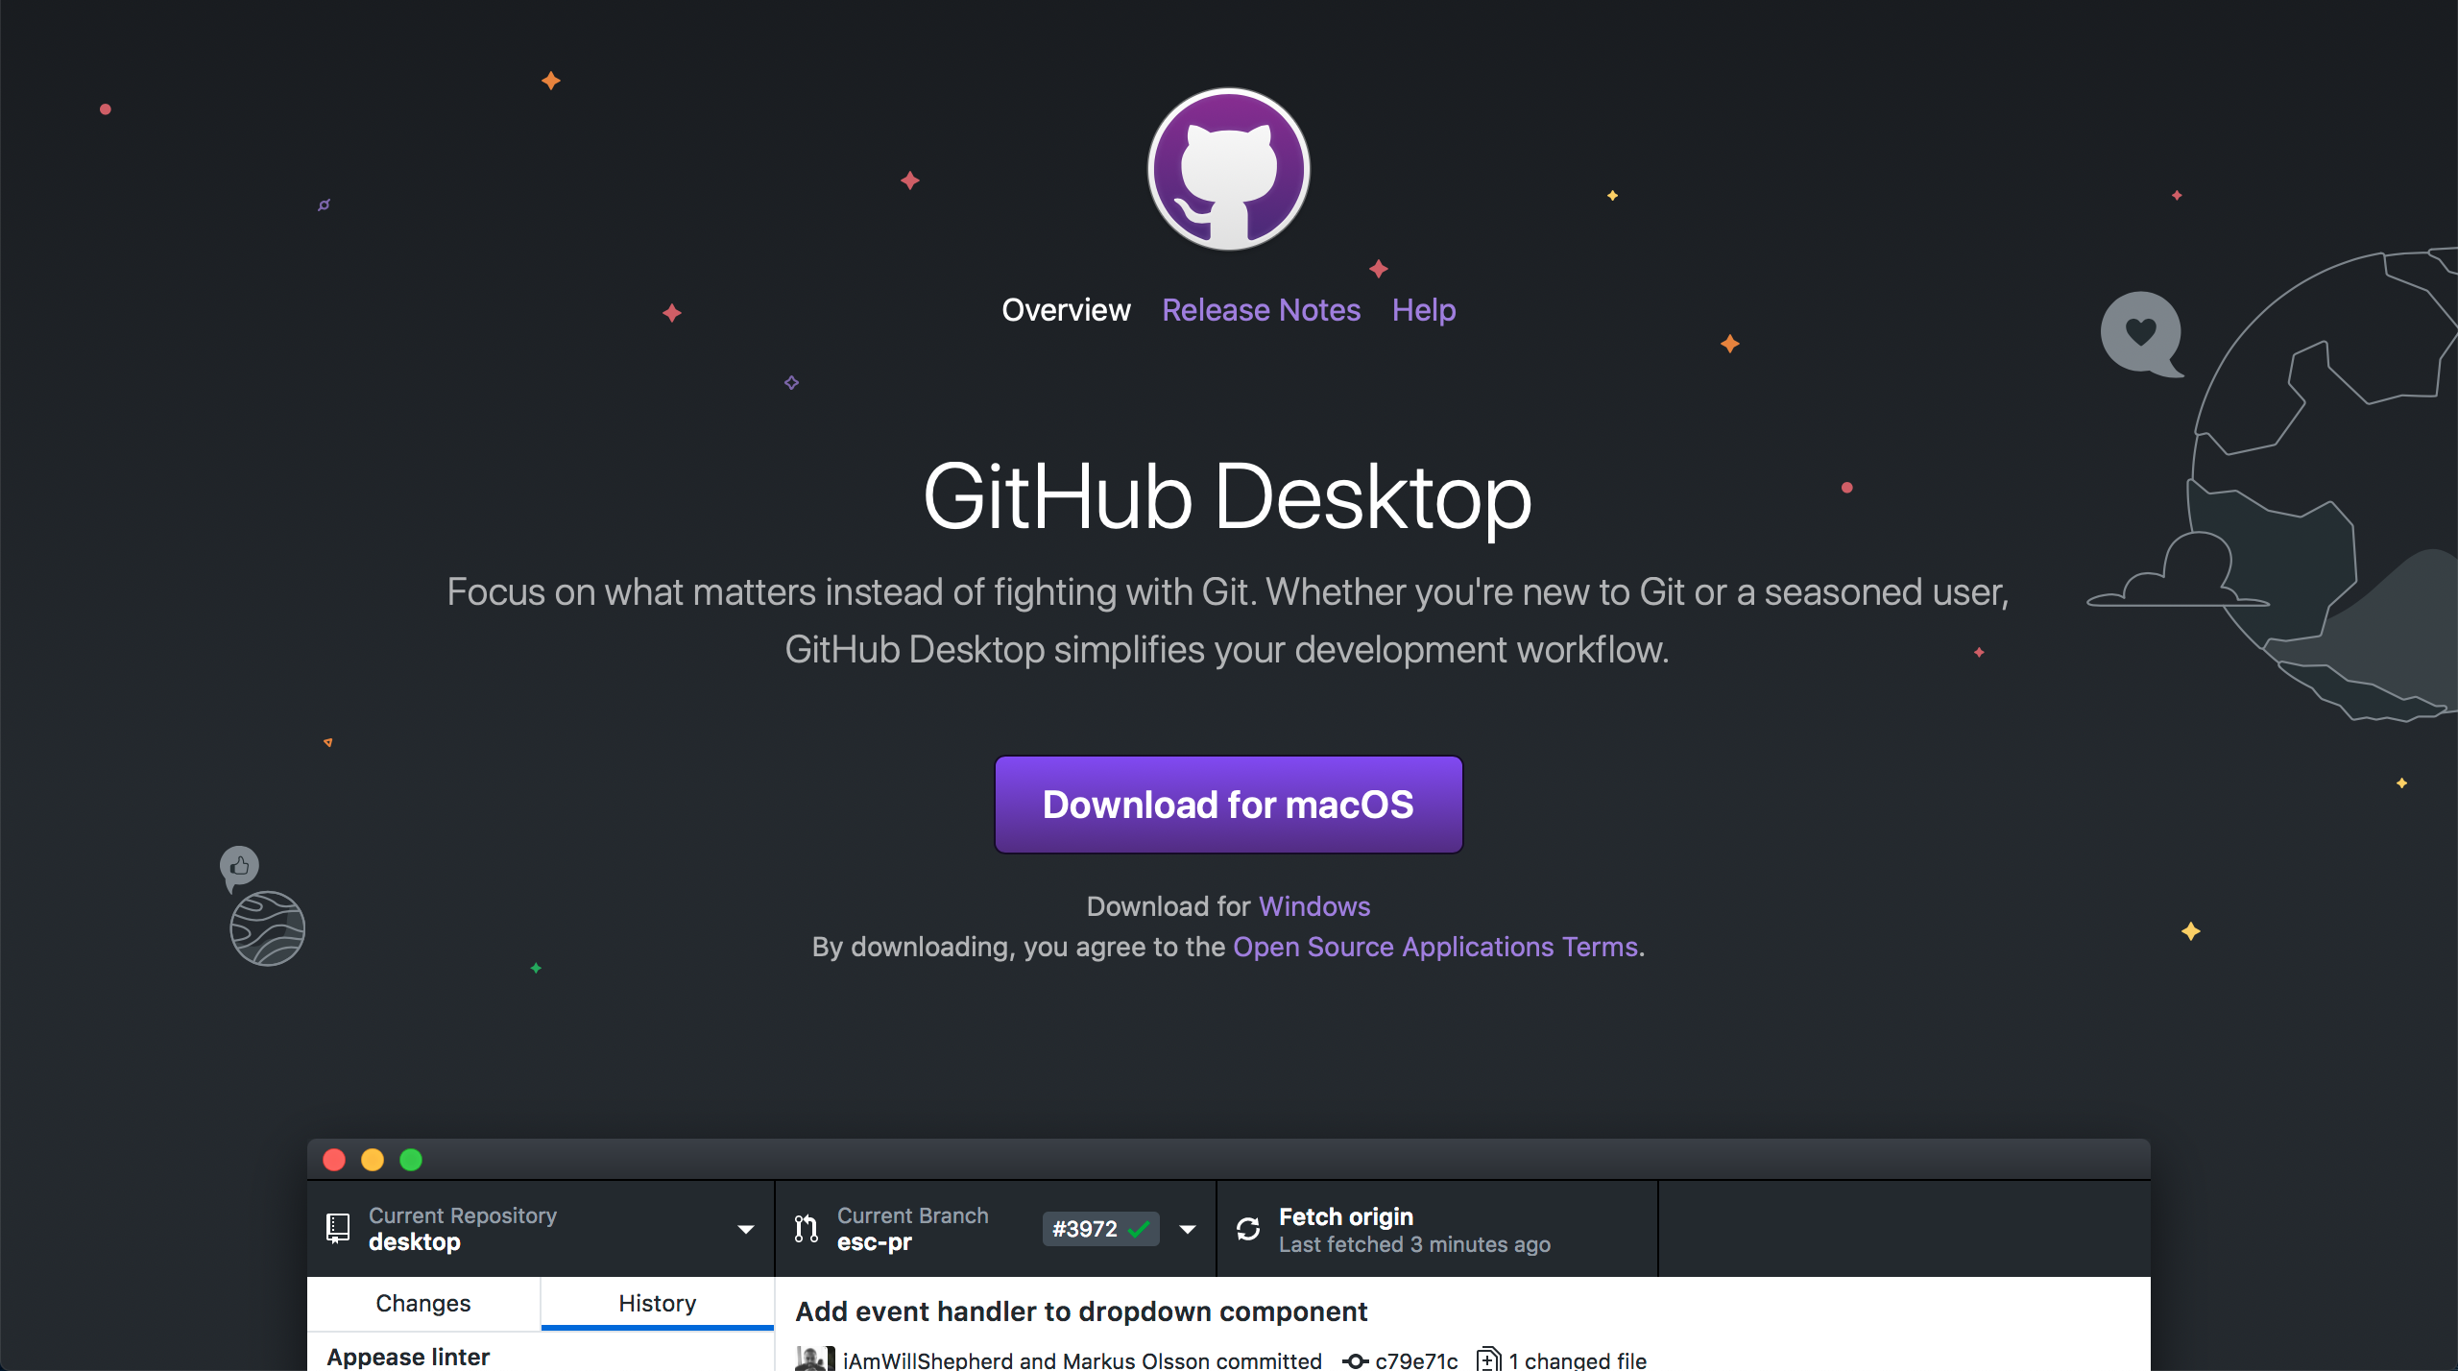
https://desktop.github.com

Slide 11
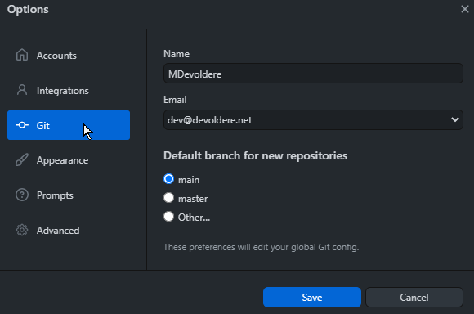
Configure your Git client
Check config info:
Fix if necessary:
$ git config --list
user.name=MDevoldere
user.email=mdevoldere@arfp.asso.fr
$ git config --global user.name "John Doe"
$ git config --global user.email jdoe@example.com

Slide 12

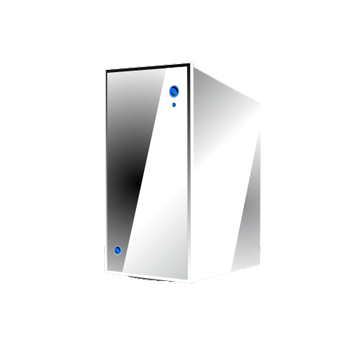
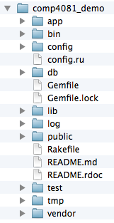
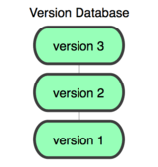
GitHub-User Perspective
You
GitHub
Working Dir
Local
Repos
Remote
Repos

Slide 13
Let’s begin with an example…
You
GitHub

Slide 14
Log into GitHub and create a repos
(with add README option)
You
GitHub
Remote
Repos

Slide 15
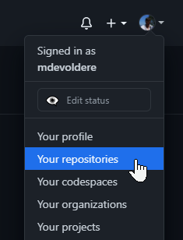

https://github.com
1. Go to your Repos page
2. On Repos page, click « New »

Slide 16
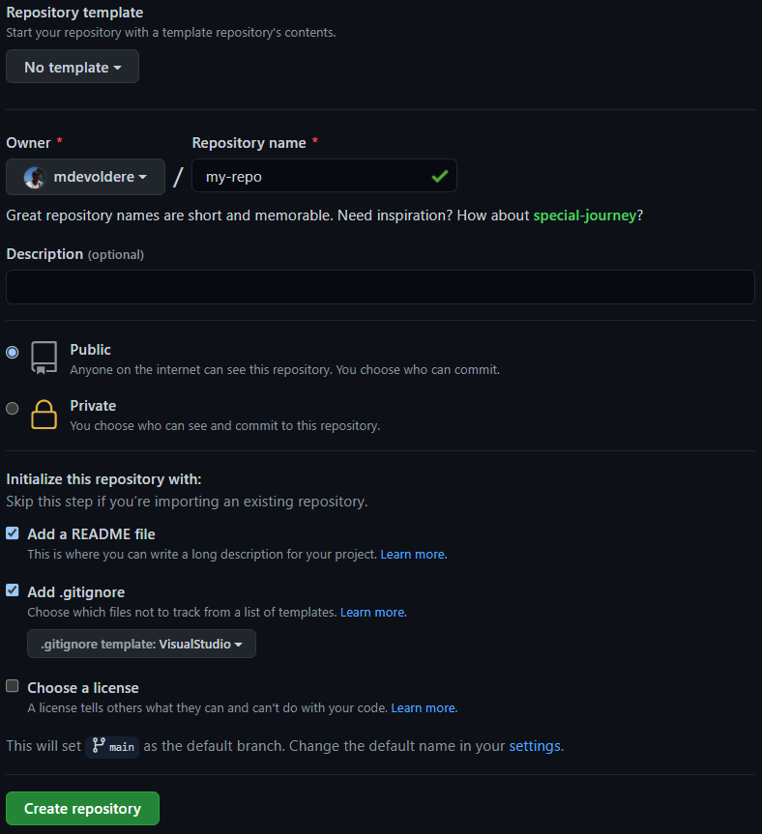

Slide 17
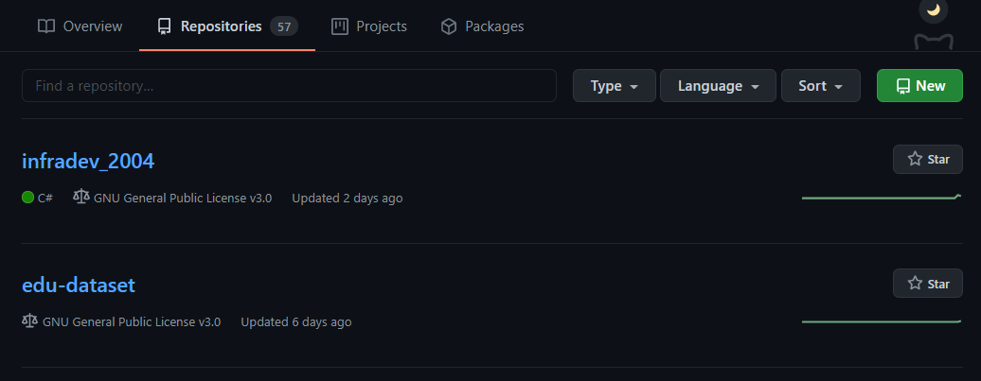
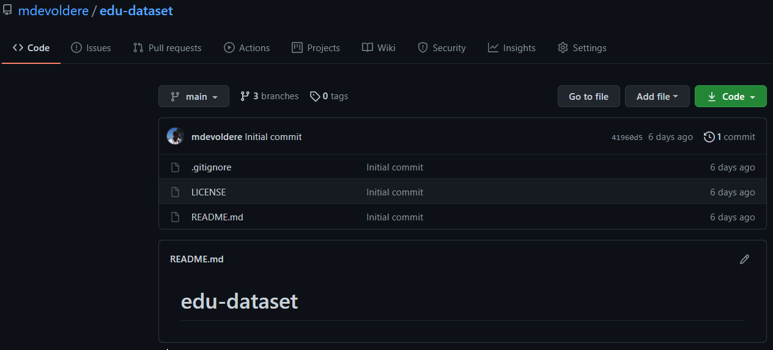

Slide 18
$ git clone https://github.com/arfp/comp4081_demo.git
You
GitHub
Working Dir
Local
Repos
Remote
Repos

Slide 19
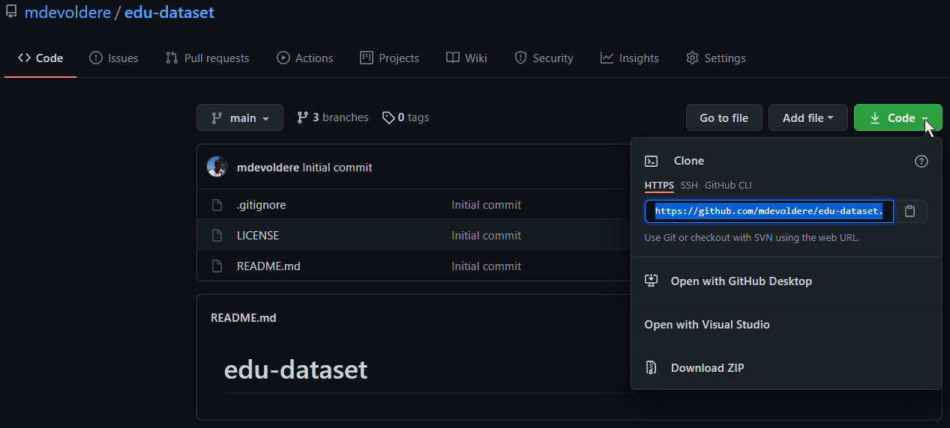
git clone https://github.com/mdevoldere/edu-dataset.git

Slide 20
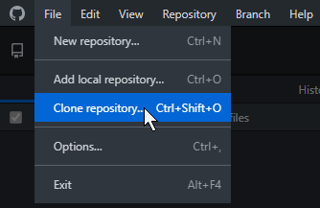
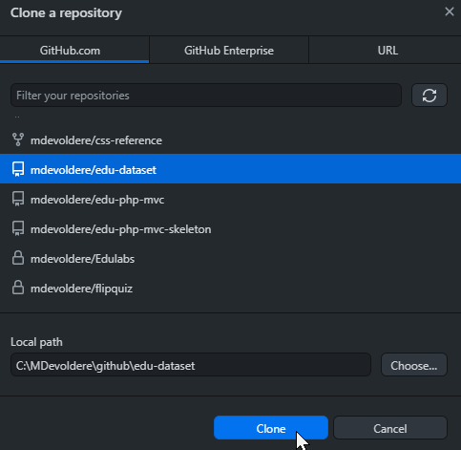

GitHub Desktop

Slide 21

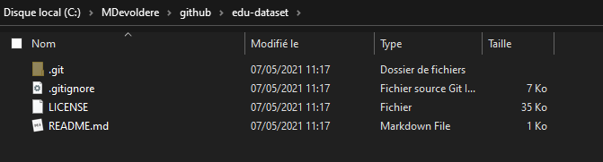

Slide 22
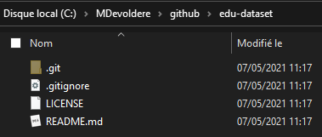
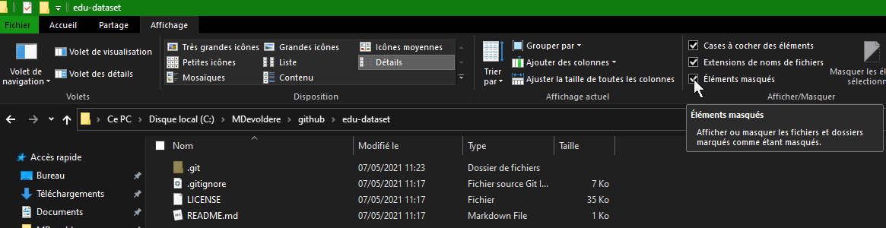
Local Repository
Working Directory (the files you are working on)

Slide 23
$ git clone https://github.com/arfp/comp4081_demo.git
You
GitHub
Working Dir
Local
Repos
Remote
Repos

Slide 24
$ cd comp4081_demo
// Add/edit files
$ git add -A
$ git commit –m "Created project skeleton"
You
GitHub
Working Dir
Local
Repos
Remote
Repos

Slide 25
$ git push
You
GitHub
Working Dir
Local
Repos
Remote
Repos

Slide 26
Questions to answer
How organized?
You
GitHub
Working Dir
Local
Repos
Remote
Repos
What operations?

Slide 27
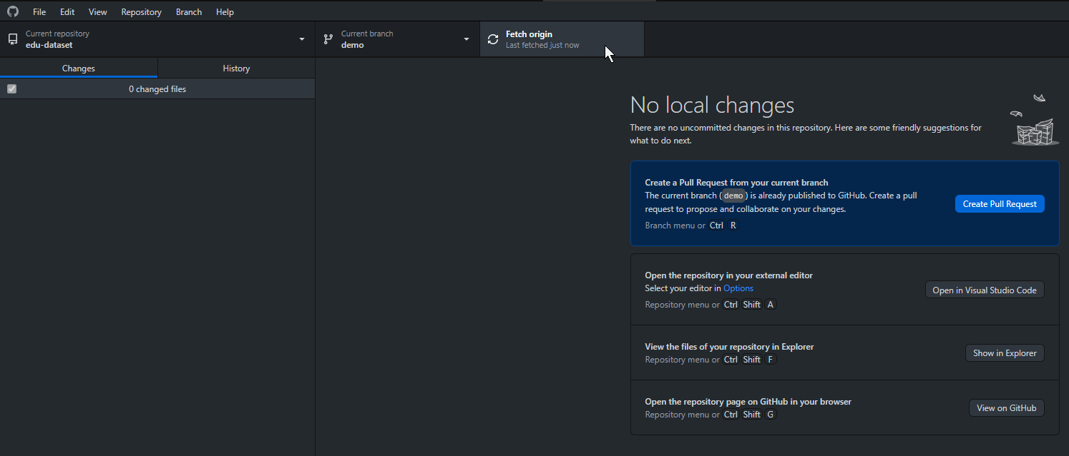
Important: before starting to work
Update your local repository
to make sure you're in sync
with the remote repository
git fetch origin

Slide 28
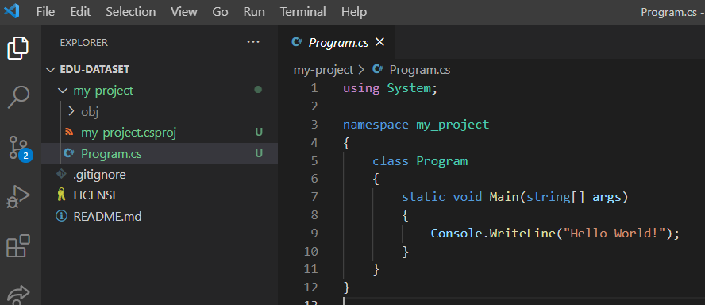
Add / Edit files

Slide 29
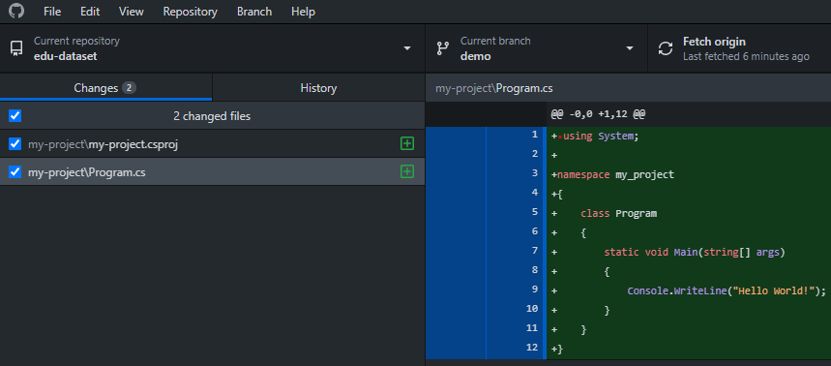
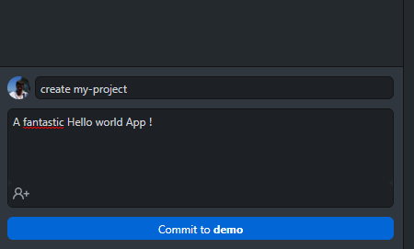

Slide 30
$ cd comp4081_demo
// Add/edit files
$ git add -A
$ git commit –m "Created project skeleton"
You
GitHub
Working Dir
Local
Repos
Remote
Repos

Slide 31
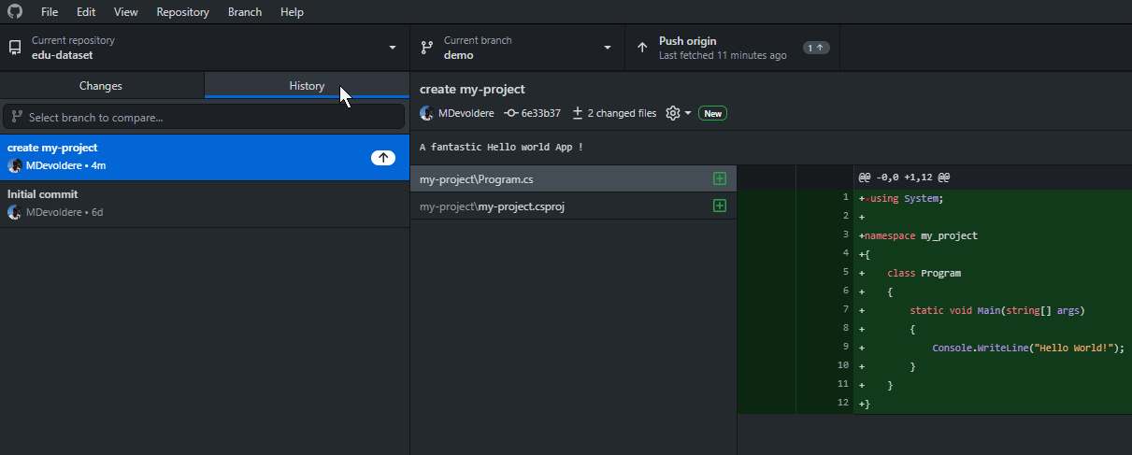

Slide 32


Slide 33
$ git push
You
GitHub
Working Dir
Local
Repos
Remote
Repos

Slide 34
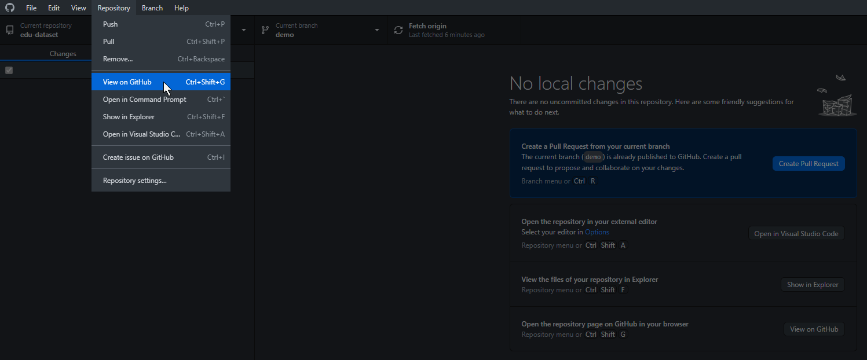

Slide 35
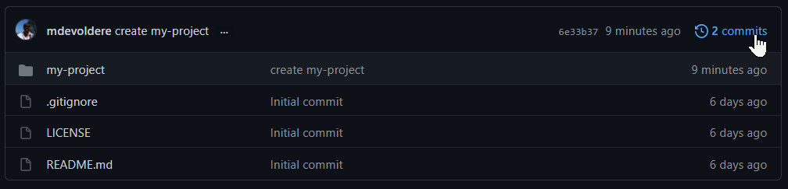
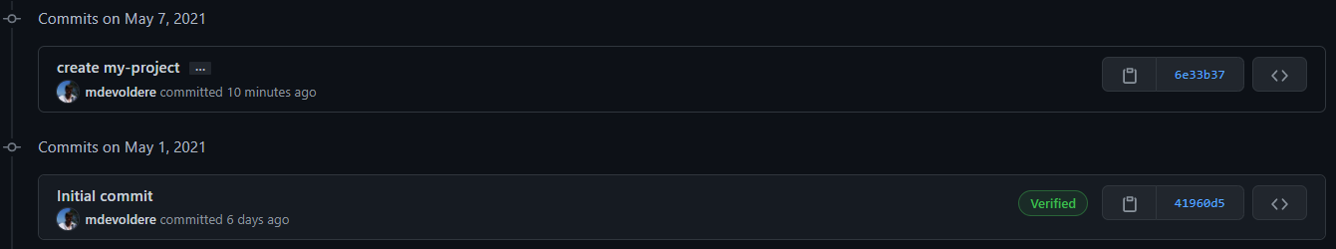
https://github.com/mdevoldere/edu-dataset

Slide 36
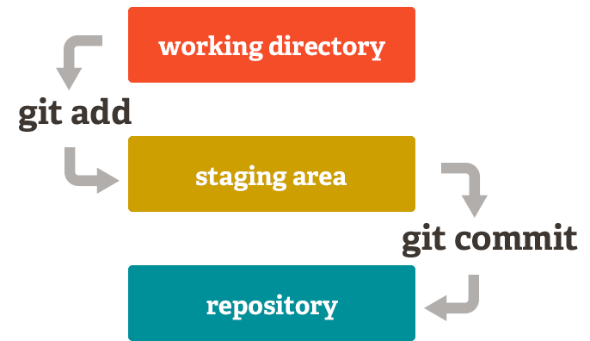
How the repos is organized
http://git-scm.com/book/

Slide 38
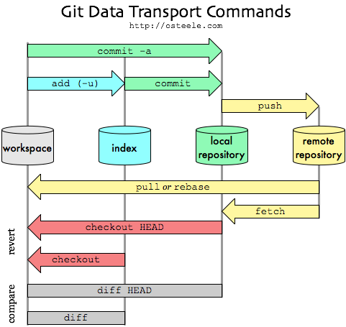
How the repos is organized
http://git-scm.com/book/

Slide 39
Github Desktop
How are commits organized?
Github.com

Slide 40
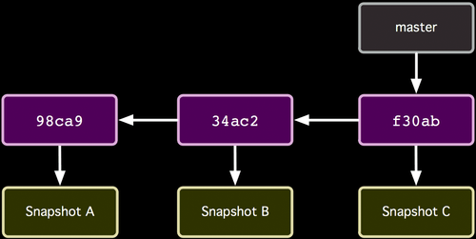
How the repos is organized
http://git-scm.com/book/

Slide 41
How the repos is organized
Commits (from oldest to newest; hashes as commit IDs)
http://git-scm.com/book/

Slide 42
How the repos is organized
Snapshot of all files at each commit
http://git-scm.com/book/

Slide 43
How the repos is organized
Branch (last commit)
http://git-scm.com/book/

Slide 44
How commit works
Before
http://git-scm.com/book/

Slide 45
How commit works
After
http://git-scm.com/book/

Slide 46
Common Workflow
Create temp local branch
Checkout temp branch
Edit/Add/Commit on temp branch
Checkout master branch
Pull to update master branch
Merge temp branch with updated master
Delete temp branch
Push to update server repos
Make changes in local branch
Merge with GitHub repos

Slide 47
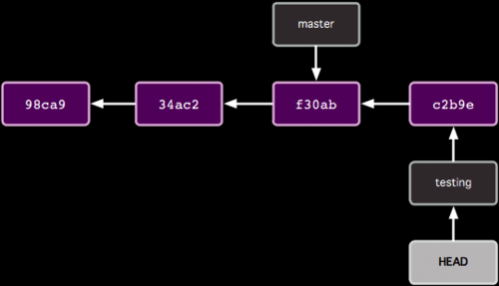
Organization with two branches

Slide 48
Organization with two branches
Last commit of each branch

Slide 49
Organization with two branches
Currently checked out branch

Slide 50
Common Workflow
Create temp local branch
Checkout temp branch
Edit/Add/Commit on temp branch
Checkout master branch
Pull to update master branch
Merge temp branch with updated master
Delete temp branch
Push to update server repos

Slide 51
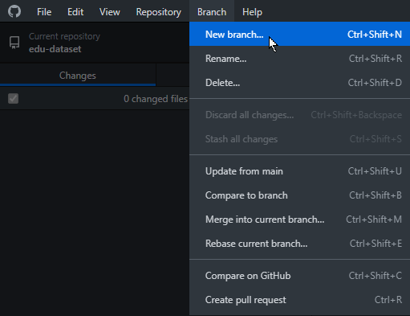
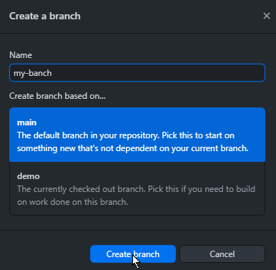
$ git branch my-branch
$ git checkout my-branch
ou
$ git checkout –b my-banch

Slide 52
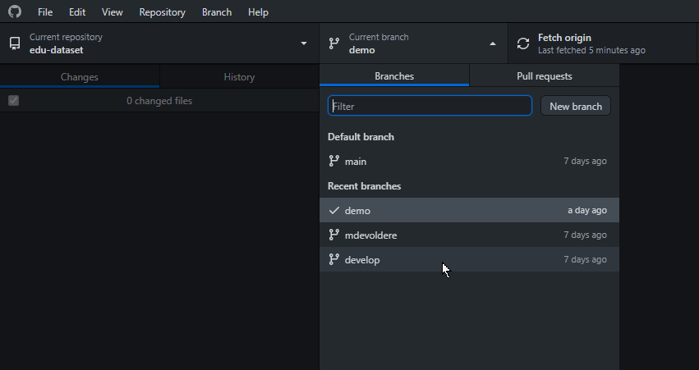
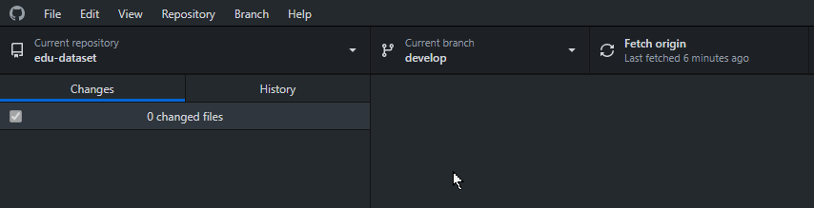

Slide 53
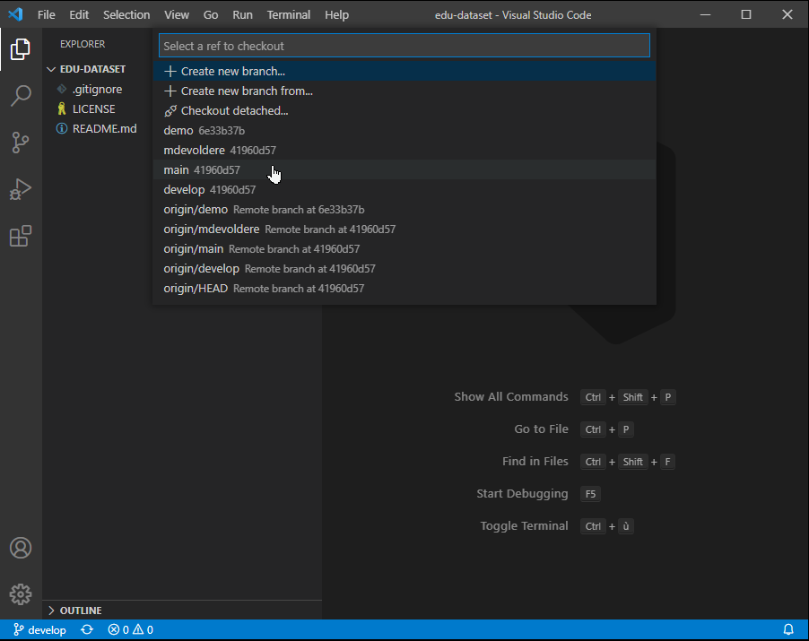

Slide 54
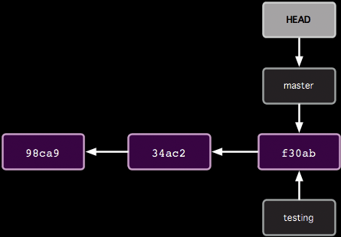
How git branch works
$ git branch testing
Before

Slide 55
How git branch works
$ git branch testing
After

Slide 56
Common Workflow
Create temp local branch
Checkout temp branch
Edit/Add/Commit on temp branch
Checkout master branch
Pull to update master branch
Merge temp branch with updated master
Delete temp branch
Push to update server repos

Slide 57
How git checkout works
$ git checkout testing
Before

Slide 58
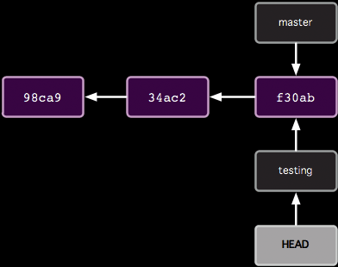
How git checkout works
$ git checkout testing
After

Slide 59
Common Workflow
Create temp local branch
Checkout temp branch
Edit/Add/Commit on temp branch
Checkout master branch
Pull to update master branch
Merge temp branch with updated master
Delete temp branch
Push to update server repos

Slide 60
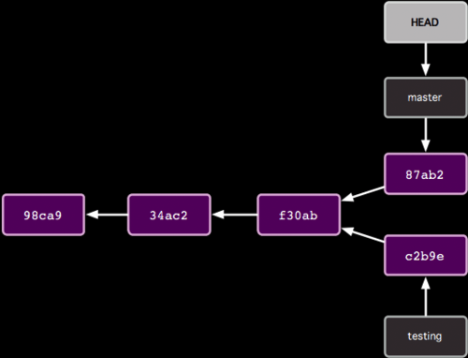
How git commit works with multiple branches
Edit some stuff
$ git add -A
$ git commit –m "blah"
Before

Slide 61
How git commit works with multiple branches
Edit some stuff
$ git add -A
$ git commit –m "blah"
After

Slide 62
Common Workflow
Create temp local branch
Checkout temp branch
Edit/Add/Commit on temp branch
Checkout master branch
Pull to update master branch
Merge temp branch with updated master
Delete temp branch
Push to update server repos

Slide 63
How git checkout works
$ git checkout master
Before

Slide 64
How git checkout works
$ git checkout master
After

Slide 65
Common Workflow
Create temp local branch
Checkout temp branch
Edit/Add/Commit on temp branch
Checkout master branch
Pull to update master branch
Merge temp branch with updated master
Delete temp branch
Push to update server repos

Slide 66
How git pull works
Someone else pushed
$ git pull
Before

Slide 67
How git pull works
Someone else pushed
$ git pull
After

Slide 68
Common Workflow
Create temp local branch
Checkout temp branch
Edit/Add/Commit on temp branch
Checkout master branch
Pull to update master branch
Merge temp branch with updated master
Delete temp branch
Push to update server repos

Slide 69
How git merge works
$ git merge testing
Before

Slide 70
How git merge works
$ git merge testing
e2b92
After

Slide 71
Common Workflow
Create temp local branch
Checkout temp branch
Edit/Add/Commit on temp branch
Checkout master branch
Pull to update master branch
Merge temp branch with updated master
Delete temp branch
Push to update server repos

Slide 72
How to delete branches
$ git branch -d testing
e2b92
Before

Slide 73
How to delete branches
$ git branch -d testing
e2b92
After

Slide 74
Common Workflow
Create temp local branch
Checkout temp branch
Edit/Add/Commit on temp branch
Checkout master branch
Pull to update master branch
Merge temp branch with updated master
Delete temp branch
Push to update server repos

Slide 75
How git push works
$ git push
e2b92
Should update server repos
(if no one else has pushed commits to master branch since last pull)

Slide 76
Tips
git output contains lots of hints
  git status is your friend!
Merging may not be as easy as showed
  E.g.: Multiple collabs updated same parts of file
Pull before starting temp branch
Team communication important !

Slide 77
Pop Quiz
5 questions
Update diagram in each
  Commit nodes
  Branch nodes
Based on actions of Alice and Bob
  Collaborating via GitHub repo

Slide 78
Start like this
Scott Fleming
SF 1
GitHub
master
11111
master
Alice
11111
Bob

Slide 79
Question 1
Alice:
  $ git clone https://github.com/whatever.git
  $ cd whatever
Bob:
  $ git clone https://github.com/whatever.git
  $ cd whatever
(include the HEAD node)

Slide 80
Question 2
Alice:
  $ git branch myfix
  $ git checkout myfix
(Alternatively)
  $ git checkout -b myfix

Slide 81
Question 3
Alice:
  $ rails generate scaffold User …
  $ git add -A
  $ git commit -m "Added User" # 22222
Bob:
  $ rails generate scaffold Micropost …
  $ git add -A
  $ git commit -m "Added Micropost" # 33333

Slide 82
Question 4
Bob:
  git push

Slide 83
Question 5
Alice:
  git pull

Slide 84
Appendix

Slide 85
What if…
Alice did this:
app/models/micropost.rb
class Micropost < ActiveRecord::Base
validates :content, length: { maximum: 140 }
end
Bob did this:
app/models/micropost.rb
class Micropost < ActiveRecord::Base
validates :content, length: { maximum: 120 }
end

Slide 86
What if Alice did this?
master
33333
$ git checkout master
$ git merge myfix
11111
22222
myfix

Slide 87
$ git merge myfix
Auto-merging app/models/micropost.rb
Automatic merge failed; fix conflict and then commit result.
app/models/micropost.rb
class Micropost < ActiveRecord::Base
<<<<<<< HEAD
validates :content, length: { maximum: 140 }
=======
validates :content, length: { maximum: 120 }
>>>>>>> myfix
end
To resolve:
Manually fix the file; git add and commit

Slide 88
Reality

Slide 89
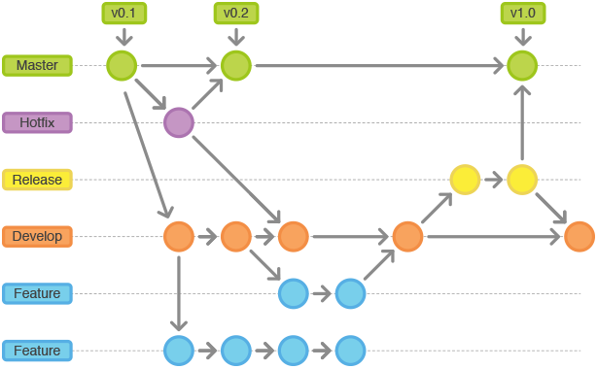
Reality

Slide 90
End

Slide 91
