Slide 1

Fully Functional Business Solutions
Power Platform Capability/Skillset Overview
David Clerk
Owner
Revised: 202509

Slide 2


Agenda
Introduction
Execution Strategy
- Project Overview
- Requirements Analysis
- Project Deliverables
- Models
- Conclusion

Slide 3
Introduction
David Clerk - Fully Functional Business Solutions (FullyFBS)
David Clerk is the founder of Fully Functional Business Solutions (FullyFBS), a start-up business which develops and maintains information technology solutions for complex business problems. I am a diverse problem solver with extensive training, knowledge and experience in data analytics via a variety of industries. I am highly proficient in the application of statistical techniques, process improvement methodologies, database management, qualitative and quantitative data analytics, visualizations, and reporting. My technical acumen, interactive leadership and proven ability to deliver great solutions provides consistent and reliable positive impacts to businesses and strategic objectives.
My approach aims to:
Employ a strategy that combines traditional planning rigor with Agile principles to adapt to the nature of work: some parts are predictable and require structured execution, while others need iterative, collaborative problem-solving.
Retain flexibility, responsiveness, and a pragmatic approach to project delivery rather than strictly adhering to a single methodology.

Slide 4
Use Case (Fictional)
CS Inc. provides maintenance services for material handling and transportation equipment. CS Inc. has a customized CRM which it uses manage its inventory, customers, and services. The current CRM has undergone multiple customizations and upgrades and has become very costly to implement new process that match the ever-growing business needs. Over the past two years CS Inc. has experience a 15% increase in services outsource to sub-contractor; however, the current system does not have automated processes that allows the company to manage sub-contractors, sub-contractor servicing, and the sub-contractor invoicing and payments process. CS Inc. has identified a high priority need to for a process to manage sub-contractor. The executive board of CS needs to make a well-informed decision which will determine if CS Inc needs to purchase a new CRM of build business solutions from its existing platforms. CS Inc.’s needs an operational model of a scalable multi-platform automated solution which it can integrate with its current CRM to help management determine if the Power Platform will meet its requirements.
This presentation demonstrates:
Seamless integration of Power Platform with Azure resources
My inherent and retained expertise in cloud-based and cross-platform data integration, enabling consistent delivery of high-value solutions

Slide 5
Execution Strategy
Strategy
FullyFBS execution strategy is built on Hybrid Agile approach. FullyFBS ‘s standard execution strategy integrates an incremental and iterative development process which leverages the Agile Alliance manifesto. FullyFBS will incessantly advocate:
Individuals and interactions over processes and tools
Working software over comprehensive documentation
Customer collaboration over contract negotiation
Responding to change over following a plan
Deliverables
With the understanding this project is for academic purpose and within the constraints of limited time, rendering of the following deliverables with deem this project a success:
Data Sources with ERD -Used DataVerse and Azure SQL)
Customized and OTB Apps - Use of Azure DB, PowerFX, Power Flows, and SQL Store Procedures
Visualizations and Dashboards - PowerBi Visuals with Use of Python Mapplot ect…
Web UI - UI hosted by Portal Management with embedded Azure AD, PowerApps, and PowerBI
Production of Invoices – Used Power Bi Report Builder for paginated reports

Slide 6
Project Overview
Opportunity
FullyFBS intends to capitalize on the plethora of the training opportunities this project provides. FullyFBS intends to provide CS Inc. with a fully function business solution by developing an application (as a model) for CS to use as a technician invoice and payments application (TIPA). Although the Use Case is fictional; the intent of this project is to provide a proof of concept for using the Power Platform for the following:
Data and Connections: Employ SQL/Azure DB, DataVerse and various connectors to create, manage, store and query data.
Analytics and Visualizations: Utilize qualitative and quantitative metrics, KPIs, visualizations, and Dashboards via Power Bi/Python.
Web Portal: Harness the capability of creating a Web Portal to broadcast applications, visualizations, and manipulate data.
Application Development: Design and develop an application via Power Apps. The platform will provide tools and features for data input, output, dataflows, workflows and automation.

Slide 7
Requirements Summary
Proposed Solution
An invoice and payment application built on a single platform which will allow connection to existing platforms, applications and/or services from on-premises or mobile devices.
Low/No Code application platform supported by easy to learn features, scalability, cost saving maintenance and upgrade cost.
Method for ranking service opportunities and technicians.
Method for ranking service opportunities and technicians, grouping service requests into maintenance groups, predicting customer maintenance needs, and assigning the service request to preferred technicians based on availability.
A scalable interactive knowledge base that provides best answers from the user’s perspective/category.
Visualizations, dashboards and data insights on customers, technicians, invoices, and payments led by business rules, KPIs, and metrics.
Method for determining, approving, and overriding service completions.

Slide 8
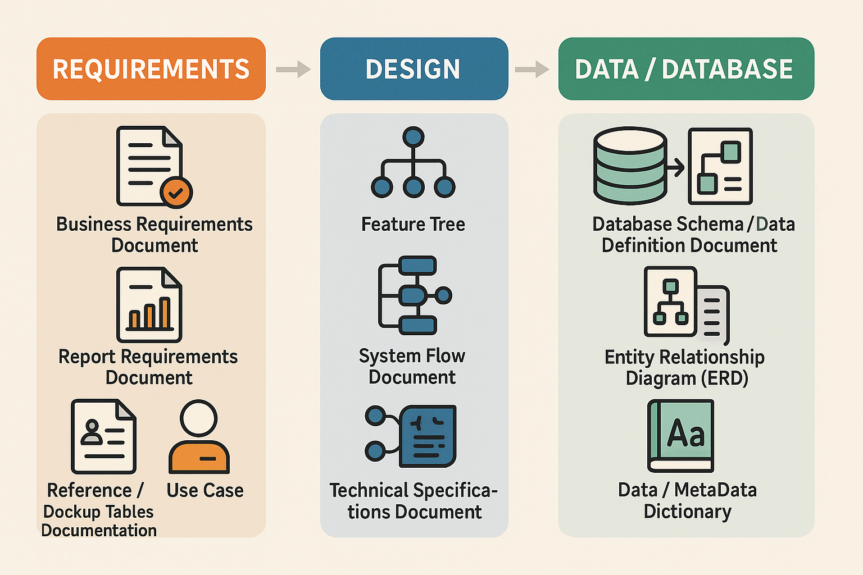
Software Development Life Cycle (SDLC)
SDLC
SDLC is the overall process of planning, developing, testing, deploying, and maintaining software. Different artifacts or documents are created during SDLC phases to ensure quality, clarity, and alignment with requirements.
Artifacts
In layman’s terms SDLC artifacts are planning and other technical documents. However, the time an effort that goes into creating, maintain and proper disposition of these documents gain them the term artifacts or works of art. Due to time constraints and the fictionality of this project, the graphic below depicts my preferred employment of each SDLC artifact.

Slide 9

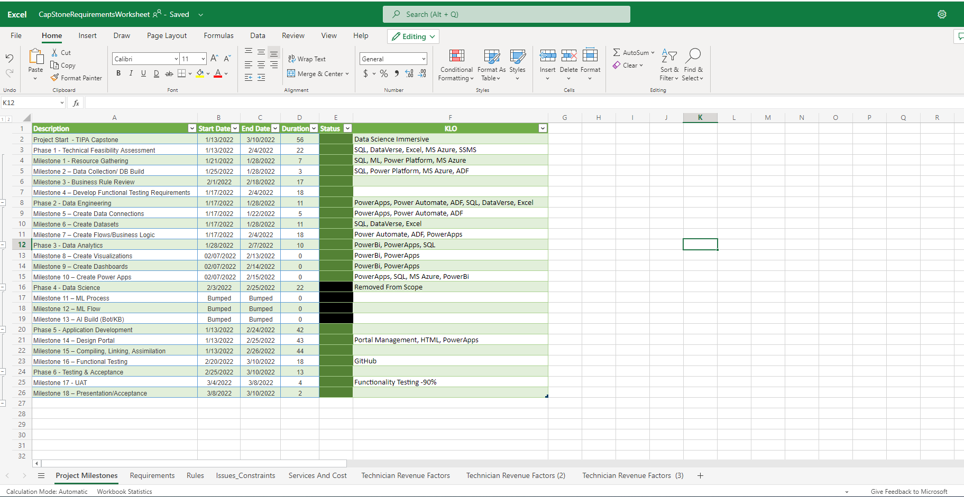
Project Management

Slide 10
Progress Report
Description | Start Date | End Date | Duration | Comp % | KLO
Project Start - TIPA Capstone | 1/13/2022 | 3/10/2022 | 56 | 100% | Data Science Immersive
Phase 1 - Technical Feasibility Assessment | 1/13/2022 | 2/4/2022 | 22 | 100% | SQL, DataVerse, Excel, MS Azure, SSMS
Phase 2 - Data Engineering | 1/17/2022 | 1/28/2022 | 11 | 100% | PowerApps, Power Automate, ADF, SQL, DataVerse, Excel, SSMS
Phase 3 - Data Analytics | 1/28/2022 | 2/7/2022 | 10 | 100% | PowerBi, PowerApps, SQL
Phase 5 - Application Development | 1/13/2022 | 2/24/2022 | 42 | 100% | Power Portal/Portal Management/ Azure Active Directory
Phase 6 - Testing & Acceptance | 2/25/2022 | 3/10/2022 | 13 | 100% | Functionality Testing of Invoices Generating

Slide 11
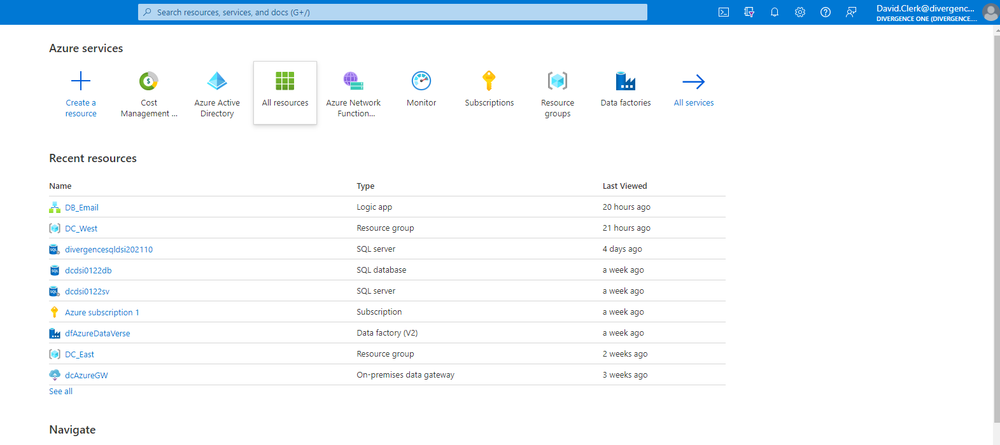
Azure Resource Administration

Slide 12
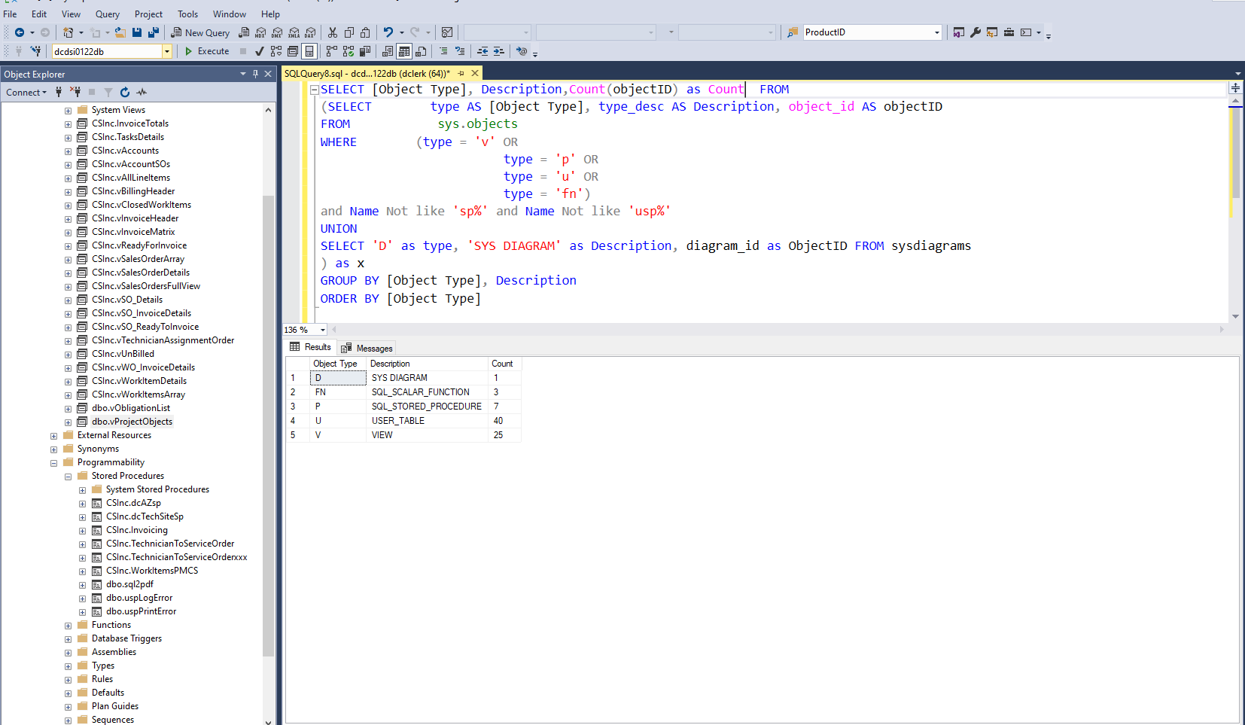
SQL DTL/ELT/ETL via SSMS

Slide 13
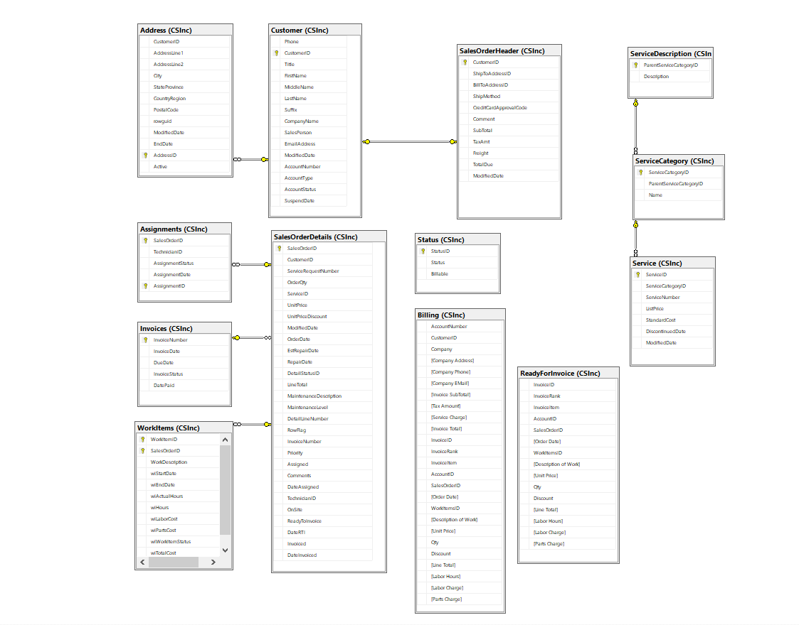
Database Design

Slide 14
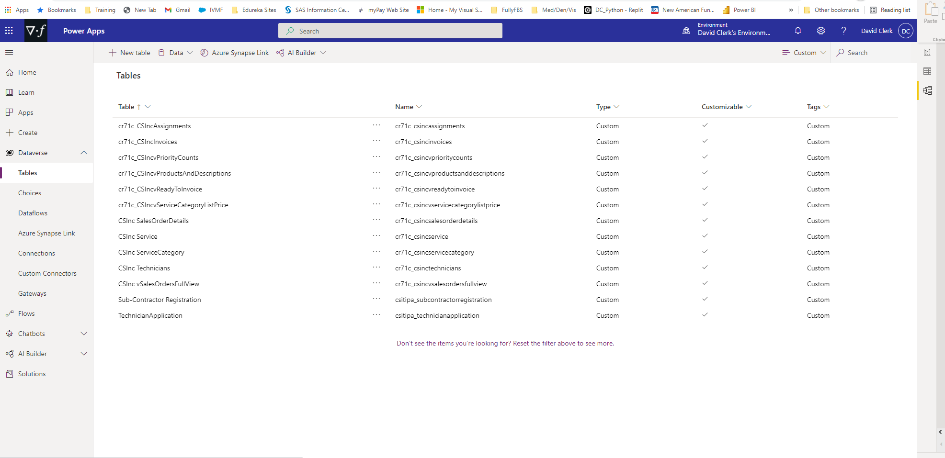
M365 DataVerse/Dynamics Integration

Slide 15
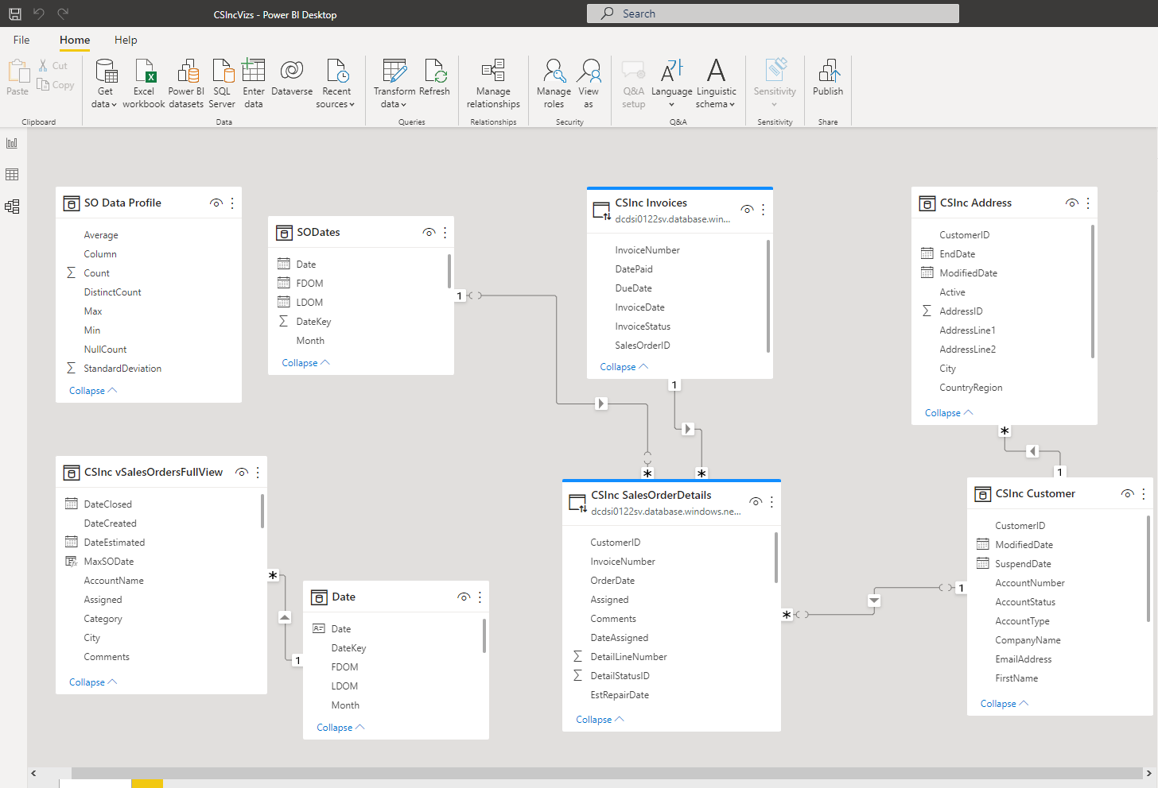
Analytical Datasets – Power BI (Power Query/DAX)

Slide 16
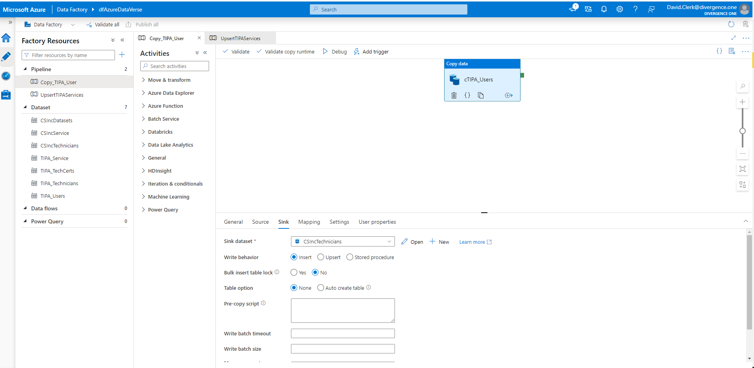
Data Flows – Azure Data Factor

Slide 17
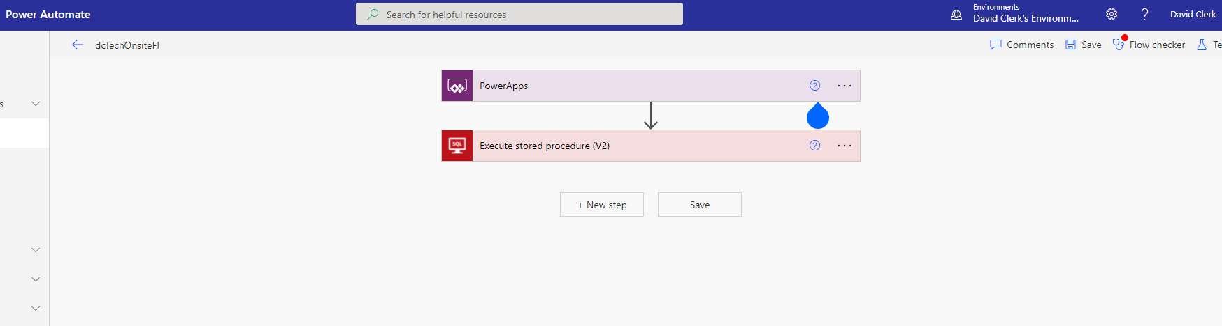
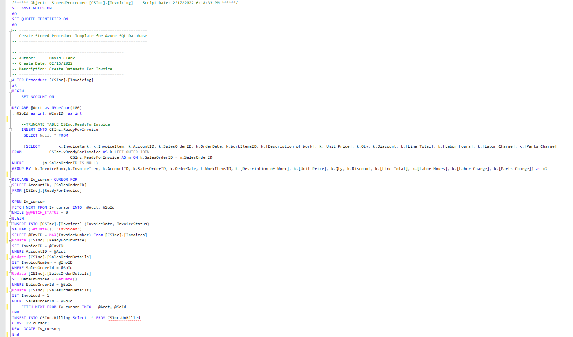
Automation – Power Automate

Slide 18
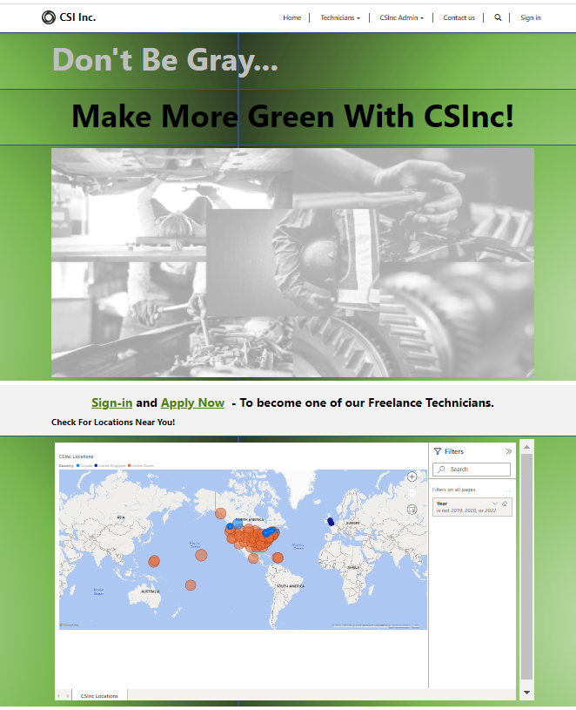
Web – Power Pages

Slide 19
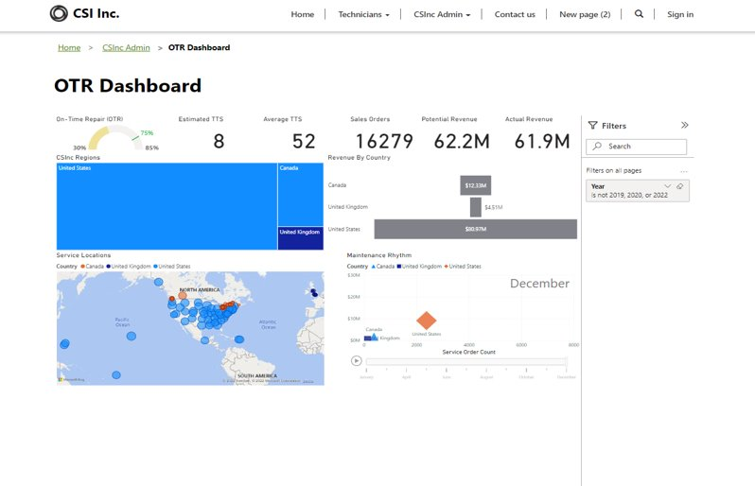
Portal Integrations Power Bi/Power Apps in Power Pages

Slide 20
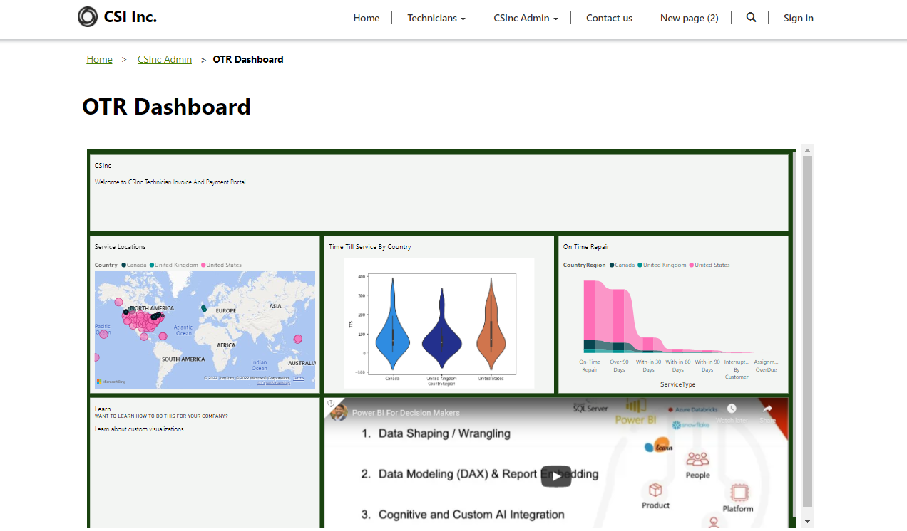
Dashboard Power Bi w/Customized Python Visualization Embedded In Power Pages

Slide 21
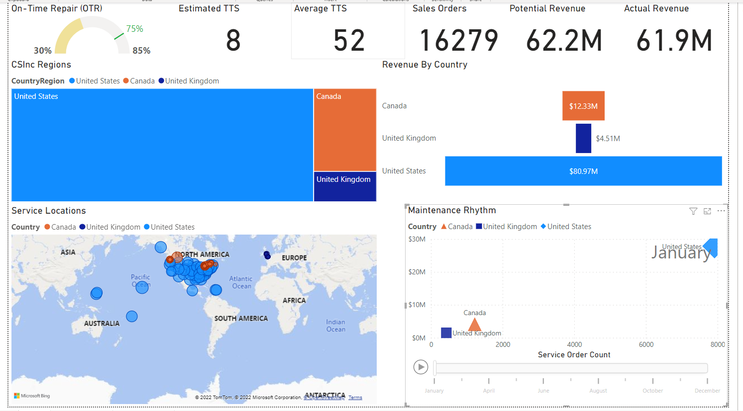
KPIs, Metrics, and Animations

Slide 22
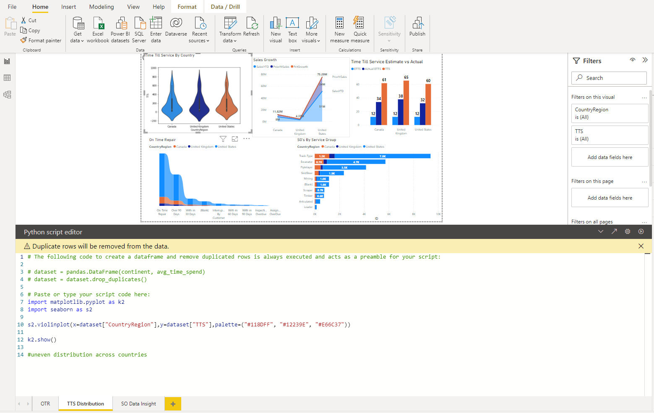
Python Integration

Slide 23
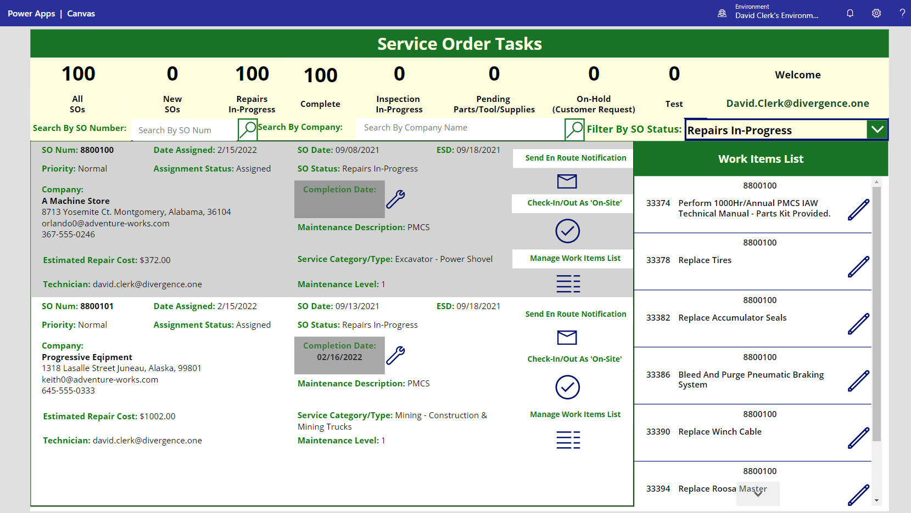
Customized Apps

Slide 24
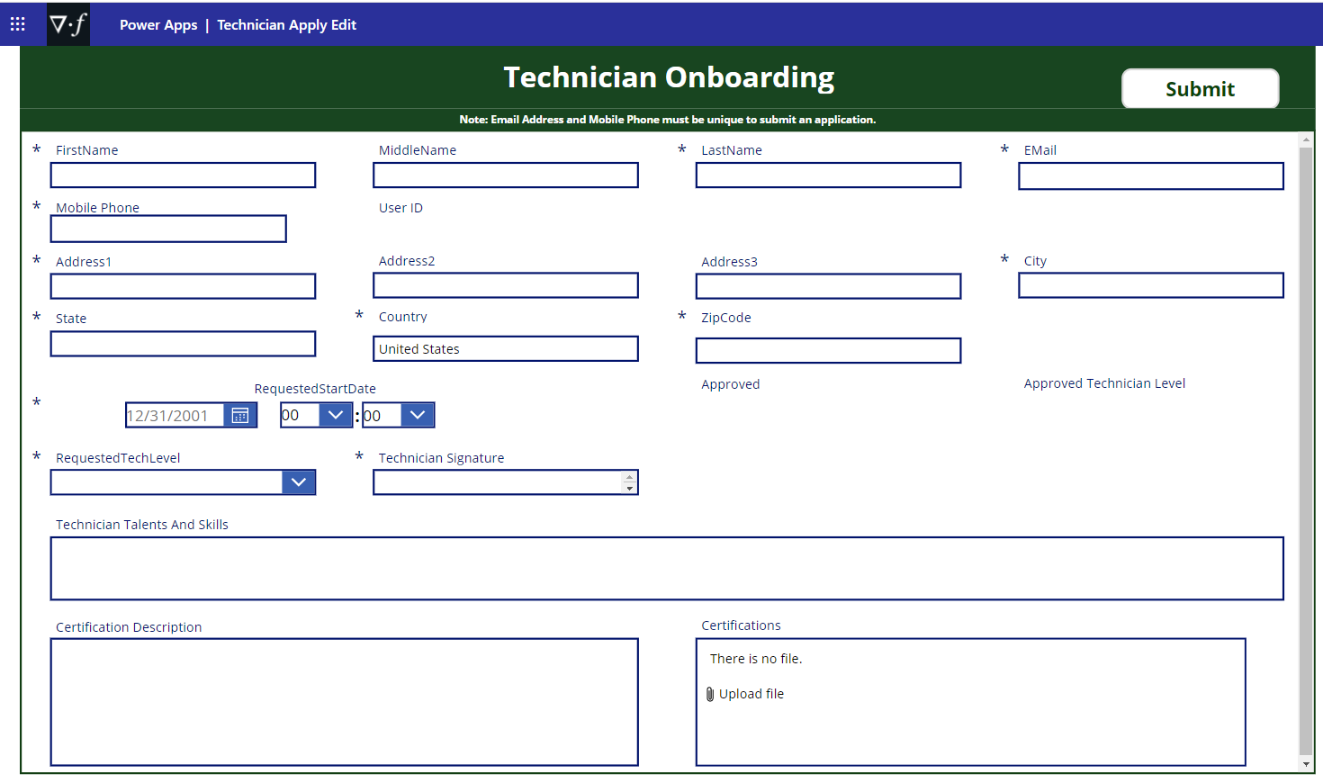
PowerApps

Slide 25
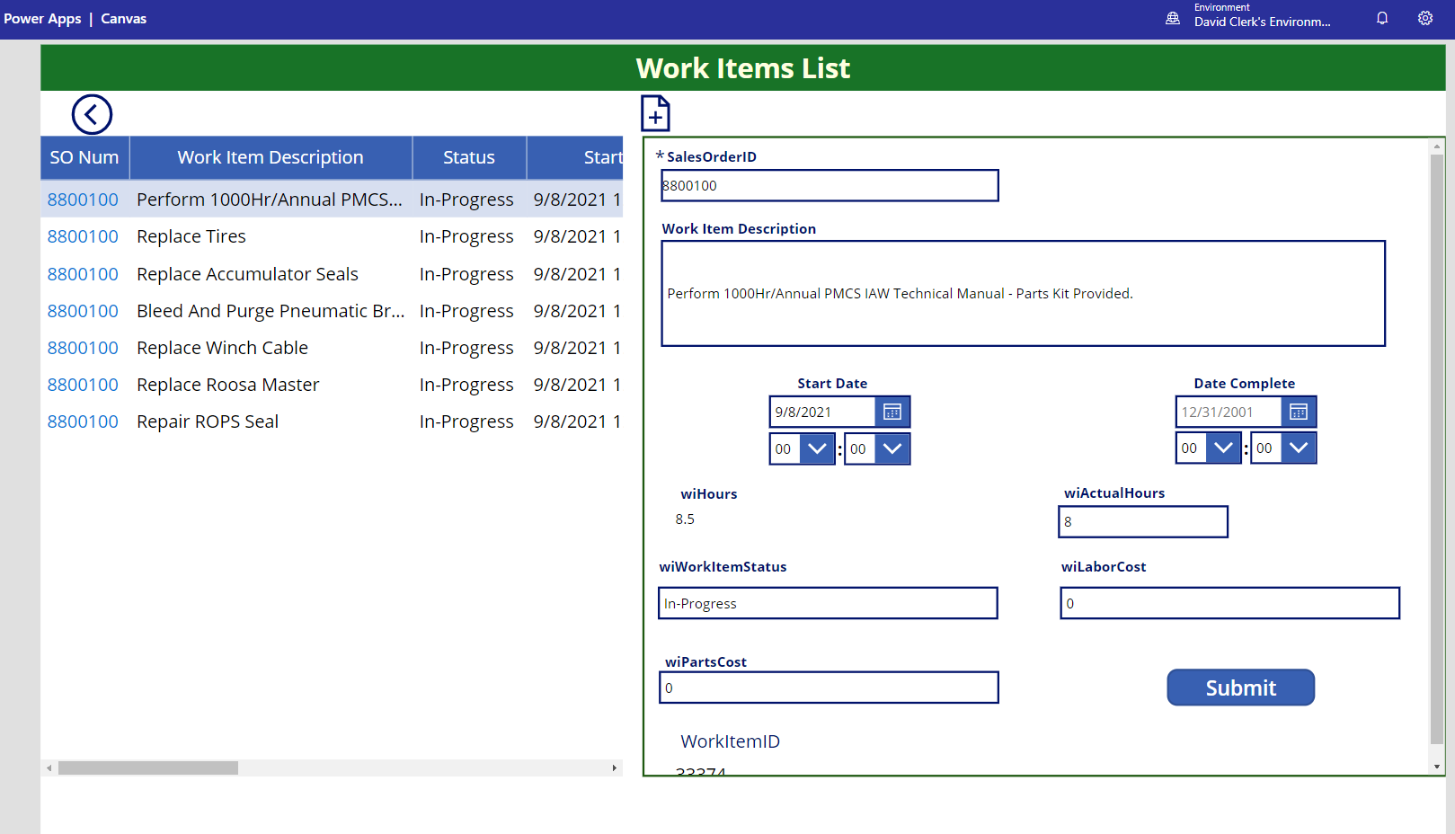
Customized Apps

Slide 26
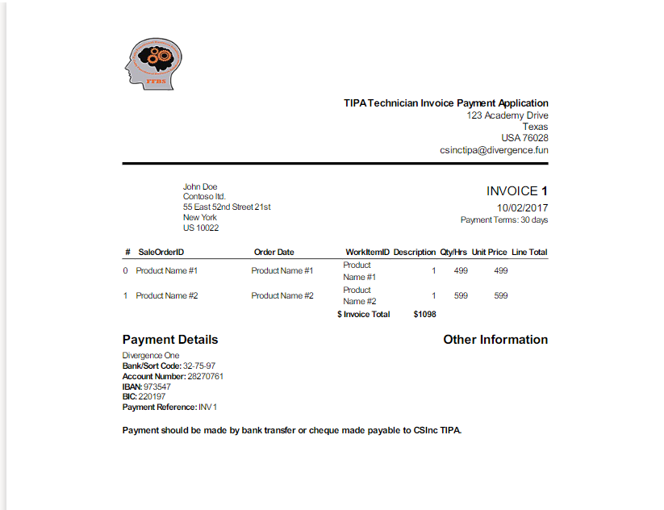

Slide 27

Questions?
A more detailed Project Proposal is available @DC_CapstoneProject

