Slide 1


Federal Procurement Data Systems (FPDS)
Web Scraping with Python in Azure Data Studio
Market Research Analysis Model
David Clerk
202201-DSI-WE
March 18, 2022

Slide 2

Use Case - Summary
Government Contracting Market Research
For Small Businesses
Less Than 25% Of Government Contracts Are Awarded To Small Businesses
Support Small Businesses As Engines For Economic Development
Gain Access To The Ingenuity That Small Business Provide
Offer Opportunities To Disadvantaged Socio-economic Groups
Government Contracts Can Provide Residual Revenue Source Via Sole-Source Contracts

Slide 3

Drivers For Improvement
Major Factors Preventing Small Businesses From Competing For Federal Government Contracts
Requirements For Contracting Are Cumbersome
Prerequisites For Federal Contract Bidding Have Costly Overhead
Contract Awarding Is Not Guaranteed to Have A ROI
Market Drivers Are Vague And/Or Misleading

Slide 4
FFBS Solution
Fully Functional Business Solutions (FFBS)
Approach
Features And Benefits
Cost Effective Consultations
Identify the products that are the right form, fit, and function for your business
Assist with assessments and administrative requirements for requirements gathering and generating proposals.
Reduce costs and overhead associated the bidding for contracts.
Remove the need for costly rangled subcriptions to public data.
Analytic Services
We remain updated on the last FAR Regulations, Contracts and Bids for every sector of business.
In house data preparation and analytics process that will do the heavy lifting for your business.
Our model can dually be used to bid for contracts in most states
You own your data
Use scalable low-cost applications to increase ROI

Slide 5
Marketing Analysis Dataset
Key Factors
Geographical | Contract Negotiations | COLUMN HEADING | Product/Service
Disasters | Price Competition | Cost Analysis | Solicitations
Population | Price Analysis | Combination Of Contract Types | Contract Awards
Crisis | Requirement Type & Complexity | Urgency | Competitors Demographics
Epidemic/ Pandemics | Extent and Nature of Subcontracting | Concurrency | Business Structure/Type
 | Performance Period | Acquisition History

Slide 6
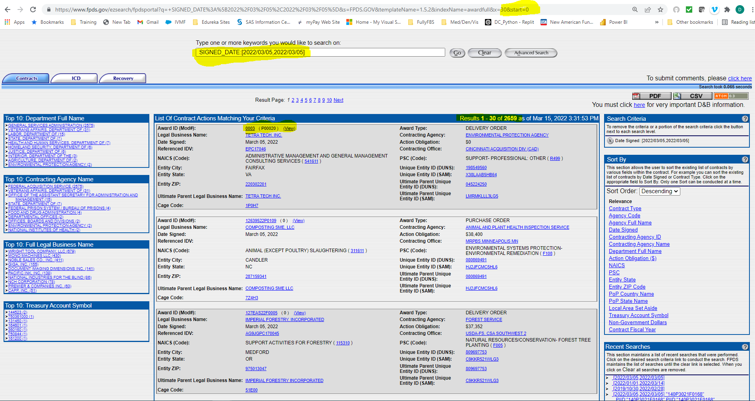
Data Capture Part 1
Scrape Part 1 of 3

Slide 7
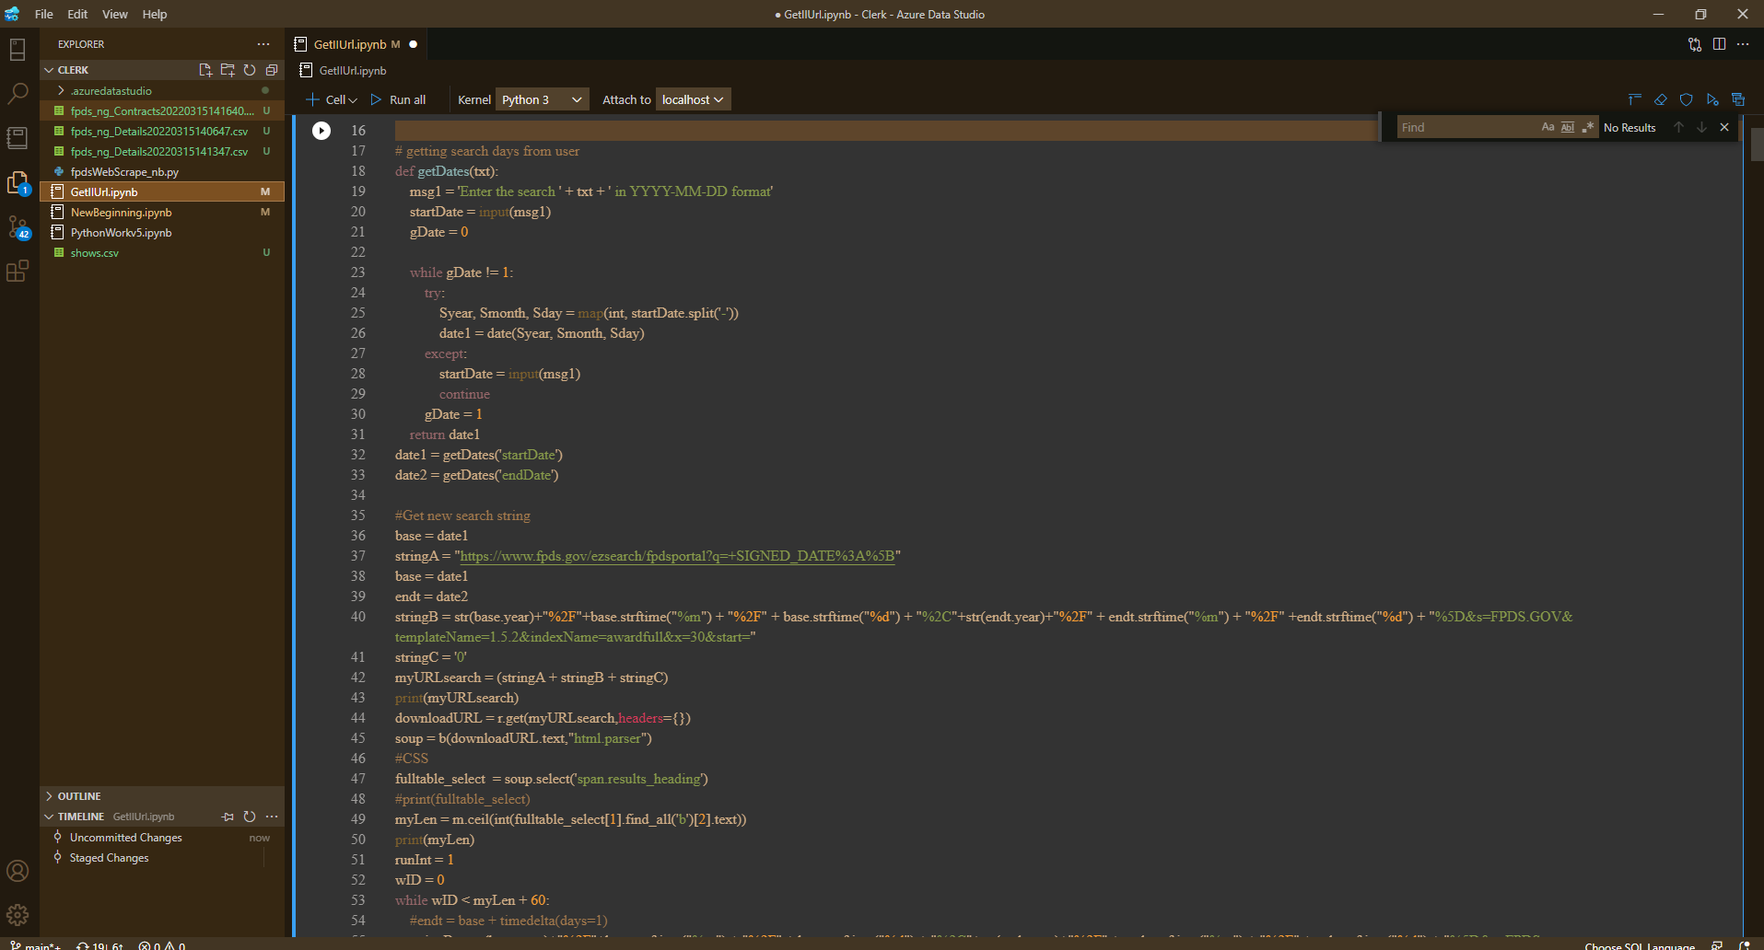
Data Capture Part 1/3 Code
Scraping Code Part 1

Slide 8
Data Capture Results Part 1
DataFrame
Scrape 1 (19 Columns)
Primary Key – N/A Columns - AwardID,AwardType,LegalBusinessName,ContractingAgency,DateSigned,ActionObligation,ReferencedIDV,ContractingOffice,NAICS_Code,PSC_Code,EntityCity,UniqueEntityID_DUNS,EntityState,UniqueEntityID_SAM,Zip,UltimateParentUniqueEntityID_DUNS,UltimateParentLegalBusinessName,UltimateParentUniqueEntityID_SAM,CAGE_Code Sample Data - 19KE5022P0073( P00001 ) (View),PURCHASE ORDER,MISCELLANEOUS FOREIGN AWARDEES,"STATE, DEPARTMENT OF", "March 05, 2022","-$2,577.12",,AMERICAN EMBASSY NAIROBI,HOTELS (EXCEPT CASINO HOTELS) AND MOTELS( 721110),"TRANSPORTATION/TRAVEL/RELOCATION- TRAVEL/LODGING/RECRUITMENT: LODGING, HOTEL/MOTEL( V231)",WASHINGTON,123456787,DC,LN9PU5M2YZN5,204050001,123456787,MISCELLANEOUS FOREIGN CONTRACTORS,LN9PU5M2YZN5,35KC0

Slide 9
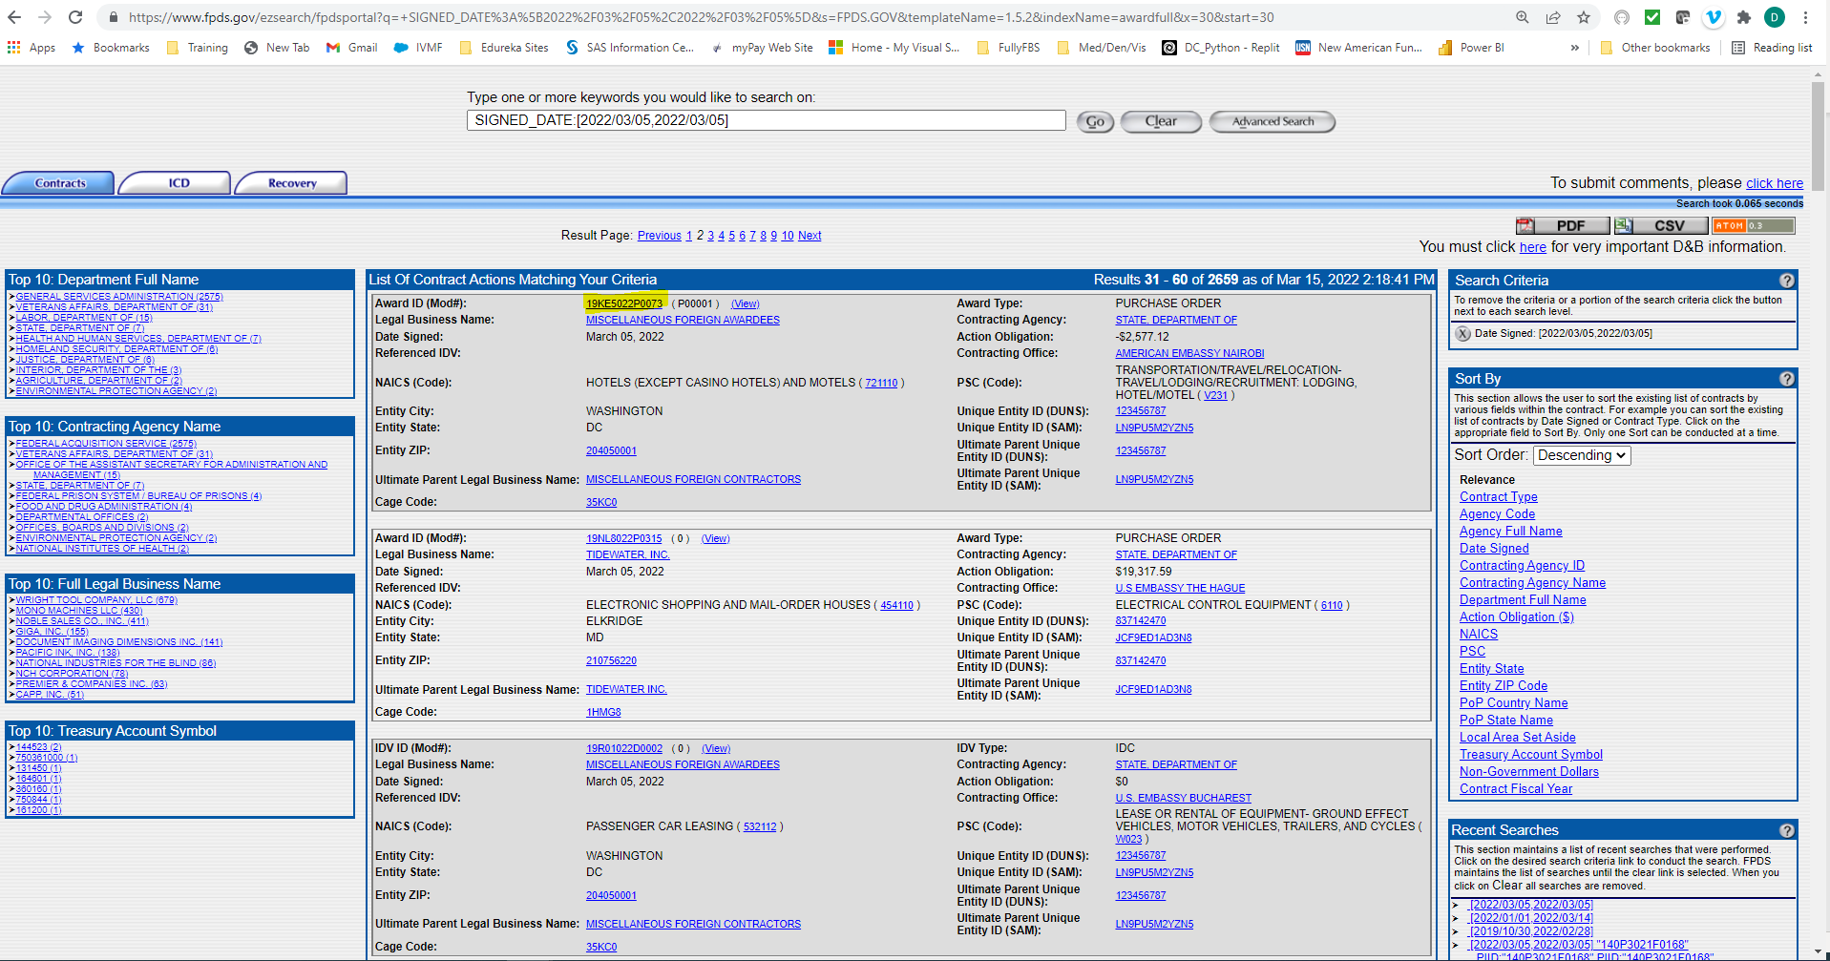



Data Capture Part 2
Scrape Part 2 of 3

Slide 10
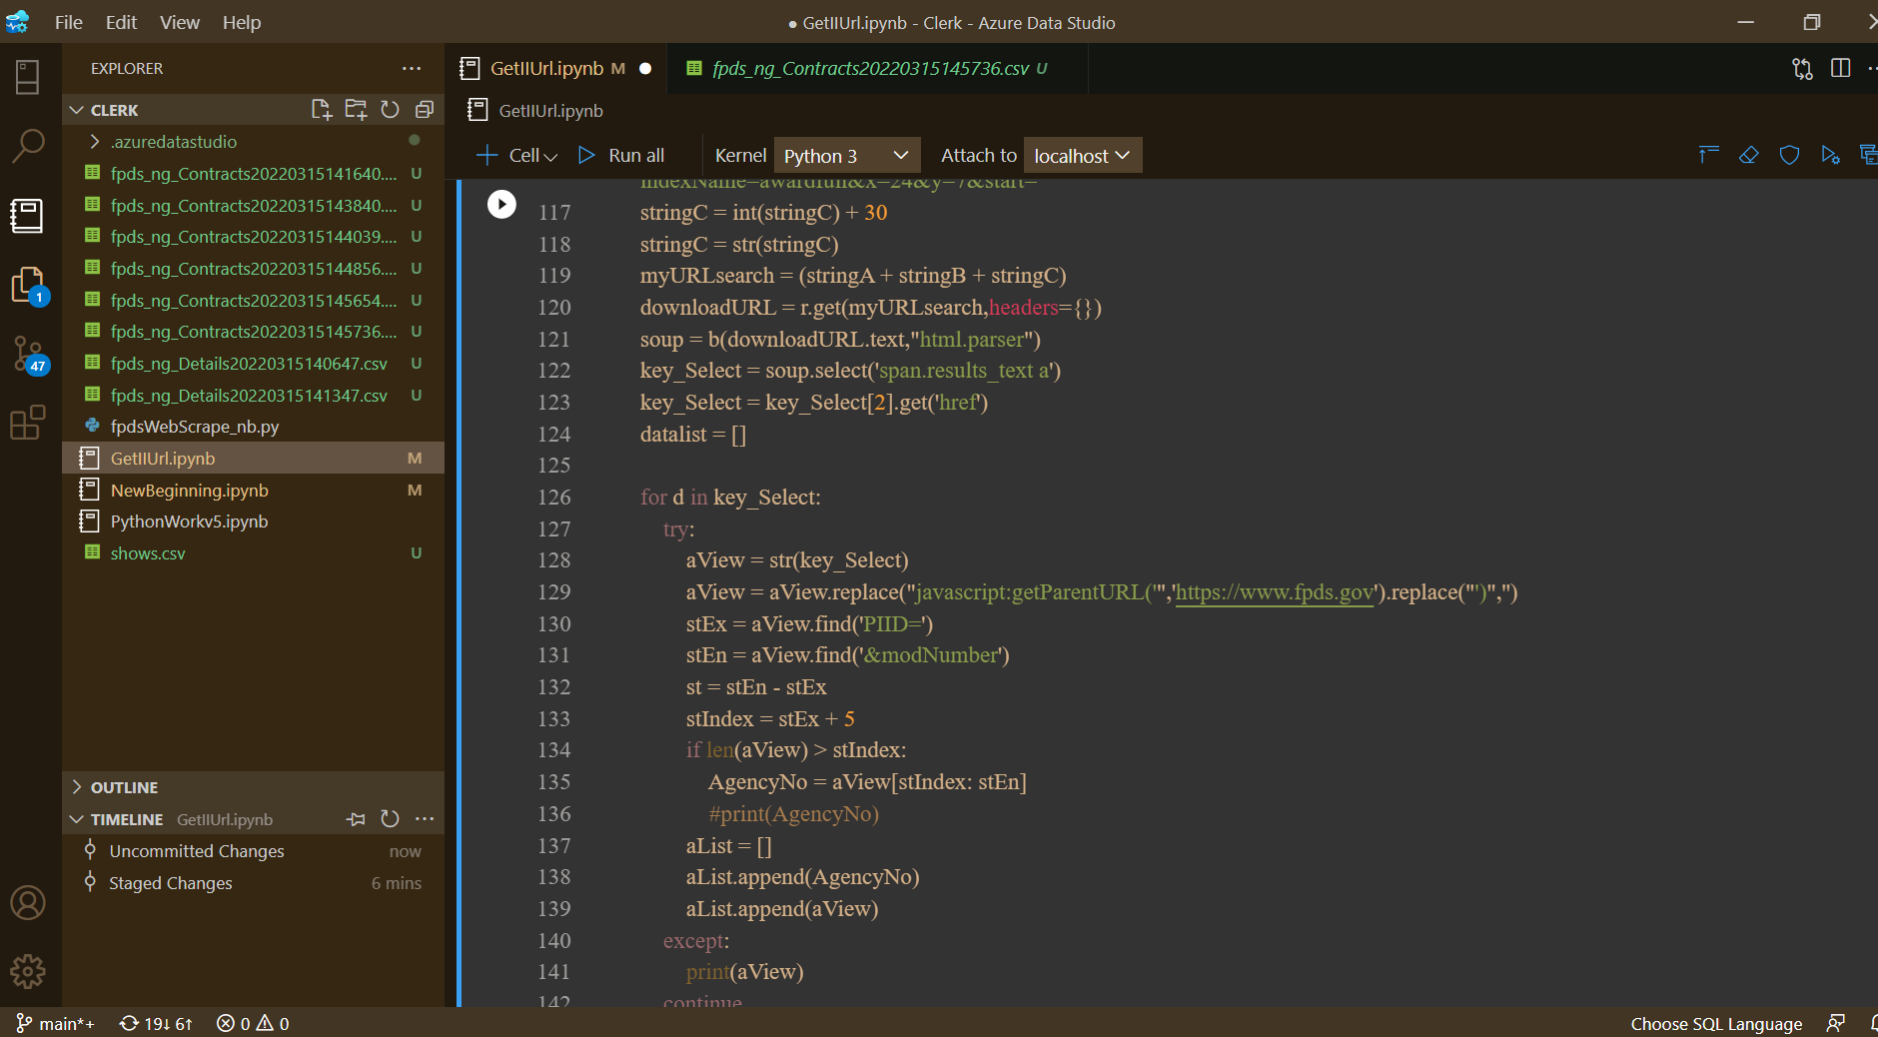
Data Capture Part 2/3 Code
Scraping Code Part 2

Slide 11
Data Capture Results Part 2
DataFrame
Scrape 2 (2 Columns)
Primary Key – N/A Columns - AwardID, ContractUrl Sample Data - 19KE5022P0073,https://www.fpds.gov/ezsearch/jsp/viewLinkController.jsp?agencyID=1900&PIID=19KE5022P0073&modNumber=P00001&transactionNumber=0&idvAgencyID=&idvPIID=&actionSource=searchScreen&actionCode=&documentVersion=1.5&contractType=AWARD&docType=B

Slide 12
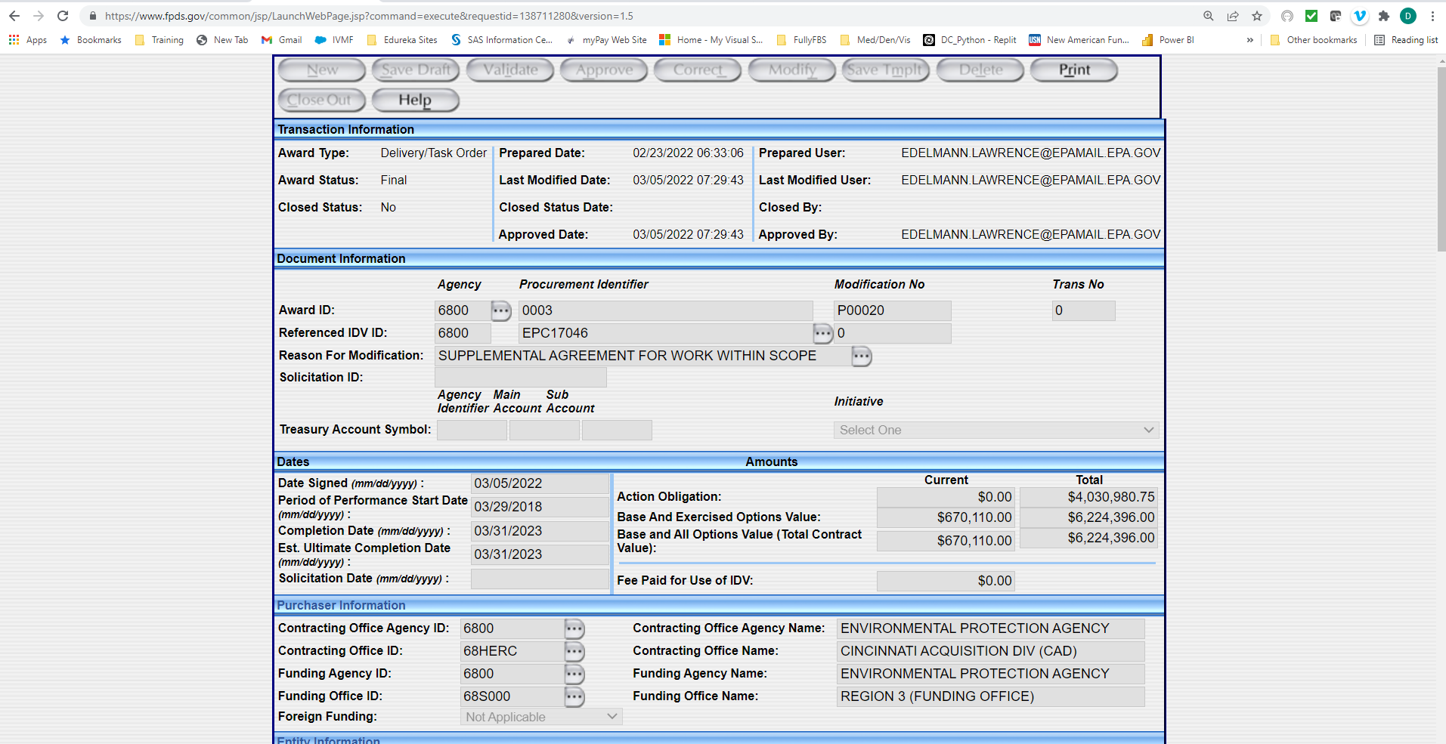
Data Capture Part 3
Scrape Part 3 of 3(Section 1 of 3)

Slide 13
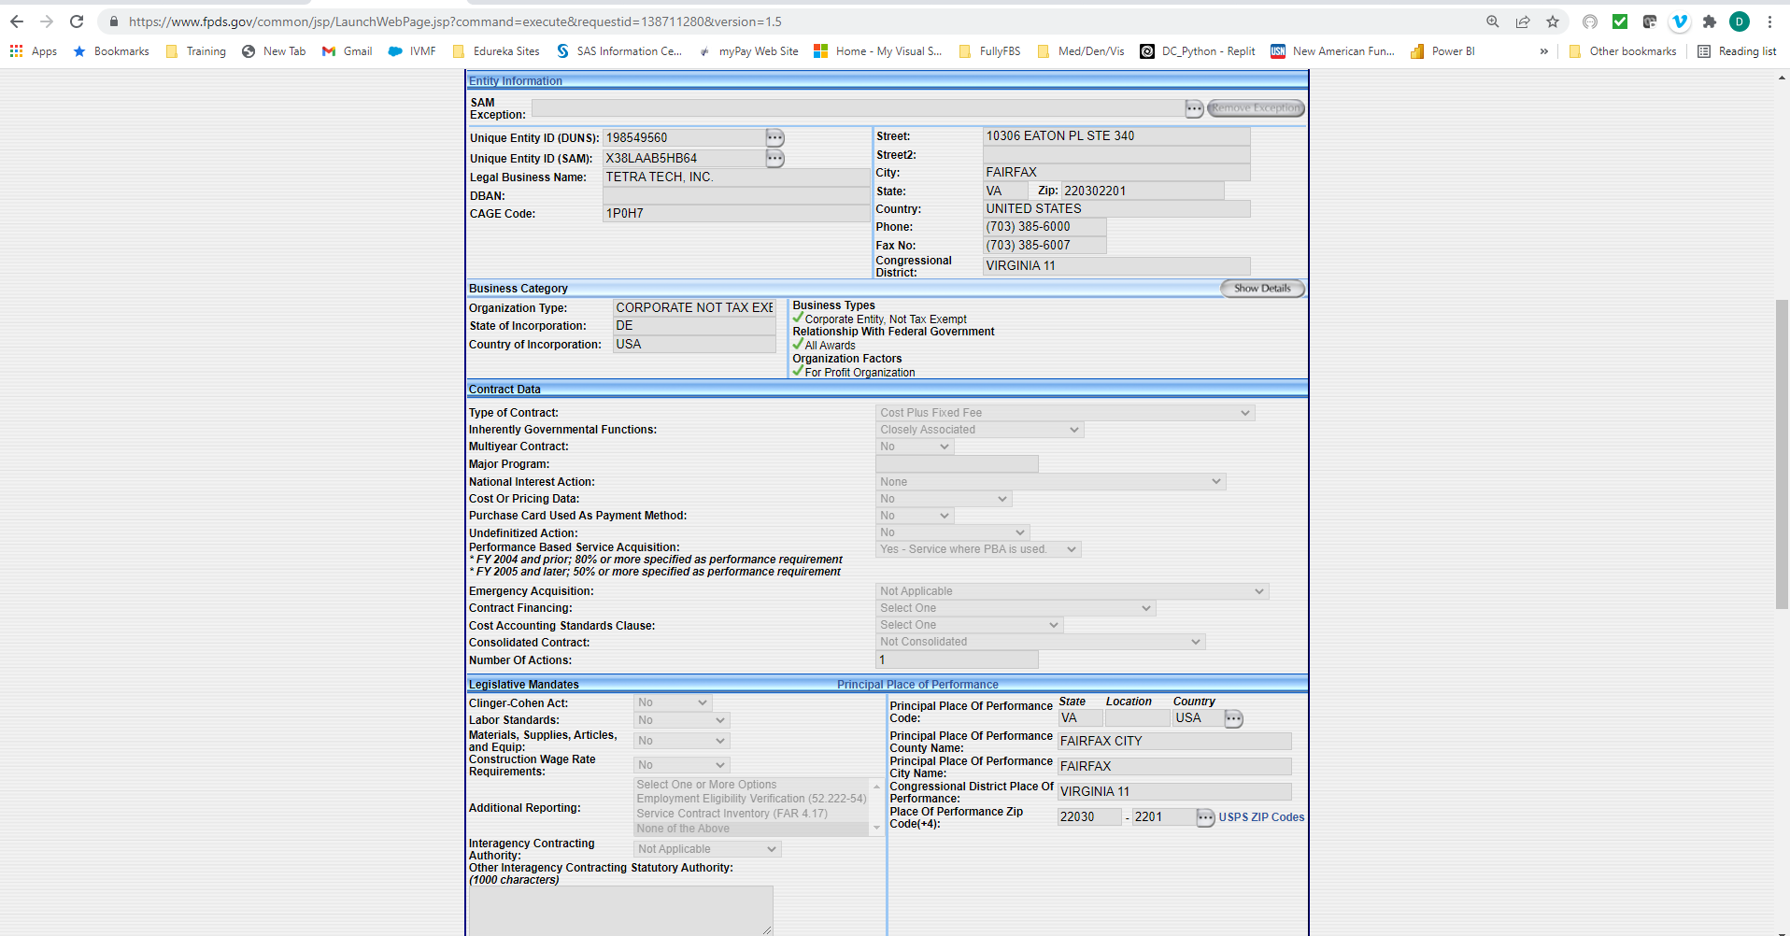
Data Capture Part 3
Scrape Part 3 of 3(Section 2 of 3)

Slide 14
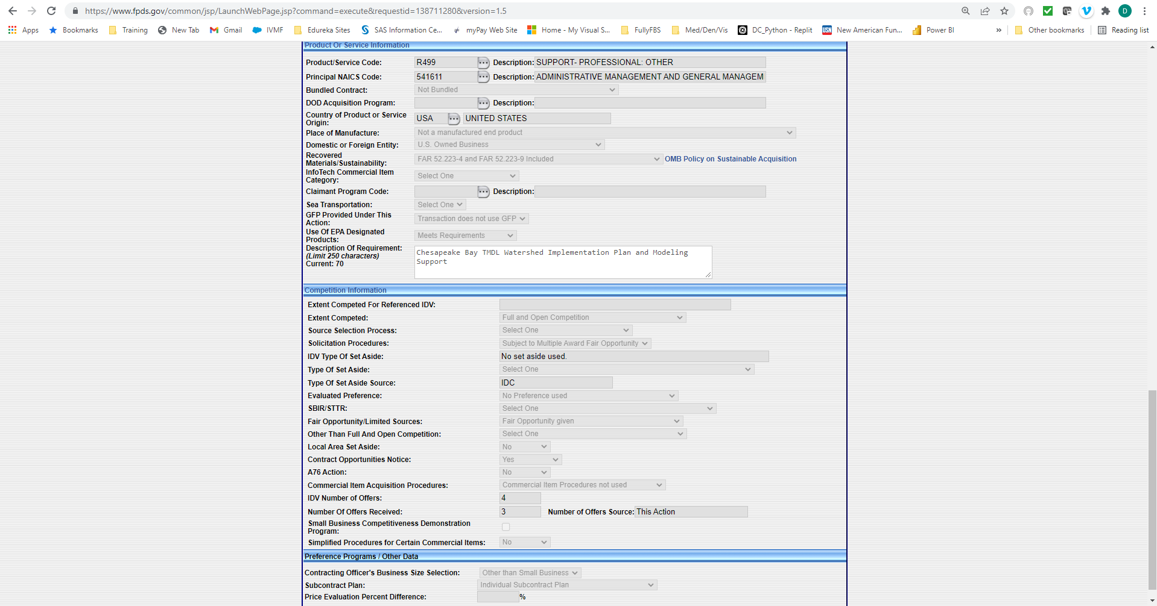
Data Capture Part 3
Scrape Part 3 of 3(Section 3 of 3)

Slide 15
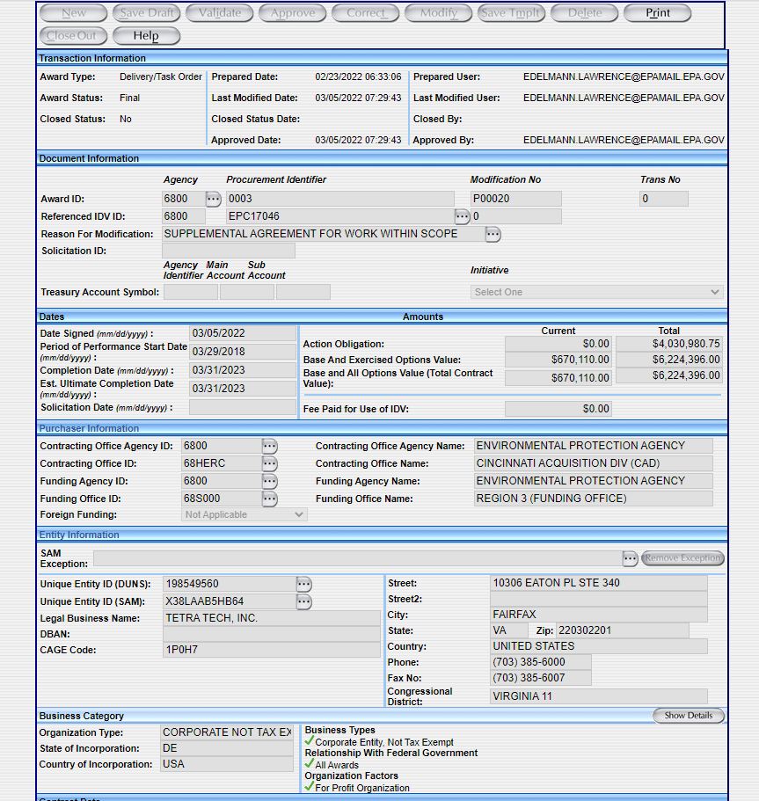
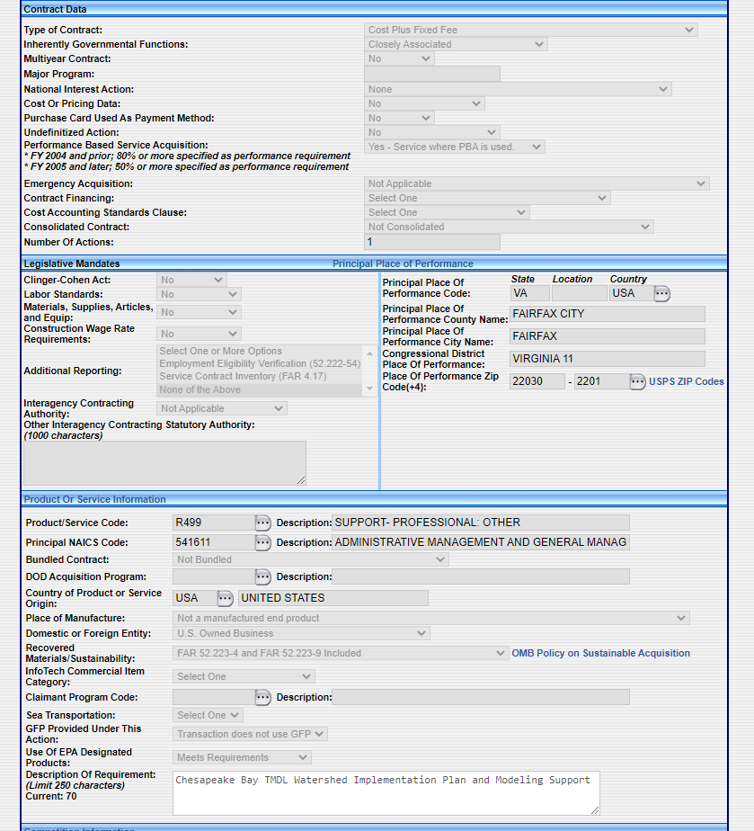
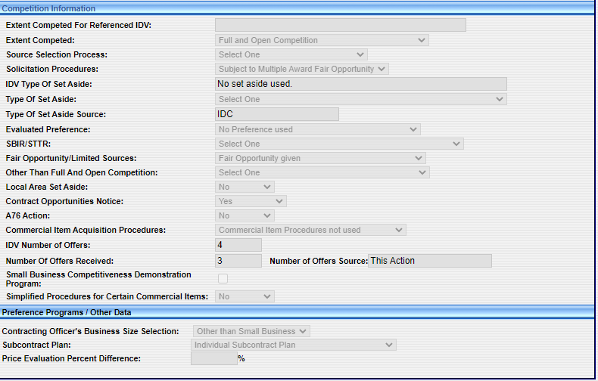
Data Capture Part 3
Web Form Scrape

Slide 16
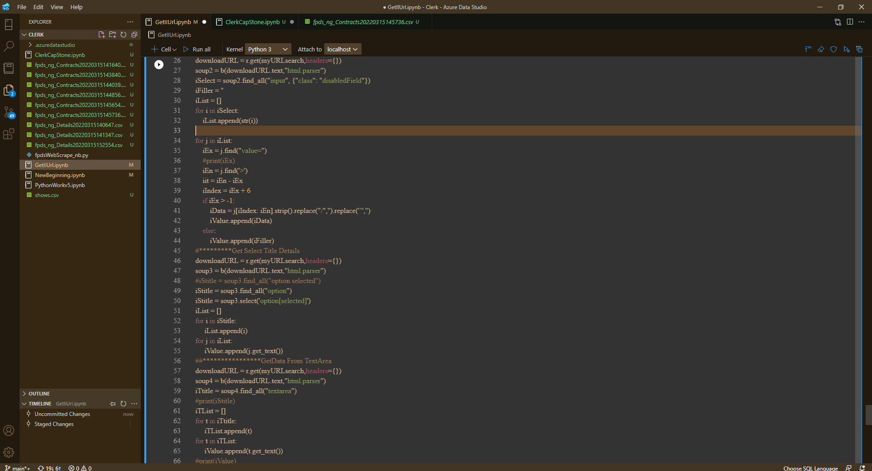
Data Capture Part 3/3 Code
Scraping Code Part 3

Slide 17
Data Capture Results Part 3
DataFrame
Scrape 3 (142 Columns)
Primary Key – AwardID Columns - 'AwardType', 'PreparedDate', 'PreparedUser', 'AwardStatus', 'LastModifiedDate', 'LastModifiedUser', 'ClosedStatus', 'ClosedStatusDate', 'ClosedBy', 'Filler1', ‘ApprovedDate', 'ApprovedBy', 'AwardIDAgency', 'AwardIDProcurementIdentifier', 'AwardIDModificationNo', 'TransNo','RefIDVIDAgency', 'RefIDVProcurementIdentifier', 'RefIDVModificationNo', 'ReasonForModification', 'SolicitationID', 'TASAgencyIdentifier', 'TASMainAccount', TASSubAccount', 'DateSigned’… Row Sample -Delivery/Task Order,05/16/2020 16:05:36,MARCIA.LEE.HE1254@HQ.DODEA.EDU,Final,05/16/2020 16:05:46,MARCIA.LEE.HE1254@HQ.DODEA.EDU,Yes,04/14/2020 20:21:21,FPDS_CLOSEOUT,,05/16/2020 16:05:46,MARCIA.LEE.HE1254@HQ.DODEA.EDU,9700,0061,1,0,9700,HE125415D0005,0,Funding Only Action,,97,0100,,05162020,09142016,11132016,11132016,,,-$0.24,"$19,999.76",,-$0.24,"$19,999.76",,-$0.24,"$19,999.76“,…

Slide 18
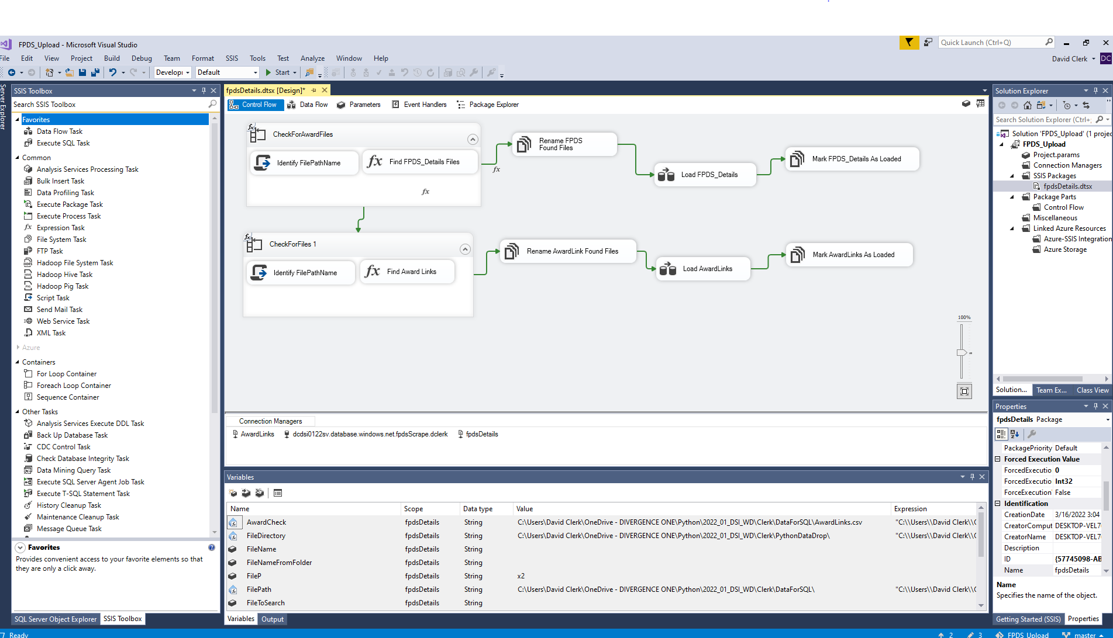
Data Wrangling Automation
SQL Server Data Tool
After 11 Passes thru Beautiful Soup

Slide 19
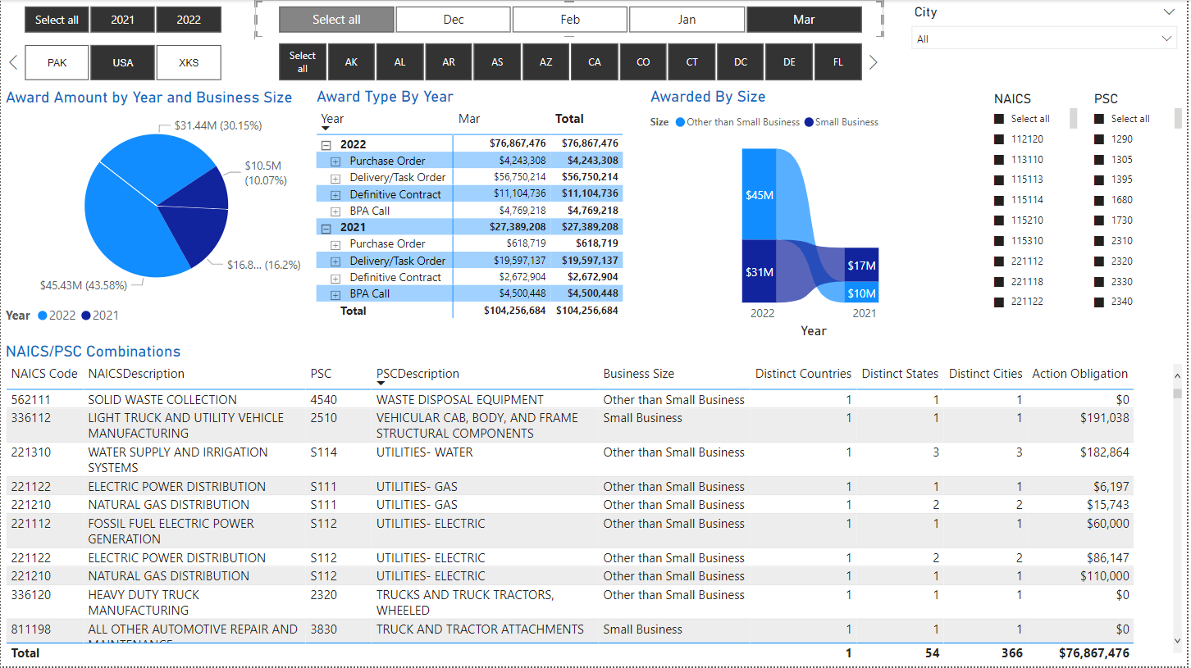
Reporting (Transforming Data To Information)
PowerBi Visualizations

Slide 20
Summary
Proof Of Concept
Proven From This Model
Obtain detailed data for public website
Manipulate and store data on cloud/local servers.
Automate the ETL/ELT process.
Visualize the data to answer business queries.
Maximize the use of coding (Python Beautiful Soup) to build models for scraping various sites/pages
Provide analytical data for marketing, pricing strategy, etc…

Slide 21
Thank You.
Questions?

