Slide 1


SMART INDIA HACKATHON 2025
MINDLEY
Problem Statement ID – 25092
Problem Statement Title-Development of a Digital Mental Health and Psychological Support System for Students in Higher Education
Theme – BioTech / MedTech / HealthTech
PS Category- Software
Team ID-
Team Name : DCube

Slide 2
MINDLEY
DCube
Solution:
The idea is to create a user-friendly student dashboard that helps individuals assess their mental health and improve focus
a simple dashboard where students can check on their mental health and find tools to help them focus better.
helps to talk with like-minded peers, but in a way that keeps you Safe and Comfortable.
Get personalized tips and resources based on the state of mental health at that moment.
A chatbot helps overcome the fear of asking for help and a friendly way to talk to
designed to be a peaceful space for a well-being journey.
How The problem is approached?
Problem: Stigma and Anonymity
Solution : Chatbot, Peer interaction.
Problem: Accessibility and Timely Support
Solution : 24/7 availability and personalized resources.
Problem: Lack of Awareness
Solution: Self-assessment Dashboard
Unique Solutions:
Gamified Coin based support System.
Context-based support( Academic stress, career Anxiety, imposter syndrome and much more).
AI detects potential risks and patterns of potential risks and an alert system for closed ones in case of emergency.
Personalized Toolkit like breathing exercise and journals.

Slide 3
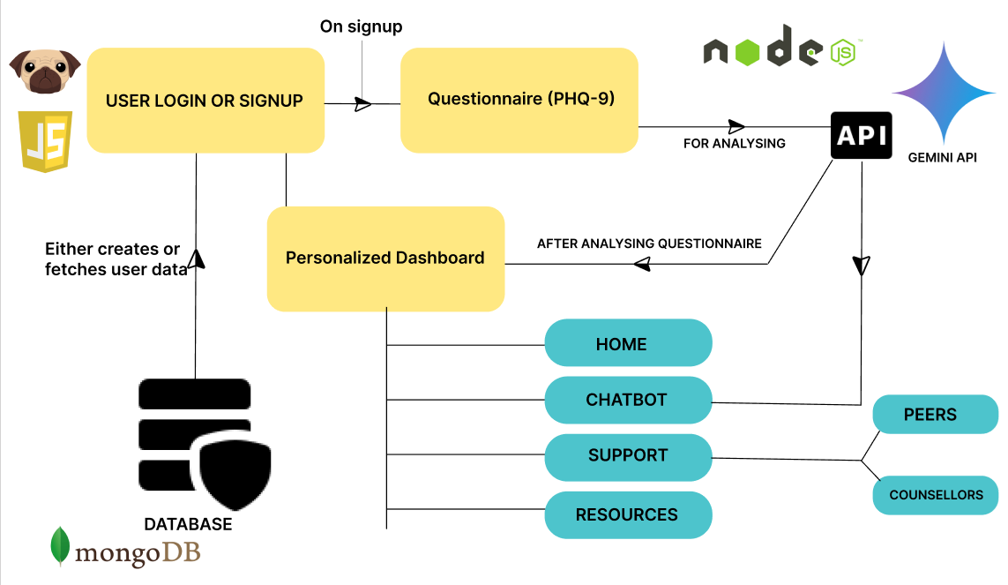
TECHNICAL APPROACH
DCube
TECHNOLOGIES USED:
Frontend:
Pug ( Templating Engine )
JavaScript
Backend:
Node js (express.js)
Services : Gemini API
(Used to Check the psychological status of the user)
Mongo DB (Server)
WORKFLOW DIAGRAM

Slide 4
FEASIBILITY AND VIABILITY
DCube
Feasibility: Our solution is low-cost , easy-deploy, scalable and a student friendly website. Can be implemented with existing skills and free( prototype ) to affordable options.
Technical
Frontend: pug, JavaScript
Backend: node.js(express.js), Gemini API.
Financial
Prototype: No-cost with existing tools.
Final product: Affordable options.
Operational
Easy to manage with minimal complexity.
Simple and user-friendly UI for easy adoption among students.
USER TRUST AND MANAGEMENT | No personal data will be shared among anyone and are encrypted. To boost engagement, peer interactions are introduced
ETHICAL & LEGAL CONSIDERATIONS | Certified therapists or counsellors are integrated for real-time guidance. compliance with mental health laws, and ethical guidelines can be ensured.
ACCESSIBILITY FOR PHYSICALLY CHALLENGED STUDENTS | The platform is designed in a way that it supports assistive features (text-to-speech) for physically disabled persons.
CONTENT MODERATION | AI-assisted moderation to detect harmful or offensive messages The user maybe given a warning, or blocked or their details will be informed to the institution.
DATA SECURITY & PRIVACY | Secure Login System Each user has their own account (username & password).

Slide 5
IMPACT AND BENEFITS
DCube
Potential impact on the target audience:
Around 23% of school students and 33.6% of college students in an average suffer from severe mental health problems and to overcome that our solution is given.
Our solution focuses on giving a user-friendly and stigma-free experience increasing student adoption.
With the in-live peer and counsellor or therapists support the student can get instant live support helping them with human interaction.
Chatbot that interacts with the user like a friend providing them comfort and make them feel safe.
Resources hub provides resources that help the user with their health conditions.
Benefits of the Solution:
Social:
Help students overcome their mental conditions like anxiety by like-minded peer interactions and counsellor interactions.
Help students focus in their academic and personal life better without any worries.
Helps prevent severe issues by alerting the closed ones of the individual when a potential risk is identified.
Economic:
Reduces health-care expenditure.
Reduces drop-outs from schools and colleges significantly improving the amount of employable graduates.

Slide 6
RESEARCH AND REFERENCES
DCube
Research and Links of reference:
According to the IMHANS study among students of classes 9–12 in Kashmir:
60–65% suffer from academic-related stress, spanning both government and private school students.
A cross-sectional survey conducted from Jan – Apr 2024 in Kashmir states that around
12.5% reported severe depression (13.4% in females).
24.3% experienced severe anxiety.
Links:
NIMHANS cross-sectional study
A study among school going students.
cross-sectional survey conducted from January to April 2024.

