Slide 1

Cyclistic Bike-Share Data Analysis Case Study
Danos Dimitris - 2024

Slide 2
Table of Contents:
Intoduction, Goals
Data overview
Exploratory Data Analysis (EDA)
Conclusion
Suggestion

Slide 3
Introduction
About the company:
Cyclistic is a bike-sharing program with an extensive fleet of classic and electric bikes with over a thousand docking stations all over Chicago.
They offer several pricing plan options such as:
Single ride passes (casual users)
Full-day passes (casual users)
Annual memberships (members)

Slide 4
Objectives
Our main objectives are:
1. Maximize the number of annual members by converting casual riders to annual members, as annual members are much more profitable than casual riders.
2. Understand how casual riders and annual members use Cyclistic bikes differently.

Slide 5
Description of data
Key Variables:
ride_id: A unique identifier for each ride.
rideable_type: Type of rideable bike used for the trip.
started_at: The date and time when the ride started.
ended_at: The date and time when the ride ended.
member_casual: Indicates whether the rider is a member or a casual user of the service.
ride_duration: Ride duration in minutes (keeping two decimal points)
day_of_the_week: Day of the week the bike ride started in Mon, Tue,... format
month: Month that the bike ride started in Jan, Feb,... format
Type of Data:
Bike Ride Data Format: csv files, relational database.
Time Period:
January 1, 2023, to December 31, 2023.
Volume:
Over 5 million entries.
Data Sources:
• Company Internal Database.

Slide 6
Data Quality:
Completeness:
Missing Values:
end_lat: 6993
end_lng: 6993
ride_duration: 272
Accuracy:
Treated some timestamps had the datetime end be before start, which is not possible. Those cases resulted in negative ride durations, and have been set as NULL. It's the 272 missing ride durations we see above.
5% of total rides where set as docked_bike, missing the information of the bike type (they are all docked bikes, the rideable_type should be either classic_bike or electric_bike).

Slide 7
Cleaning results for columns created:
Cleaning results for columns used:
ride_id: No issues found. Has been set to VARCHAR(16), primary key.
rideable_type: docked_bike not specified (classic_bike, electric_bike, docked_bike).
started_at, ended_at: Within range. Some end before starting, resulting in negative ride_durations, that have been cleaned and set to NULL.
start_lat, start_lng: No issues found.
end_lat: Had three invalid 0.0 values, have been set to NULL.
end_lng: Had three invalid 0.0 values, have been set to NULL.
member_casual: No issues found.
Cleaning results for columns created:
ride_duration: Duration of ride in min, have set negative durations to NULL, won't tamper with our analysis.
day_of_the_week: No issues.
month: No issues.

Slide 8
Exploratory Data Analysis (EDA)

Slide 9
Comparing
Members and Casual Users
Distributions

Slide 10
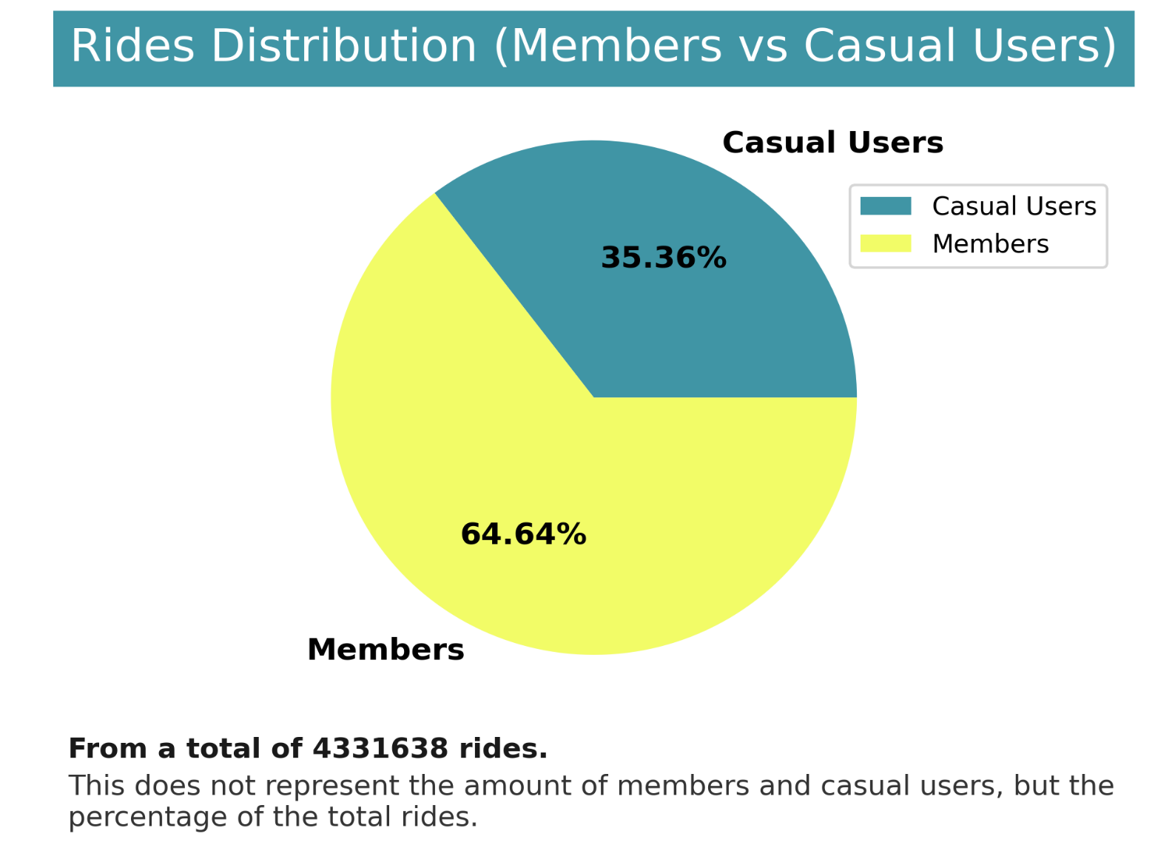
Pie Chart: Number of Rides (Members vs Casual Users)
Main Takeaways
The pie chart illustrates the distribution of rides between members and casual users, indicating the proportion of total rides attributed to each user group.
Members:
Majority Share: Members account for the majority of rides. This suggests a strong and consistent user base within the membership program, likely comprising regular commuters or frequent users of bike services.
Casual Users:
Substantial Share: Casual users contribute a significant portion of rides. This highlights the importance of catering to casual users and accommodating their needs within the bike-sharing system.

Slide 11
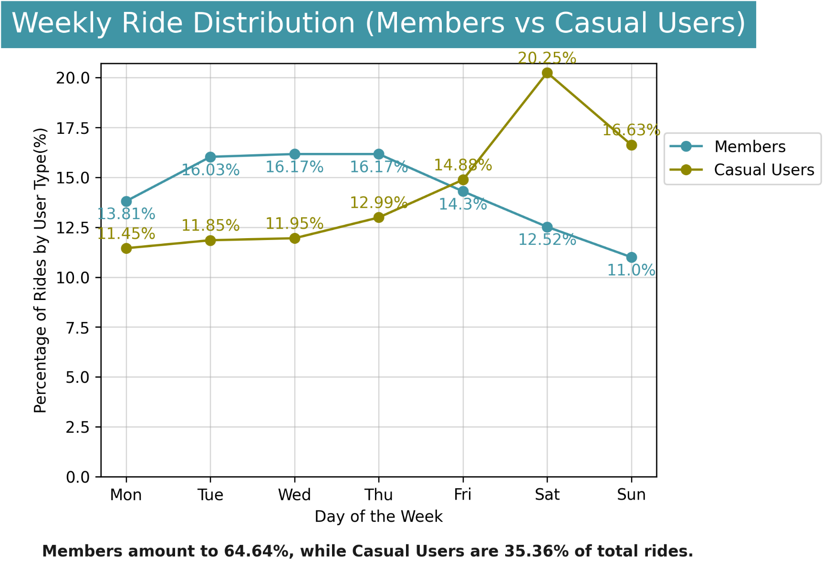
Weekly Ride Distribution (Members vs Casual Users)
Main Takeaways
Day-of-the-Week Distribution: Both members and casual users exhibit distinct patterns in ride distribution across different days of the week, reflecting potential variations in usage behavior or preferences.
Members:
Midweek Peak: Members show peak ride percentages in the middle of the week. This suggests that members may utilize bike services more frequently for commuting purposes or weekdays.
Casual Users:
Weekend Peak: Casual users demonstrate a significant increase in ride percentages during the weekend. This surge suggests that casual users may prefer bike services for leisure or weekend activities, contributing to higher usage during weekends.
Members demonstrate different behaviors from casuals users, as members ride more during weekdays, while casual users use them more on weekends.

Slide 12
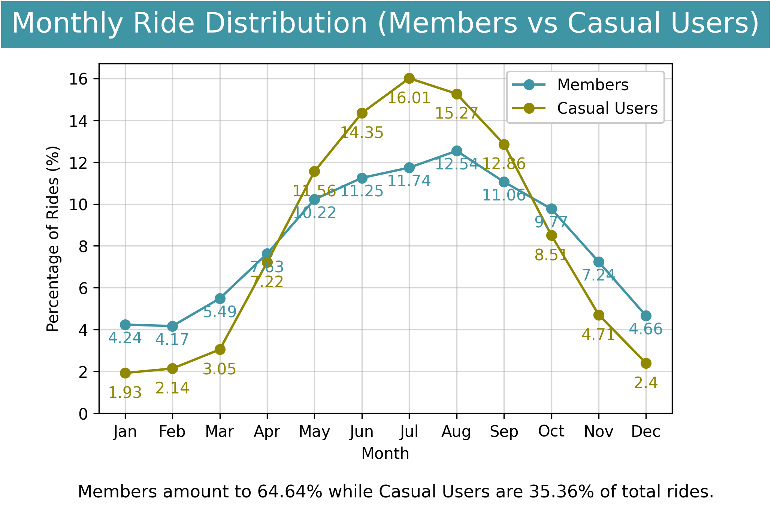
Monthly Ride Distribution (Members vs Casual Users)
Main Takeaways:
Ride Distribution Exhibits Seasonal Trends:
Ride counts, fluctuate throughout the year, reach an all-time low during winter, while peaking during the summer months for both members and casual users.These fluctuations may be influenced by factors such as weather conditions and holidays.
Peak Season Summer: The summer months (June, July, and August) see the highest percentages of rides for both members and casual users, indicating a surge in usage during vacation seasons or warmer weather.
Differences between members and casual users:
The distribution of rides among members has lower variance compared to casual users, indicating a more consistent usage pattern among members. This suggests that members may use the bike services more regularly, likely for commuting or habitual activities, while casual users may be more influenced by external factors such as weather and holidays.

Slide 13


Recap: Comparing Members and Casual Users Distributions
Members:
commute much more regularly.
are using the services more during middle of the week, most likely to commute to work.
while having the same seasonal trends, use the bikes more consistently all year around (flatter distribution).
Casual Users:
commute less regularly.
are using the services more during Fridays and weekends, most likely for leisure activities.
while having the same seasonal trends, we observe a lot more variance compared to members.

Slide 14
Exploring Ride Durations

Slide 15
Analysis of Central Tendency Measures for Ride Duration
Employed a trimmed mean approach with a conservative trim level of 5%. This decision was made to ensure the inclusion of a broad range of data points, while mitigating some of the impact of extreme outliers as there are:
durations are from 0 sec up to 1 minute.
durations that last weeks or more.
By comparing the mean, median, and trimmed mean ride durations, we can draw several conclusions:
Group | Mean | Median | Trimmed Mean 5% cut
All | 15.95 min | 9.80 min | 12.44 min
Members | 12.13 min | 8.62 min | 10.44 min
Casual Users | 22.94 min | 12.75 min | 17.27 min
Ride durations: members and casual users
Members have much smaller ride durations than casuals, and much less variance as we are going to see later on the plots, most likely due to brief repeated commutes on weekdays from members.
Casual users have longer ride durations.
The difference between the mean and the median, suggests the presence of long ride durations, particularly among casual users, which skews the mean upwards.
The larger difference between the mean and the trimmed mean for casuals indicates the presence of more extreme ride durations especially for casual users.
Note: Side by side comparisons between the mean duration and trimmed mean duration graphs will be shown.

Slide 16
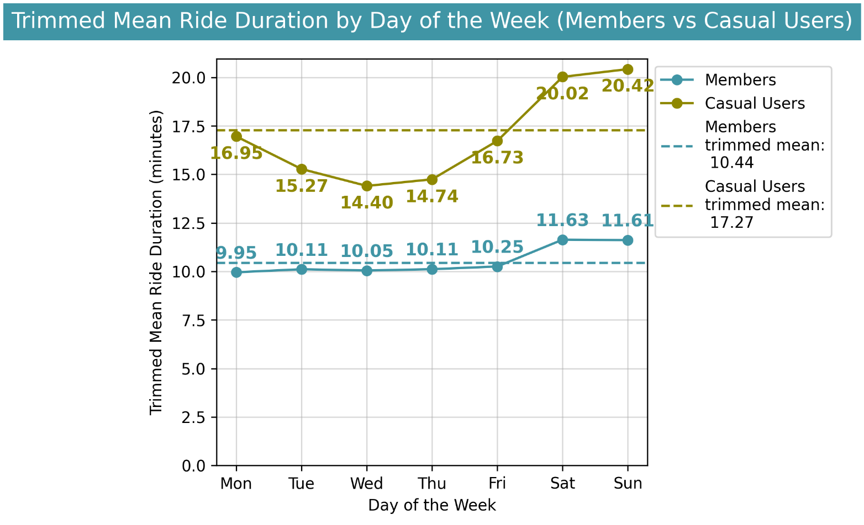
Weekly Ride Distribution (Members vs Casual Users)
Main Takeaways Day-of-the-Week Patterns: Both members and casual users show distinct patterns in ride durations across different days of the week, indicating potential differences in usage behavior. Casual users show significantly higher ride durations compared to members.
Members:
Consistent Patterns: Members demonstrate relatively consistent ride durations from Monday to Friday, suggesting regular commuting habits or usage patterns during weekdays (may be commuting to work).
Weekend Variations: Ride durations for members increase notably during the weekend, indicating a preference for longer rides during leisure time or weekend outings.
Casual Users:
Varying Patterns: Casual users exhibit more variability in ride durations across different days of the week compared to members.
Weekend Surges: Ride durations for casual users increase significantly during the weekend, indicating a preference for longer rides during leisure time or weekend outings.

Slide 17
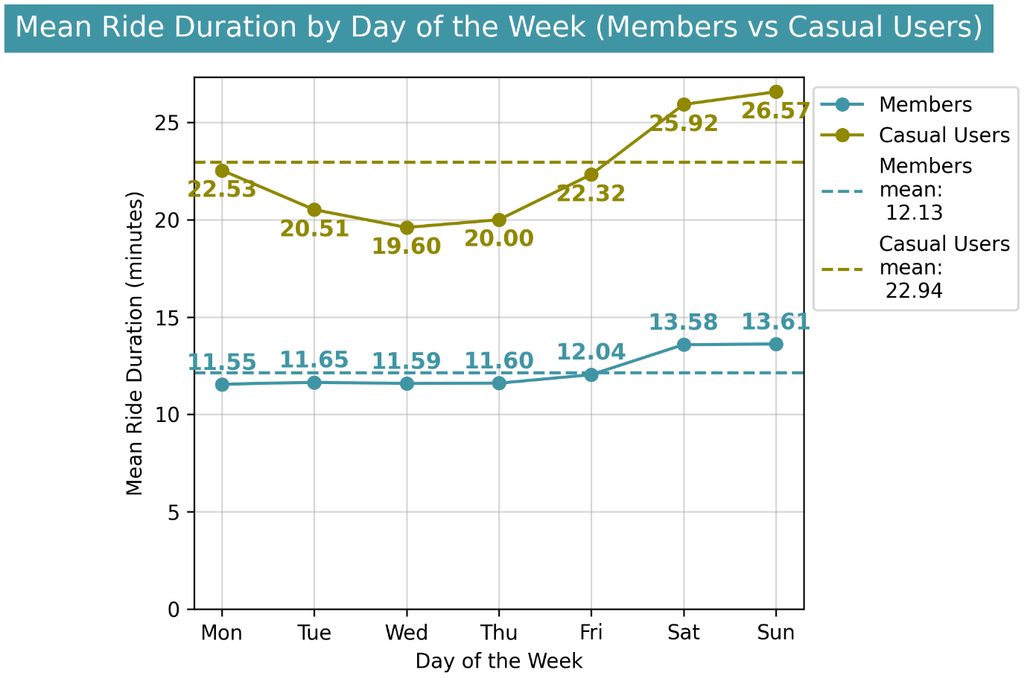
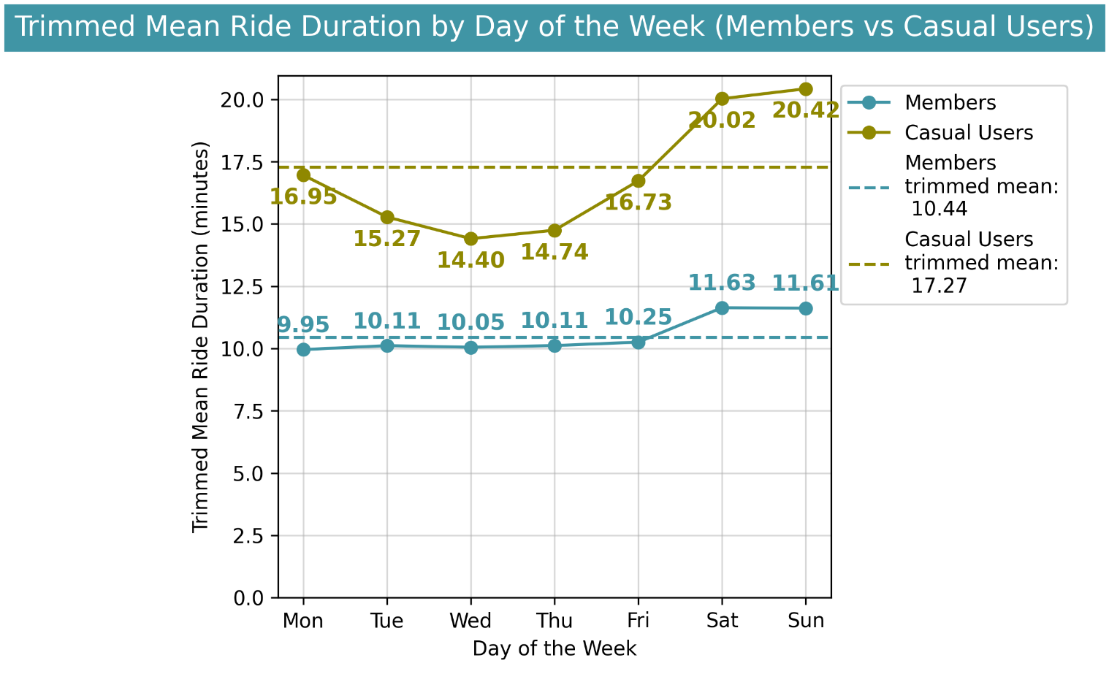
Weekly Ride Distribution (Members vs Casual Users)
Comparing mean ride duration with trimmed mean ride durations: Both the mean ride duration and the trimmed mean ride duration exhibit similar patterns. However, the mean values are significantly larger, particularly for casual riders. This discrepancy is due to the presence of some rides with exceptionally long durations, which heavily influence the mean calculations.

Slide 18
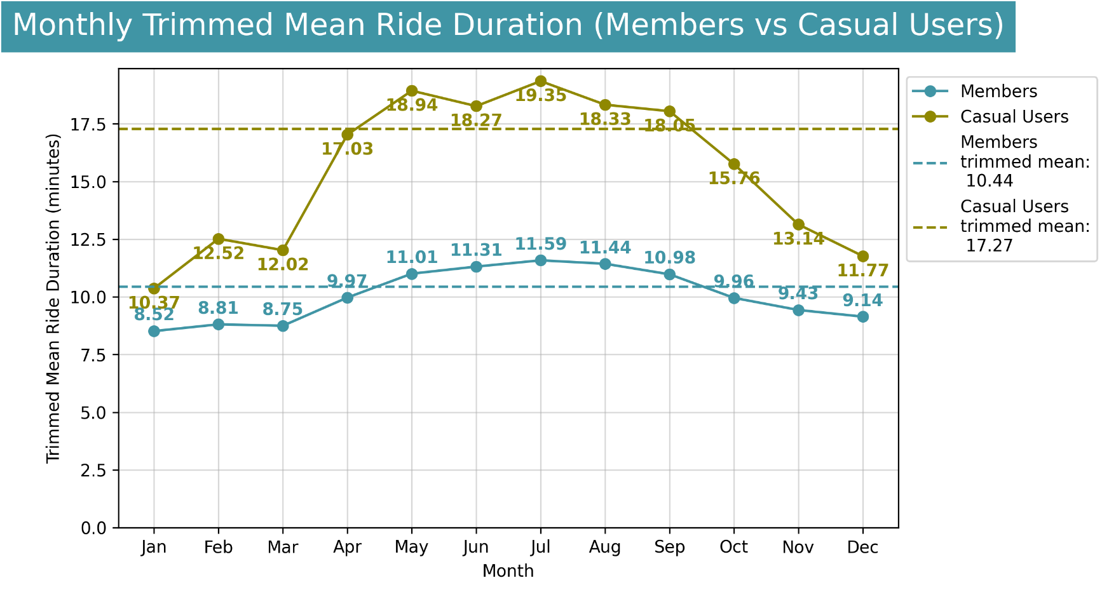
Monthly Ride Distribution (Members vs Casual Users)
Main Takeaways Seasonal Variations: Ride durations exhibit fluctuations throughout the year, likely influenced by seasonal factors such as weather and holidays. They reach an all-time low during winter and experience a significant and steady increase at the start of spring, peaking during July and August. Casual users show significantly higher ride durations compared to members.
Members:
Consistent Durations: Despite fluctuations, ride durations for members generally remain within a relatively narrow range, indicating consistent usage patterns over time. This consistency reinforces the hypothesis that members use bikes for commuting purposes, as travel times remain relatively stable throughout the year.
Casual Users:
Higher Variability: Ride durations for casual users demonstrate greater variability compared to members, with larger fluctuations observed throughout the year.

Slide 19
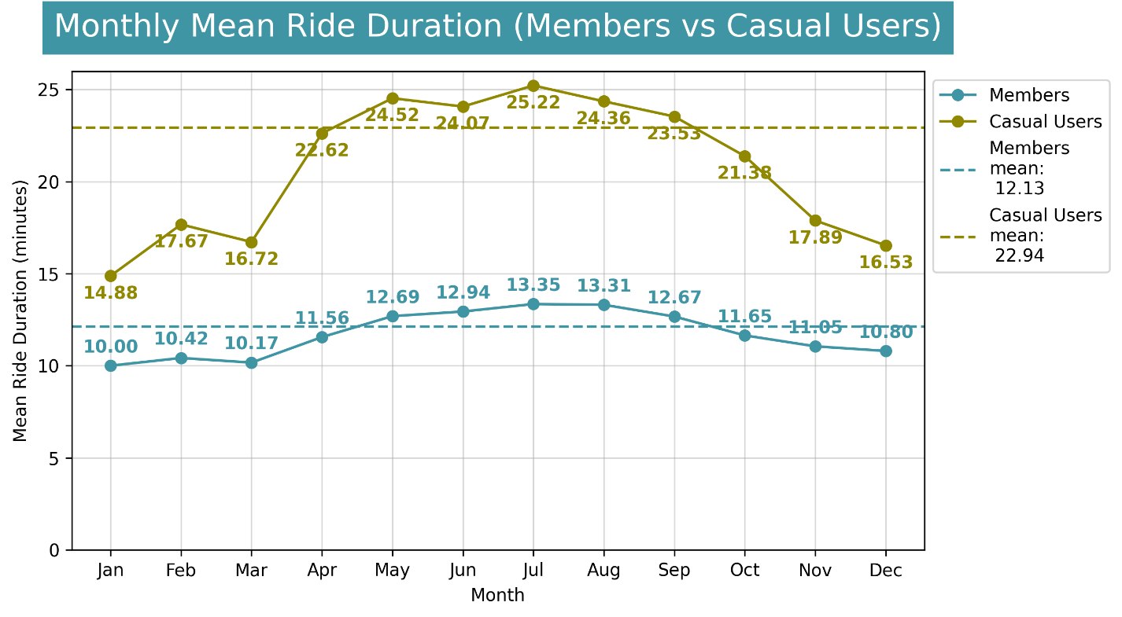
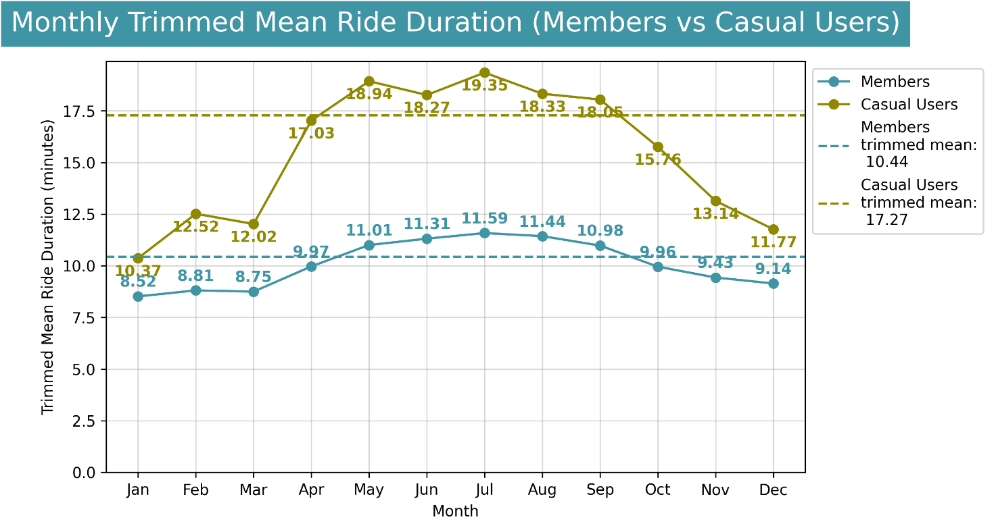
Monthly Ride Distribution (Members vs Casual Users)
Comparing mean ride duration with trimmed mean ride durations: Both the mean ride duration and the trimmed mean ride duration exhibit similar patterns. However, the mean values are significantly larger, particularly for casual riders. This discrepancy is due to the presence of some rides with exceptionally long durations, which heavily influence the mean calculations.

Slide 20
Recap: Ride durations for Members and Casual Users
Members:
exhibit shorter ride durations.
have consistent ride durations from Monday to Friday, most likely due to commuting to work.
while having a seasonal pattern, the ride duration are more consistent all year around (flatter distribution), maybe due to the more consistent usage patterns.
Casual Users:
exhibit longer ride durations.
casual users exhibit more variability in ride durations across different days of the week.
the seasonal pattern is more obvious, as we observe a lot more variance compared to members.

Slide 21
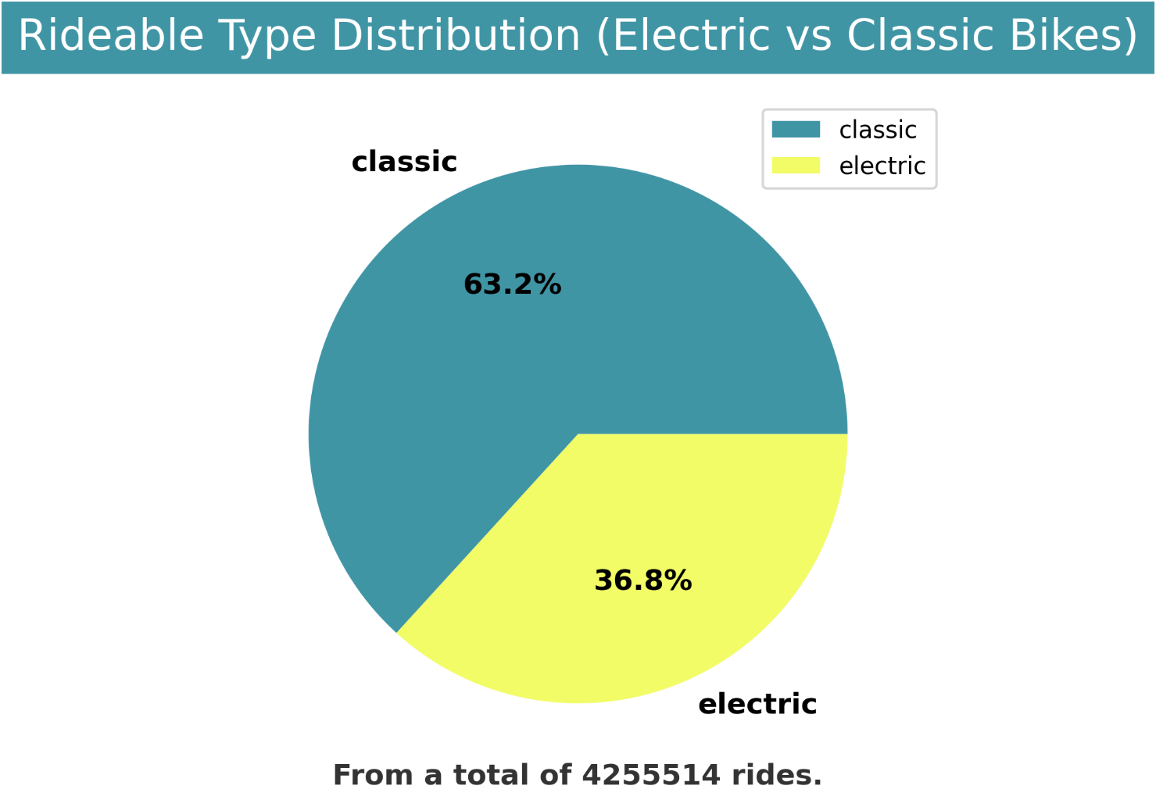
Pie Chart: Rideable Type Distribution (Electric vs Classic Bikes)
Main Takeaways
Dominant Usage: Classic bikes are significantly more popular than electric bikes, with over 63% of riders opting for classic bikes. This demonstrates a strong preference for classic bikes among the user base.
Opportunity for Expansion: The lower percentage of electric bike usage suggests room for growth. Increased promotion and awareness of electric bike benefits could help boost their adoption rate.

Slide 22
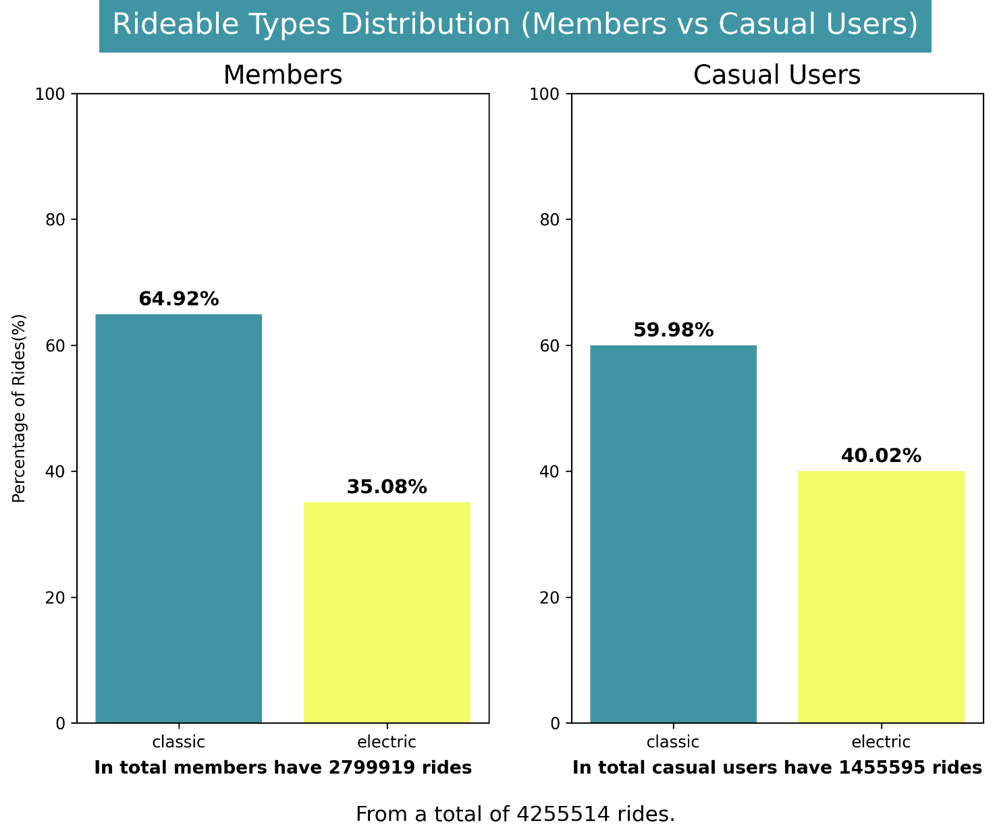
Bar Charts: Rideable Types Distribution (Members vs Casual Users)
Main Takeaways
Members:
Members prefer classic bikes: Among members, classic bikes are more popular. This indicates a stronger preference for classic bikes among members.
Casual Users:
Preference for classic bikes: Casual users prefer classic bikes also, but exhibit a more pronounced preference for electric bikes compared to members. This suggests that casual users may find electric bikes more appealing or convenient for their riding needs.

Slide 23
Conclusions

Slide 24
Conclusions recap
Rides Distribution:
Members account for 64% of total rides, while casual users represent 36%.
Weekly Ride Distribution: A distinction emerges between members and casuals—members tend to utilize the service more on weekdays, whereas casual users show higher activity levels on weekends.
Monthly Ride Distribution: Both members and casual users exhibit similar monthly ride patterns, with activity dipping during winter and peaking in summer. However, casual users display greater variability.
Ride Duration:
Weekly Mean Ride Duration: Both groups peak during weekends, with a more notable increase for members and a significant one for casual users, likely attributable to increased leisure time.
Members: Show consistent ride durations from Monday to Friday, indicating regular commuting habits or weekday usage patterns (possibly related to work commutes).
Casual Users: Exhibit greater variability in ride durations across different days of the week compared to members, with a more pronounced peak on weekends.
Bike Types:
Electric bikes constitute 36.8% of total rides, while classic bikes make up the remaining 63.2%.
Members Rideable Type Distribution: Members show a clear preference for classic bikes, possibly due to shorter ride durations for their weekday needs.
Casual Users Rideable Type Distribution: Casual users also prefer classic bikes but exhibit a more pronounced preference for electric bikes compared to members, indicating a higher preference or convenience for electric bikes among this group.

Slide 25
Recap: Members
Commute much more regularly and consistently all year around, using the services more during middle of the week, most likely to commute to work.
While having the same seasonal trends, use the bikes more consistently all year around (flatter distribution).
Have shorter ride durations, with a less variance across days or months, compared to casual users, and show consistent ride durations from Monday to Friday, indicating regular commuting habits and weekday usage patterns. Ride durations peek on weekends.
Members show a clear preference for classic bikes.

Slide 26
Recap: Casual Users
Commute less regularly and not consistently like members all year around, using the services more on weekends, most likely for leisure activities.
While having the same seasonal trends, use the bikes less consistently all year around (greater variance).
Have longer ride durations, with a lot more variance across days or months, compared to members, and exhibit greater variability in ride durations across different days of the week compared to members. Ride durations peek on weekends.
Casual users also prefer classic bikes but exhibit a more pronounced preference for electric bikes compared to members.

Slide 27
Suggestions

Slide 28
Suggestions
To Turn Casual Users into Members:
A New Tailored Membership Package: Introduce a membership package tailored to the preferences of casual users, such as weekend or Friday to Saturday memberships. This complementary option won't disrupt current memberships, which primarily serve weekday commuting needs.
Optimize Fleet and Pricing: Tailor the bike fleet and pricing structure to cater to the higher preference for electric bikes among casual users. Prioritize electric bikes in the fleet and adjust pricing accordingly to better align with their preferences.
Marketing Campaigns:
Post-April Advertising: Launch targeted advertising and social media campaigns after April, capitalizing on the significant increase in bike usage observed during this period, which peaks in summer. This strategic timing aims to maximize engagement and conversion rates.
Pre-September Promotional Offers: Implement promotional offers and incentives before September to boost customer retention during the anticipated autumn-winter drop-off in bike usage. By providing attractive discounts or perks, the service can encourage continued usage and loyalty among members and casual users alike.

Slide 29
Thank you

