Slide 1
Machine Learning for Success
Ibad, Patricia, Gergana, Diego

Slide 2

Hello!
We are In too deep
For this Hackathon we have chosen to take the Amazon challenge in a new direction:
We developed a Machine Learning-inspired solution for Higher Education.

Slide 3
1.
The idea
The Student dream:
Getting the highest grades and conserving your social life

Slide 4
The gist of it...
Machine Learning for Success (H.E):
Get tips from top achievers
Achieve a good GPA
Keep Social
Find People that can help you
Find out about your habits
Get meaningful feedback
Sleep well!

Slide 5
2.
Structure
The skeleton of a great project.

Slide 6
The Software
AWS:
S3 for cloud storage
Lambda for cloud computing
ML Solutions
Website Hosting
Python
MySQL
CSS

Slide 7
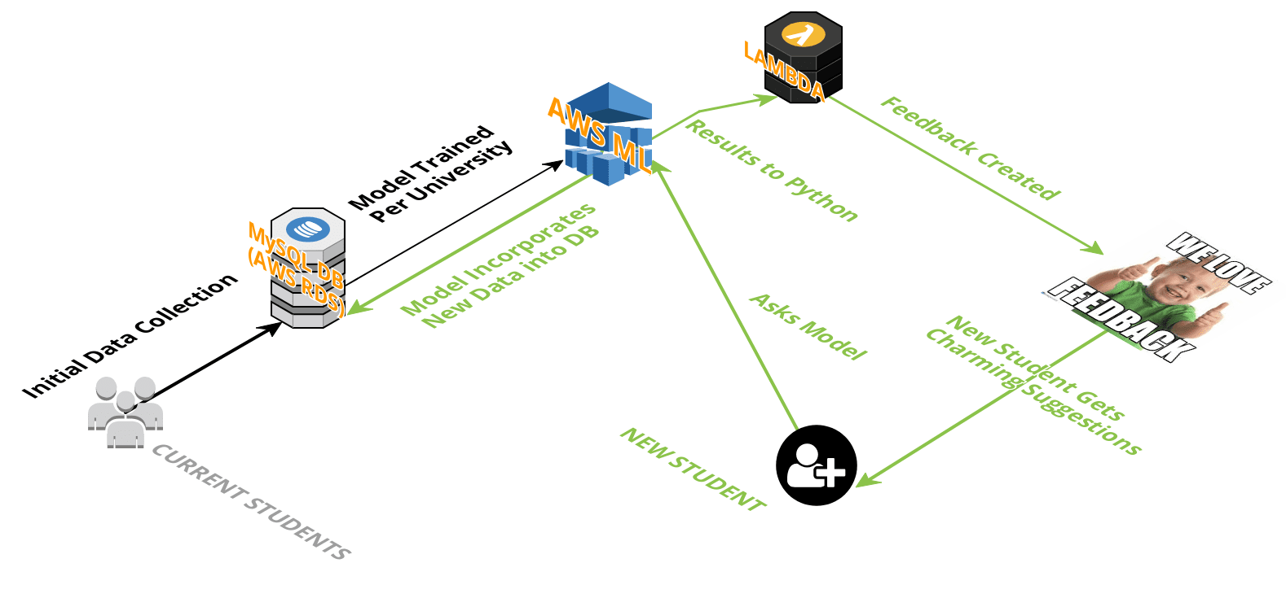
Architecture

Slide 8
DEMO TIME!

Slide 9
3.
Challenges we faced
Amazon Web Services Authorization
Creation of data
Fitting good ML model

Slide 10

4.
Future Work
Implement Buddy System
Graphs of whole Class (Anon.)
Have direct links to resources: Generate statistics related to usage and success rate – Compare Suggested to Outside-of-Course material

Slide 11
Thanks!
Any questions?

