Slide 1

Identifying Attractive Neighbourhoods in London for Opening an Upmarket Cocktail Bar Using Machine Learning and K-Means Clustering
Daumantas Dulius
31/01/2021

Slide 2
Background
Nationally, the night-time economy is the UK's fifth-biggest industry, accounting for at least 8% of the UK's employment and annual revenues of £66bn.
Of all of London’s most alluring venues and spaces, the capital’s seemingly endless array of chic and exclusive cocktail bars are perhaps the most inspiring. From ultra-lustrous sky bars overlooking the capital’s famous skyline and riverside to eccentric and quirky lounge bars in the heart of Shoreditch, all offering a sublime otherworldly experience seemingly disconnected from reality.
But if you were to pick but one neighbourhood in London to open up your very own high-end cocktail bar to maximise profits where would you choose? From Mayfair, Chelsea, Kensington to St Pauls, Bond Street, and Waterloo, the possibilities are endless.
Thankfully I have done the hard work for you, by utilising machine learning techniques I will present to you, London’s most appealing neighbourhood to open up your very own little piece of intoxicating heaven.

Slide 3
Data Acquisition & Cleaning
For this study I will make use of geospatial data mostly consisting of the geographical coordinates of each Inner London postcode’s centroid from OpenStreetMap, as well as venue data from Foursquare’ s API including a venue’s name, location, popularity, category, and so on. The data analysis and implementation of machine learning algorithms will be done in Python.
To begin, each postcode and associated neighbourhood and coordinates of its centroid were scraped and sourced from the web (OpenStreetMap) and compiled into a pandas data frame.
To obtain venue information within these postcodes, calls were made to Foursquare’ s API, where for each venue the following data was extracted:
Neighbourhood Latitude
Neighbourhood Longitude
Venue
Venue Latitude
Venue Longitude
Venue Category

Slide 4
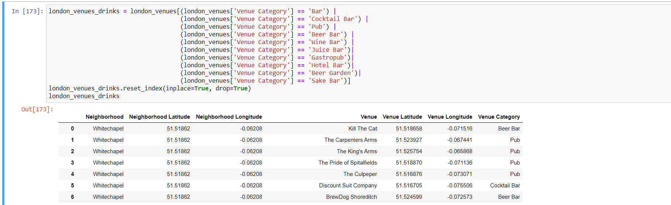
Data Acquisition & Cleaning (2)
The data frame containing the venue information for each area was further cleaned by filtering the entries down to night-time venues only, the first few rows are shown below.

Slide 5
Exploratory Data Analysis
Next, one hot encoding was applied to the filtered data and the proportion of each venue type within each post code was calculated.
At this stage the question arises of how to use the data in its current form to work out the most attractive neighbourhood in which to open up a cocktail bar. For simplicity it is assumed that areas with the highest concentration of cocktail bars are likely to be neighbourhoods where running such venues is highly profitable, as local demand is very high.
Thus naturally the next step was to sort each type of venue in each area by its frequency, giving us the ranking of how common each type of venue is for a given post code,
This data was then plotted as a bar chart shown on the next slide to give some indication on potential candidates, though further analysis had to be performed as a high fraction of cocktail bars in one area doesn’t necessarily mean it is the most common venue type in that area, in the next few slides I go through how K-means clustering was employed to further narrow down potential neighbourhood candidates.

Slide 6
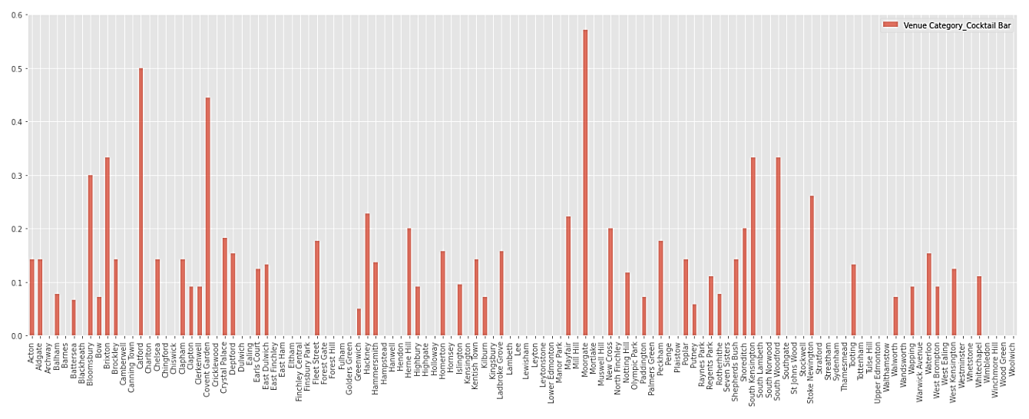
Exploratory Data Analysis (2)

Slide 7
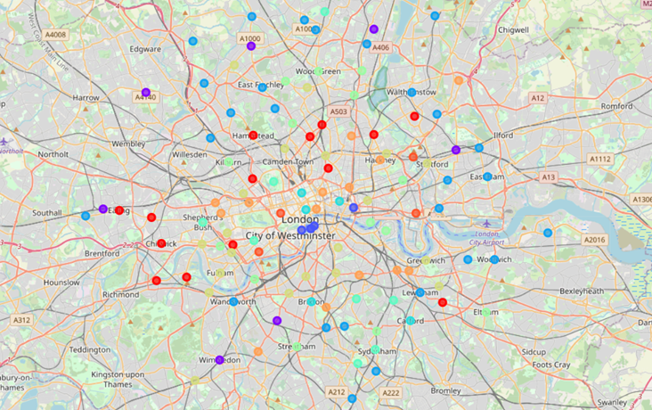
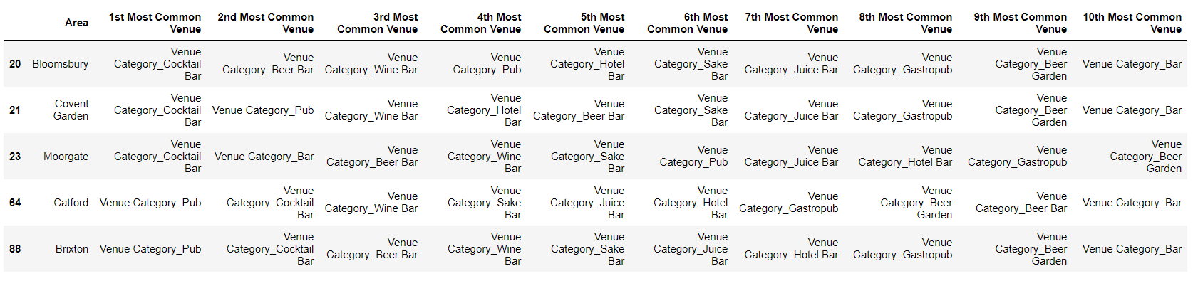
Implementation of the K-Means Clustering Algorithm
The K-means clustering algorithm is a machine learning method of vector quantisation, which aims to partition n observations into k clusters in which each observation belongs to the cluster with the nearest mean. In other words, observations with similar characteristics (in this case the most common venue types in a given post code) are grouped within the same cluster.
Upon inspection of the various clusters created using the K-means clustering algorithm, the cluster most suitable for our purposes was identified as cluster 4, shown below. This is because as shown, contained within this cluster are three areas with cocktail bars as the most common night-time venue for those respective post codes, and is the only cluster to contain such areas.

Slide 8
Recommendations
The three neighbourhoods identified above in Figure 3.1 with cocktail bars as their most common night-time venue are therefore:
Bloomsbury
Covent Garden
Moorgate
Of these three areas, Moorgate has the highest number of cocktail bars as a fraction of total night-time venues (57%) in the area, in fact it is the only London neighbourhood where cocktail bars make up the majority of night-time venues (excluding clubs).
Therefore this study recommends Moorgate (EC2) at the most appropriate neighbourhood for one to open up a lavish, new cocktail bar – due to the high local demand, though the other two areas highlighted above (Bloomsbury and Covent Garden) would also be very good options.

