Slide 1
bioSite: Ideas, Sketches and Inspiration
DeJanae Faison

Slide 2
Front-end Style Guide

Slide 3
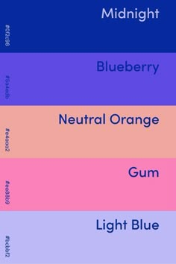
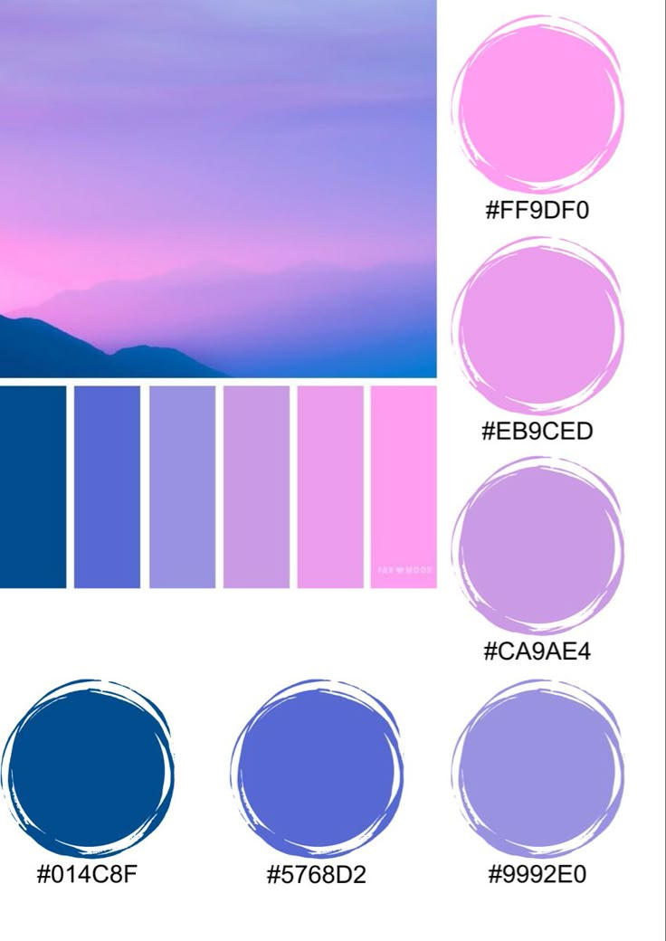
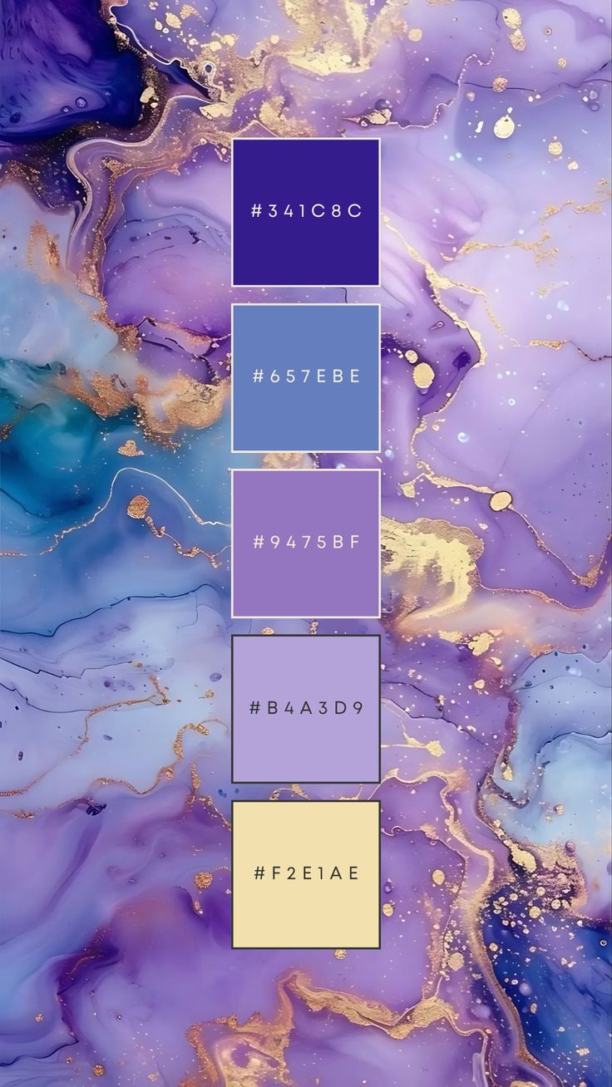
Front-end Style Guide: Color Palette Choices

Slide 4
Wireframes and Sketches

Slide 5
Interview:
What kind of hobbies do you enjoy?
“Metaphysics and decorating”
Do you feel your hobbies reflect who you are?
“Yes; always changing, growing, and evolving”
What is your greatest accomplishment?
“My Son”
Do you have any small goals?
“Yes, fixing up our new place”
Do you have any big goals?
“Yes, buying a house for my family”
Describe yourself in one word
“Human”
How will you achieve your goals?
“Make a check list and start checking things off”
What is a skill that you are particularly proud of?
“The ability to create whatever I think of”
What is your biggest drive/inspiration in life?
“My family”
You’re a new crayon in the box: What color would you be and why?
“Indigo fields; when I meditate it is always the first color I see in a giant field”

Slide 6
Short Bio

Slide 7
3 Hobby Images

Slide 8
3 Goals & Accomplishments Images

Slide 9
1 portrait

