Slide 1
Outland Adventures Solution
Vaneshiea Bell
Jess Monnier
DeJanae Faison

Slide 2
Blue Team Introduction
Jess: Technical Sergeant in the Air Force. Background in teaching (math) and in Korean language. Currently training into the cyber field in the Air Force.
DeJanae: Background in Front End and Gaming Development. 3D creator and currently working in Back End development.
Vee: Data Analyst at Waste Management specializing in route optimization, with a background in customer service, nail technology, and pursuing a Software Development degree

Slide 3

Outland Adventures Case Study
Founder Blythe Timmerson and Jim Ford wanted to share their hiking and camping passion by providing guidance and equipment to a wide audience
Goals:
Introducing people to the beauty and challenges of nature
Planning and guiding trips to various exciting locations
Offering equipment for purchase or rental
Needs addressed by our project:
Comparison of equipment rentals and purchases
Trends in trip destinations over time

Slide 4
Assumptions
Our case study focused on several key questions regarding Outland Adventures' operations, particularly examining the trends in trip sales across three target continental regions. We analyzed whether it was still viable to continue selling equipment, given potential shifts in demand, and assessed whether the equipment in stock had aged past its useful point—specifically, equipment that was over five years old. We made several important assumptions based on these factors:
First, we assumed that the age of equipment has a greater impact on rental items than on new equipment sales. Rental equipment, being used regularly by customers, experiences wear and tear that significantly affects its longevity and reliability. For instance, a piece of rental equipment with four years of regular use is likely to be in worse condition compared to an item that has sat unused in packaging for the same period. This distinction helped guide our analysis of the equipment's potential for future rentals and sales, and informed our recommendations regarding inventory management and equipment replacement.

Slide 5
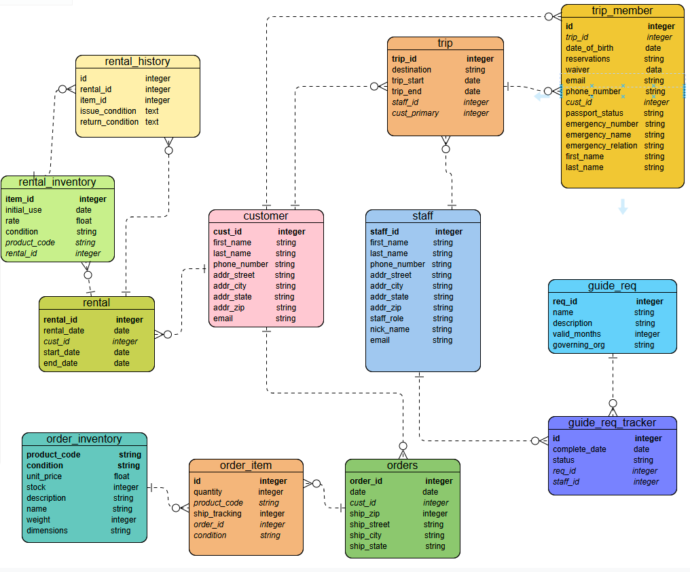
Finalized ERD

Slide 6
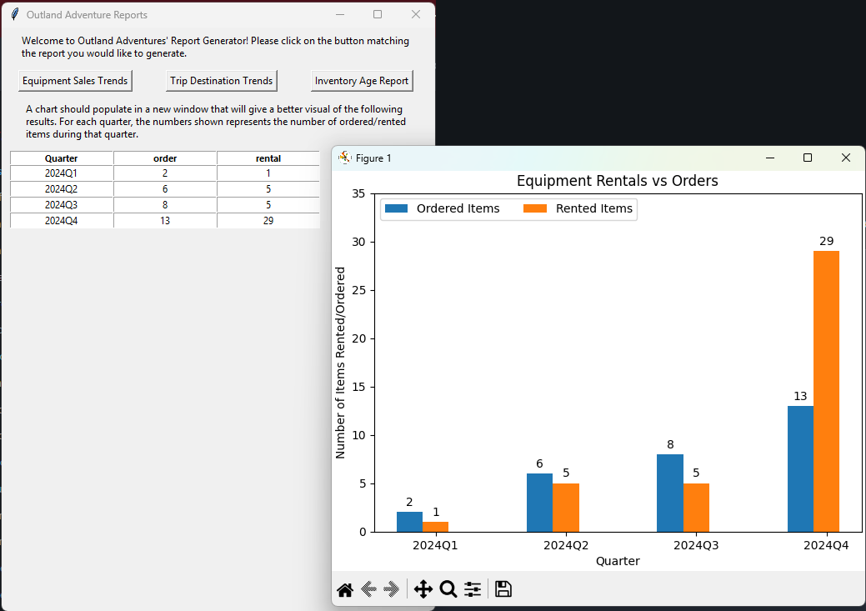
Report #1: Equipment Sales
The founders wondered whether the amount of equipment sales justified keeping new equipment on hand to sell.
To answer this question, we built a report that compared the number of items rented vs sold quarterly.
This report required some clever SQL querying:
A case to define the quarters
Grouping by quarter
Joining the rental and rental_history tables, as well as joining the order and order_item tables

Slide 7
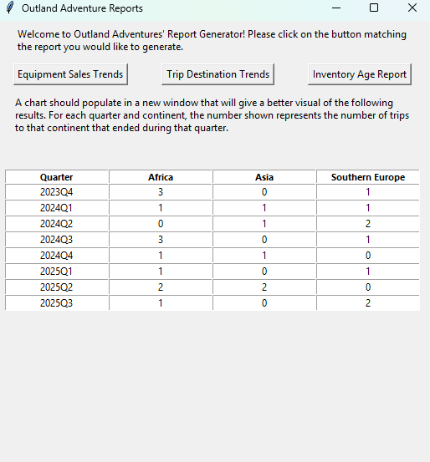
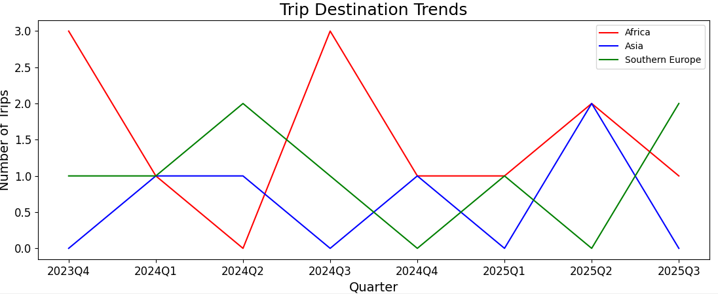
Report #2: Location Bookings
The founders of Outland Adventures are concerned that bookings to specific continental regions might be declining over time. Are there areas they should remove as options for trips?
To date, trips have been led to Africa, Asia, and Southern Europe.
Would a report on trips to these areas reveal a decline in bookings over time?
Answering these questions required some interesting SQL querying:
A case to group by quarter
Combining the use of substring, LIKE, and grouping to get the count of trips per continent

Slide 8
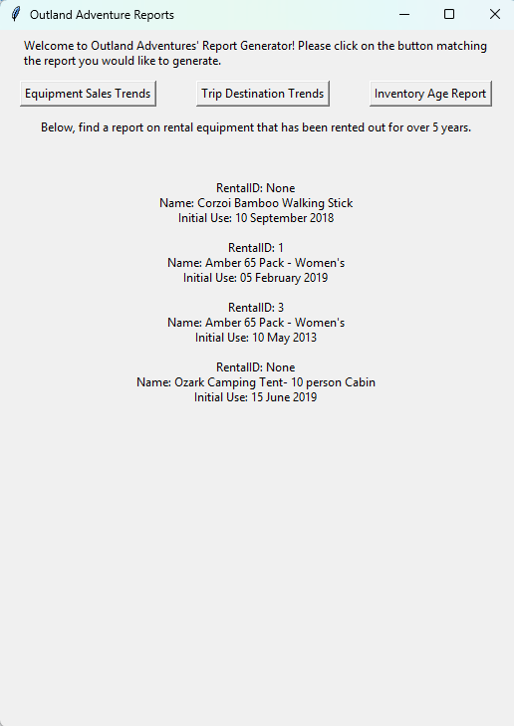
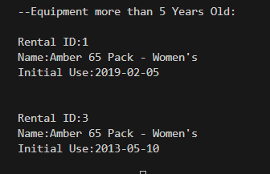
Report #3: Inventory Age
The founders were concerned about the age of their inventory
Any equipment over 5 years old should be accounted for
The query can be displayed in the table
Displaying all the inventory that is over 5 years old
This required using SQL's INNER JOIN functionality.
Above: The raw Python script results
Right: The results added to our tkinter report app

Slide 9
Conclusion
In conclusion, our case study on Outland Adventures provided valuable insights into their operations and inventory management. By analyzing the sales trends and rental data across different regions, we were able to assess the viability of continuing equipment sales, especially in terms of age and wear. The reports we generated helped address concerns about declining bookings in specific regions and identified equipment that needed replacement due to age. Through thoughtful SQL queries and data analysis, we delivered actionable recommendations, ensuring the founders could make informed decisions about their business strategies. Overall, this analysis highlighted the importance of data-driven decision-making in optimizing both the product offerings and the trip services provided by Outland Adventures, ultimately enhancing their ability to maintain a sustainable and profitable business model.

