Slide 1
Barriers and Challenges to Implementing a Just Culture
DeJanae Faison
M9-Establishing a Just, Learning Culture
Due 9.28.25

Slide 2
What is Just Culture?
It is an environment where accountability is held, mistakes are not shameful and learning is encouraged
“When engineers make mistakes and feel safe when giving details about it, they are not only willing to be held accountable, but also enthusiastic in helping the rest of the company avoid the same error in the future. This is what creates organizational learning.”
It is a cultivation of a tradition based on behaving according to what is morally right and fair

Slide 3
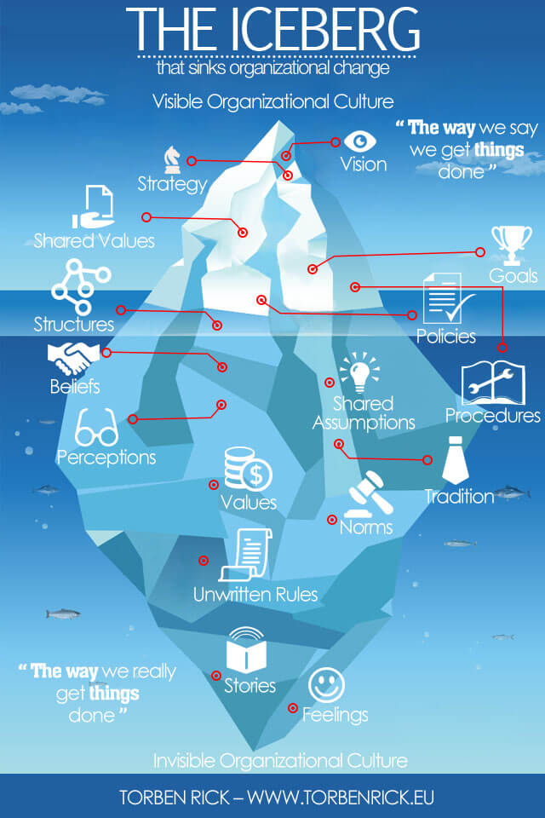

Slide 4
Benefits of a Just Culture

Slide 5
Barriers & Challenges: Part 1

Slide 6
Barriers & Challenges: Part 2

Slide 7
Resources:
Kim, G., Debois, P., Willis, J., Humble, J., & Allspaw, J. (2017). The DevOps handbook : how to create world-class agility, reliability, and security in technology organizations. It Revolution Press, Llc.
‌van Marum, S., Verhoeven, D., & de Rooy, D. (2022). The Barriers and Enhancers to Trust in a Just Culture in Hospital Settings: A Systematic Review. Journal of Patient Safety, Publish Ahead of Print(7). https://doi.org/10.1097/pts.0000000000001012
‌Overcoming Barriers to a Just Culture – Health Quality Alberta- Just Culture. (2025). Justculture.hqa.ca. https://justculture.hqa.ca/overcoming-barriers-to-a-just-culture/
Understand the Role of Culture and Resilience. (2025). Trailhead. https://trailhead.salesforce.com/content/learn/modules/continuous-innovation-with-copado/understand-the-role-of-culture-and-resilience
Rick, T. (2015, August 23). Corporate culture at Amazon hit by iceberg symptom. Torben Rick. https://www.torbenrick.eu/blog/culture/corporate-culture-at-amazon-hit-by-iceberg-symptom/
‌
‌
‌

