Slide 1
Barriers and Challenges to Implementing a Just Culture
DeJanae Faison
M9-Establishing a Just, Learning Culture
Due 9.28.25

Slide 2
What is Just Culture?
It is an environment where accountability is held, mistakes are not shameful and learning is encouraged
“When engineers make mistakes and feel safe when giving details about it, they are not only willing to be held accountable, but also enthusiastic in helping the rest of the company avoid the same error in the future. This is what creates organizational learning.”
It is a cultivation of a tradition based on behaving according to what is morally right and fair

Slide 3
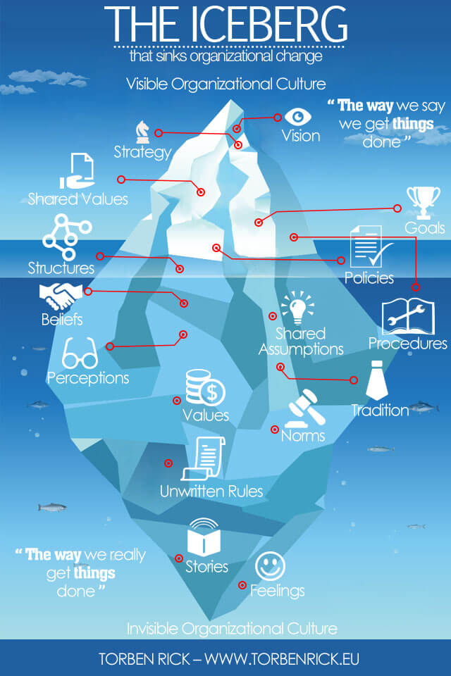
How Work Culture is more than it seems:

Slide 4
Benefits of a Just Culture
Increases incident and near miss reporting
Improves organizational learning and system thinking
Creates a resilient organization
Though a system will experience pitfalls, how to rebound from them will reflect on how the team runs
Strengthens staff trust and safety culture
When an incident occurs and not one individual is pinned, it creates a culture of safety

Slide 5
Barriers & Challenges: Part 1
Fear of punishment and blame
A research study in Health Care workers was done to understand the challenges of a Just Culture
“Factors such as a lack of confidence in clinical skills, more fear of shame/blame by less experienced workers, and knowledge of the existing error reporting system will influence a person’s trust in error reporting (experience)”
This feeling can be universal whether it is in a personal setting or any professional environment
But it is a natural need to shift blame to people
This can lead to Lack of Trust and Psychological Safety

Slide 6
Barriers & Challenges: Part 2

Slide 7
Overcoming the challenges
Blame
Lack of Openess

Slide 8
Key Take Aways

Slide 9
Resources:
Kim, G., Debois, P., Willis, J., Humble, J., & Allspaw, J. (2017). The DevOps handbook : how to create world-class agility, reliability, and security in technology organizations. It Revolution Press, Llc.
‌van Marum, S., Verhoeven, D., & de Rooy, D. (2022). The Barriers and Enhancers to Trust in a Just Culture in Hospital Settings: A Systematic Review. Journal of Patient Safety, Publish Ahead of Print(7). https://doi.org/10.1097/pts.0000000000001012
‌Overcoming Barriers to a Just Culture – Health Quality Alberta- Just Culture. (2025). Justculture.hqa.ca. https://justculture.hqa.ca/overcoming-barriers-to-a-just-culture/
Understand the Role of Culture and Resilience. (2025). Trailhead. https://trailhead.salesforce.com/content/learn/modules/continuous-innovation-with-copado/understand-the-role-of-culture-and-resilience
Rick, T. (2015, August 23). Corporate culture at Amazon hit by iceberg symptom. Torben Rick. https://www.torbenrick.eu/blog/culture/corporate-culture-at-amazon-hit-by-iceberg-symptom/
‌
‌
‌

