Slide 1
Barriers and Challenges to Implementing a Just Culture
DeJanae Faison
M9-Establishing a Just, Learning Culture
Due 9.28.25

Slide 2
What is Just Culture?
It is an environment where accountability is held, mistakes are not shameful and learning is encouraged
“When engineers make mistakes and feel safe when giving details about it, they are not only willing to be held accountable, but also enthusiastic in helping the rest of the company avoid the same error in the future. This is what creates organizational learning.”
It is a cultivation of a tradition based on behaving according to what is morally right and fair

Slide 3
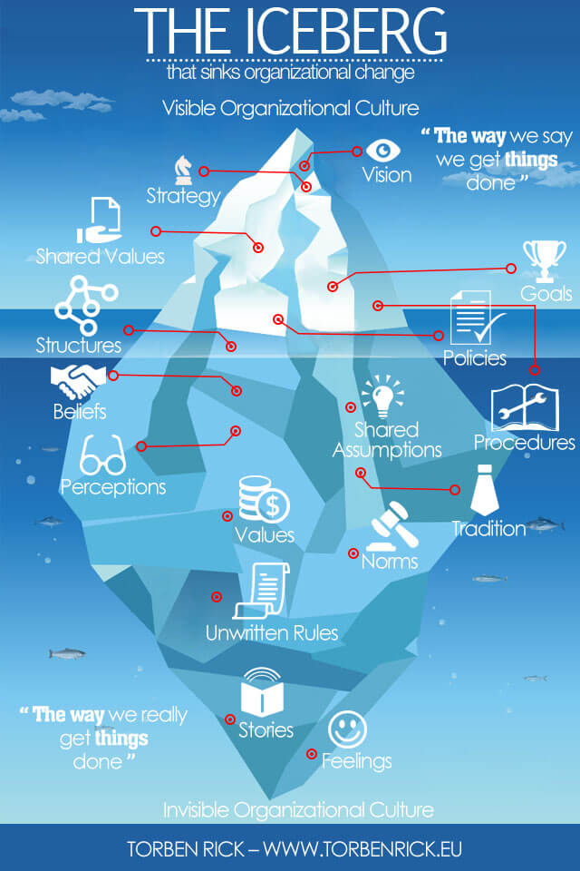
How Work Culture is more than it seems:

Slide 4
Benefits of a Just Culture
Increases incident and near miss reporting
Improves organizational learning and system thinking
Creates a resilient organization
Though a system will experience pitfalls, how to rebound from them will reflect on how the team runs
Strengthens staff trust and safety culture
When an incident occurs and not one individual is pinned, it creates a culture of safety

Slide 5
Barriers & Challenges: Part 1
Fear of punishment and blame
A research study in Health Care workers was done to understand the challenges of a Just Culture
“Factors such as a lack of confidence in clinical skills, more fear of shame/blame by less experienced workers, and knowledge of the existing error reporting system will influence a person’s trust in error reporting (experience)”
This feeling can be universal whether it is in a personal setting or any professional environment
But it is a natural need to shift blame to people
This can lead to Lack of Trust and Psychological Safety

Slide 6
Barriers & Challenges: Part 2
Resource Constraints
Having limited time, spending, or any resource it can be easy for a team to shift their values
Where the team may know what is just however can not adhere to them because of the restraints
On the other end of the process, if there is something that goes wrong, they may not have time to reflect and learn from those events

Slide 7
Overcoming the challenges
Blame
Avoid snappy and quick judgements
Identify areas of weakness rather than problems of people
Lack of Openness
Make it available to team how to make an appropriate response if something goes bad
Establish leadership, communication methods and other forms of structure from the start

Slide 8
Key Take Aways
DevOps is more than its technical knowledge and dense know how
It requires a cultural shift within the organization
Openness is key
The culture is how the status quo is changed

Slide 9
Resources:
Kim, G., Debois, P., Willis, J., Humble, J., & Allspaw, J. (2017). The DevOps handbook : how to create world-class agility, reliability, and security in technology organizations. It Revolution Press, Llc.
‌van Marum, S., Verhoeven, D., & de Rooy, D. (2022). The Barriers and Enhancers to Trust in a Just Culture in Hospital Settings: A Systematic Review. Journal of Patient Safety, Publish Ahead of Print(7). https://doi.org/10.1097/pts.0000000000001012
‌Overcoming Barriers to a Just Culture – Health Quality Alberta- Just Culture. (2025). Justculture.hqa.ca. https://justculture.hqa.ca/overcoming-barriers-to-a-just-culture/
Understand the Role of Culture and Resilience. (2025). Trailhead. https://trailhead.salesforce.com/content/learn/modules/continuous-innovation-with-copado/understand-the-role-of-culture-and-resilience
Rick, T. (2015, August 23). Corporate culture at Amazon hit by iceberg symptom. Torben Rick. https://www.torbenrick.eu/blog/culture/corporate-culture-at-amazon-hit-by-iceberg-symptom/
Yuson, I. G. (2024, April 12). DevOps: not a role, but a culture - Ingenuity - Medium. Medium; Ingenuity. https://medium.com/ingenuity-ph/devops-not-a-role-but-a-culture-5fe016b3626f
‌

