Slide 1
Technology Value Stream
DeJanae Faison
Module 1.2 Assignment
Due 8.17.25

Slide 2

What is the Technology Value Stream?
Process of turning a business hypothesis into a product or service
Product or Service delivers a value to the customer or stakeholder
Work flow that starts as an idea, planned, implemented in code, deployed and given value
Focus is on the work itself and the flow of value
To create something ‘tangible’
Ensuring a fast flow without causing disruptions, and if they do occur the flow will continue smoothly

Slide 3
Value Stream, Value Stream Management and Value Stream Mapping
A quick breakdown:
 | Value Stream | Value Stream Management | Value Stream Mapping
Definition | Actual flow of work delivering value | Practice of measuring and improving the value stream | Visual diagram of value stream
When | Ongoing, the actual process | Ongoing operational practice | Periodically done time-bound activity
Output | Product/Service | Metrics or improvements made from product or service | Map

Slide 4
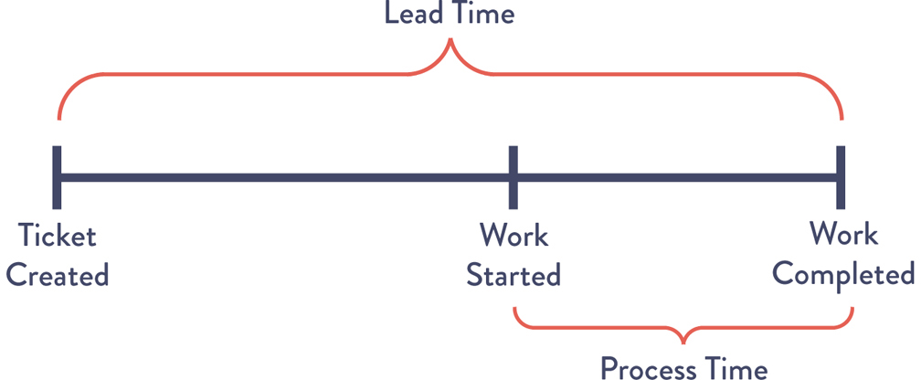

Lead Time vs Processing Time
Lead Time
Lead Time is the overall timeline that sandwiches when a request is made and when the request has been completed
The request can include updates or new features
What the customer experiences
Shorter lead time = happier customers

Slide 5

Lead Time vs Processing Time
Processing Time
Portion within the lead time
Time it takes actually working on the request
From start to finish
This does not include waiting and queue times

Slide 6

The Common Scenario: Deployments taking Months
Sometimes, Deployments can need months
Deployment can mean updates, patches, or overall, all making the software available for its audience
It takes months when organizations are complex, scarce resources or tightly coupled systems
Result: changes sit in queues, integration occurs rarely, releases become risky and slow — lead time measured in weeks to months. Business impact: slower feedback loops, reduced agility, higher risk on each release.
This can slow down the Technology Value Stream
Deployment at a snail’s pace

Slide 7

Our DevOPS Ideal: Deployment Lead times of Minutes
In a perfect world, fast constant feedback allows for fast implantation and integration time
This can be achieved with:
Integration of automation
Continuously checking small changes
Exploratory testing
Modular architecture
Loosely coupled
Well encapsulation
This Photo by Unknown Author is licensed under CC BY-SA-NC
Deployment as fast as a swordfish

Slide 8
Metrics to track
How do we keep track of the stream? Here is a number of things to help create a sense of time
Number of work items completed in a set time period
Helps when understanding of the pacing of the project
The proportion between work items worked on at the time and how much time has passed (in other words tracking how long it takes to complete the work item)
Change failure rate

Slide 9

Next Steps…
Map your technology value stream end-to-end (visualize queues & handoffs).
Measure current lead time and processing time separately.
Identify largest queue(s) and risky handoffs.
Pilot small-batch CI/CD flow on one product/team.
Track metrics and iterate (aim for incremental reductions).

Slide 10
Thank you for your time

Slide 11
Resources
OpenAI. (2023). ChatGPT (Feb 13 version) [Large language model]. https://chat.openai.com
‌Kim, G., Debois, P., Willis, J., Jez Humble, & Allspaw, J. (2021). The DevOps handbook : how to create world-class agility, reliability, & security in technology organizations. It Revolution Press, Llc.
Kenton, W. (2024, June 5). What is Lead Time? Investopedia. https://www.investopedia.com/terms/l/leadtime.asp
‌What Is Software Deployment? (2023, June 26). PagerDuty. https://www.pagerduty.com/resources/continuous-integration-delivery/learn/what-is-software-deployment/
‌

