Slide 1
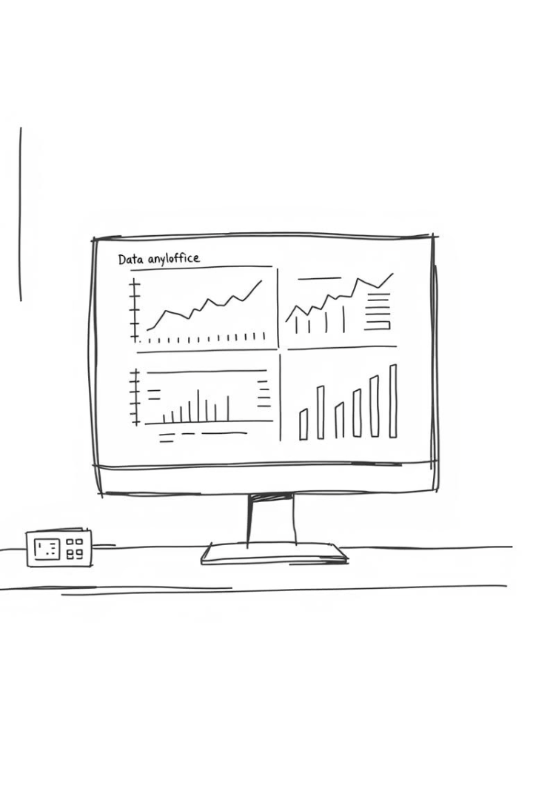
Bank Customer Churn Prediction
Presented by Denis Githaka. This project predicts bank customer churn using machine learning.
by Denis Githaka
DG

Slide 2
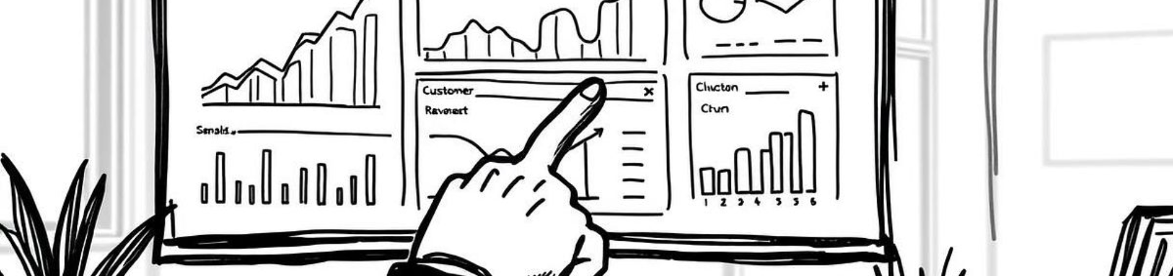
Project Overview
Understand Customer Churn
Predict Churn Using ML
Deploy Insights
Analyze factors driving customer turnover.
Use multiple algorithms to estimate churn risk.
Present predictions via an interactive Streamlit app.

Slide 3
Dataset & Structure
Dataset Details
Project Components
10,000 customers without missing data
Data and notebooks
Features: CreditScore, Age, Balance, Products
Streamlit app for predictions
Target: Churn status (Exited)
Saved ML models
Documentation files

Slide 4
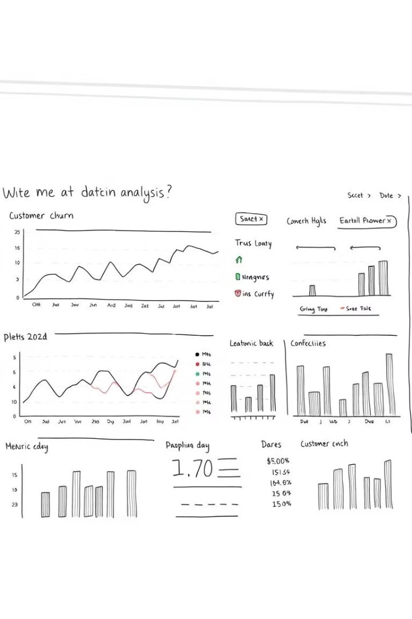
Exploratory Data Analysis
Churn Proportion
Categorical Trends
About 20% customers churn; dataset imbalanced.
Higher churn among Germany & Spain customers, females, inactive members.
Continuous Variables
Age, balance, and product count impact churn; salary less so.

Slide 5
Feature Engineering & Preprocessing
Feature Engineering
Data Preprocessing
BalanceSalaryRatio
Dropped customer IDs
TenureByAge
One-Hot Encoding for categorical data
CreditScoreGivenAge
Min-Max scaling for numeric features
Custom pipeline for deployment

Slide 6



Model Selection & Evaluation
Models Explored
Evaluation Metrics
Logistic Regression
Recall to catch all churn cases
SVM with RBF and Polynomial kernels
Precision for targeting churn correctly
Random Forest
F1-score and ROC AUC balance
XGBoost

Slide 7
Best Model & Streamlit App
Random Forest Performance
App Features
Precision: 0.88
Single and batch predictions
Recall: 0.53
Form input or CSV upload
F1-score: 0.66
Feature importance visualization
Accuracy: 0.95
Interactive exploratory data analysis

Slide 8
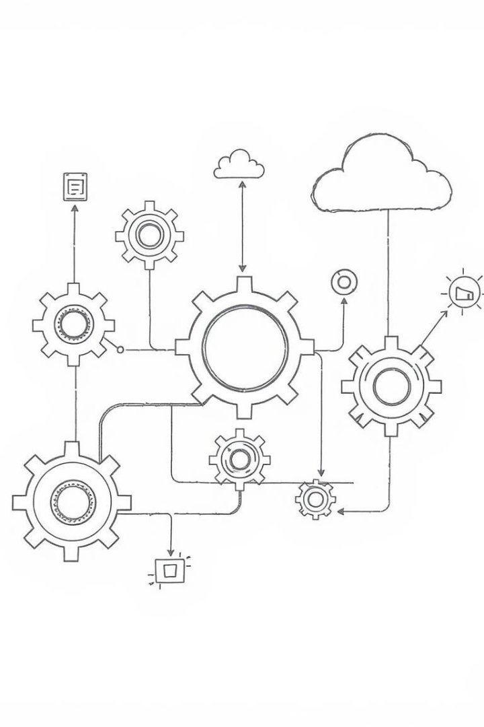
Future Work & Closing
Next Steps
Improvements
Add SHAP/LIME for model explainability.
Address class imbalance with SMOTE; deploy via Docker.
Automation
Incorporate CI/CD pipelines for continuous integration.
Thank you! Questions welcome. See GitHub and Kaggle for code and data.

