Slide 1

ProjectWorkPhase1(19CS702) – Review 1
A NUTRIENT RECOMMENDATION SYSTEM WITH CLIMATE PREDICTION USING RANDOM FOREST ALGORITHM
Submitted by:
DIVYA S (212221040043)-CSE
MATLIN LIGINSHA M (212221040104)-CSE
2021-2025 Batch
TEAM NO:2
Under the guidance of:
Mr.Anish Kumar
Associate professor,Department of AI
DEPARTMENT OF COMPUTER SCIENCE AND ENGINEERING
SAVEETHA ENGINEERING COLLEGE
(Autonomous Institution – UGC, Govt. of India)
(Affiliated to Anna University, Approved by AICTE - Accredited by NBA & NAAC – ‘A’ Grade - ISO 9001:2015 Certified)
Saveetha Nagar, Thandalam, Chennai-602 105, TamilNadu, INDIA.

Slide 2
Agenda
Introduction
Abstract
Purpose of your project
Proposed Methodology
Expected results and its Implications
Literature review
Project Plan
Conclusion
References

Slide 3
Introduction
Agriculture plays a very important role in national economic growth. Agriculture contributes 17-18% to India's GDP and ranks second worldwide in farm outputs.
Plants need fertilizers and fertilizers replace the nutrients which crops take from the top layer of the soil. The absence of fertilizers can cause a drastic reduction in the volume of crop output. But fertilization requires precise action.
Rainfall patterns and the amount of nutrients needed for a certain crop must be considered when using fertilizers.
The proposed model also uses a machine learning algorithm (random forest algorithm with k-fold cross validation technique) and takes two inputs from the user that are crop and location. After applying the algorithm, the model predicts the amount of nutrients required along with the best time to use fertilizers. The website is built using Flask Python (web framework) to provide access on all platforms and can be shared among users.

Slide 4
ABSTRACT
Fertilizer use is typically under the limited control of farmers. For the farmers to achieve higher yields and reduce fertilizer loss, competent guidance is required for the best use of these fertilizers.
There is a connection between rainfall volume and nutrient loss for various fertilizer applications after each rainfall event. Rainfall that is moderate and falls at the right moment can help nutrients penetrate the soil's rooting zone and dissolve dry fertilizer.
However, too much rain can increase the possibility of runoff and the pace at which nutrients like nitrogen (N) which is quintessential, phosphorus (P), and potassium (K) which are crucial, manganese (Mn), and boron (B) that are present in the soil. This research presents nutrient recommendations using an updated iteration of the random forest algorithm which is based on time-series data to forecast the required quantity of nutrients for various crops by examining rainfall patterns and crop fertility.

Slide 5
Purpose of the project
In this study, a predictive model for the nutrients required for crops was obtained using random forest. Random Forest Regression represents the model with K-Fold Cross Validation technique and the model with acceptable accuracy for the prediction is then obtained.
The algorithm requires input from the user (such as location and cropping). The location is fed to the Weather API which will return certain characteristics (e.g. temperature, humidity, rainfall) and if there is a possibility of heavy rainfall, a precautionary message is displayed to the user; otherwise, the proposed algorithm is followed.

Slide 6
Proposed Methodology
In this study, a predictive model for the nutrients required for crops was obtained using random forest. Random Forest Regression represents the model with K-Fold Cross Validation technique and the model with acceptable accuracy for the prediction is then obtained.
The algorithm requires input from the user (such as location and cropping). The location is fed to the Weather API which will return certain characteristics (e.g. temperature, humidity, rainfall) and if there is a possibility of heavy rainfall, a precautionary message is displayed to the user; otherwise, the proposed algorithm is followed.

Slide 7
Expected Results and Implications
To accurately determine whether a specific crop can be grown in a typical soil land based on the soil's nitrogen (N), potassium (K), and phosphorus (P) content. Additionally, provide a list of crops suitable for the soil and forecast the next 7 days of climatic conditions.

Slide 8
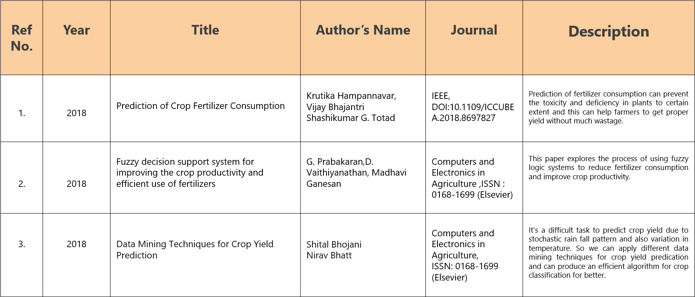
Literature Review
.

Slide 9
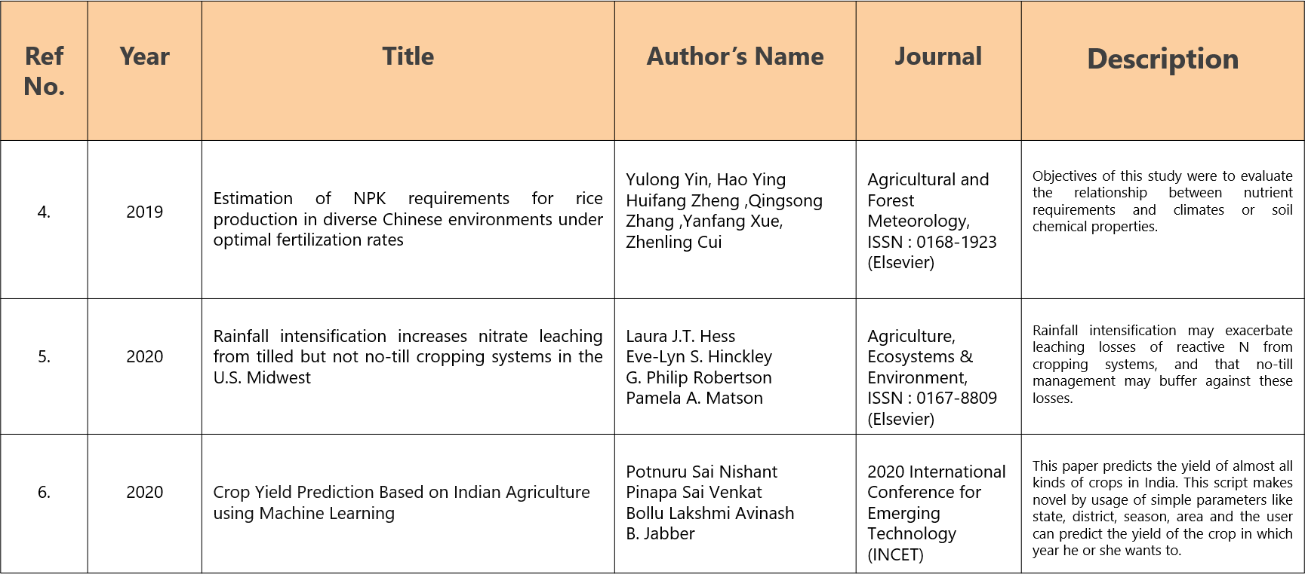
Literature Review
.

Slide 10
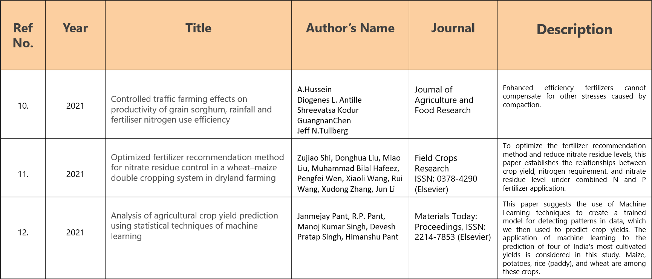
Literature Review
.

Slide 11
Scope of the project
The project provides valuable support to the agriculture sector, particularly for small- and medium-scale farmers who may lack access to advanced agronomy services. The model not only helps optimize fertilizer usage but also offers actionable insights that aid in mitigating water pollution by reducing the risk of nutrient leaching. Additionally, it assists farmers in planning fertilization activities based on real-time weather data, minimizing the chances of nutrient runoff due to heavy rainfall.
Future enhancements include expanding accessibility by introducing native-language support and incorporating speech recognition to accommodate users who may be unfamiliar with English or unable to read. These additions will make the platform more user-friendly for diverse demographics, thereby promoting broader adoption of eco-fertilization practices across regions.

Slide 12
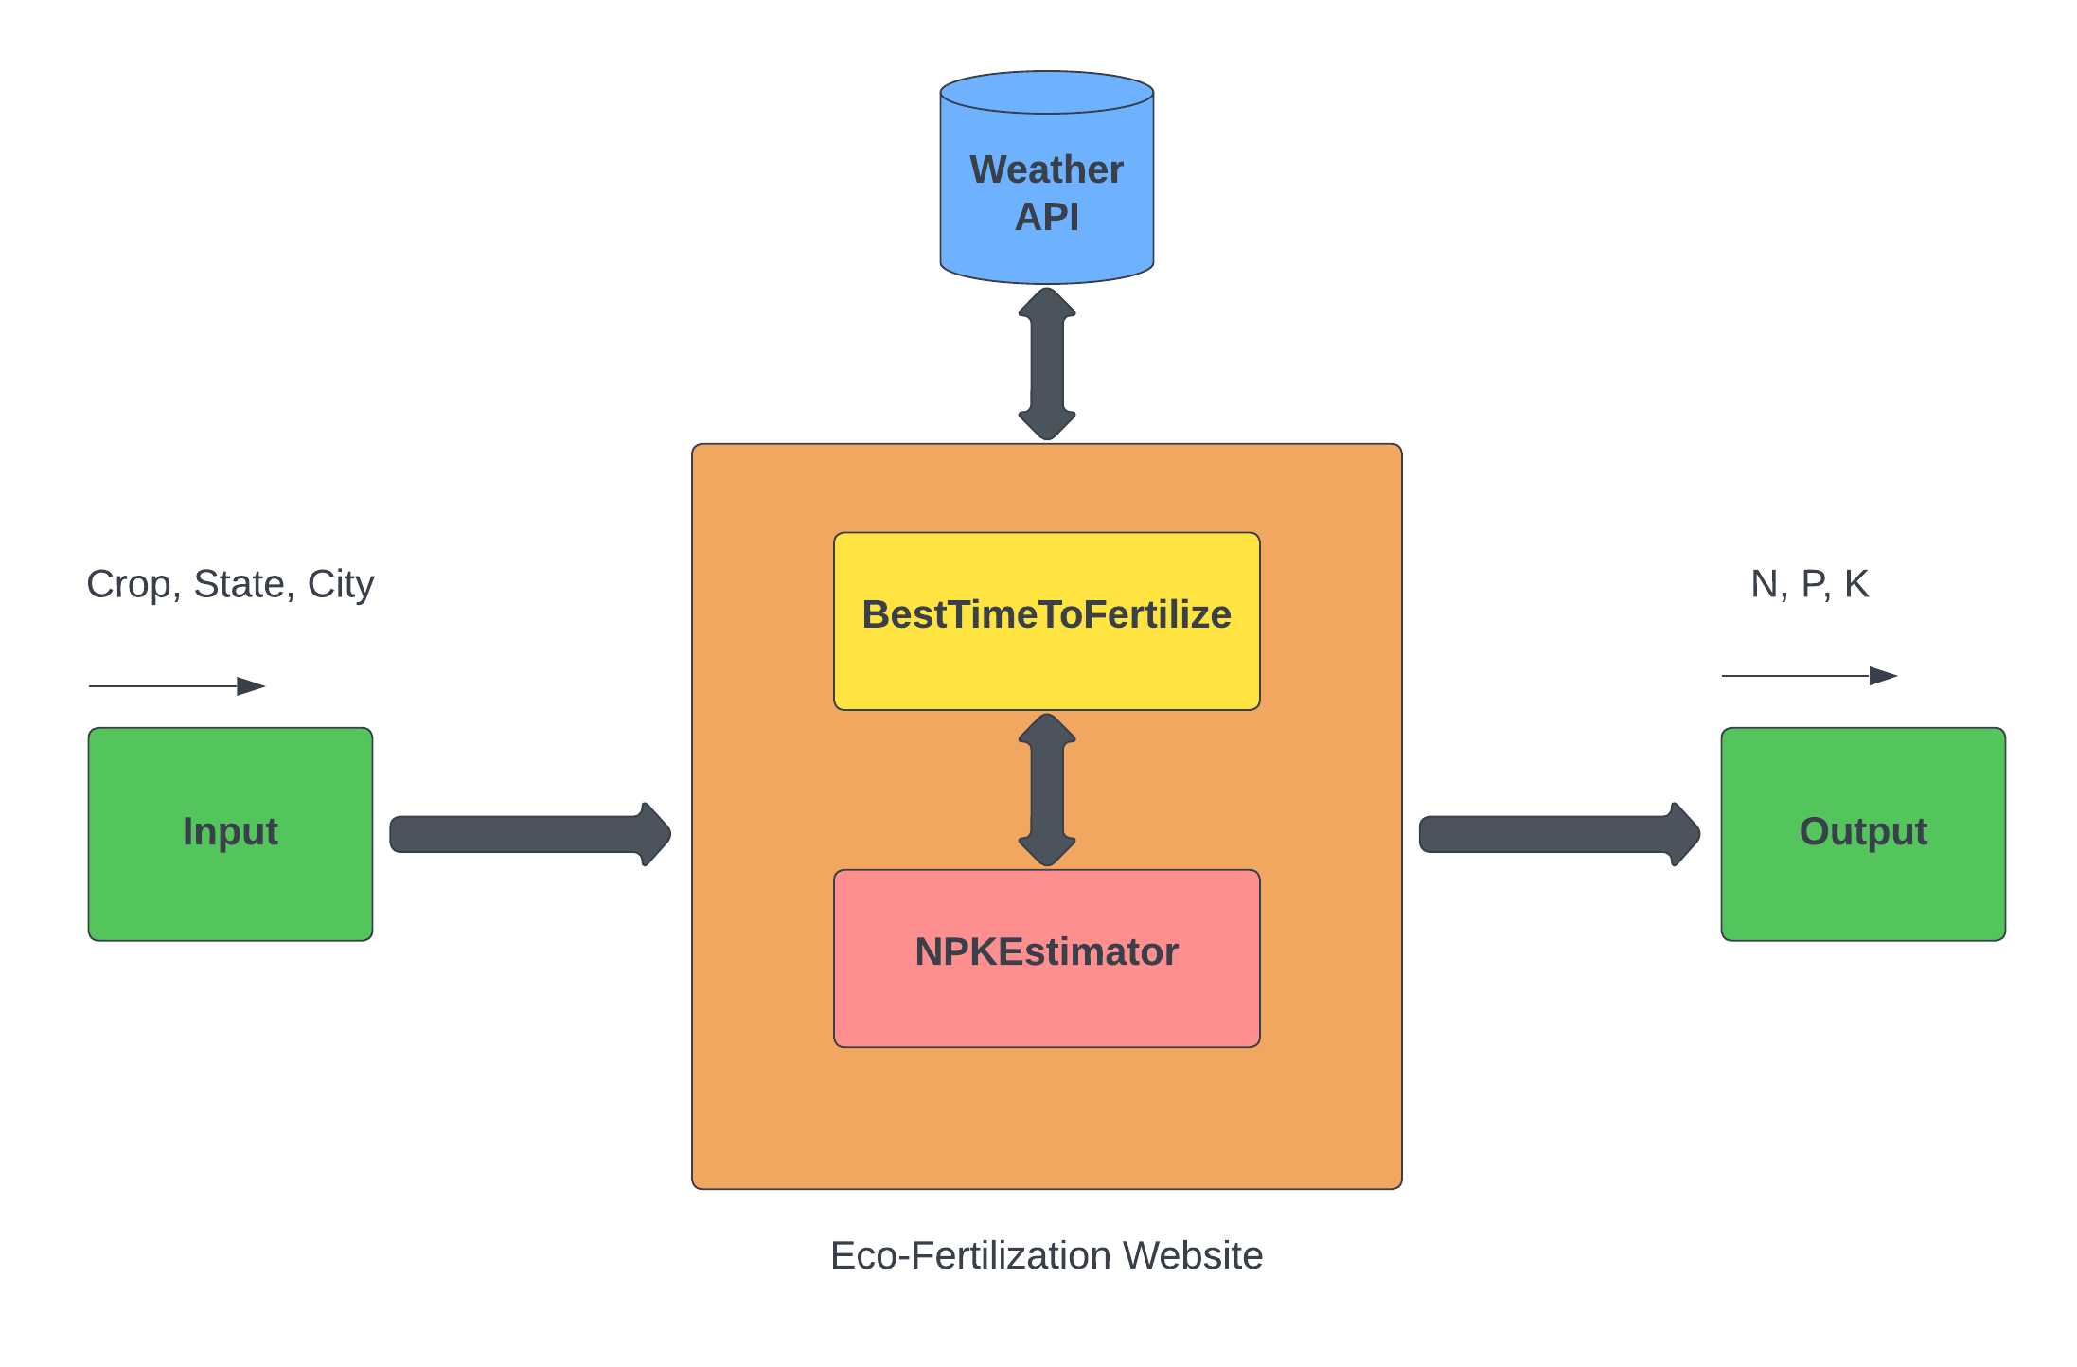
ARCHITECTURE DIAGRAM

Slide 13
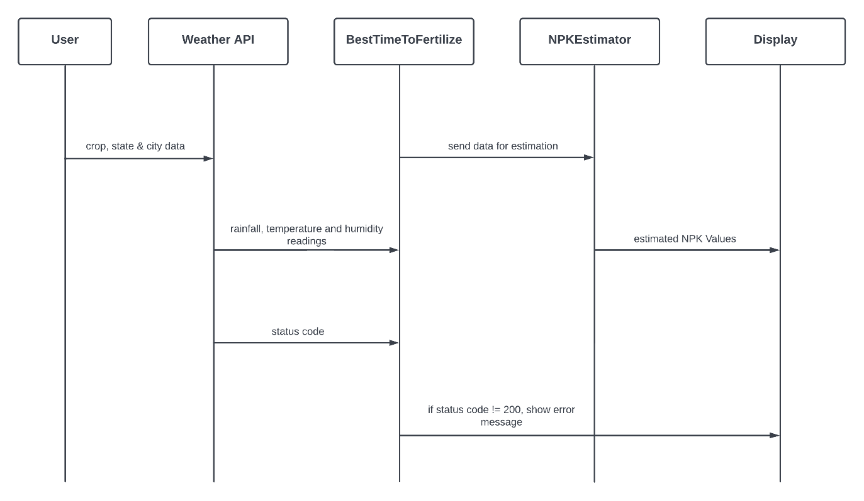
SEQUENCE DIAGRAM

Slide 14
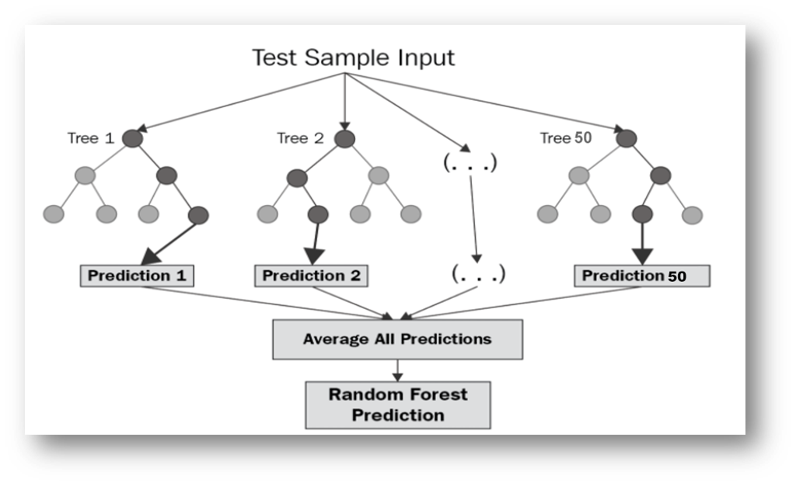
IMPLEMENTATION
Random Forest Regression
A group of several decision trees called a random forest (RF) are trained using different subsets of data and have changeable hyper-parameters. In our project, we are going to take crop and location as input, and based on it, we will predict the value of N, P, and K. First, we will divide our dataset into training and test datasets, where the training dataset is 80% of the original data and the rest 20% is test data.

Slide 15
WORKFLOW
The workflow,
Step 1: The dataset of size n = 2200 is divided into training and test dataset (where the raining set is 80% and the test set is 20% that is training set=1,760 and the test set=240).
Step 2: Apply random forest regression to each N, P and K (Nitrogen, Phosphorus & Potassium) value with n estimators=50 (n estimators is the number of decision trees).
Step 3: Train the N Label, P Label and K Label with the training dataset and dependent variable (Where the dependent variable is N for N Label, P for
P Label and K for K Label).
Step 4: Each N Label, P Label and K Label generates a 50-decision tree as an output based on the training dataset.

Slide 16
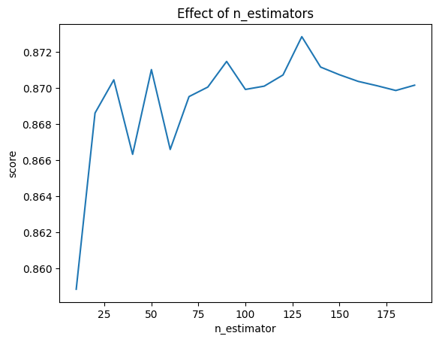
CODE
Optimizing the Number of Estimators for a Random Forest Model estimators = np.arange(10, 200, 10)
scores = []
for n in estimators:
model.set_params(n_estimators=n)
model.fit(X_train, y_train)
scores.append(model.score(X_test, y_test))
plt.title("Effect of n_estimators")
plt.xlabel("n_estimator")
plt.ylabel("score")
plt.plot(estimators, scores)

Slide 17
CODE
crop = input("Enter crop name: ").strip()
city = input("Enter city name: ").strip()
state = input("Enter state name: ").strip()
bttf = BestTimeToFertilize(city_name=city, state_name=state)
response_code = bttf.api_caller()
if bttf.is_api_call_success():
alert_type, alert_message = bttf.best_time_fertilize()
print("\n7-Day Weather Report:")
for day in bttf.weather_data:
print(f"Date: {day['Date']}, Temperature: {day['Temperature']}°C, "
f"Relative Humidity: {day['Relative Humidity']}%, Rainfall: {day['Rainfall']} mm, "
f"Probability of Precipitation: {day['Probability of Precipitation']}%")

Slide 18
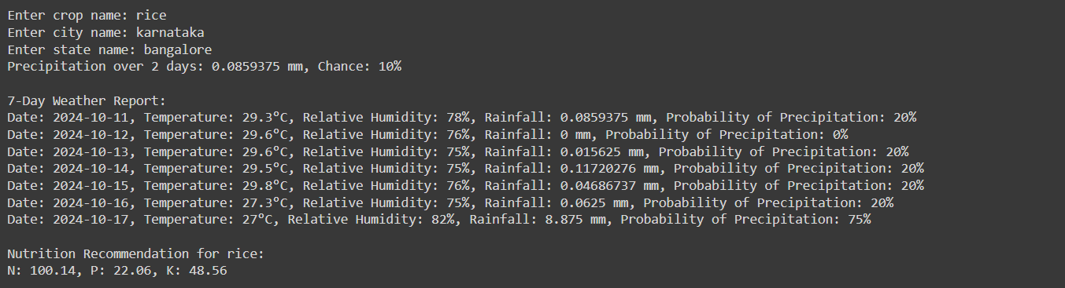
OUTPUT

Slide 19
Conclusion
By accurately analyzing the soil’s nitrogen (N), potassium (K), and phosphorus (P) content, it becomes possible to determine which crops can thrive in the given soil conditions. Matching the nutrient levels with the crop requirements ensures optimal growth and yield potential. Additionally, factoring in the 7-day weather forecast helps in making informed decisions regarding the timing of planting, irrigation, and other agricultural activities, enhancing the likelihood of success. This holistic approach to soil analysis and climate forecasting enables farmers to maximize productivity while reducing the risks associated with unfavorable conditions.

Slide 20
References
[1] Krutika Hampannavar,Vijay Bhajantri,Shashikumar G. Totad , “Prediction of Crop Fertilizer Consumption,” Fourth International Conference on Computing Communication Control and Automation (ICCUBEA), 2018, PP. 1-5
[2] G. Prabakaran,D. Vaithiyanathan, Madhavi Ganesan , “Fuzzy decision support system for improving the crop productivity and efficient use of fertilizers ,” Computers and Electronics in Agriculture, vol-150, 2018, PP. 88-97
[3] Shital Bhojani,Nirav Bhatt, “Data Mining Techniques for Crop Yield Prediction,” Computers and Electronics in Agriculture, vol-6, 2018, PP. 357-358
[4] Yulong Yin, Hao Ying,Huifang Zheng ,Qingsong Zhang ,Yanfang Xue,Zhenling Cui , “Estimation of NPK requirements for rice production in diverse Chinese environments under optimal fertilization rates ,” Agricultural and Forest Meteorology, vol-279, 2019, PP. 1-6
[5] Laura J.T. Hess,Eve-Lyn S. Hinckley,G. Philip Robertson,Pamela A. Matson , “Rainfall intensification increases nitrate leaching from tilled but not no-till cropping systems in the U.S. Midwest ,” Agriculture, Ecosystems & Environment, vol-290, 2020, PP. 1-10
[6] Potnuru Sai Nishant,Pinapa Sai Venkat,Bollu Lakshmi Avinash,B. Jabber , “Crop Yield Prediction Based on Indian Agriculture using Machine Learning,” 2020 International Conference for Emerging Technology (INCET), 2020, PP. 1-4
[7] Tony Yang,Kadambot H.M. ,Siddique,Kui Liu , “Cropping systems in agriculture and their impact on soil health ,” Global Ecology and Conservation, vol-23, year, PP. 1-13
[8] János Kátai,Ágnes Oláh Zsuposné,Magdolna Tállai,Tarek Alshaal, “Would fertilization history render the soil microbial communities and their activities more resistant to rainfall fluctuations? ,” Ecotoxicology and Environmental Safety, vol-201, 2020, PP. 1-11
[9] Usman Ahmed,Jerry Chun-Wei Lin, Gautam Srivastava,Youcef Djenouri , “A nutrient recommendation system for soil fertilization based on Evolutionary Computation,” computers and Electronics in Agriculture, vol-189, 2021, PP. 1-7
[10] A.Hussein , Diogenes L. Antille , Shreevatsa Kodur , GuangnanChen,Jeff N.Tullberg , “Controlled traffic farming effects on productivity of grain sorghum, rainfall and fertiliser nitrogen use efficiency,” Journal of Agriculture and Food Research, vol-3, 2021, PP. 1-17
[11] Zujiao Shi, Donghua Liu, Miao Liu, Muhammad Bilal Hafeez, Pengfei Wen, Xiaoli Wang, Rui Wang, Xudong Zhang, Jun Li , “Optimized fertilizer recommendation method for nitrate residue control in a wheat–maize double cropping system in dryland farming ,” Field Crops Research , vol-271, 2021, PP. 1-10

Slide 21
References
[12] Janmejay Pant, R.P. Pant, Manoj Kumar Singh, Devesh Pratap Singh, Himanshu Pant , “Analysis of agricultural crop yield prediction using statistical
techniques of machine learning ,” Materials Today: Proceedings, vol-46, 2021, PP. 1-10
[13] Benny Antony , “Prediction of the production of crops with respect to rainfall.,” Environmental Research, vol-202, 2021, PP. 1-5
[14] Akash Manish Lad, K. Mani Bharathi, B. Akash Saravanan, R. Karthik, “Factors affecting agriculture and estimation of crop yield using supervised learning
algorithms ,” Materials Today: Proceedings,, 2022, PP. 1-10
[15] Raves Akhtar, Shabbir Ahmad Sofi, “Precision agriculture using IoT data analytics and machine learning,” Journal of King Saud University - Computer and
Information Sciences, 2021, PP. 1-17
[16] Fang-binQIAOJi-kunHUANG, “Farmers' risk preference and fertilizer use,” Journal of Integrative Agriculture,vol-20, PP. 1987-1995
[17] Saheed Garnaik, Prasanna Kumar Samant, Mitali Mandal, Tushar Ranjan Mohanty, Sanat Kumar Dwibedi, Ranjan Kumar Patra, Kiran Kumar Mohapatra, R.H. Wanjari, Debadatta Sethi, Dipaka Ranjan Sena, Tek Bahadur Sapkota, Jagmohan Nayak, Sridhar Patra, Chiter Mal Parihar, Hari Sankar Nayak, “Untangling the effect of soil quality on rice productivity under a 16-years long-term fertilizer experiment using conditional random forest,” Computers and Electronics in
Agriculture, vol-197,2022, PP. 1-10
[18] Rubby Aworka, Lontsi Saadio Cedric, Wilfried Yves Hamilton Adoni, Jérémie Thouakesseh Zoueu, Franck Kalala Mutombo, Charles Lebon Mberi Kimpolo, Tarik Nahhal, Moez Krichen, “Agricultural decision system based on advanced machine learning models for yield prediction: Case of East African countries,” Smart Agricultural Technology, vol-3, 2022, PP. 1-9
[19] Senthil Kumar Swami Durai, Mary Divya Shamili, “Smart farming using Machine Learning and Deep Learning techniques,” Decision Analytics Journal, vol- 2, 2022, PP. 1-30
[20] M.S. Suchithra, Maya L. Pai, “Improving the prediction accuracy of soil nutrient classification by optimizing extreme learning machine parameters,” Information Processing in Agriculture, vol-7, 2022, PP. 1-11

