Slide 1

Exploratory Data Analysis
G2M insight for Cab Investment firm
6/21/2022

Slide 2

Problem Statement
XYZ is a private firm in US. Due to remarkable growth in the Cab Industry in last few years and multiple key players in the market, it is planning for an investment in Cab industry and as per their Go-to-Market(G2M) strategy they want to understand the market before taking final decision between the companies Yellow Cab and Pink Cab.

Slide 3
Approach
To decide which company is a better investment opportunity for XYZ we will try to respond the following questions:
• Which company has had more profit over the years?
• Which company has users with better income?
• Which company has more users by city?
• Which company has more ride throughout the years?
• Which company tend to retain more customers?

Slide 4
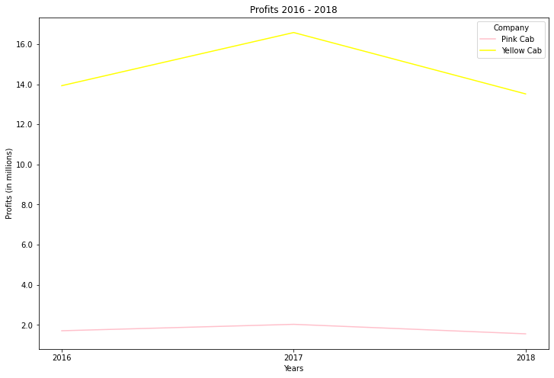
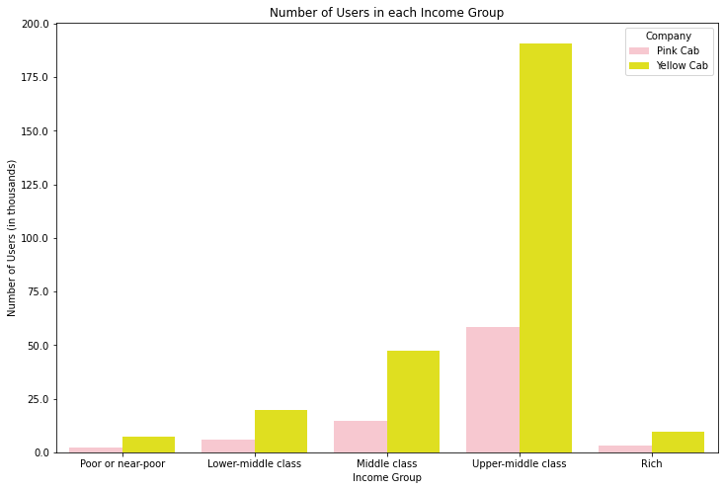
EDA
Which company has had more profit over the years?
Yellow Cab has earned 8.3 times the earnings of Pink Cab.
Which company has users with better income?
In each economic group Yellow Cab has more users than Pink Cab.

Slide 5
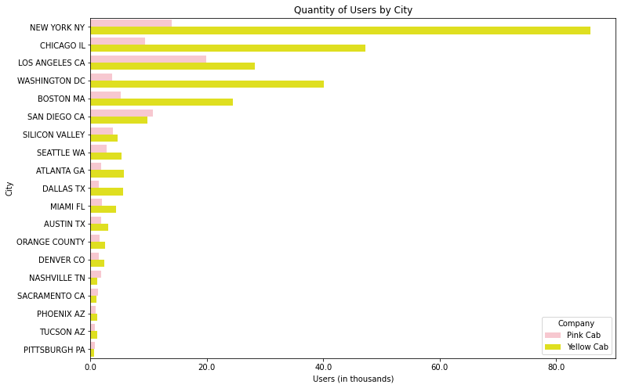
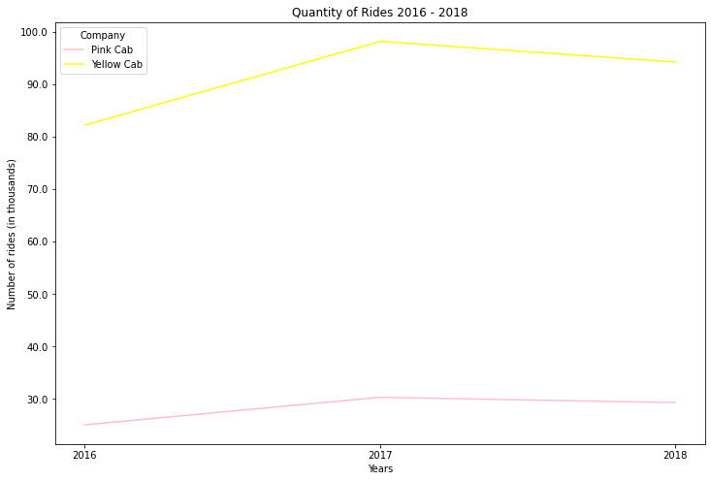
EDA
Which company has more users by city?
In the Top 5 cities with the largest number of users, Yellow Cab has more presence than Pink Cab.
Which company has more ride throughout the years?
Yellow Cab has had 3.25 more trips than Pink Cab in the period from 2016 to 2018.

Slide 6
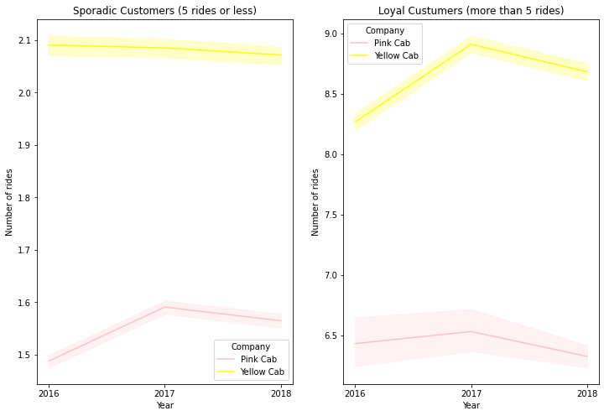
EDA
Which company tend to retain more customers?
We categories the customers as sporadics and loyal based on the number of rides they take in each company every year (5 rides or less is consider a sporadic customer in our analysis), and we found that Yellow Cab is doing a better job than Pink Cab in customer retention.

Slide 7
Recommendations
Based on the questions previously analyzed and answered, we can conclude that Yellow Cab is a better option to invest than Pink Cab.
Profit through the years: Yellow Cab has earned 8.3 times the earnings of Pink Cab in the period from 2016 to 2018.
User income profile: In each economic group (Poor or near-poor, Lower-middle class, Middle class, Upper-middle class, Rich) Yellow Cab has more users than Pink Cab.
Users by city: In the Top 5 cities with the largest number of users Yellow Cab has more presence than Pink Cab.
Volume of rides: Yellow Cab has had 3.25 more trips than Pink Cab in the period from 2016 to 2018.
Customer retention: We categories the customers as sporadics and loyal based on the number of rides they take in each company every year (5 rides or less is consider a sporadic customer in our analysis), and we found that Yellow Cab is doing a better job than Pink Cab in customer retention.

Slide 8
Thank You

