Slide 1

Exploratory Data Analysis
Investment Opportunity Analysis for Taxi Companies
17/09/2023

Slide 2

Agenda
Problem Statement
Initial Data Approach
EDA
EDA Summary
Recommendations

Slide 3
Problem Statement
We have been employed by a private firm in the US, XYZ, to consult on investment in the cab industry.
As per their Go-to-Market (G2M) strategy they need to understand the market before taking a final decision, so we aim to undertake an exploratory data analysis (EDA) of the companies under consideration using historical data in order to identify investment opportunities.
We have been provided with historical data from 2016 to 2018 for two companies, the Pink Cab company and the Yellow Cab Company. The historical data spans 4 datasets.

Slide 4
Initial Data Approach
Provided data:
Cab_Data.csv : consists of transaction IDs and fields concerning the journeys made associated to the transactions.
City.csv : contains data regarding cities in which the cabs operate, and basic population and demand data.
Customer_ID.csv : Provides profile details (age and gender) for individual customers.
Transaction_ID.csv : Links customer ID and transaction ID, and gives payment method information.
Data preparation:
Converting data of travel from integers to actual dates in the given range of dates.
Inserting a field for calculated profit per trip.
Merging all data into a “master” dataframe to centralise information.

Slide 5
Initial Data Approach
Provided data:
Cab_Data.csv : consists of transaction IDs and fields concerning the journeys made associated to the transactions.
City.csv : contains data regarding cities in which the cabs operate, and basic population and demand data.
Customer_ID.csv : Provides profile details (age and gender) for individual customers.
Transaction_ID.csv : Links customer ID and transaction ID, and gives payment method information.
Data preparation:
Converting data of travel from integers to actual dates in the given range of dates.
Inserting a field for calculated profit per trip.
Merging all data into a “master” dataframe to centralise information.

Slide 6
EDA
Where we can, we aim to support intuitive and qualitative results with statistically significant evidence.
It is important to note that the data’s microstructure is complex; this EDA is an introductory exploration of the data even though it does paint a clear picture.
We analyse:
Profit structures
Demand seasonalities
Customer income microstructure
Age demographics

Slide 7
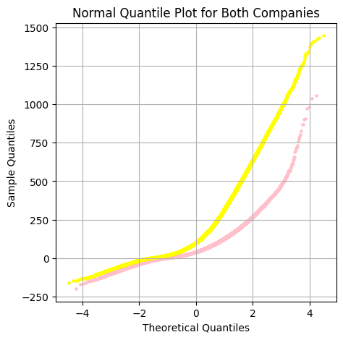
Profits Analysis
We begin with a basic analysis, comparing mean profits per ride between the two companies.
We can safely assume independence between the two companies, and normality is checked via a normal quantile plot, shown below. The fit is close to a straight line so the assumption of normality is well-founded.

Slide 8
Profits Analysis
Assuming equal variances would not be appropriate, so we apply Welch’s t-test.
Mean profit per ride for Pink Cab is $62.65 and for Yellow Cab is $160.26, so we apply a one-sided Welch t-test.
The 5% significance level critical value is 1.64 and the t-test statistic is 231.00, so we conclude the mean profit per ride is statistically significantly higher for Yellow Cab than for Pink Cab.

Slide 9
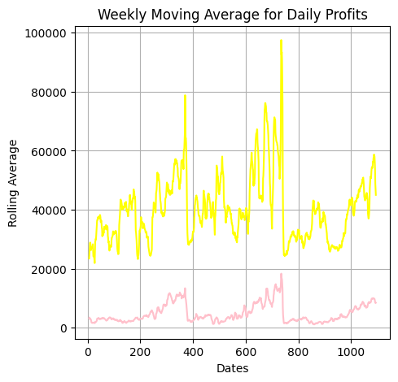
Profits Temporal Analysis
It is important to check whether the difference in mean profit per ride is well-spread throughout the data, in particular the later we have in the sample data.
We aggregate profit per ride daily for each company and plot the weekly moving average of daily profits.
There is a clear qualitative difference in profits between the companies at all time points – this combined with the previous profit analysis significantly favours the Yellow Cab company.

Slide 10
Seasonality Analyses
We saw earlier that there is potentially a lot of seasonality in the underlying structure of the profits per ride. This makes intuitive sense, as profits derive from the underlying demand which is obviously seasonal; people prefer taking cabs late after parties, during rainy months etc.
It is clear that both companies have a similar seasonal component and that the Yellow cab’s prospects seem better in the given time window, but it may be useful to explore potential for future growth by exploring the trends in the demand.
We perform a time-series seasonal decomposition analysis on an additive model to confirm similarity of seasonal components and to check the trend of the Pink Cab company is not outstripping that of the Yellow Cab company.

Slide 11
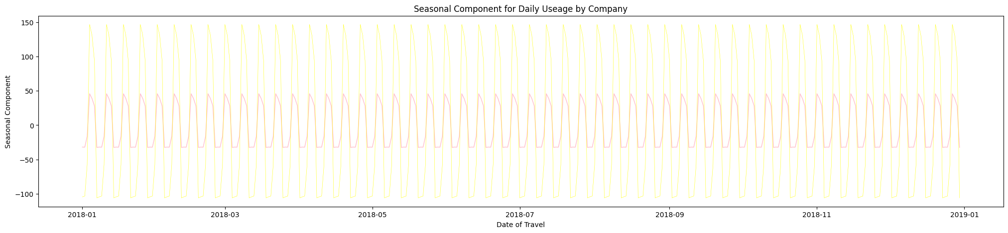
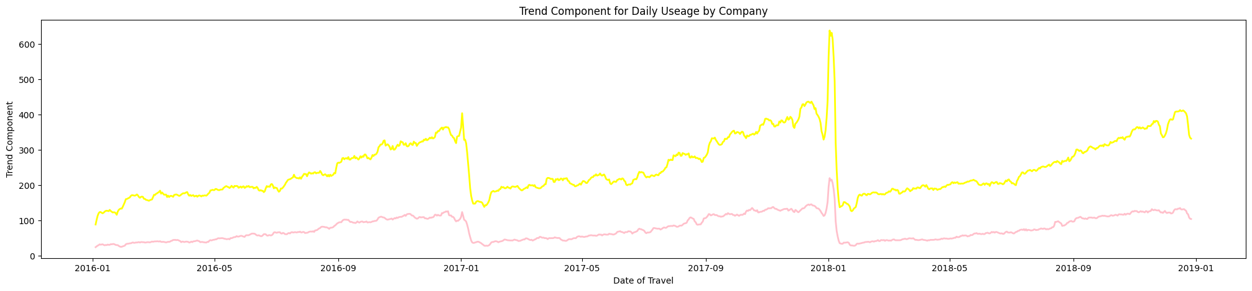
Seasonal Component
Trend Component Yellow Cab consistently higher

Slide 12
Customer Income Analysis
Profits and customer usage are useful metrics in investment consultancy, another useful such metric is average customer income.
Just because the Yellow Cab company’s usage is trending much better than Pink Cab, significantly higher income for customers of Pink Cab could compensate.
From what we see adjacent, there does not seem to be significant difference.
We aim to apply Welch’s t-test to confirm this claim.
City | Mean Income, Pink | Mean Income, Yellow
ATLANTA GA | 14902.657981 | 15033.438706
AUSTIN TX | 14593.396631 | 14863.617773
BOSTON MA | 15074.554109 | 15383.779213
CHICAGO IL | 15109.388393 | 15062.991561
DALLAS TX | 14831.777896 | 14906.678261
DENVER CO | 14946.052653 | 15027.279053
LOS ANGELES CA | 15037.574872 | 15102.801057
MIAMI FL | 15049.001797 | 14842.310689
NASHVILLE TN | 14463.192472 | 14906.545899
NEW YORK NY | 15195.245525 | 15120.299778
ORANGE COUNTY | 15187.355610 | 15191.537343
PHOENIX AZ | 14966.599167 | 15075.148148
PITTSBURGH PA | 14511.603803 | 14316.633431
SACRAMENTO CA | 15364.508228 | 15193.667166
SAN DIEGO CA | 15042.495008 | 15056.662762
SEATTLE WA | 14788.842925 | 14940.778184
SILICON VALLEY | 15281.650572 | 15207.380564
TUCSON AZ | 14733.638693 | 15239.501877
WASHINGTON DC | 14754.610014 | 14432.625948

Slide 13
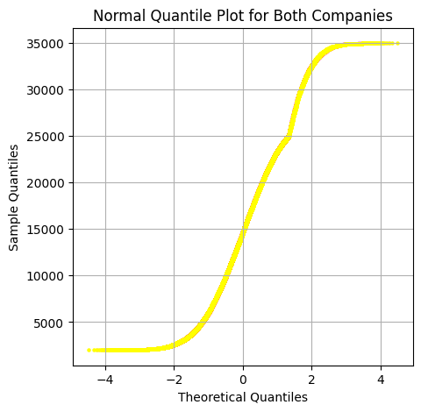
Welch T-Tests
Though we don’t assume equal variances, we have assumed normality, which is well-founded according to the normal quantile plot below.
We also assume independence between the two distributions.
95% significance two-tailed Welch t-tests
ATLANTA GA : Not
AUSTIN TX : Not
BOSTON MA : Statistically Significantly Different
CHICAGO IL : Not
DALLAS TX : Not
DENVER CO : Not
LOS ANGELES CA : Not
MIAMI FL : Not
NASHVILLE TN : Not
NEW YORK NY : Not
ORANGE COUNTY : Not
PHOENIX AZ : Not
PITTSBURGH PA : Not
SACRAMENTO CA : Not
SAN DIEGO CA : Not
SEATTLE WA : Not
SILICON VALLEY : Not
TUCSON AZ : Not
WASHINGTON DC : Statistically Significantly Different

Slide 14
Income per Customer Conclusions
From results prior, we saw the average Pink Cab company customer is richer than that of the Yellow Cab company in Washington DC.
We have the opposite observation in Boston MA.
These opposing conclusions somewhat muddy the waters.
However, incomes in the other location are not significantly different.
It is safe to conclude one small opposing conclusion does not carry enough weight in this analysis, which is heavily in favour of the Yellow Cab company.

Slide 15
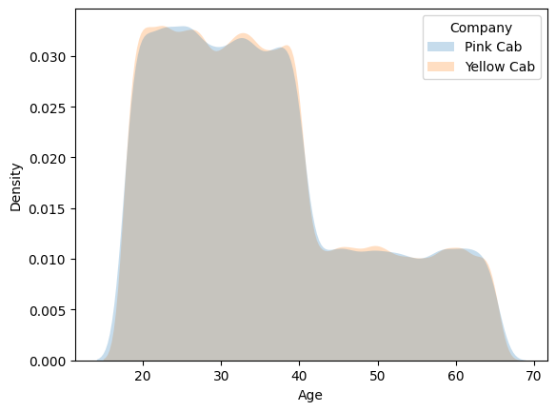
Age Demographic Analysis
The distributions of ages between the two companies are of interest to the investor for various reasons:
Older customers are generally wealthier.
That being said, younger customers are potentially more long-term customers.
Companies appealing to a wider variety of age groups have greater potential for growth.
Saving us from much more complex analysis, the qualitative kernel density plot of the age demographics between the companies suggests they are very similar.

Slide 16
Non-Parametric Distribution Similarity Analysis
The given distributions do not seem to fit any pre-defined models well (without delving into additive/mixture modelling) so we apply non-parametric methods.
We can run a two-sided, non-parametric Kolmogorov-Smirnov two-sample test.
Comparing the K-S test statistic to the approximate 95% critical value, we see that the two distributions are nowhere near being statistically significantly different.
We conclude age demographics are statistically similar.

Slide 17
EDA Summary & Recommendations
Profits per ride for Yellow Cab are statistically significantly higher.
This statistical difference is homogeneous temporally.
Seasonal decomposition of daily profits by company suggest trend for that of Yellow Cab is much greater than that for Pink Cab.
Overall, income per customer is statistically similar between companies.
Age demographics are also statistically similar between companies.
It is clear that the Yellow Cab company is a better investment according to the analysis presented.

Slide 18
Caveats & Further Explorations
We must note the historical time period the data spans is 2016-2018, a long time ago and arguably not a vast time period.
With a pandemic in the meantime, any extrapolation of results enclosed to today’s date may be dangerous.
The pandemic would be a particularly interesting case to consider alongside third-party data for the US. Different states had differing policies and cultures surrounding public transport.
With the potential to leverage third-party data to aid in forecasting the data further towards the present day, a proper analysis to compensate for the age of the data could be huge.

Slide 19
Thank You

