Slide 1

Exploratory Data Analysis
G2M for Cab Investment
21/11/2022

Slide 2

Agenda
Problem Statement
Approach
EDA
EDA Summary
Recommendations

Slide 3
Problem Statement
Which company has maximum cab users at a particular time period?
Does margin proportionally increase with increase in number of customers?
What are the attributes of these customer segments?

Slide 4
Approach
4 Datasets
City
Transactions
Customers
Cab_Info
19 Cities
Population
Users

Slide 5
Cab_Info
Transactions
Customers
Transaction ID
Date of Travel
Company
City
KM Travelled
Price Charged
Cost of Trip
Transaction ID
Customer ID
Payment_Mode
Customer ID
Gender
Age
Income(USD/Month)

Slide 6
EDA
Cab_Info
Transactions
Customers
Master Dataframe
YellowCab
PinkCab

Slide 7
EDA
YellowCab
PinkCab
12 columns
274681 rows
New column profit
Date as index
12 columns
84711 rows
New column profit
Date as index

Slide 8
YellowCab
 | KM Travelled | Price Charged | Cost Trip | Age | Income
Mean | 22,6 | 458,2 | 297,9 | 35,3 | 15045
STD | 12,23 | 288,4 | 162,5 | 12,6 | 7962,7
Median | 22,4 | 425 | 295,60 | 33 | 14676
Mean and Median are quite close in all features which suggest that the data is well distributed

Slide 9
PinkCab
 | KM Travelled | Price Charged | Cost Trip | Age | Income
Mean | 22,6 | 310 | 248,1 | 35,3 | 15059
STD | 12,23 | 182 | 135,4 | 12,6 | 7991,1
Median | 22,4 | 298,1 | 246,3 | 33 | 14713
Mean and Median are quite close in all features which suggest that the data is well distributed

Slide 10
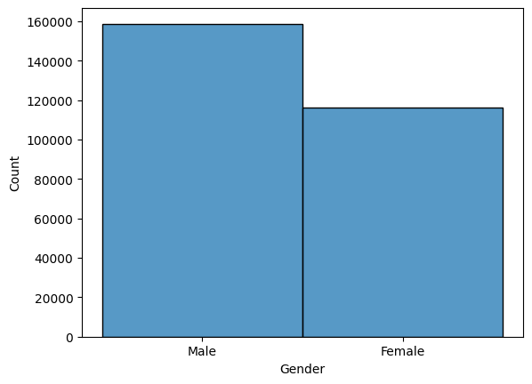
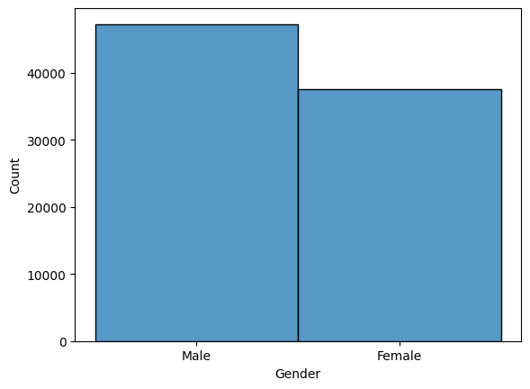
Customer Profile
YellowCab
PinkCab

Slide 11
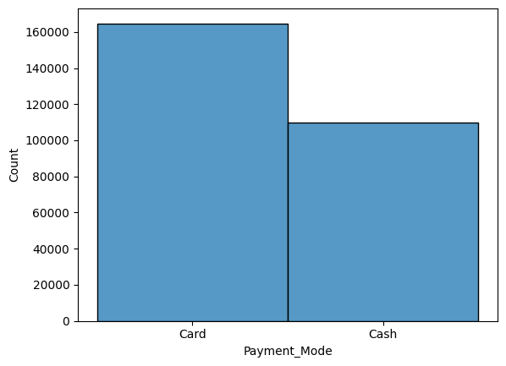
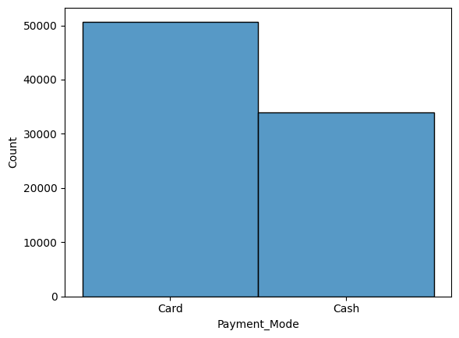
Customer Profile
YellowCab
PinkCab

Slide 12
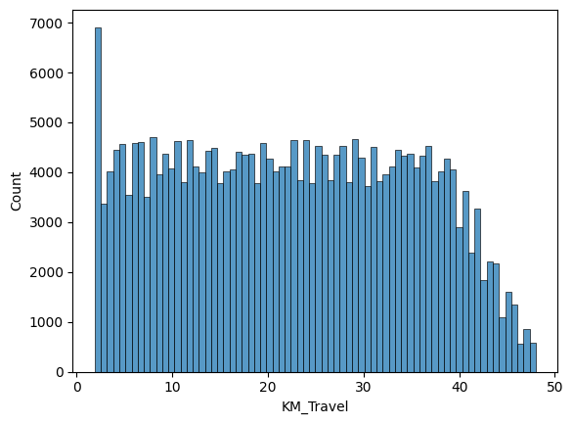
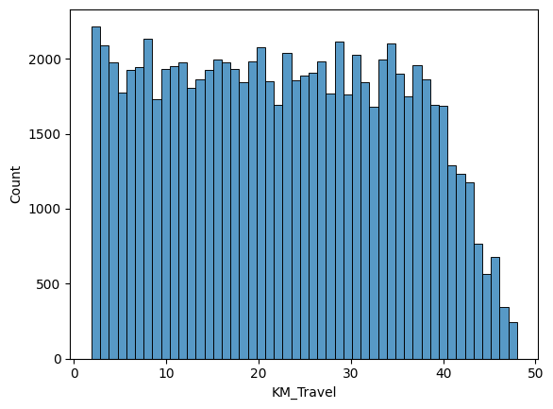
Customer Profile
YellowCab
PinkCab

Slide 13
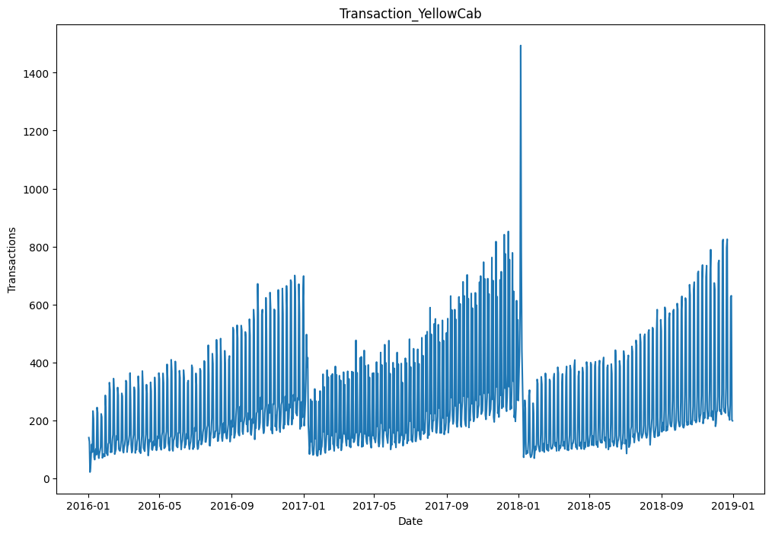
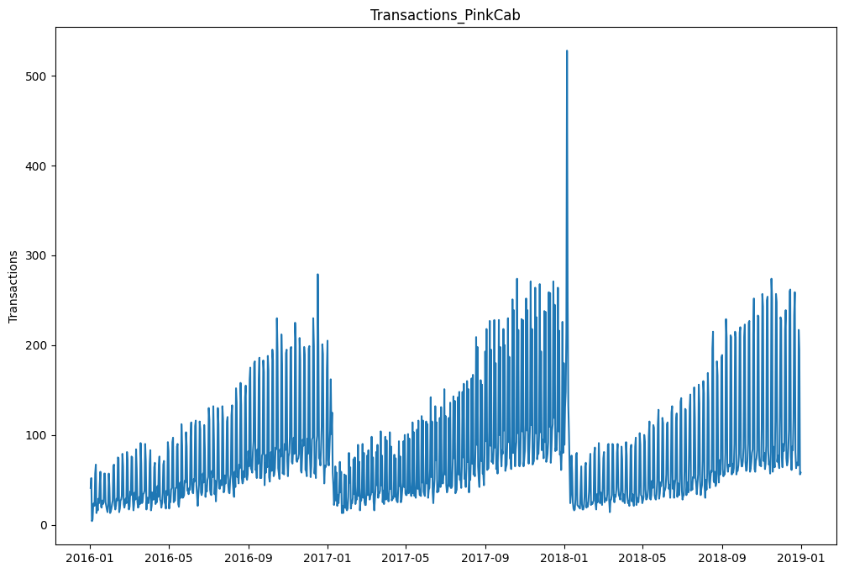
Transactions over Time
YellowCab
PinkCab
Trend and Seasonlity in both companies
1st January is the peak
YellowCab has more volume compared with PinkCab

Slide 14
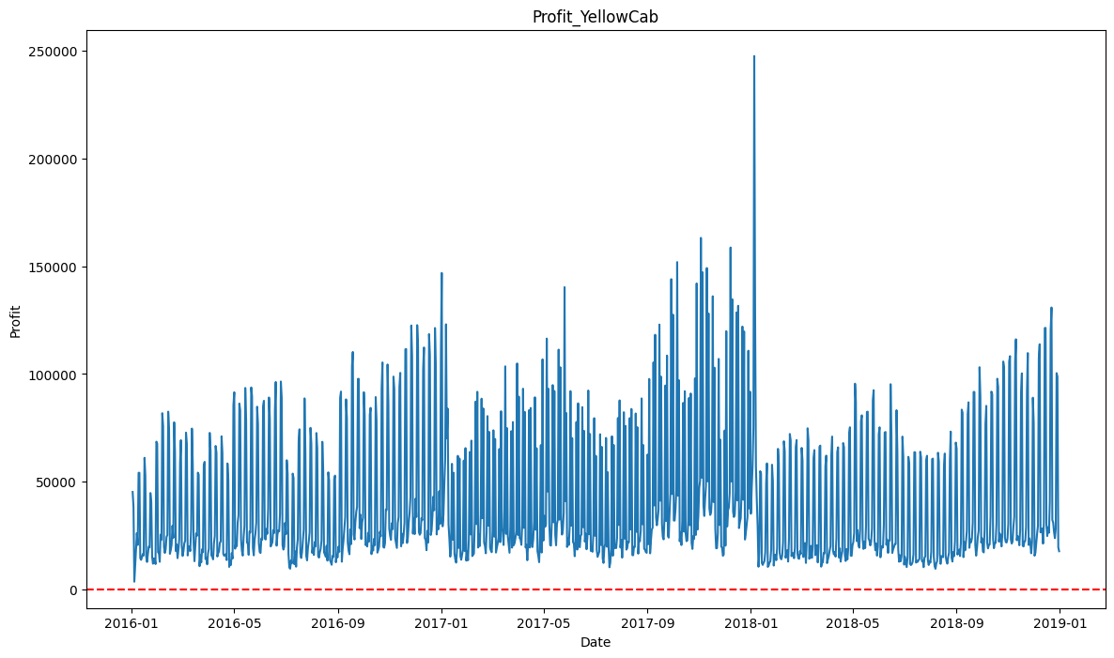
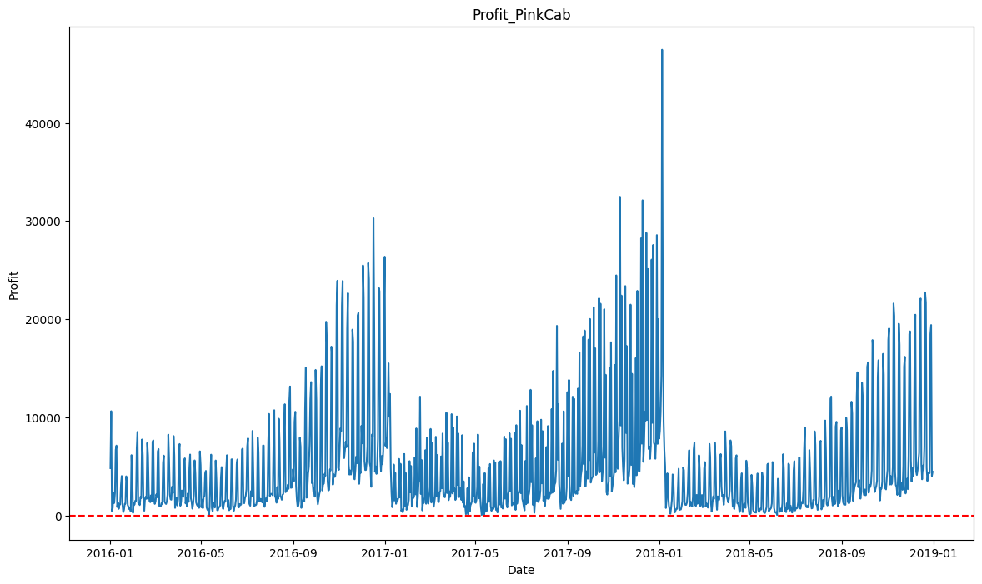
Profit
YellowCab
PinkCab
Looking to the behavour we can see that profit tends to follow trend and seasonality
PinkCab is closer to 0 in some periods where Yellowcab has bigger margin.

Slide 15
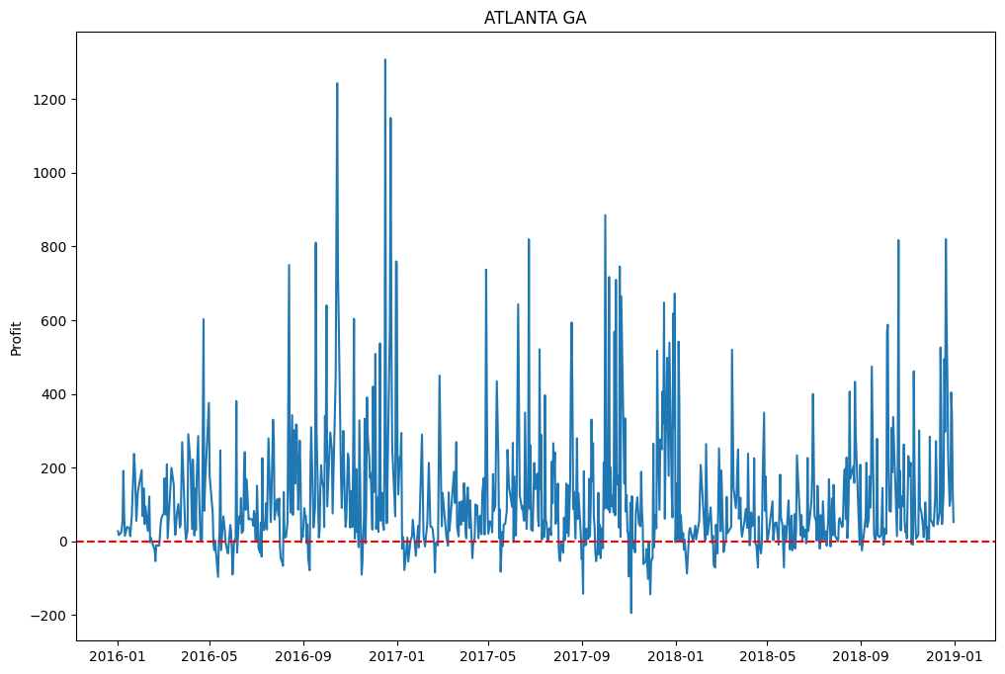
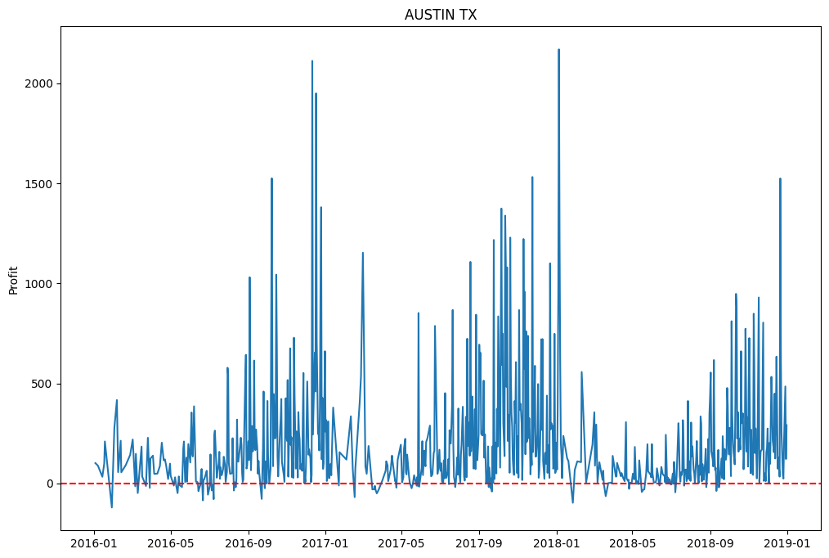
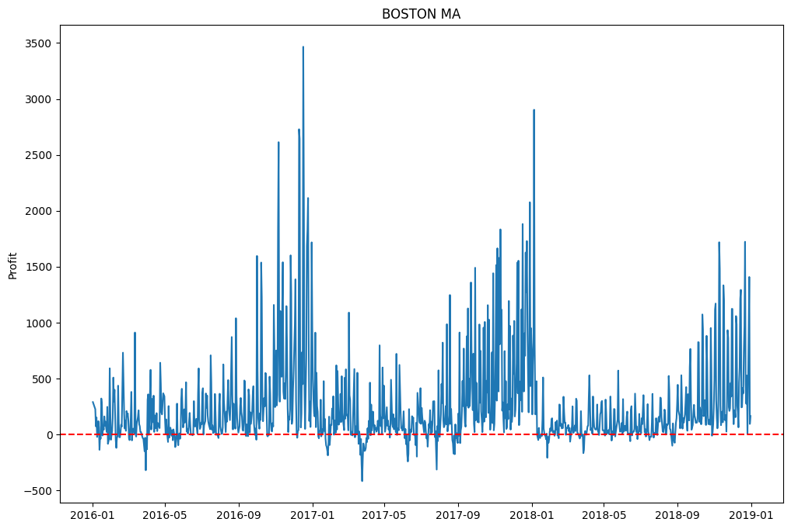
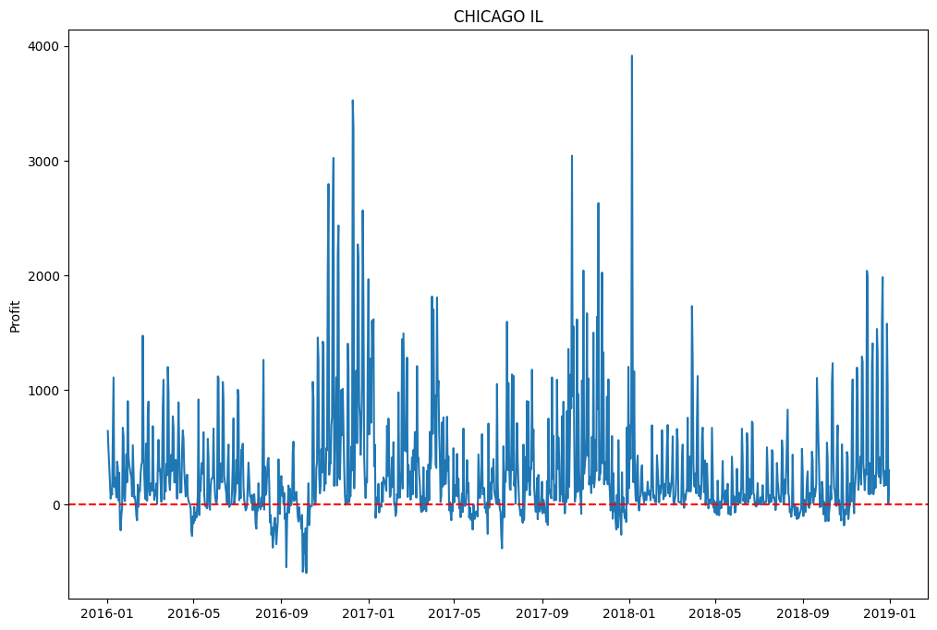
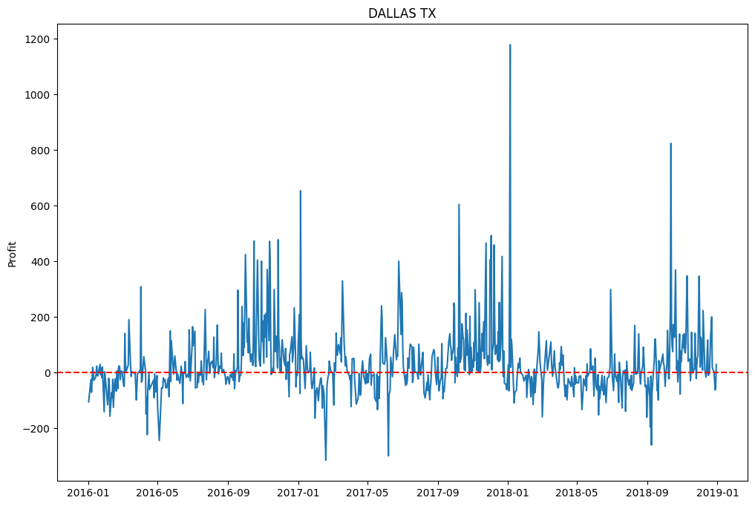
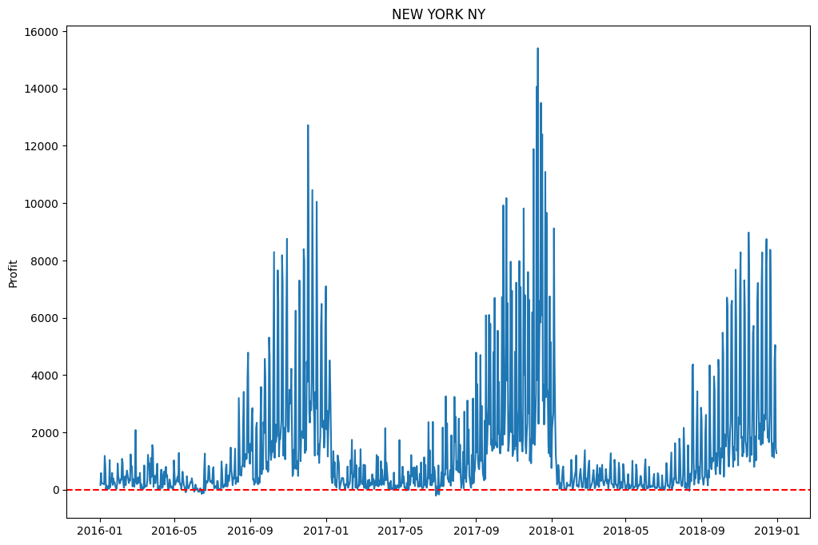
Profit by city
PinkCab

Slide 16
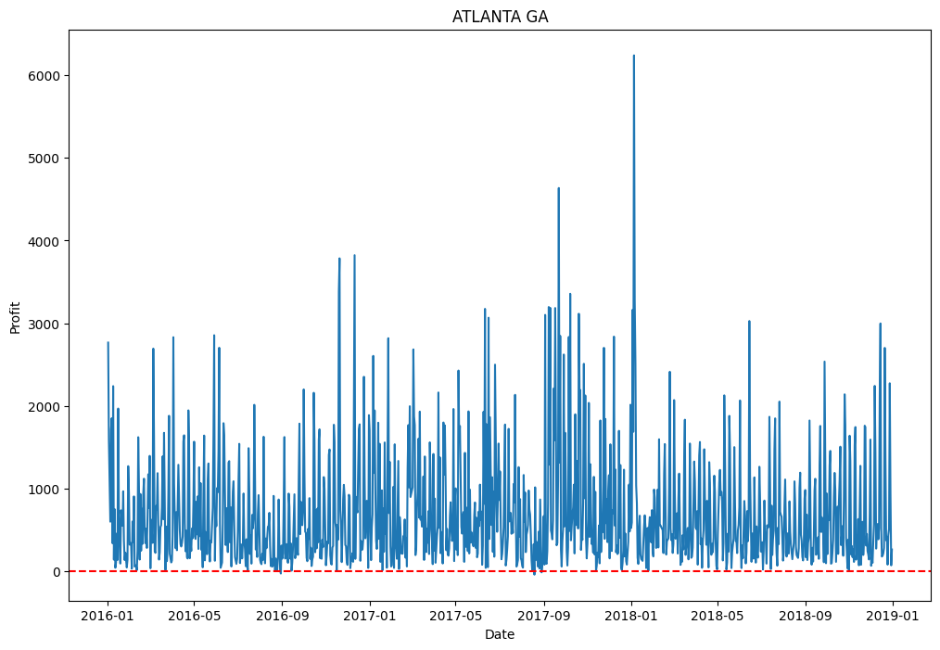
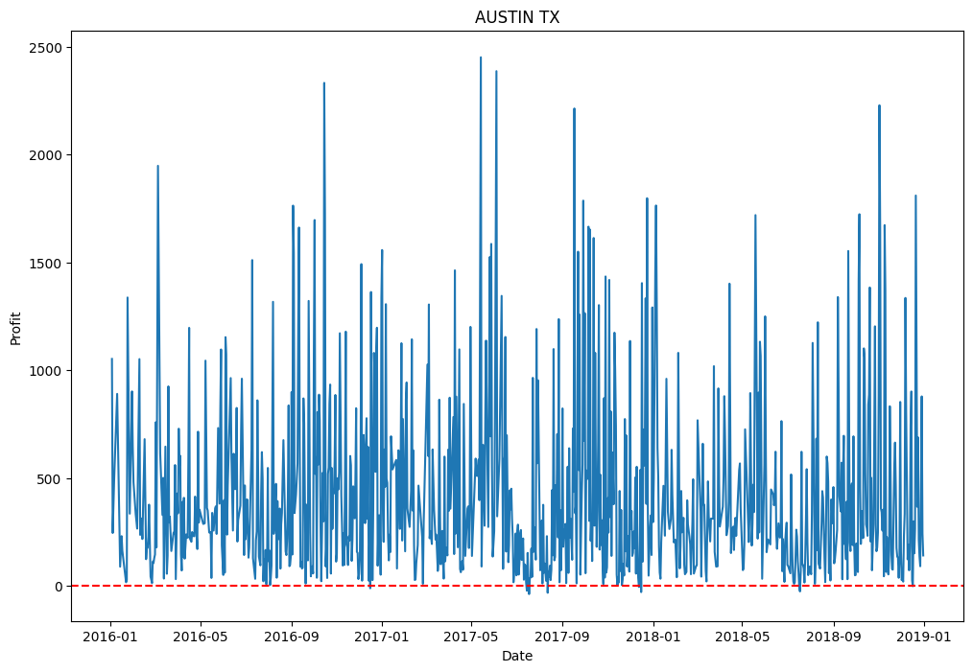
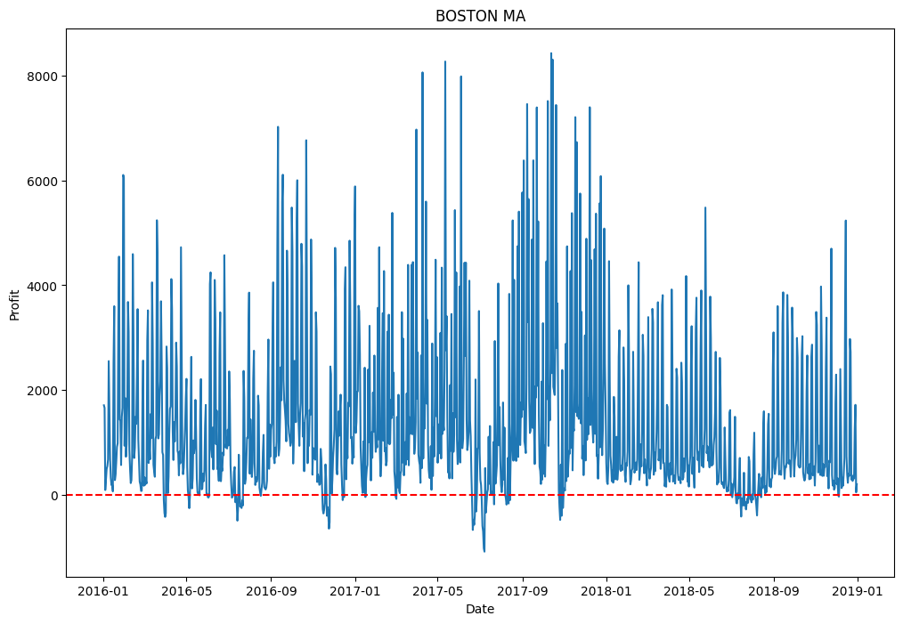
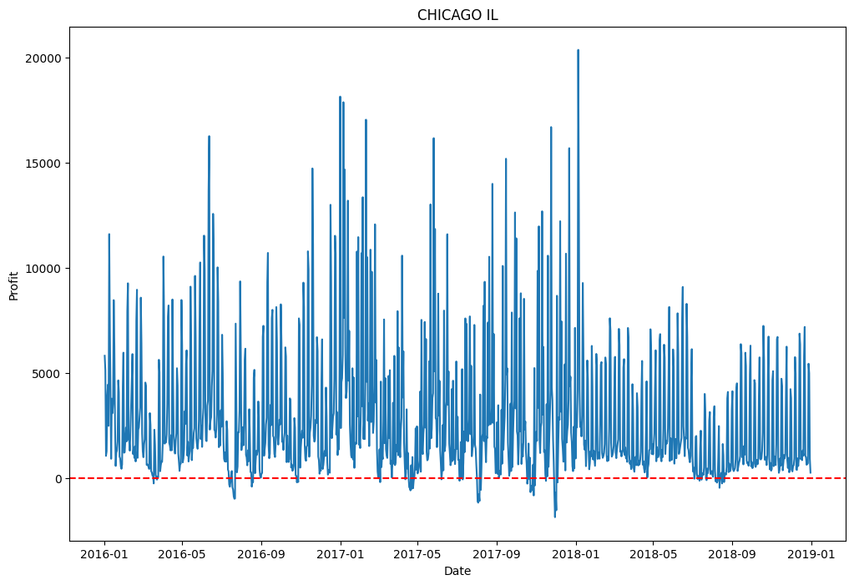
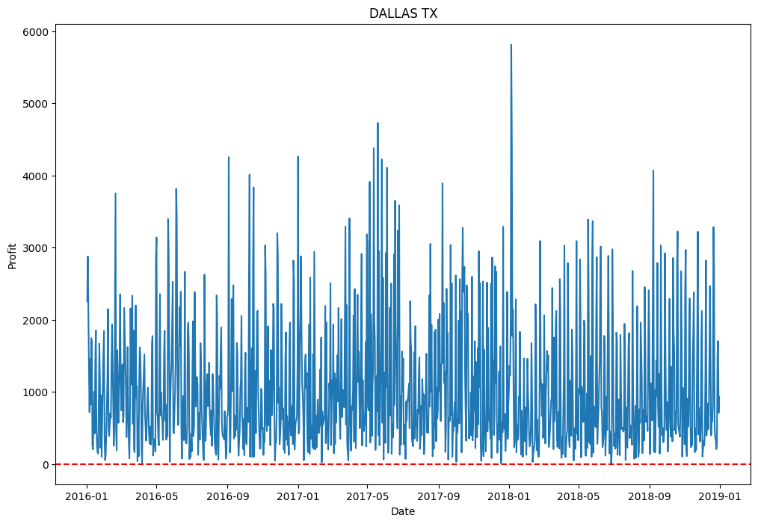
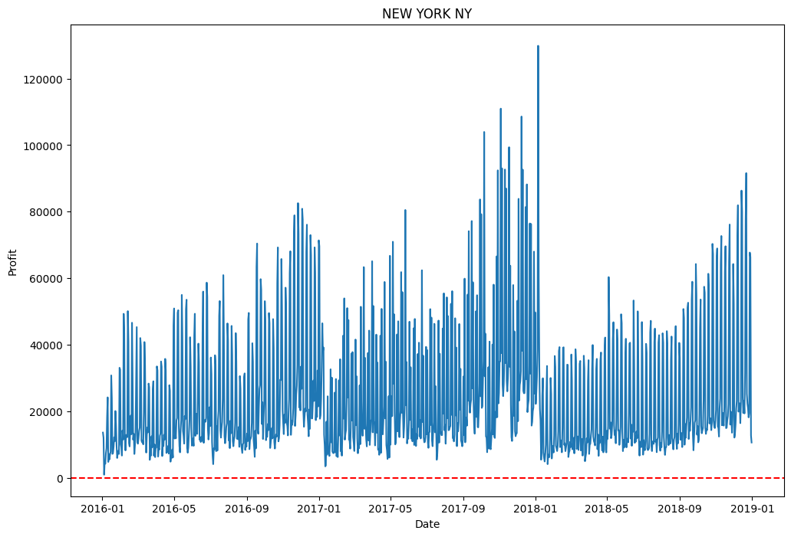
Profit by city
YellowCab

Slide 17
EDA Summary
YellowCab has more volume than PinkCab
YellowCab is more profitable than PinkCab
Customers profile is similar between both companies
We can see that is a seasonal business

Slide 18
Thank You

