Slide 1

Exploratory Data Analysis
G2M insight for Cab Investment firm
04/13/2023

Slide 2
Agenda
Executive Summary
Problem Statement
Approach
EDA
EDA Summary
Recommendations

Slide 3

Executive Summary
Details about two companies, Pink Cab and Yellow Cab, are provided in the Go-2-Market (G2M) dataset.
Understanding the information and developing future investment plans are the objectives of the analysis.

Slide 4
Problem Statement
XYZ is a private firm in US. Due to remarkable growth in the Cab Industry in last few years and multiple key players in the market, it is planning for an investment in Cab industry and as per their Go-to-Market(G2M) strategy they want to understand the market before taking final decision.

Slide 5
Approach
We collected 4 datasets namely: Cab_Data, Customer_ID, Transaction_ID, and City.
We performed an EDA to understand the relations between the data and to determine which company is a better choice for investment opportunity for XYZ.
To better investigate, we generated few hypotheses :
Which cab is more popular in different cities?
How is the cab usage according to age?
Which cab will people with different income choose?
Which cab has travelled more distance?
What is the cost of trip of each cab?
Which cab has more profited generated?
What is the number of car users in different cities?

Slide 6
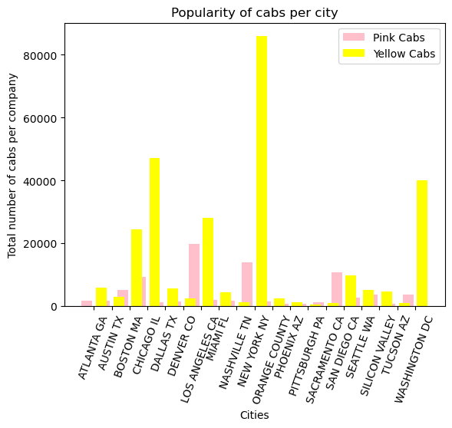
Exploratory Data Analysis
Yellow cab is more popular in most of the cities than pink cab.

Slide 7
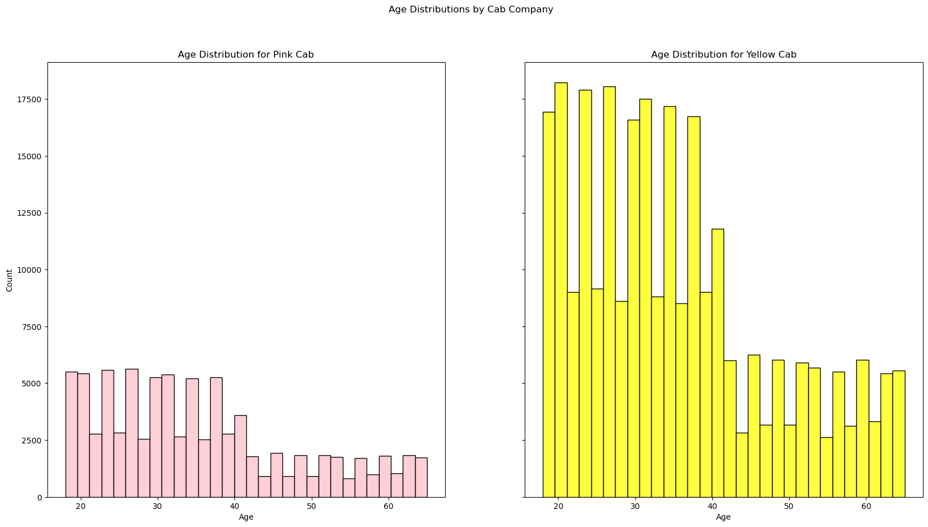
Exploratory Data Analysis
People of all age use more yellow cab than pink cab.

Slide 8
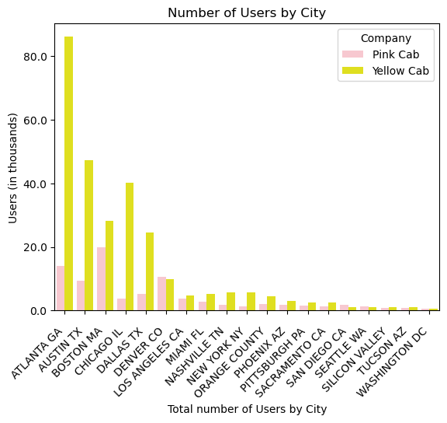
Exploratory Data Analysis
Majority of the cab users take yellow can more than pink can in each city.

Slide 9
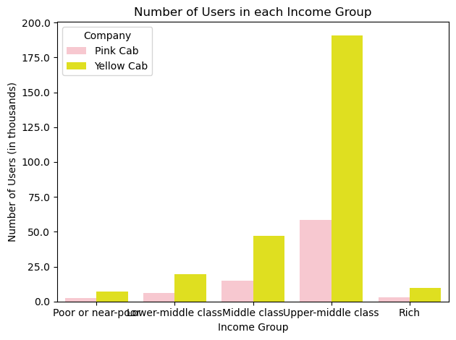
Exploratory Data Analysis
Every income group people prefer to use more yellow can than pink cab.

Slide 10
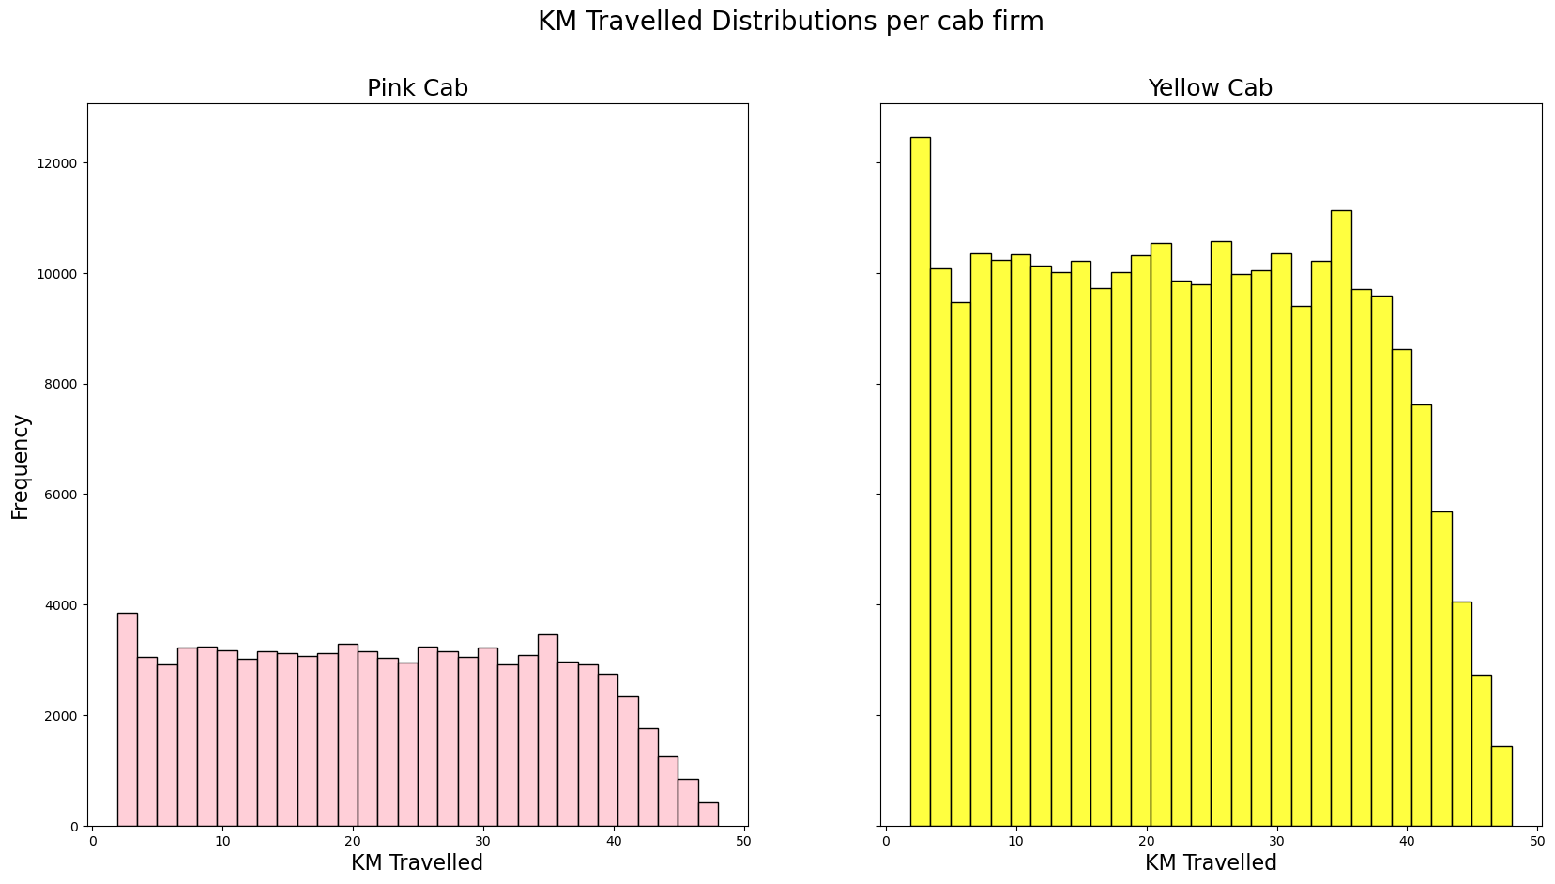
Exploratory Data Analysis
Distance travelled by yellow cab is more than pink cab.

Slide 11
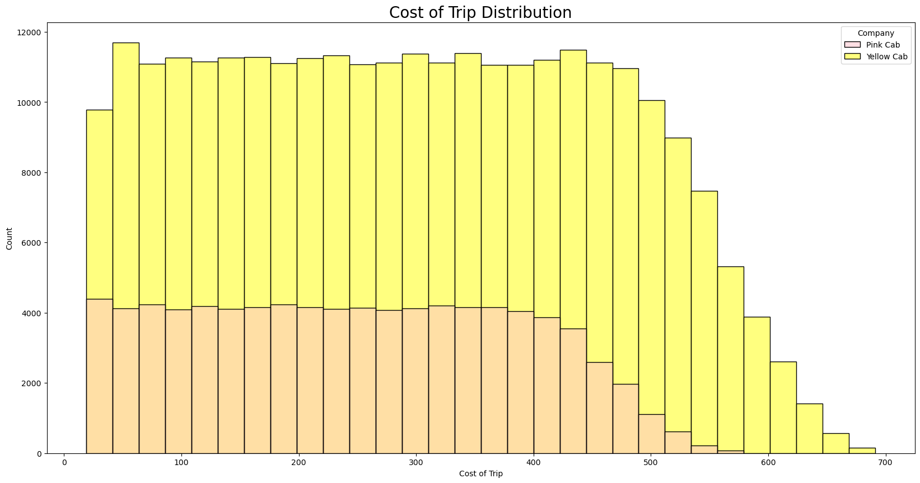
Exploratory Data Analysis
Cost of trip for yellow cab is more than pink cab.

Slide 12
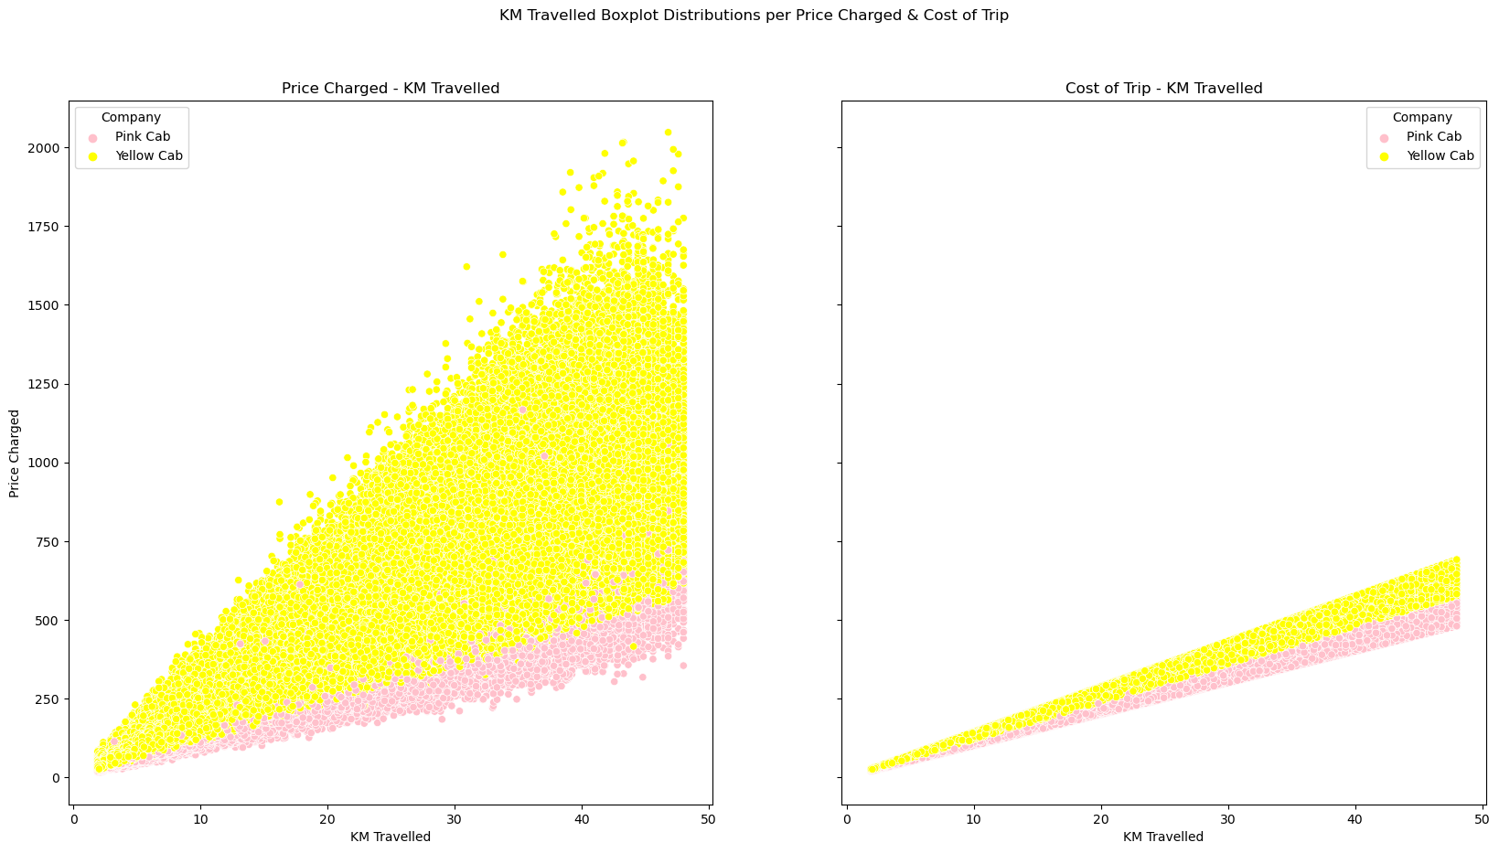
Exploratory Data Analysis
The profit generated by yellow cab is more than pink cab.

Slide 13
EDA Summary and Recommendation
Following the analysis, we can state that the yellow company is the one in which the investment should be made, and as a result, it is the one that will make the most money and attract the most customers. The reasons for this are as follows:
Yellow cab is more popular in cities than pink cab.
People of all age use more yellow cab than pink cab.
Majority of the cab users take yellow can more than pink can in each city.
Every income group people prefer to use more yellow can than pink cab.
Distance travelled by yellow cab is more than pink cab.
Cost of trip for yellow cab is more than pink cab.
The profit generated by yellow cab is more than pink cab.
We strongly advise investing in the yellow cab sector based on all of these conclusions from the exploratory data study.

Slide 14
Thank You

