Slide 1

Exploratory Data Analysis
<G2M Data>
<21 October 2022>

Slide 2
Agenda
Executive Summary
Problem Statement
Approach
EDA
EDA Summary
Recommendations

Slide 3

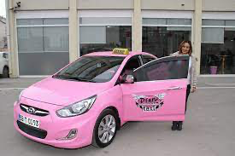
Executive Summary and Problem Statement
The G2M dataset gives the details about two companies (Pink cab and Yellow cab).
The goal of this presentation is to understand the data and plan future strategies

Slide 4
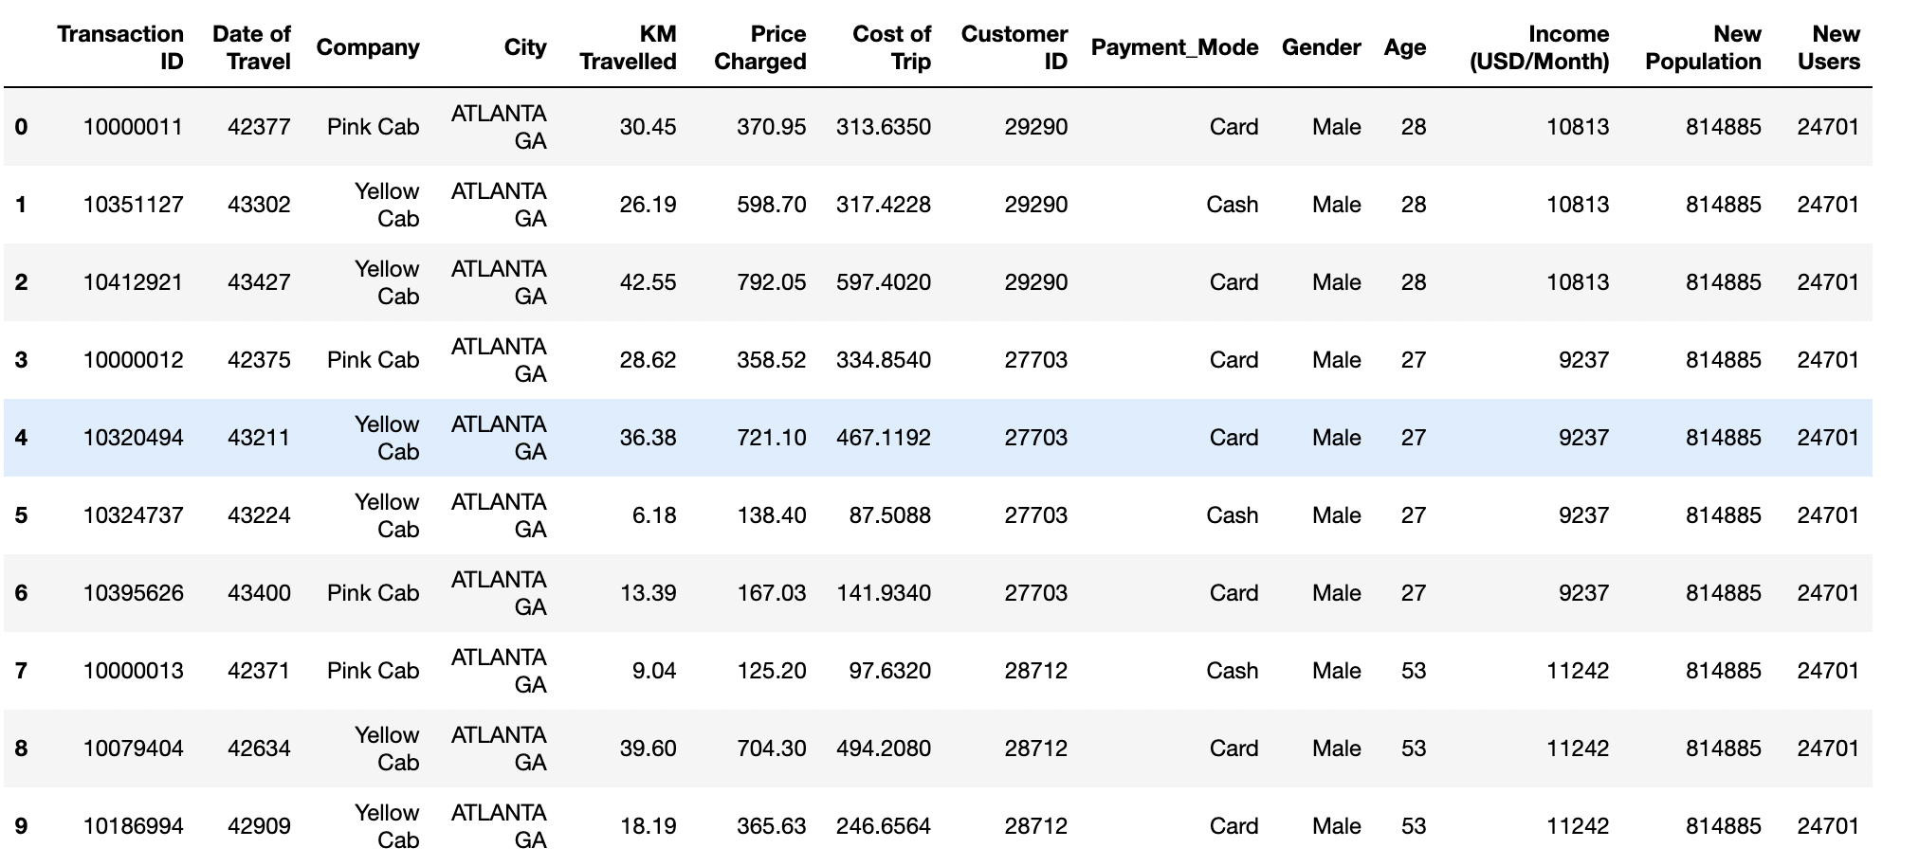
Dataset

Slide 5

EDA
Columns | Unique Values
Transaction ID | 359392
Date of Travel | 1095
Company | 2
City | 19
KM Travelled | 874
Price Charged | 99176
Cost of Trip | 16291
Customer ID | 46148
Payment Mode | 2
Gender | 2
Age | 48
Income (USD/Month) | 22725
Population and Users | 19
The table 1 gives the columns present in the master dataset and the unique values.
Transaction ID is unique for each transaction.
Companies – two companies being investigated - Pink Cab -Yellow Cab
Payment mode – two payment modes being studies
- Cash
- Card
Shape of dataset Rows : 359392 Columns : 14

Slide 6
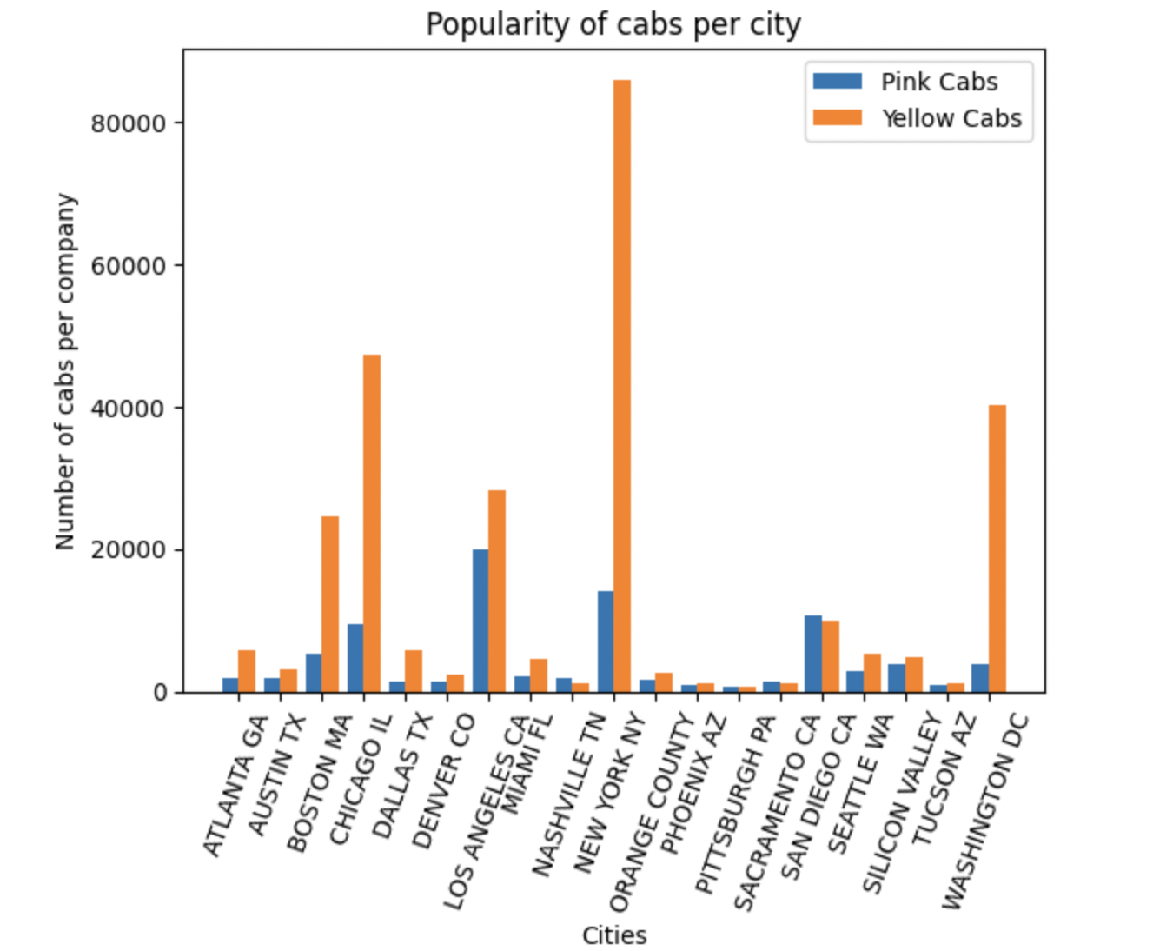
EDA (Continued)
The graph gives the distribution of number of transactions per city.
As we can see, the popularity of yellow cabs is more than or comparable to pink cabs in all the cities.
The cities NASHVILLE TN, SARCAMENTO CA, SAN DIEGO CA have pink cabs more than yellow cabs.

Slide 7
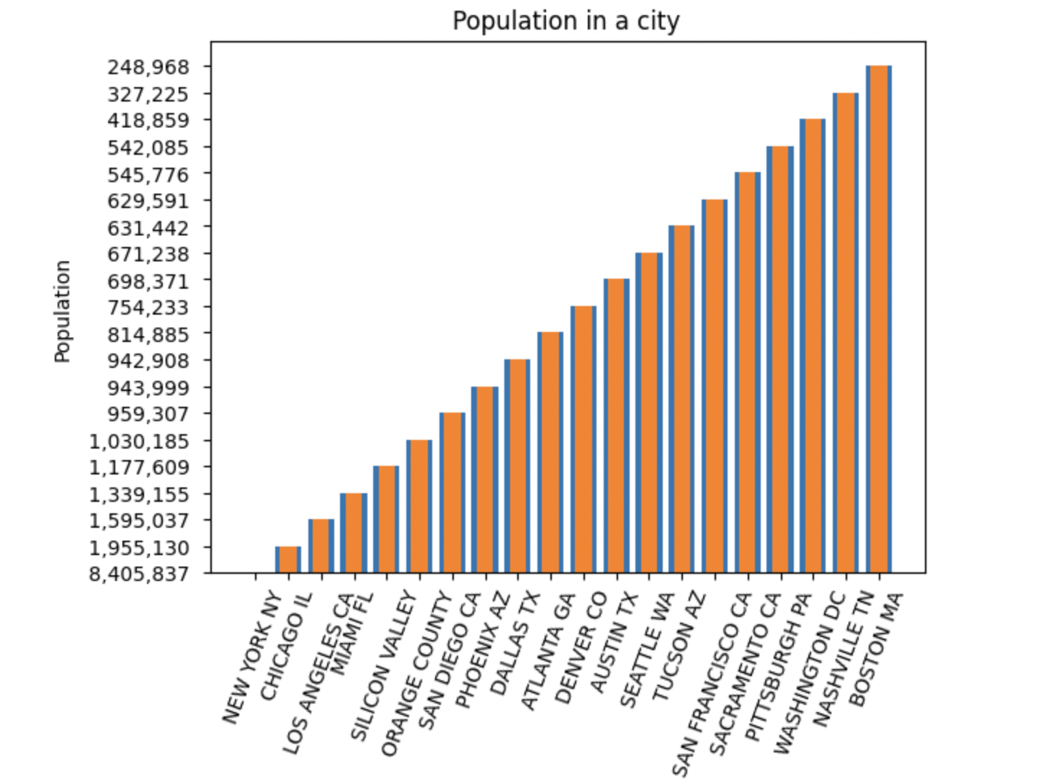
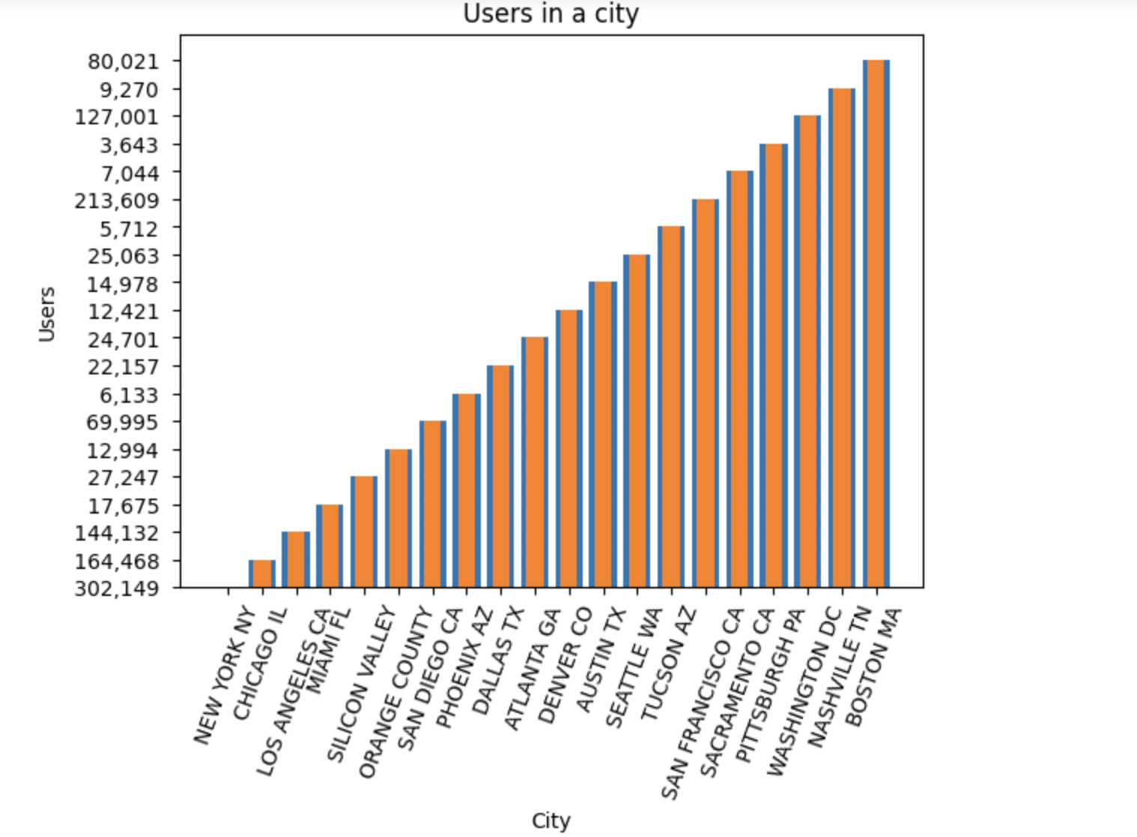
EDA (Continued)
BOSTON MA has the highest population and NEW YORK NY has the lowest population.
BOSTON MA has the highest users and NEW YORK NY has the lowest number of users

Slide 8
EDA (Continued)
Most of the users travel greater than 30 KMs.
KM Travelled | Frequency
33.60 | 1536
24.00 | 1080
22.80 | 1075
35.70 | 1069
16.80 | 1065
37.44 | 1062
39.60 | 1056

Slide 9
Recommendations
Users travelling greater than 30 Km drive most of the sales. They can be incentivized to encourage usage.
The cities with lower populations have high taxi usage.
The cities NASHVILLE TN, SARCAMENTO CA, SAN DIEGO CA have pink cabs more than yellow cabs.
In these cities, yellow cabs can run some advertisements to make themselves more popular.

Slide 10
Thank You

