Slide 1
Operator Overloading
CS-2303
System Programming Concepts
(Slides include materials from The C Programming Language, 2nd edition, by Kernighan and Ritchie, from C: How to Program, 5th and 6th editions, by Deitel and Deitel, and from
The C++ Programming Language, 3rd edition, by Bjarne Stroustrup)

Slide 2
Why Operator Overloading?
Readable code
Extension of language to include user-defined types
    I.e., classes
Make operators sensitive to context
Generalization of function overloading

Slide 3
Simple Example
class complex {
double real, imag;
public:
complex(double r, double i) :
real(r), imag(i) {}
}
Would like to be able to write:–
complex a = complex(1, 3.0);
complex b = complex(1.2, 2);
complex c = b;
a = b + c;
b = b+c*a;
c = a*b + complex(1,2);
I.e., would like to write
ordinary arithmetic expressions
on this user-defined class.

Slide 4
With Operator Overloading, We Can
class complex {
double real, imag;
public:
complex(double r, double i) :
real(r), imag(i) {}
complex operator+(complex a, complex b);
complex operator*(complex a, complex b);
complex& operator=(complex a, complex b);
...
}

Slide 5
General Format
returnType operator*(parameters);
↑ ↑ ↑
any type keyword operator symbol
Return type may be whatever the operator returns
  Including a reference to the object of the operand
Operator symbol may be any overloadable operator from the list.

Slide 6
C++ Philosophy
All operators have context
    Even the simple “built-in” operators of basic types
    E.g., '+', '-', '*', '/' for numerical types
    Compiler generators different code depending upon type of operands
Operator overloading is a generalization of this feature to non-built-in types
    E.g., '<<', '>>' for bit-shift operations and also for stream operations

Slide 7
C++ Philosophy (continued)
Operators retain their precedence and associativity, even when overloaded
Operators retain their number of operands
Cannot redefine operators on built-in types
Not possible to define new operators
    Only (a subset of) the built-in C++ operators can be overloaded

Slide 8
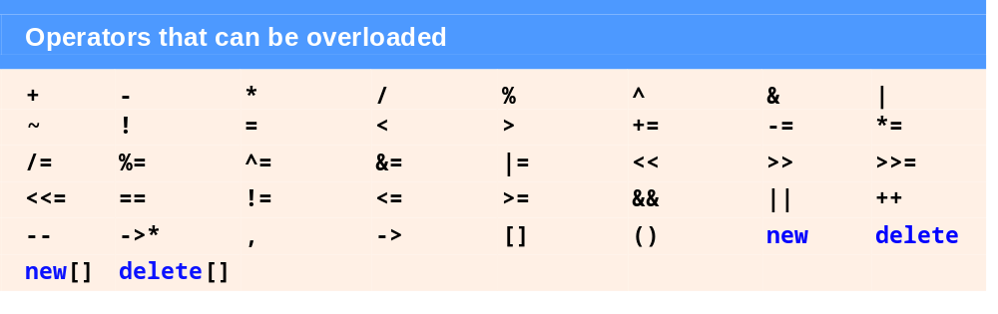

Operators that Can and Cannot be Overloaded
Deitel & Deitel, Figure 22.1
Deitel & Deitel, Figure 22.2

Slide 9
Outline
Fundamentals of Operator Overloading
Restrictions on Operator Overloading
Operator Functions as Class Members vs. Global Functions
Overloading Stream Insertion and Stream Extraction Operators

Slide 10
Operator Overload Function
Either
  a non-static member function definition
  or
  a global function definition
      Usually a friend of the class
Function “name” is keyword operator followed by the symbol for the operation being overloaded
  E.g. operator+, operator=

Slide 11
Operator Overload Function (continued)
Operator overload function is a function just like any other
Can be called like any other – e.g.,
  a.operator+(b)
C++ provides the following short-hand
a+b

Slide 12
Operator Overload Function (continued)
If operator overload function is declared global then
  operator+(a, b)
also reduces to the following short-hand
a+b

Slide 13
Operator Overloading (continued)
To use any operators on a class object, …
  The operator must be overloaded for that class.
Three Exceptions: {overloading not required}
  Assignment operator (=)
    Memberwise assignment between objects
    Dangerous for classes with pointer members!!
  Address operator (&)
    Returns address of the object in memory.
  Comma operator (,)
    Evaluates expression to its left then the expression to its right.
    Returns the value of the expression to its right.

Slide 14
Questions?

Slide 15

Operator Functions as Class Members
Leftmost operand must be of same class as operator function.
Use this keyword to implicitly get left operand argument.
Operators (), [], -> or any assignment operator must be overloaded as a class member function.
Called when
  Left operand of binary operator is of this class.
  Single operand of unary operator is of this class.

Slide 16
Operator Functions as Global Members
Need parameters for both operands.
Can have object of different class than operator.
Can be made a friend to access private or protected data.

Slide 17
Stream Insertion and Extraction Operators as Global Functions
Overload << operator used where
  Left operand of type ostream &
    Such as cout object in cout << classObject
Overload >> has left operand of istream &
  Left operand of type istream &
    Such as cin object in cout >> classObject
Reason:–
  These operators are associated with class of right operand

Slide 18
Commutative operators
May need + to be commutative
    So both “a + b” and “b + a” work as expected.
Suppose we have two different classes
  Overloaded operator can only be member function when its class is on left.
      HugeIntClass + long int
    Can be member function
  For the other way, you need a global overloaded function.
      long int + HugeIntClass

Slide 19
Example – Deitel & Deitel §23.5
<< and >> operators
  Already overloaded to process each built-in type (pointers and strings).
  Can also process a user-defined class.
    Overload using global, friend functions
Example program
  Class PhoneNumber
    Holds a telephone number
  Prints out formatted number automatically.
    (123) 456-7890

Slide 20
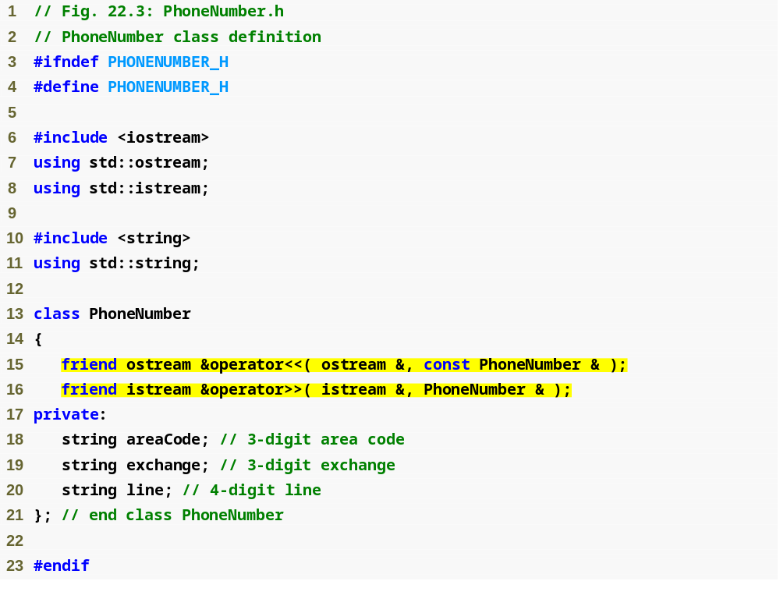
Example §23.5 (continued)
Note also: returns a reference!
Notice function prototypes for overloaded operators >> and << (must be global, friend functions)

Slide 21
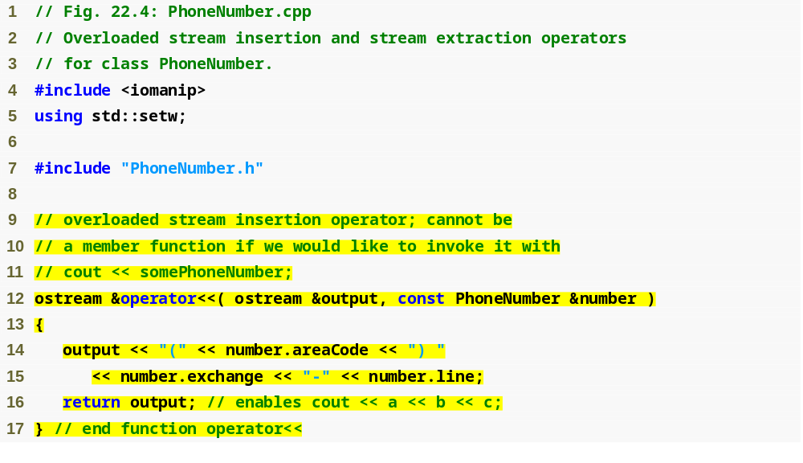
Example §23.5 (continued)
Allows cout << phone; to be interpreted as: operator<<(cout, phone);
Display formatted phone number

Slide 22
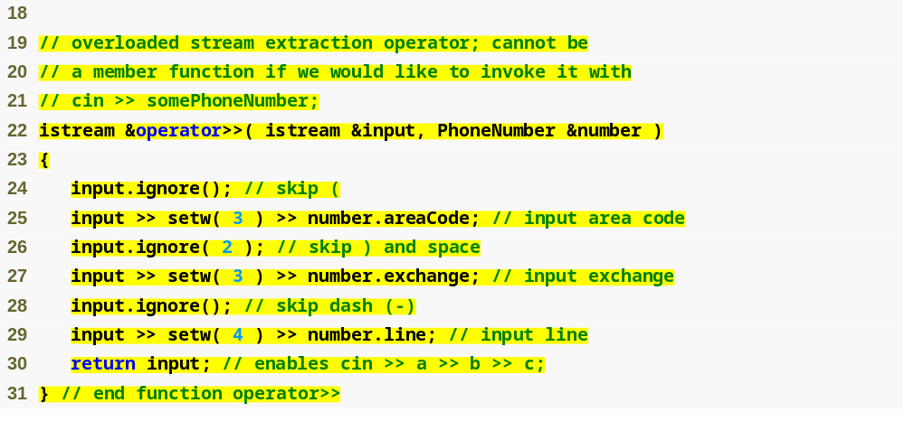
Example §23.5 (continued)
ignore skips specified number of characters from input (1 by default)
Input each portion of phone number separately

Slide 23
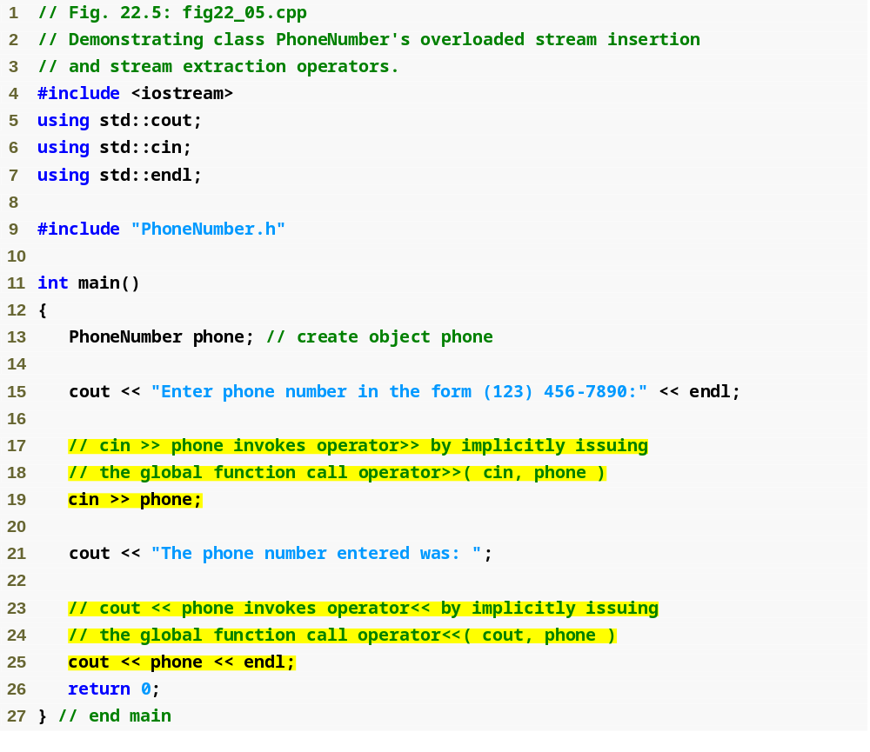
Example §23.5 (concluded)
Invoke overloaded >> and << operators to input and output a PhoneNumber object

Slide 24
Questions?

Slide 25
Unary Operators
Can overload as
  Non-static member function with no arguments.
  As a global function with one argument.
    Argument must be class object or reference to class object.
Why non-static?
  static functions only access static data
  Not what is needed for operator functions

Slide 26
Example – D & D §22.6
Overload '!' to test for empty string
When compiler encounters
  while (!s) …
  if (!s) …
it generates the call to
  s.operator!()
Implemented as:–
  class String {
  public:
  bool operator!() const;
  …
  };

Slide 27
Overloading Binary Operators
Non-static member function with one argument.
or
Global function with two arguments:
  One argument must be class object or reference to a class object.
This is the mechanism by which
the compiler prevents you from
redefining built-in operations!

Slide 28
Overloading Binary Operators (continued)
If a non-static member function, it needs one argument.
class String {
public:
String & operator+=( const String &);
…
};
By shorthand rule
    y += z becomes y.operator+=( z )

Slide 29
Overloading Binary Operators (continued)
If a global function, it needs two arguments
class String {
public:
String & operator+=( String &,
const String & );
…
};
By short-hand rule
    y += z becomes operator+=(y, z)

Slide 30
Overloading Operators
On the previous slide, y and z are assumed to be String-class objects or references to String-class objects.
There are two ways to pass arguments to the global function:–
  With an argument that is an object (this requires a copy of the object) or
  with an argument that is a reference to an object (this means the side effects of the function called to implement the overloaded operator can side-effect this object that is called-by-reference!)

Slide 31
Questions?

Slide 32
Next Time
Array Class
  Deitel & Deitel

