Slide 1
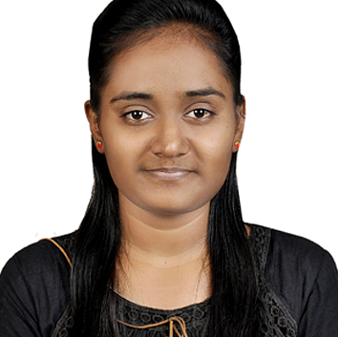
Devika Gaikwad
Analyst/Software Engineer
Bachelor of Engineering
Information Technology: 2016 - 2020
Skills Java 8 /J2EE
Spring Boot
Spring MVC
Spring REST
Angular
Bootstrap
Database
SQL database – Oracle, MySQL
No SQL database – MongoDB
Web Technologies
HTML5
CSS3
Javascript
AddOns
Github
Maven
Postman
Additional Details
Leadership
Communication Skills
Team management
Mumbai
devika-madhusudan.gaikwad@capgemini.com
+91 8668671990
A4
Software Engineer who is Strong in design and integration with intuitive problem-solving skills. Passionate about implementing and launching new projects.
Ready to learn new technologies and implement them to further improve my knowledge.
Eager to work in a team of dedicated people and serve a key role in the enhancement and development of the project.
Has working knowledge on Java, Spring Framework, MongoDB and Angular on an intermediate level.
Also Implemented Java, Spring, Angular ,MongoDB technologies in case study and upskilling day by day.
Online Hotel Management Application
Developed Online Hotel Management Application using spring microservices and AngularJs with MongoDB as database in agile methodology of software development model.
Completed ”Java Full Stack Training with Angular“ training

