Slide 1
SECURE DATA HIDING IN IMAGES USING STEGANOGRAPHY
CAPSTONE PROJECT
Presented By:
Student Name : D Mrityunjaya Pradhan
College Name & Department : Gandhi Institute For Education And Technology, Computer Science Engineering

Slide 2
OUTLINE
Problem Statement
Technology used
Wow factor
End users
Result
Conclusion
Git-hub Link
Future scope

Slide 3
PROBLEM STATEMENT
Data Security Risks – Sensitive information is vulnerable to cyber threats, interception, and unauthorized access during transmission.
Traditional Encryption Limitations – Encrypted data can attract attackers, making it a target for decryption attempts.
Need for Covert Communication – Existing security methods lack an effective way to hide data without detection.
Steganalysis Threats – Modern detection techniques can expose hidden data, compromising confidentiality.
Maintaining Image Quality – Embedding data in images without noticeable distortion remains a technical challenge.

Slide 4
TECHNOLOGY USED
Libraries Used
OpenCV (cv2) – For reading, modifying, and saving images.
OS Module – For executing system commands (e.g., opening the encrypted image).
String Module – Can be used for character encoding.
Programming Language
Python – The project is implemented using Python due to its simplicity and powerful libraries for image processing.
Platforms Supported
Windows – Uses os.system("start encryptedImage.jpg") to open the image.

Slide 5
WOW FACTORS
Enhanced Security – Uses advanced steganographic techniques to hide data securely within images.
Encryption Integration – Combines encryption with steganography, making hidden data unreadable without the key.
Multi-Layered Embedding – Supports multiple hidden messages with varying encryption levels in a single image.
Detection Resistance – Modifies image patterns to avoid detection by steganalysis tools and AI systems.
High Image Quality – Maintains image integrity with minimal distortion across various formats and resolutions.

Slide 6
END USERS
Cybersecurity Professionals – To securely transmit sensitive information without detection.
Journalists & Whistleblowers – To protect confidential sources and securely share information.
Government & Military Agencies – For covert communication and secure data exchange.
Corporate Organizations – To safeguard intellectual property and confidential business data.
Individuals & Privacy Enthusiasts – To protect personal data from unauthorized access and cyber threats.

Slide 7
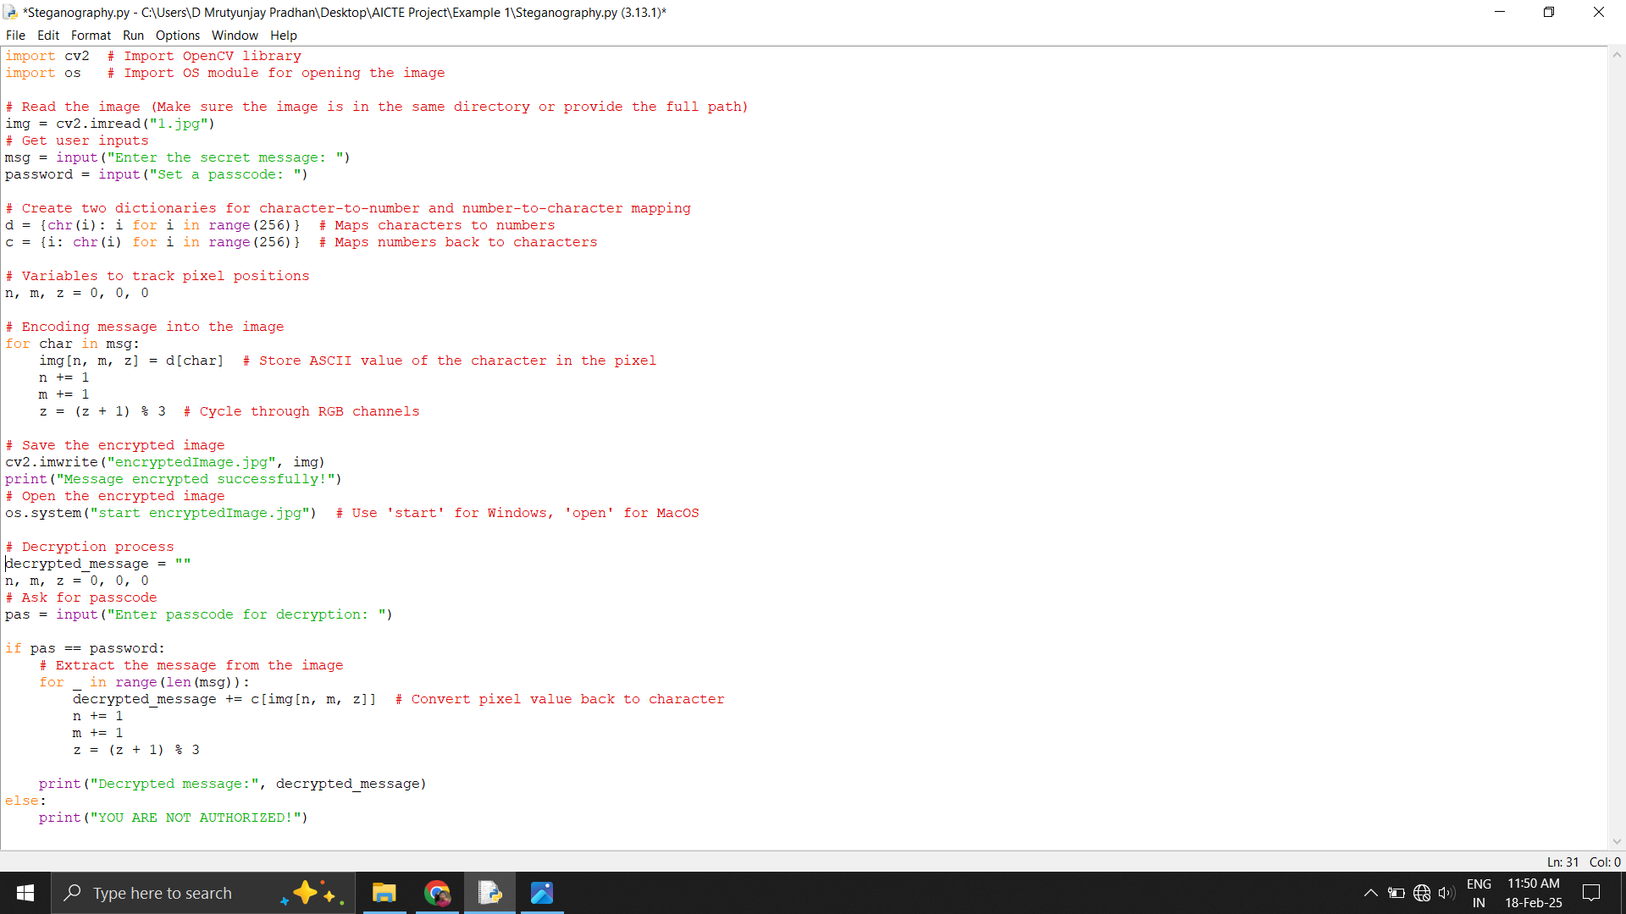

RESULTS
Encryption Code
1.jpg

Slide 8
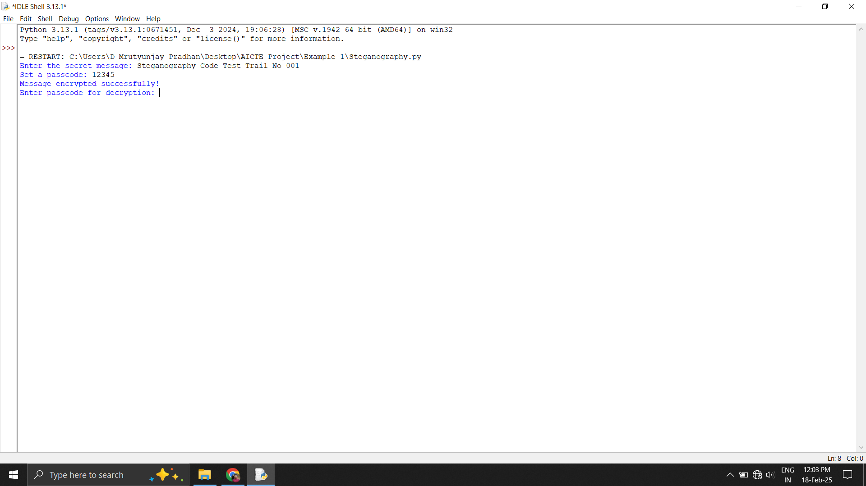

RESULTS
Encryption code excution
encryptedImage.jpg

Slide 9
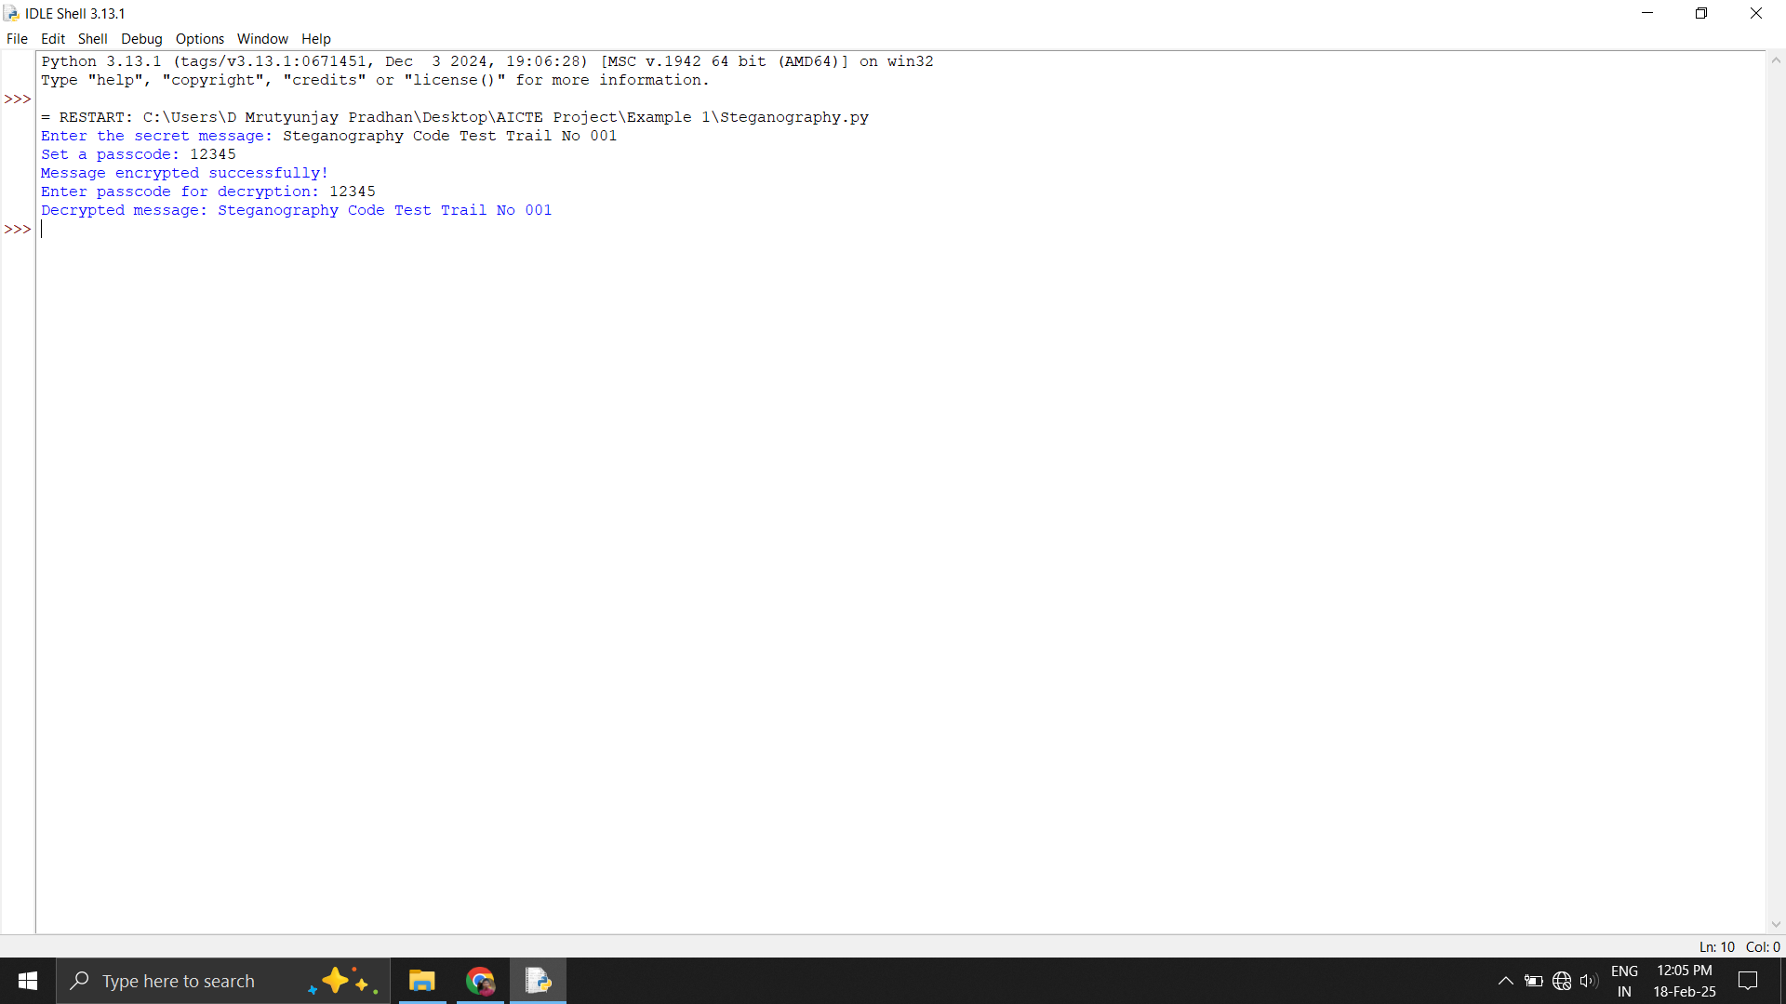
RESULTS
Decryption Code
Decrypted Text

Slide 10
CONCLUSION
The "Secure Data Hiding in Images Using Steganography" project provides an effective and reliable method for concealing sensitive information within digital images. By integrating encryption with steganographic techniques, the system ensures secure data transmission while minimizing the risk of detection. This approach is valuable for cybersecurity, secure communication, and digital watermarking, making it applicable across industries such as defense, corporate security, and personal privacy protection. With advancements in AI, blockchain, and quantum cryptography, the future of steganography promises even stronger and more resilient security solutions. Overall, this project highlights the importance of hidden data transmission in today's evolving digital landscape.

Slide 11
GITHUB LINK
Github Link : https://github.com/D-Mrutyunjay-Pradhan/Image-steganography-using-python.git

Slide 12
FUTURE SCOPE(OPTIONAL)
Enhanced AI-Powered Steganography – The integration of AI and machine learning can improve adaptive steganographic techniques, making hidden data more secure and undetectable.
Quantum-Resistant Steganography – As quantum computing advances, new cryptographic methods can be combined with steganography to ensure long-term security.
Integration with Blockchain – Steganography can be used alongside blockchain technology for secure, tamper-proof data transmission and authentication.
Advanced Cybersecurity Applications – Future cybersecurity solutions can integrate steganography for secure communication in industries like banking, healthcare, and government.
Steganography in IoT & Cloud Security – With the rise of IoT and cloud computing, steganographic techniques can be applied to secure data transmission and prevent cyber threats.

Slide 13
THANK YOU

