Slide 1

Python

Slide 2
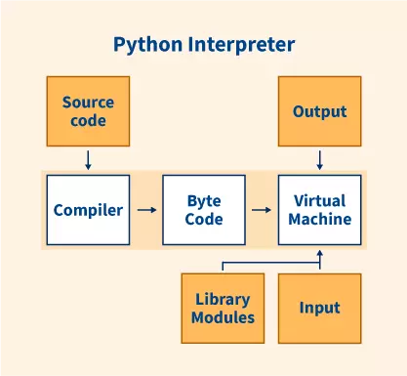

Slide 3
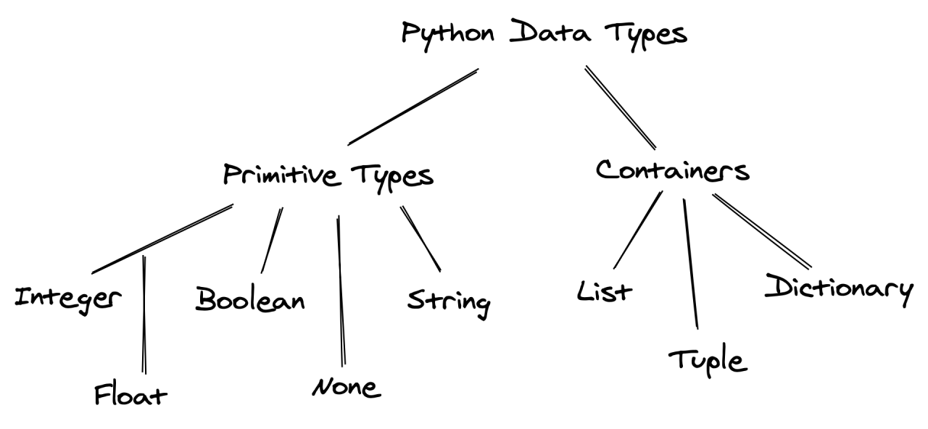
https://www.scholarhat.com/tutorial/python/data-types-in-python

Slide 4
1. Numeric data types in Python
# integer variable.
a=150
print("The type of variable having value", a, " is ", type(a))
# float variable.
b=20.846
print("The type of variable having value", b, " is ", type(b))
# complex variable.
c=18+3j
print("The type of variable having value", c, " is ", type(c))

Slide 5
2. Python String Data Type
str = 'Hello World!’
print (str) # Prints complete string
print (str[0]) # Prints first character of the string
print (str[2:5]) # Prints characters starting from 3rd to 5th
print (str[2:]) # Prints string stating from 3rd character
print (str * 2) # Prints string two times
print (str + "TEST") # Prints concatenated string

Slide 6
3. Python List Data Type
list = [ 'abcd', 786 , 2.23, 'Scholar-Hat', 70.2 ]
tinylist = [123, 'Scholar-Hat']
print (list) # Prints complete list
print (list[0]) # Prints first element of the list
print (list[1:3]) # Prints elements starting from 2nd till 3rd
print (list[2:]) # Prints elements starting from 3rd element
print (tinylist * 2) # Prints list two times
print (list + tinylist) # Prints concatenated lists

Slide 7
4. Python Tuple Data Type
tuple = ( 'abcd', 786 , 2.23, 'Scholar-Hat', 70.2 )
tinytuple = (123, 'Scholar-Hat')
print (tuple) # Prints the complete tuple
print (tuple[0]) # Prints first element of the tuple
print (tuple[1:3]) # Prints elements of the tuple starting from 2nd till 3rd
print (tuple[2:]) # Prints elements of the tuple starting from 3rd element
print (tinytuple * 2) # Prints the contents of the tuple twice
print (tuple + tinytuple) # Prints concatenated tuples

Slide 8
5. Python Range Data Type
for i in range(1, 5):
print(i)

Slide 9
6. Python Dictionary Data Type
dict = {}
dict['one'] = "This is one"
dict[2] = "This is two"
tinydict = {'name': 'Scholar-Hat','code':6734, 'dept': 'sales'}
print (dict['one']) # Prints value for 'one' key
print (dict[2]) # Prints value for 2 key
print (tinydict) # Prints complete dictionary
print (tinydict.keys()) # Prints all the keys
print (tinydict.values()) # Prints all the values

Slide 10
7. Python Boolean Data Type
a = True
# display the value of a
print(a)
# display the data type of a
print(type(a))

Slide 11
8. Python Set Data Type
my_set = {1, 2, 3, 4, 5}
print(my_set)

Slide 12
Data type conversion function
a = str(1) # a will be "1"
b = str(2.2) # b will be "2.2"
c = str("3.3") # c will be "3.3"
print (a)
print (b)
print (c)

Slide 13
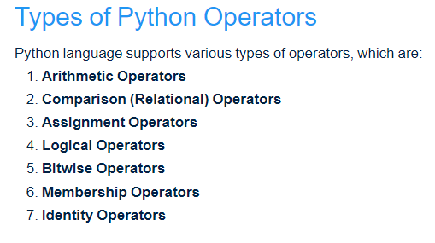
https://www.scholarhat.com/tutorial/python/operators-of-python

Slide 14
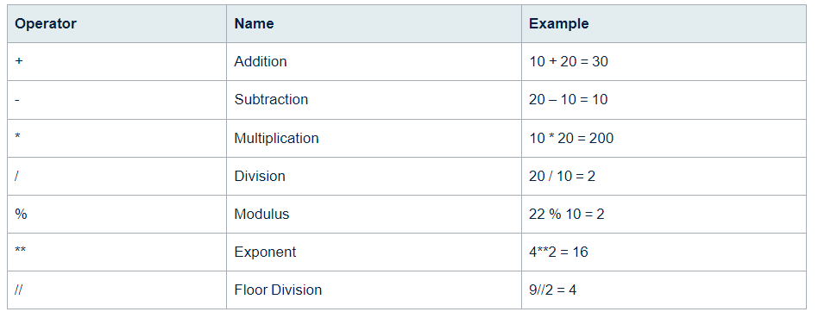
1. Python Arithmetic Operators

Slide 15
a = 21
b = 10
# Addition
print ("a + b : ", a + b)
# Subtraction
print ("a - b : ", a - b)
# Multiplication
print ("a * b : ", a * b)
# Division
print ("a / b : ", a / b)
# Modulus
print ("a % b : ", a % b)
# Exponent
print ("a ** b : ", a ** b)
# Floor Division
print ("a // b : ", a // b)

Slide 16
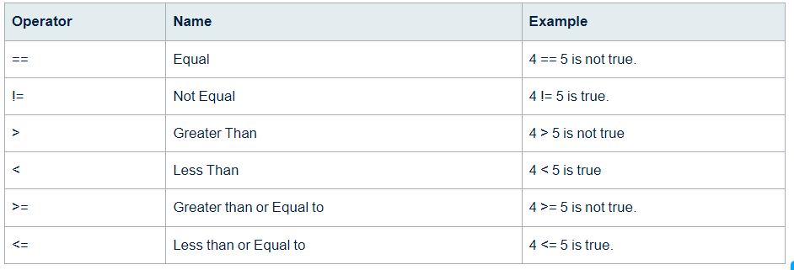
2. Python Comparison Operators

Slide 17
a = 4
b = 5
# Equal
print ("a == b : ", a == b)
# Not Equal
print ("a != b : ", a != b)
# Greater Than
print ("a > b : ", a > b)
# Less Than
print ("a < b : ", a < b)
# Greater Than or Equal to
print ("a >= b : ", a >= b)
# Less Than or Equal to
print ("a <= b : ", a <= b)

Slide 18
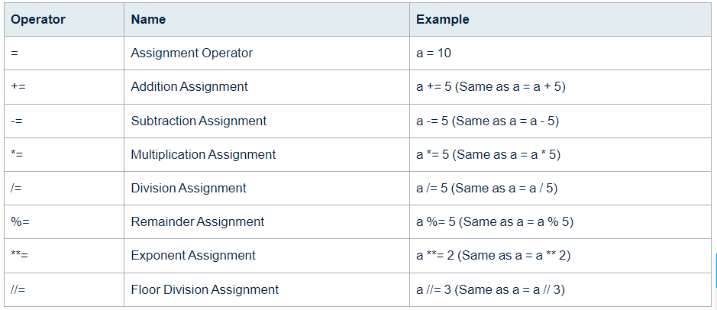
3. Python Assignment Operators

Slide 19
# Assignment Operator
a = 10
# Addition Assignment
a += 5
print ("a += 5 : ", a)
# Subtraction Assignment
a -= 5
print ("a -= 5 : ", a)
# Multiplication Assignment
a *= 5
print ("a *= 5 : ", a)
# Division Assignment
a /= 5
print ("a /= 5 : ",a)
# Remainder Assignment
a %= 3
print ("a %= 3 : ", a)
# Exponent Assignment
a **= 2
print ("a **= 2 : ", a)
# Floor Division Assignment
a //= 3
print ("a //= 3 : ", a)

Slide 20
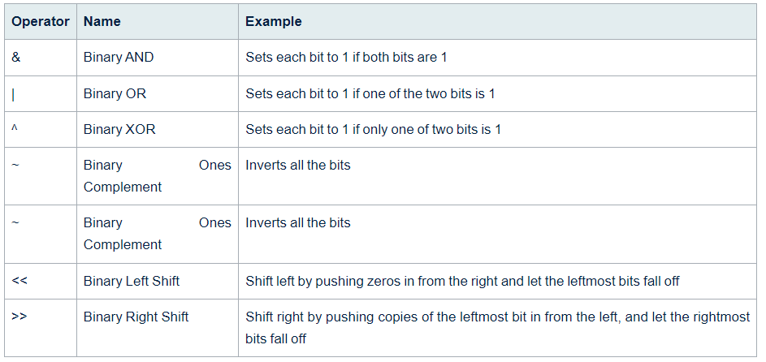
4. Python Bitwise Operators

Slide 21
a = 60 # 60 = 0011 1100
b = 13 # 13 = 0000 1101
# Binary AND
c = a & b # 12 = 0000 1100
print ("a & b : ", c)
# Binary OR
c = a | b # 61 = 0011 1101
print ("a | b : ", c)
# Binary XOR
c = a ^ b # 49 = 0011 0001
print ("a ^ b : ", c)
# Binary Ones Complement
c = ~a; # -61 = 1100 0011
print ("~a : ", c)
# Binary Left Shift
c = a << 2; # 240 = 1111 0000
print ("a << 2 : ", c)
# Binary Right Shift
c = a >> 2; # 15 = 0000 1111
print ("a >> 2 : ", c)

Slide 22
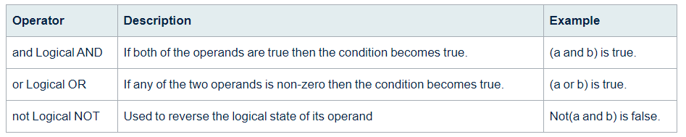
5. Python Logical Operators

Slide 23
x = 5
y = 10
if x > 3 and y < 15:
print("Both x and y are within the specified range")

Slide 24
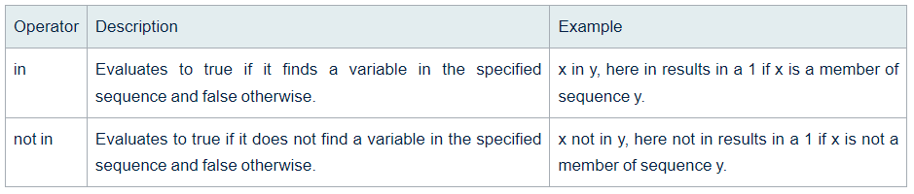
6. Python Membership Operators

Slide 25
fruits = ["apple", "banana", "cherry"]
if "banana" in fruits:
print("Yes, banana is a fruit!")
else:
print("No, banana is not a fruit!")

Slide 26
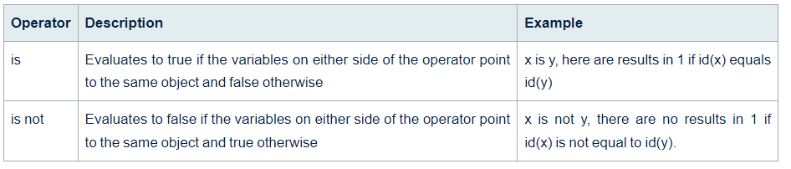
7. Python Identity Operators

Slide 27
x = 10
y = 5
if x is y:
print("x and y are the same object")
else:
print("x and y are not the same object")

Slide 28
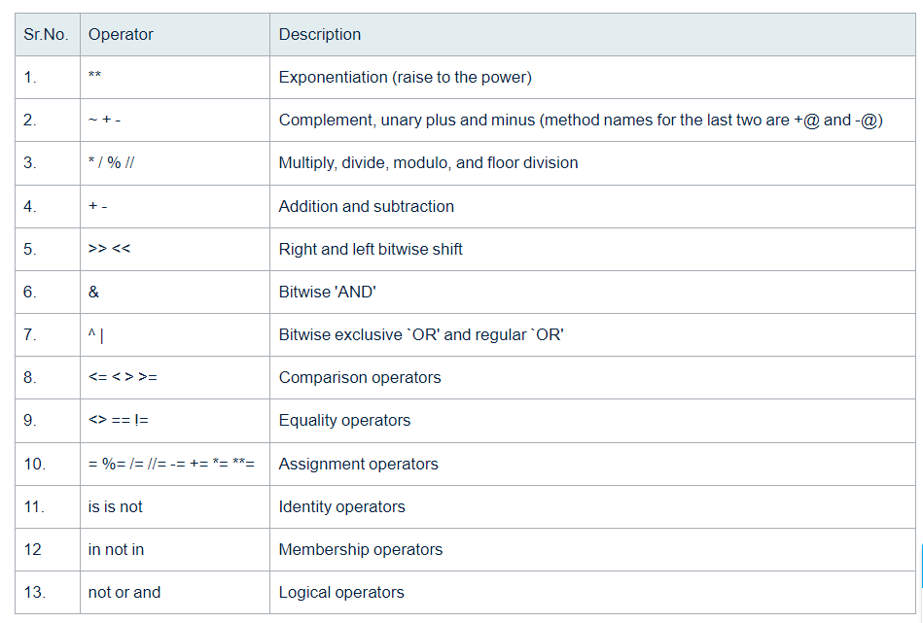
Python Operators Precedence

Slide 29
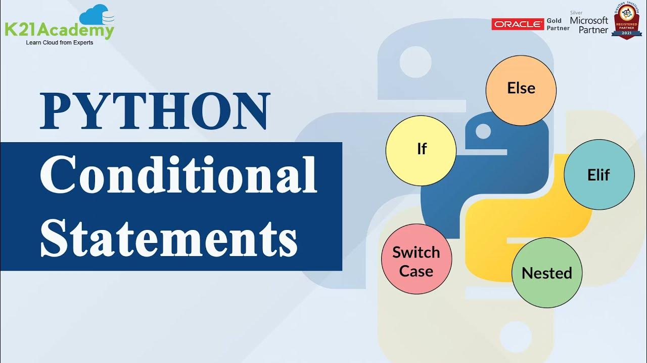

Slide 30
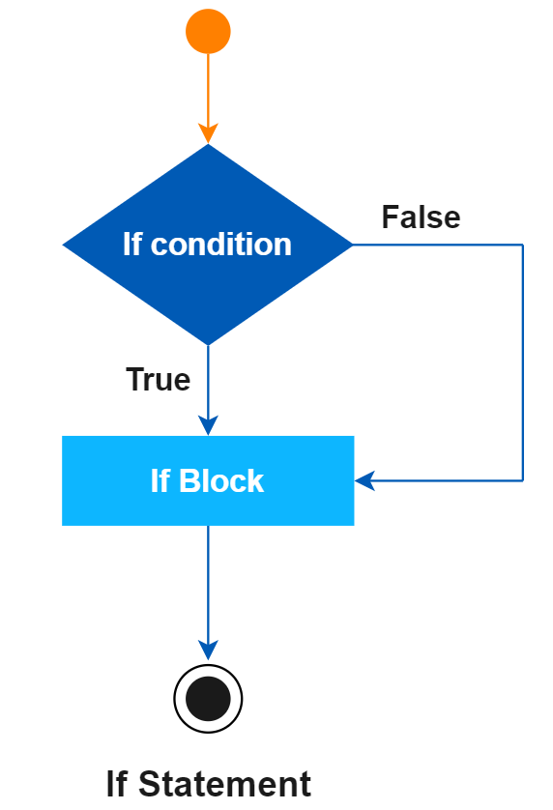
1. If statements in python
num = 8
if num > 0:
print("The number is positive.")

Slide 31
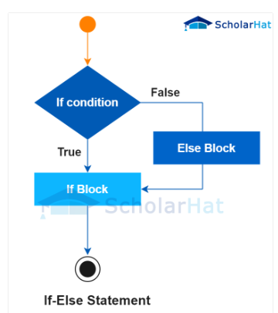
2. If else statement in python
num = 11
if num % 2 == 0:
print("The number is even.")
else:
print("The number is odd.")

Slide 32
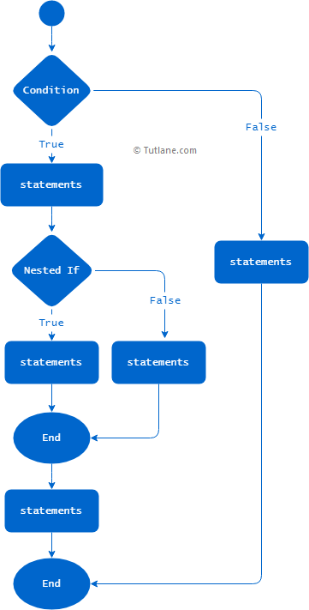
3. Nested if else statement in Python
num = 3
if num > 0:
if num % 2 == 0:
print("The number is positive and even.")
else:
print("The number is positive but odd.")
else:
print("The number is not positive.")

Slide 33
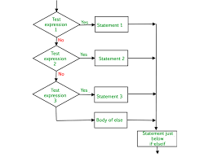
4. Python if-elif-else Ladder
x = 11
if x == 2:
print("x is equal to 2")
elif x == 3:
print("x is equal to 3")
elif x == 4:
print("x is equal to 4")
else:
print("x is not equal to 2, 3, or 4")

Slide 34
Short Hand if Statement
i = 21
if i > 15: print("i is greater than 15")
Short Hand if-else statement
age = 12
message = "You can vote" if age >= 18 else "You cannot vote yet"
print(message)

Slide 35
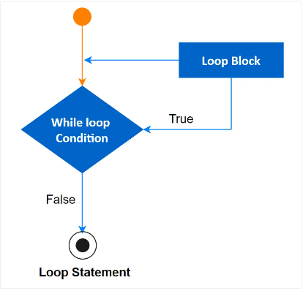
Different Types of Loops in Python
Python while loop
Python for loop
Python nested loop
1. Python while loop
count = 0
while (count < 10):
print ('The count is:', count)
count = count + 1
print ("Good bye!")
https://www.scholarhat.com/tutorial/python/python-while-loop

Slide 36
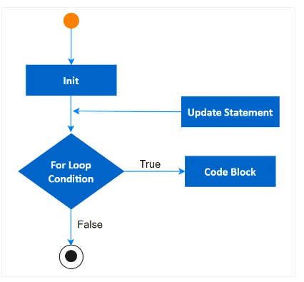
2. Python for loop
# First Example
for letter in 'Python':
print ('Current Letter :', letter)
# Second Example
fruits = ['guava', 'apple', 'mango']
for fruit in fruits:
print ('Current fruit :', fruit)
print ("Good bye!")
https://www.scholarhat.com/tutorial/python/python-while-loop

Slide 37
3. Python Nested loop
i = 2
while(i < 100):
j = 2
while(j <= (i/j)):
if not(i%j): break
j = j + 1
if (j > i/j) : print (i, " is prime")
i = i + 1
print ("Good bye!")

Slide 38
Loop Control Statements in Python
Break
Continue
Pass
1. Break
2. Continue
3. Pass
for i in range(10):
if i == 5:
break
print(i)
for i in range(10):
if i % 2 == 0:
continue
print(i)
for i in range(10):
# Do nothing
pass

Slide 39
Python Match Case Statement
# simple match case statement
def runMatch():
num = int(input("Enter a number between 1 and 3: "))
num=1
# match case
match num:
# pattern 1
case 1:
print("One")
# pattern 2
case 2:
print("Two")
# pattern 3
case 3:
print("Three")
# default pattern
case _:
print("Number not between 1 and 3")
runMatch()

Slide 40
List, Tuple, String, and Dictionary Iteration Using for Loops
1. Lists
4. Dictionaries
my_list = [1, 2, 3, 4, 5]
for item in my_list:
print(item)
Keys: Iterate over the keys of the dictionary.
Values: Iterate over the values of the dictionary.
Items: Iterate over key-value pairs.
my_dict = {'a': 1, 'b': 2, 'c': 3}
for key in my_dict:
print(key)
2. Tuples
my_tuple = (10, 20, 30, 40, 50)
for item in my_tuple:
print(item)
for value in my_dict.values():
print(value)
3. Strings
for key, value in my_dict.items():
print(f"Key: {key}, Value: {value}")
my_string = "hello"
for char in my_string:
print(char)

Slide 41
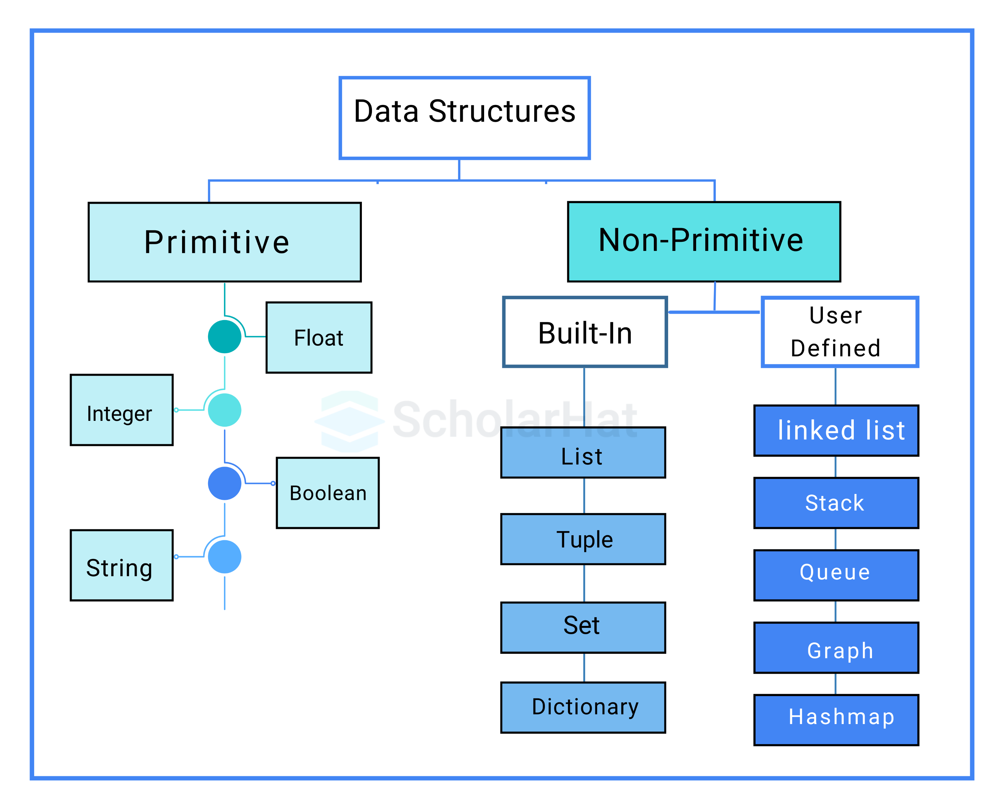

Slide 42
Built-In Data Structures in Python
1. Python Lists
# Initializing a List
myList = ["ScholarHat", "Shailendra Chuauhan", "Girdhar Singh"]
# Display the list
print("A diverse Python list: ")
print(myList)
# Creating a Nested List
nestedList = [["Sakshi", "Sourav"], ["Pradnya", "Pragati"]]
print("\nNested List: ")
print(nestedList)
# Accessing elements from the list
print("\nAccessing elements from the list:")
print(nestedList[0][1])
print(myList[2])
# Accessing elements using negative indexing
print("\nAccessing elements with negative indexing:")
# Print the last element of the list
print(myList[-1])
# Print the second last element of the list
print(myList[-2])

Slide 43
1. Add Elements
3. Delete Elements
my_list = [1, 2, 3]
my_list.append(4) # my_list becomes [1, 2, 3, 4]
my_list = [1, 2, 3]
my_list.remove(2) # my_list becomes [1, 3]
my_list = [1, 2, 3]
my_list.extend([4, 5]) # my_list becomes [1, 2, 3, 4, 5]
my_list = [1, 2, 3]
element = my_list.pop()
# element becomes 3, my_list becomes [1, 2]
my_list = [1, 2, 3]
my_list.insert(1, 1.5) # my_list becomes [1, 1.5, 2, 3]
my_list = [1, 2, 3]
my_list.clear() # my_list becomes []
2. Modify Elements
my_list = [1, 2, 3]
index = my_list.index(2) # index becomes 1
4. Sort Elements
my_list = [3, 1, 2]
my_list.sort() # my_list becomes [1, 2, 3]
my_list.sort(reverse=True) # my_list becomes [3, 2, 1]
my_list = [1, 2, 2, 3]
count = my_list.count(2) # count becomes 2
my_list = [3, 1, 2]
new_list = sorted(my_list) # new_list becomes [1, 2, 3]

Slide 44
5. Copy Lists
7. List Methods Overview
append(x): Adds an element to the end of the list.
extend(iterable): Extends the list by appending elements from an iterable.
insert(i, x): Inserts an element at a given position.
remove(x): Removes the first occurrence of an element.
pop([i]): Removes and returns the item at the given position in the list.
clear(): Removes all items from the list.
index(x): Returns the index of the first occurrence of an element.
count(x): Returns the number of occurrences of an element.
sort(key=None, reverse=False): Sorts the list in place.
reverse(): Reverses the elements of the list in place.
copy(): Returns a shallow copy of the list.
my_list = [1, 2, 3]
new_list = my_list.copy() # new_list is [1, 2, 3]
my_tuple = (1, 2, 3)
my_list = list(my_tuple) # my_list becomes [1, 2, 3]
6. Join Lists
list1 = [1, 2]
list2 = [3, 4]
result = list1 + list2 # result becomes [1, 2, 3, 4]
my_list = [1, 2]
result = my_list * 3 # result becomes [1, 2, 1, 2, 1, 2]

Slide 45
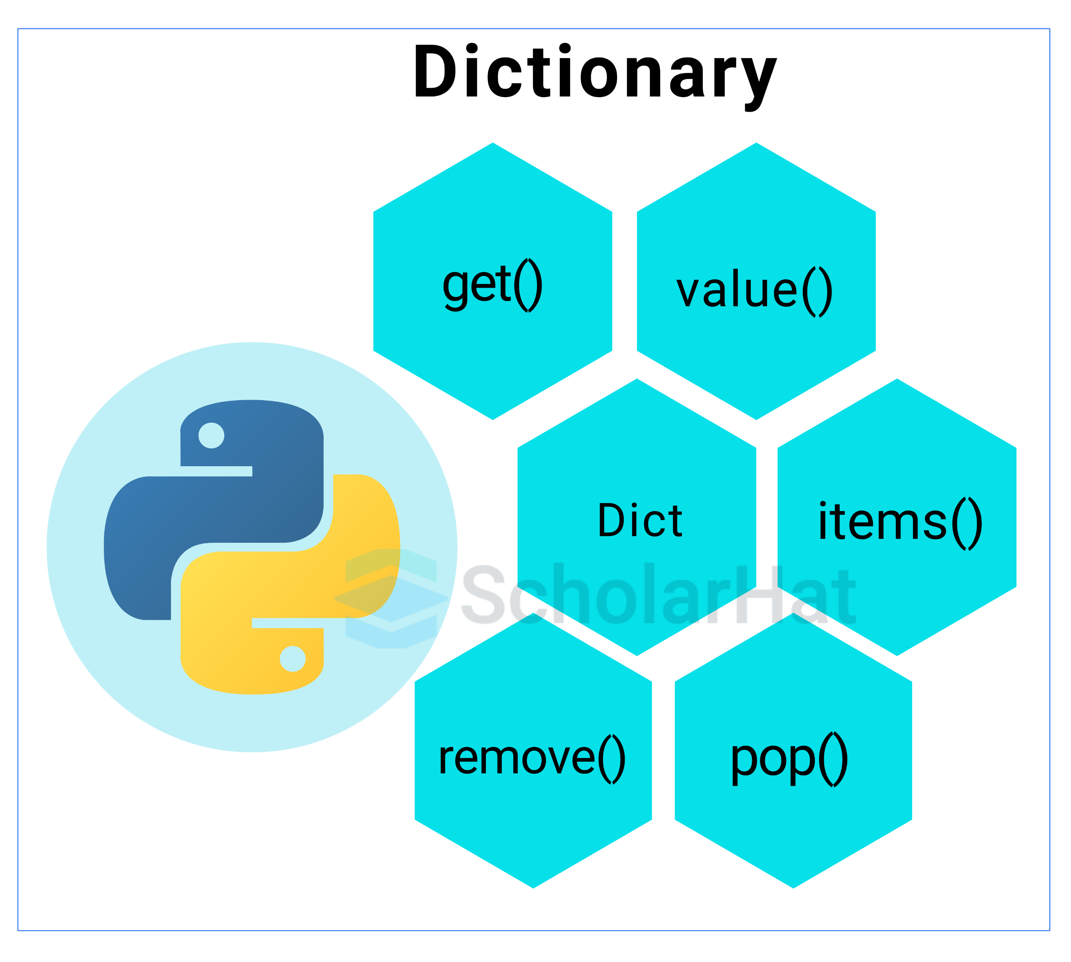
2. Python Dictionary
# Creating a Dictionary with mixed keys
myDict = {'Course': 'Python', 34: ['Beginner', 'Advanced']}
print("Created Dictionary: ")
print(myDict[34][0])
print(myDict)
# Accessing an element using its key
print("Accessing an element using its key:")
print(myDict['Course'])
# Accessing an element using the get() method
print("Accessing an element using get():")
print(myDict.get(34))
# Creating a dictionary using dictionary comprehension
squaredDict = {x: x**2 for x in range(1, 6)}
print("Dictionary comprehension example:")
print(squaredDict)

Slide 46
my_dict = {'name': 'Alice', 'age': 30}
Access:
print(my_dict['name']) # Output: Alice
Loop:
for key in my_dict:
print(key, my_dict[key])
for key, value in my_dict.items():
print(key, value)
Changes:
my_dict['age'] = 31
Add:
Copy:
new_dict = my_dict.copy()
my_dict['city'] = 'New York'
Nested:
Remove:
nested_dict = {
'person1': {'name': 'Alice', 'age': 30},
'person2': {'name': 'Bob', 'age': 25}
}
print(nested_dict['person1']['name'])
# Output: Alice
del my_dict['city']
Merge:
dict1 = {'a': 1, 'b': 2}
dict2 = {'c': 3, 'd': 4}
merged = dict1 | dict2
print(merged)

Slide 47
Dictionary:
# Create a dictionary
my_dict = {'name': 'Alice', 'age': 30}
# Access a value
print(my_dict['name']) # Output: Alice
# Change a value
my_dict['age'] = 31
# Add a new key-value pair
my_dict['city'] = 'New York'
# Remove a key-value pair
del my_dict['city']
# Loop through the dictionary
for key, value in my_dict.items():
print(f'{key}: {value}')
# Copy the dictionary
new_dict = my_dict.copy()
# Create a nested dictionary
nested_dict = {
'person1': {'name': 'Alice', 'age': 30},
'person2': {'name': 'Bob', 'age': 25}
}
print(nested_dict['person1']['name']) # Output: Alice

Slide 48
3. Python Tuples
# Defining a Tuple with string elements
myTuple = ('Welcome', 'to', 'ScholarHat')
print("\nTuple with strings:")
print(myTuple)
# Converting a list to a Tuple
myList = [100, 200, 300, 400]
print("\nTuple created from a list:")
myTuple = tuple(myList)
# Accessing elements through indexing
print("Accessing the first element of the tuple:")
print(myTuple[0])
# Using negative indexing to access elements
print("\nAccessing the last element of the tuple using negative indexing:")
print(myTuple[-1])

Slide 49
1. Creating Tuples
3. Updating Tuples
# Creating a tuple
my_tuple = (1, 2, 3, 'a', 'b', 'c')
single_element_tuple = (1,) # Note the comma
empty_tuple = ()
# Creating a new tuple by concatenation
my_tuple = (1, 2, 3)
new_tuple = my_tuple + (4, 5)
print(new_tuple) # Output: (1, 2, 3, 4, 5)
# Creating a new tuple by slicing and concatenation
my_tuple = (1, 2, 3, 4, 5)
new_tuple = my_tuple[:2] + (10, 20) + my_tuple[3:]
print(new_tuple) # Output: (1, 2, 10, 20, 4, 5)
2. Accessing Tuple Elements
my_tuple = (1, 2, 3, 'a', 'b', 'c')
# Accessing elements
print(my_tuple[0]) # Output: 1
print(my_tuple[3]) # Output: 'a'
# Negative indexing
print(my_tuple[-1]) # Output: 'c'
print(my_tuple[-2]) # Output: 'b'
4. Unpacking Tuples
# Unpacking
a, b, c, d, e, f = my_tuple
print(a) # Output: 1
print(f) # Output: 'c'
# Unpacking with less/more variables
first, *middle, last = (1, 2, 3, 4, 5)
print(first) # Output: 1
print(middle) # Output: [2, 3, 4]
print(last) # Output: 5

Slide 50
5. Looping Through Tuples
7. Tuple Methods
my_tuple = (1, 2, 2, 3, 2, 4)
count_of_2 = my_tuple.count(2)
print(count_of_2) # Output: 3
my_tuple = (1, 2, 3, 'a', 'b', 'c')
# Looping through tuple
for item in my_tuple:
print(item)
my_tuple = (1, 2, 3, 4, 5)
index_of_3 = my_tuple.index(3)
print(index_of_3) # Output: 2
# If the value is not found
# index_of_10 = my_tuple.index(10) # Raises ValueError
6. Joining Tuples
tuple1 = (1, 2, 3)
tuple2 = (4, 5, 6)
# Joining tuples
combined_tuple = tuple1 + tuple2
print(combined_tuple) # Output: (1, 2, 3, 4, 5, 6)

Slide 51
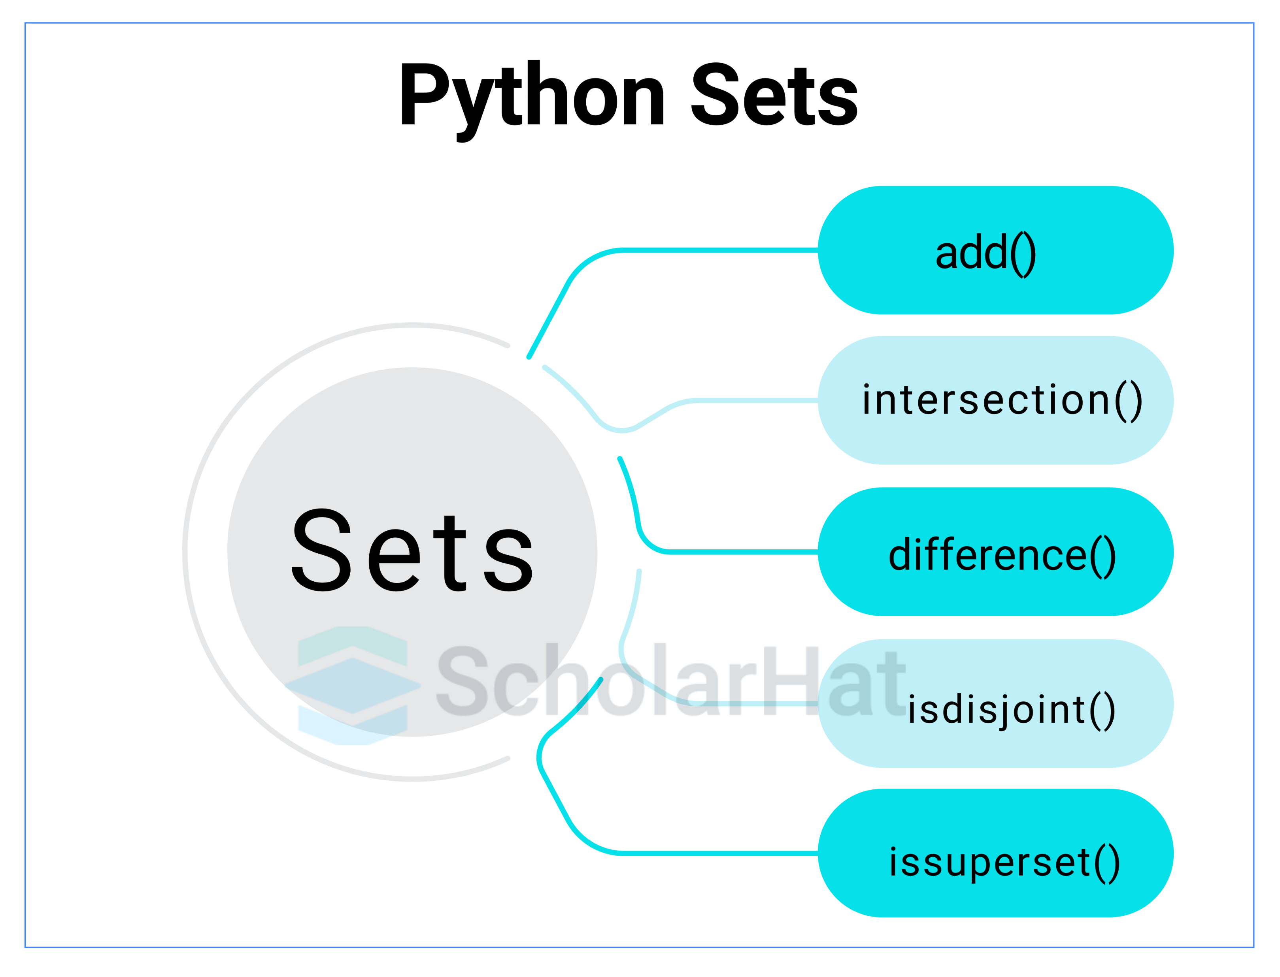
4. Python Sets
# Creating a Set of both string and numerical values
mySet = set([90, 'ScholarHat', 3.14, 'Shailendra Chauhan', 400, 'Sakshi'])
print("\nA Set with mixed value types:")
print(mySet)
# Iterating through the set using a for loop
print("\nIterating through the elements of the set:")
for item in mySet:
print(item, end=" ")
print()
#Iterating through the elements of the set: Sakshi 3.14 ScholarHat 400 90 Shailendra Chauhan
#print(“hai”)
#Iterating through the elements of the set: Sakshi 3.14 ScholarHat 400 90 Shailendra Chauhan hai
# Membership testing using the 'in' keyword
print("'ScholarHat' present in the set:", 'ScholarHat' in mySet)
# Creating a regular set
regular_set = set(["Sakshi", "Pragati", "Shobha"])
print("Regular Set:")
print(regular_set)
# Creating a frozenset
immutable_set = frozenset(["Sourav", "Shailendra", "Girdhar"])
print("\nFrozen Set:")
print(immutable_set)

Slide 52
Accessing Elements in a Set
Removing Elements from a Set
my_set = {1, 2, 3, 4, 5}
# Checking for membership
if 3 in my_set:
print("3 is in the set")
my_set = {1, 2, 3, 4}
# Using remove() (will raise KeyError if 5 is not in the set)
my_set.remove(3)
print(my_set) # Output: {1, 2, 4}
# Using discard() (will not raise an error if 5 is not in the set)
my_set.discard(5)
print(my_set) # Output: {1, 2, 4}
Adding Elements to a Set
my_set = {1, 2, 3}
my_set.add(4)
print(my_set) # Output: {1, 2, 3, 4}
my_set = {1, 2, 3}
element = my_set.pop()
print(f"Removed element: {element}")
print(my_set)
Looping Through a Set
my_set = {1, 2, 3, 4}
for element in my_set:
print(element)

Slide 53
Joining Sets
Sets support several operations to combine them:
Union: Combine two sets
Intersection: Find common elements
Difference: Find elements in one set but not in another
Symmetric Difference: Find elements in either of the sets but not in both.
set1 = {1, 2, 3}
set2 = {3, 4, 5}
# Union
union_set = set1.union(set2)
print(union_set) # Output: {1, 2, 3, 4, 5}
# Intersection
intersection_set = set1.intersection(set2)
print(intersection_set) # Output: {3}
# Difference
difference_set = set1.difference(set2)
print(difference_set) # Output: {1, 2}
# Symmetric Difference
symmetric_difference_set = set1.symmetric_difference(set2)
print(symmetric_difference_set) # Output: {1, 2, 4, 5}

Slide 54
Common Set Methods
Here’s a quick summary of some other useful set methods:
clear(): Removes all elements from the set.
copy(): Returns a shallow copy of the set.
issubset(other_set): Returns True if the set is a subset of other_set.
issuperset(other_set): Returns True if the set is a superset of other_set.
update(other_set): Updates the set with elements from other_set.
intersection_update(other_set): Updates the set with the intersection of itself and other_set.
difference_update(other_set): Updates the set by removing elements found in other_set.
symmetric_difference_update(other_set): Updates the set with the symmetric difference of itself and other_set.

Slide 55
my_set = {1, 2, 3}
other_set = {2, 3, 4}
# Copy
set_copy = my_set.copy()
print(set_copy) # Output: {1, 2, 3}
# Clear
my_set.clear()
print(my_set) # Output: set()
# Re-initialize sets
my_set = {1, 2, 3}
my_set.update(other_set)
print(my_set) # Output: {1, 2, 3, 4}

Slide 56
STRING
1. String Indexing
3. Modify Methods
s = "Hello, World!"
print(s[0]) # Output: H
print(s[7]) # Output: W
s = "Hello, World!"
new_s = s.replace("World", "Python")
print(new_s) # Output: Hello, Python!
s = "Hello, World!"
print(s.upper()) # Output: HELLO, WORLD!
#Negative indices count from the end of the string:
print(s[-1]) # Output: !
print(s[-2]) # Output: d
s = "Hello, World!"
print(s.lower()) # Output: hello, world!
s = " Hello, World! "
print(s.strip()) # Output: Hello, World!
2. String Slicing
s = "Hello, World!"
print(s[0:5]) # Output: Hello
print(s[7:]) # Output: World!
print(s[:5]) # Output: Hello
print(s[::2]) # Output: Hlo ol!
4. String Concatenation
s1 = "Hello"
s2 = "World"
result = s1 + ", " + s2 + "!"
print(result) # Output: Hello, World!

Slide 57
6. Escape Characters
Escape characters are used to represent special characters within a string:
\n for a new line
\t for a tab
\\ for a backslash
\" for a double quote
\' for a single quote
5. String Formatting
name = "Alice"
age = 30
print(f"Name: {name}, Age: {age}") # Output: Name: Alice, Age: 30
template = "Name: {}, Age: {}"
print(template.format("Alice", 30)) # Output: Name: Alice, Age: 30
s = "Hello\tWorld!\nThis is a line break."
print(s)
# Output:
# Hello World!
# This is a line break.
name = "Alice"
age = 30
print("Name: %s, Age: %d" % (name, age)) # Output: Name: Alice, Age: 30
7. String Split
s = "apple,banana,cherry"
result = s.split(",")
print(result) # Output: ['apple', 'banana', 'cherry']
s = "apple,banana,cherry,date"
result = s.split(",", 2)
print(result) # Output: ['apple', 'banana', 'cherry,date']

