Slide 1
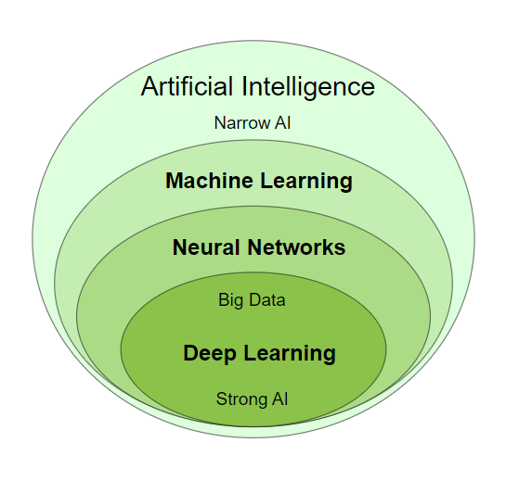
Artificial intelligence
Machine Learning is a subfield of Artificial intelligence

Slide 2
Traditional programming
Data + Algorithms = Results
Machine learning
Data + Results = Algorithms

Slide 3
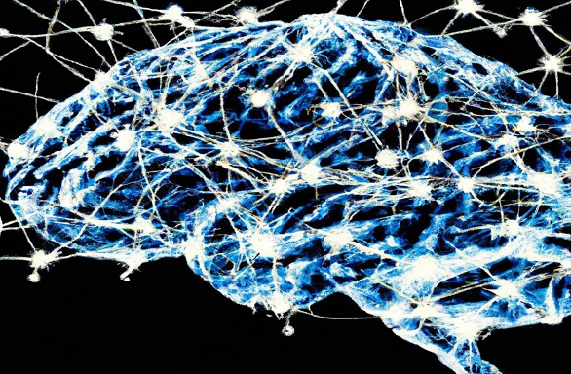
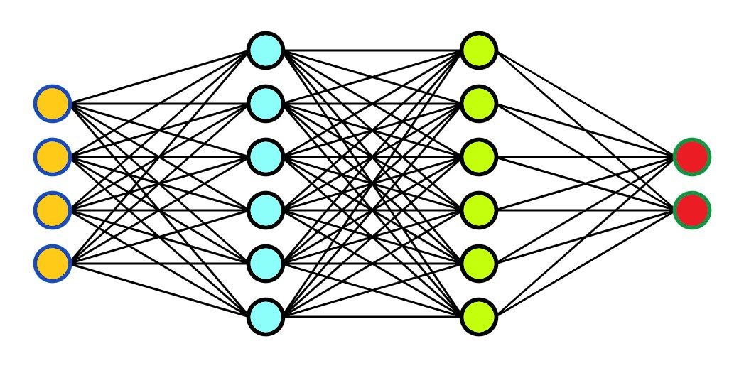
Neural Networks is:
A programming technique
A method used in machine learning
A software that learns from mistakes

Slide 4
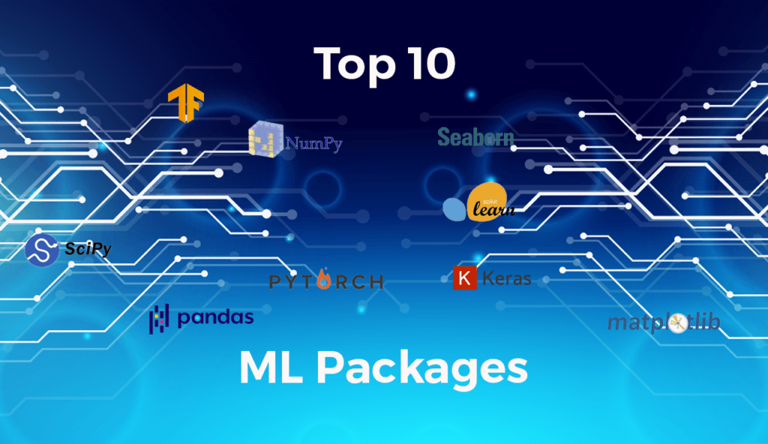

Slide 5
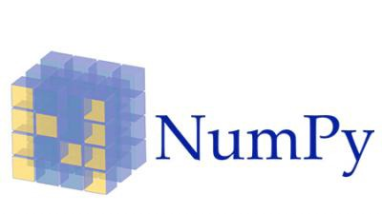
NumPy is a very popular python library for large multi-dimensional array and matrix processing, with the help of a large collection of high-level mathematical functions.
It is very useful for fundamental scientific computations in Machine Learning. It is particularly useful for linear algebra, Fourier transform, and random number capabilities.
High-end libraries like TensorFlow uses NumPy internally for manipulation of Tensors.

Slide 6
# Python program using NumPy
# for some basic mathematical
# operations
import numpy as np
# Creating two arrays of rank 2
x = np.array([[1, 2], [3, 4]])
y = np.array([[5, 6], [7, 8]])
# Creating two arrays of rank 1
v = np.array([9, 10])
w = np.array([11, 12])
# Inner product of vectors
print(np.dot(v, w), "\n")
# Matrix and Vector product
print(np.dot(x, v), "\n")
# Matrix and matrix product
print(np.dot(x, y))
219 [29 67] [[19 22] [43 50]]

Slide 7

SciPy is a very popular library among Machine Learning enthusiasts as it contains different modules for optimization, linear algebra, integration and statistics.
There is a difference between the SciPy library and the SciPy stack.
The SciPy is one of the core packages that make up the SciPy stack.
SciPy is also very useful for image manipulation.

Slide 8
# Python script using Scipy
# for image manipulation
from scipy.misc import imread, imsave, imresize
# Read a JPEG image into a numpy array
img = imread('D:/Programs / cat.jpg') # path of the image
print(img.dtype, img.shape)
# Tinting the image
img_tint = img * [1, 0.45, 0.3]
# Saving the tinted image
imsave('D:/Programs / cat_tinted.jpg', img_tint)
# Resizing the tinted image to be 300 x 300 pixels
img_tint_resize = imresize(img_tint, (300, 300))
# Saving the resized tinted image
imsave('D:/Programs / cat_tinted_resized.jpg', img_tint_resize)
!pip install imageio import imageio from imageio import imread, imsave

Slide 9



Original image:
Tinted image:
Resized tinted image:

Slide 10

Scikit-learn is one of the most popular ML libraries for classical ML algorithms.
It is built on top of two basic Python libraries, viz., NumPy and SciPy.
Scikit-learn supports most of the supervised and unsupervised learning algorithms.
Scikit-learn can also be used for data-mining and data-analysis, which makes it a great tool who is starting out with ML.

Slide 11
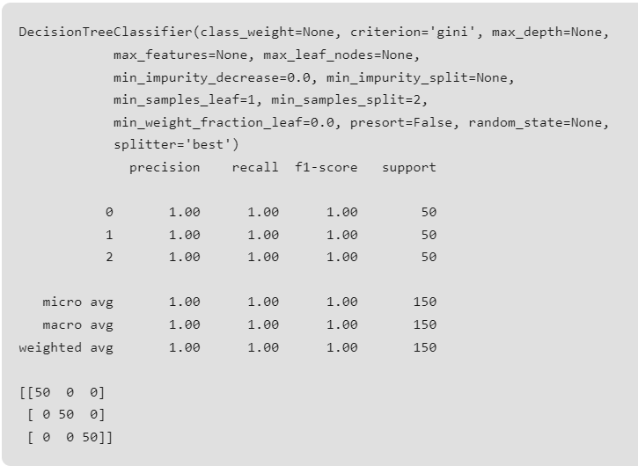
# Python script using Scikit-learn
# for Decision Tree Classifier
# Sample Decision Tree Classifier
from sklearn import datasets
from sklearn import metrics
from sklearn.tree import DecisionTreeClassifier
# load the iris datasets
dataset = datasets.load_iris()
# fit a CART model to the data
model = DecisionTreeClassifier()
model.fit(dataset.data, dataset.target)
print(model)
# make predictions
expected = dataset.target
predicted = model.predict(dataset.data)
# summarize the fit of the model
print(metrics.classification_report(expected, predicted))
print(metrics.confusion_matrix(expected, predicted))

Slide 12

We all know that Machine Learning is basically mathematics and statistics.
Theano is a popular python library that is used to define, evaluate and optimize mathematical expressions involving multi-dimensional arrays in an efficient manner.
It is achieved by optimizing the utilization of CPU and GPU.
It is extensively used for unit-testing and self-verification to detect and diagnose different types of errors.
Theano is a very powerful library that has been used in large-scale computationally intensive scientific projects for a long time but is simple and approachable enough to be used by individuals for their own projects.

Slide 13
# Python program using Theano
# for computing a Logistic
# Function
import theano
import theano.tensor as T
x = T.dmatrix('x')
s = 1 / (1 + T.exp(-x))
logistic = theano.function([x], s)
logistic([[0, 1], [-1, -2]])
array([[0.5, 0.73105858], [0.26894142, 0.11920292]])

Slide 14
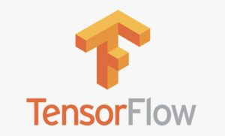
TensorFlow is a very popular open-source library for high performance numerical computation developed by the Google Brain team in Google.
As the name suggests, Tensorflow is a framework that involves defining and running computations involving tensors.
It can train and run deep neural networks that can be used to develop several AI applications.
TensorFlow is widely used in the field of deep learning research and application.

Slide 15
# Python program using TensorFlow
# for multiplying two arrays
# import `tensorflow`
import tensorflow as tf
# Initialize two constants
x1 = tf.constant([1, 2, 3, 4])
x2 = tf.constant([5, 6, 7, 8])
# Multiply
result = tf.multiply(x1, x2)
# Initialize the Session
sess = tf.Session()
# Print the result
print(sess.run(result))
# Close the session
sess.close()
[ 5 12 21 32]

Slide 16

It provides many inbuilt methods for groping, combining and filtering data.
Keras is a very popular Machine Learning library for Python.
It is a high-level neural networks API capable of running on top of TensorFlow, CNTK, or Theano.
It can run seamlessly on both CPU and GPU.
Keras makes it really for ML beginners to build and design a Neural Network.
One of the best thing about Keras is that it allows for easy and fast prototyping.

Slide 17

PyTorch is a popular open-source Machine Learning library for Python based on Torch, which is an open-source Machine Learning library that is implemented in C with a wrapper in Lua.
It has an extensive choice of tools and libraries that support Computer Vision, Natural Language Processing(NLP), and many more ML programs.
It allows developers to perform computations on Tensors with GPU acceleration and also helps in creating computational graphs.

Slide 18
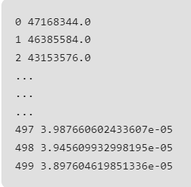
# Python program using PyTorch
# for defining tensors fit a
# two-layer network to random
# data and calculating the loss
import torch
dtype = torch.float
device = torch.device("cpu")
# device = torch.device("cuda:0") Uncomment this to run on GPU
# N is batch size; D_in is input dimension;
# H is hidden dimension; D_out is output dimension.
N, D_in, H, D_out = 64, 1000, 100, 10
# Create random input and output data
x = torch.random(N, D_in, device=device, dtype=dtype)
y = torch.random(N, D_out, device=device, dtype=dtype)
# Randomly initialize weights
w1 = torch.random(D_in, H, device=device, dtype=dtype)
w2 = torch.random(H, D_out, device=device, dtype=dtype)
learning_rate = 1e-6
for t in range(500):
# Forward pass: compute predicted y
h = x.mm(w1)
h_relu = h.clamp(min=0)
y_pred = h_relu.mm(w2)
# Compute and print loss
loss = (y_pred - y).pow(2).sum().item()
print(t, loss)
# Backprop to compute gradients of w1 and w2 with respect to loss
grad_y_pred = 2.0 * (y_pred - y)
grad_w2 = h_relu.t().mm(grad_y_pred)
grad_h_relu = grad_y_pred.mm(w2.t())
grad_h = grad_h_relu.clone()
grad_h[h < 0] = 0
grad_w1 = x.t().mm(grad_h)
# Update weights using gradient descent
w1 -= learning_rate * grad_w1
w2 -= learning_rate * grad_w2

Slide 19

Pandas is a popular Python library for data analysis.
It is not directly related to Machine Learning. As we know that the dataset must be prepared before training.
In this case, Pandas comes handy as it was developed specifically for data extraction and preparation.
It provides high-level data structures and wide variety tools for data analysis.
It provides many inbuilt methods for grouping, combining and filtering data.

Slide 20
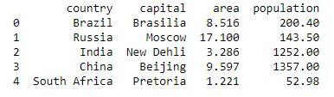
# Python program using Pandas for
# arranging a given set of data
# into a table
# importing pandas as pd
import pandas as pd
data = {"country": ["Brazil", "Russia", "India", "China", "South Africa"],
"capital": ["Brasilia", "Moscow", "New Delhi", "Beijing", "Pretoria"],
"area": [8.516, 17.10, 3.286, 9.597, 1.221],
"population": [200.4, 143.5, 1252, 1357, 52.98] }
data_table = pd.DataFrame(data)
print(data_table)

Slide 21
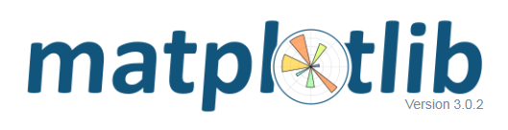
Matplotlib is a very popular Python library for data visualization.
Like Pandas, it is not directly related to Machine Learning.
It particularly comes in handy when a programmer wants to visualize the patterns in the data.
It is a 2D plotting library used for creating 2D graphs and plots.
A module named pyplot makes it easy for programmers for plotting as it provides features to control line styles, font properties, formatting axes, etc.
It provides various kinds of graphs and plots for data visualization, viz., histogram, error charts, bar chats, etc,

Slide 22
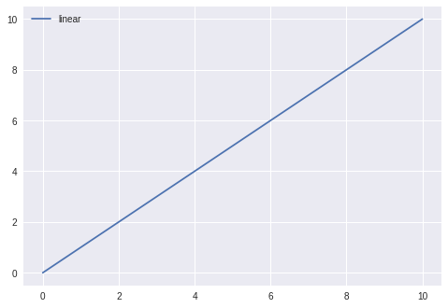
# Python program using Matplotlib
# for forming a linear plot
# importing the necessary packages and modules
import matplotlib.pyplot as plt
import numpy as np
# Prepare the data
x = np.linspace(0, 10, 100)
# Plot the data
plt.plot(x, x, label ='linear')
# Add a legend
plt.legend()
# Show the plot
plt.show()

Slide 23
Machine Learning Algorithms
Types of Machine Learning Algorithms
Machine learning algorithms are classified into 4 types:
Supervised
Unsupervised Learning
Semi-supervised Learning
Reinforcement Learning

Slide 24
Supervised Learning
Supervised learning is a machine learning approach where algorithms learn from labeled data.The algorithm receives input data and corresponding correct output labels in this process. The objective is to train the algorithm to predict accurate labels for new, unseen data. Examples of supervised learning algorithms include:
Decision Trees
Support Vector Machines
Random Forests
Naive Bayes
These algorithms can be used for classification, regression, and time series forecasting tasks. Supervised learning is widely used in various domains, including healthcare, finance, marketing, and image recognition, to make predictions and gain valuable insights from data.

Slide 25
Unsupervised Learning
In this machine learning approach, algorithms analyze unlabeled data without predefined output labels. The objective is to discover patterns, relationships, or structures within the data. Unlike supervised learning, unsupervised learning algorithms work independently to uncover hidden insights and group similar data points together. Common unsupervised learning techniques include clustering algorithms like:
K-means
Hierarchical clustering
Dimensionality Reduction Methods like PCA and t-SNE

Slide 26
Semi-supervised Learning
Semi-supervised learning is a hybrid machine learning approach that combines labeled and unlabeled data for training.
It leverages the limited labeled data and a larger set of unlabeled data to improve the learning process.
The idea is that the unlabeled data provide additional information and context to enhance the model's understanding and performance.
By utilizing the unlabeled data effectively, semi-supervised learning can overcome the limitations of relying solely on labeled data.
This approach is particularly useful when acquiring labeled data is expensive or time-consuming.
Semi-supervised learning techniques can be applied to various tasks, such as classification, regression, and anomaly detection, allowing models to make more accurate predictions and generalize better in real-world scenarios.

Slide 27
Reinforcement Learning
Reinforcement learning is a machine learning algorithm inspired by how humans learn from trial and error.
Here, an agent interacts with an environment and learns to make optimal decisions to maximize cumulative rewards.
The agent receives feedback through rewards or penalties based on its actions.
The agent learns to take actions that lead to the most favorable outcomes over time.
It is commonly used in robotics, game playing, and autonomous systems.
It enables machines to learn from their experiences, adapt to changing environments, and achieve long-term goals through a sequence of actions.
This dynamic approach to learning makes reinforcement learning a powerful technique for tackling complex decision-making problems.

Slide 28
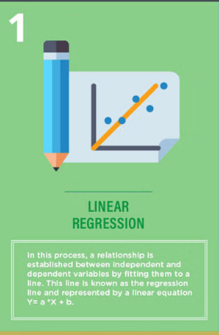
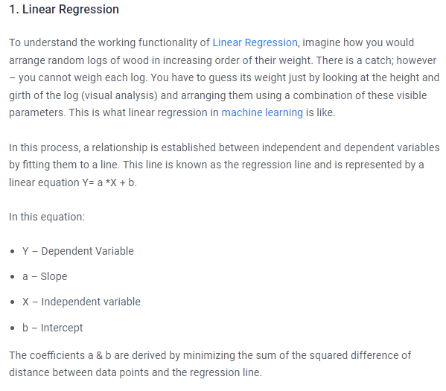
Machine Learning Algorithms

Slide 29
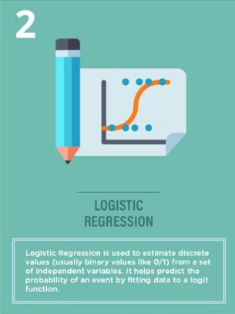
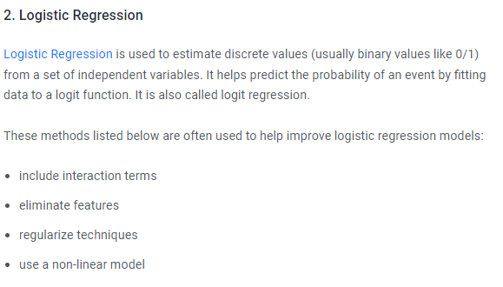
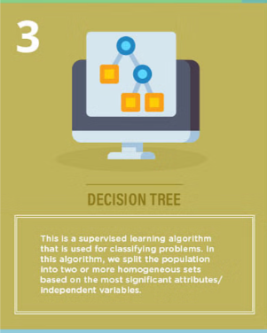
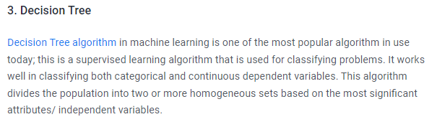

Slide 30
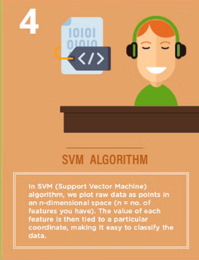
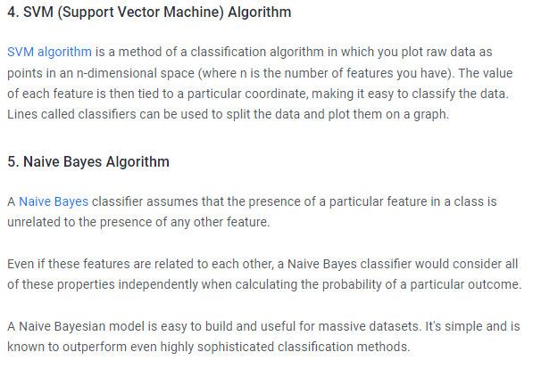
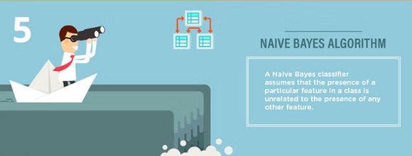

Slide 31
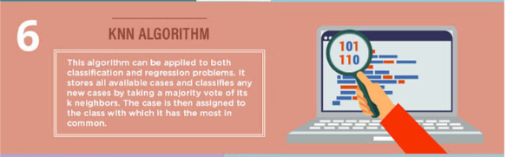
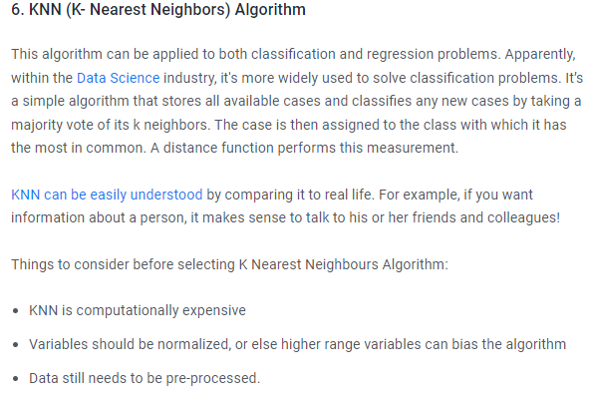

Slide 32
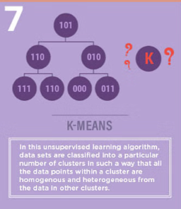
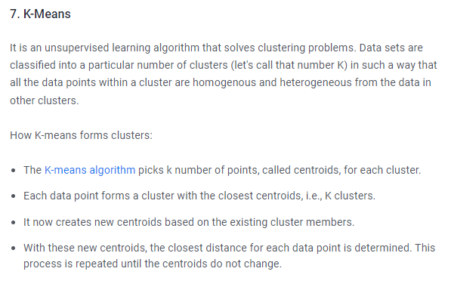

Slide 33
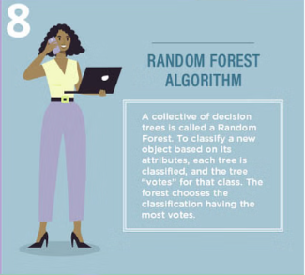
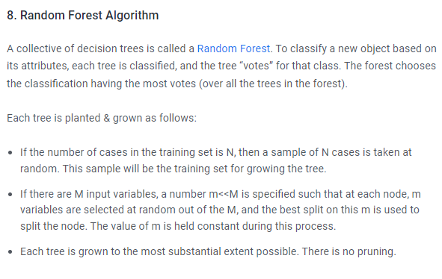

Slide 34
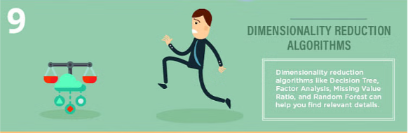
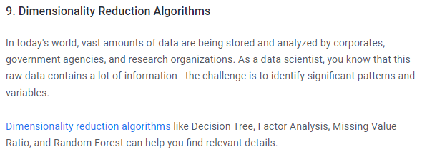

Slide 35
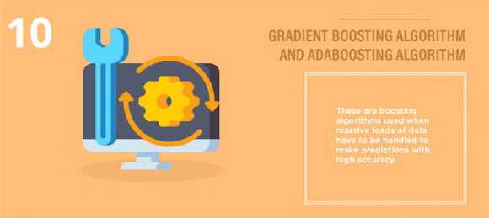
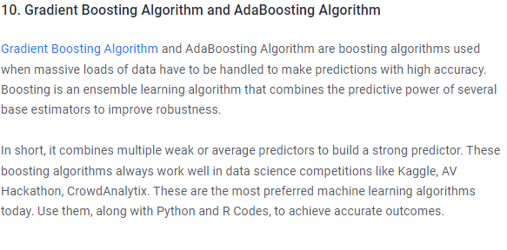

Slide 36
Pandas is a Python library used for working with data sets.
It has functions for analyzing, cleaning, exploring, and manipulating data.
The name "Pandas" has a reference to both "Panel Data", and "Python Data Analysis" and was created by Wes McKinney in 2008.

Slide 37
Why Use Pandas?
Pandas allows us to analyze big data and make conclusions based on statistical theories.
Pandas can clean messy data sets, and make them readable and relevant.
Relevant data is very important in data science.
What Can Pandas Do?
Pandas gives you answers about the data. Like:
Is there a correlation between two or more columns?
What is average value?
Max value?
Min value?
Pandas are also able to delete rows that are not relevant, or contains wrong values, like empty or NULL values. This is called cleaning the data.

Slide 38
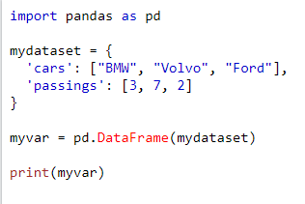
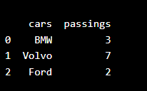
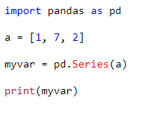
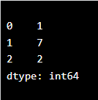

Slide 39
(ML) algorithms output
Continuous Output:
Regression algorithms typically produce continuous outputs. Examples include predicting house prices, stock prices, or the temperature.
Discrete Output:
Classification algorithms produce discrete outputs, usually in the form of class labels. Examples include predicting whether an email is spam or not, identifying the species of a flower, or classifying images into different categories.
Probabilistic Output:
Some algorithms output probabilities associated with each class in classification tasks. These probabilities represent the likelihood of each class given the input features. Algorithms such as logistic regression, softmax regression, and some neural networks produce probabilistic outputs.
Ranking Output:
Ranking algorithms assign a ranking to items based on their relevance or importance. These algorithms are common in information retrieval systems, search engines, and recommendation systems.
Sequence Output:
Sequence prediction algorithms output a sequence of values or symbols. Examples include predicting the next word in a sentence (language modeling), generating captions for images, or translating text from one language to another.
Anomaly Detection:
Anomaly detection algorithms identify unusual patterns or outliers in data. The output may be a binary classification (normal or anomaly) or a score indicating the degree of anomaly.
Clustering:
Clustering algorithms group similar data points together into clusters. The output may be the cluster assignments for each data point or centroids representing cluster centers.
Reinforcement Learning:
In reinforcement learning, the output is typically an action selected by the agent based on the current state and policy. The action can be discrete (e.g., choosing among a set of predefined actions) or continuous (e.g., selecting a value from a continuous action space).
Multi-label Classification:
In multi-label classification, the output is a set of binary labels indicating the presence or absence of each class. Each instance can belong to multiple classes simultaneously.
Structured Output:
Structured output algorithms produce complex outputs that have a specific structure, such as graphs, trees, or sequences with dependencies between elements.
The choice of output type depends on the nature of the problem, the available data, and the desired outcome of the ML task. It's essential to select an appropriate output type that aligns with the goals of the project and the characteristics of the data.

