Slide 1
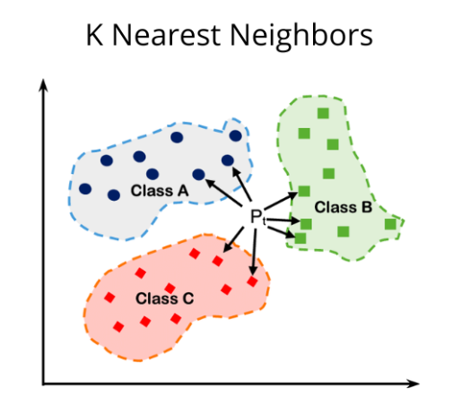

Slide 2

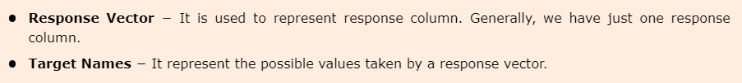
Modelling
Dataset Loading
Features
The variables of data are called its features. They are also known as predictors, inputs or attributes.
Response
It is the output variable that basically depends upon the feature variables. They are also known as target, label or output.
example datasets like iris and digits for classification and the Boston house prices for regression.

Slide 3
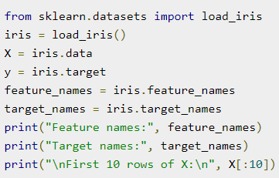
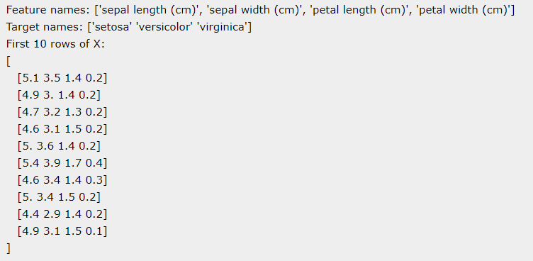

Slide 4
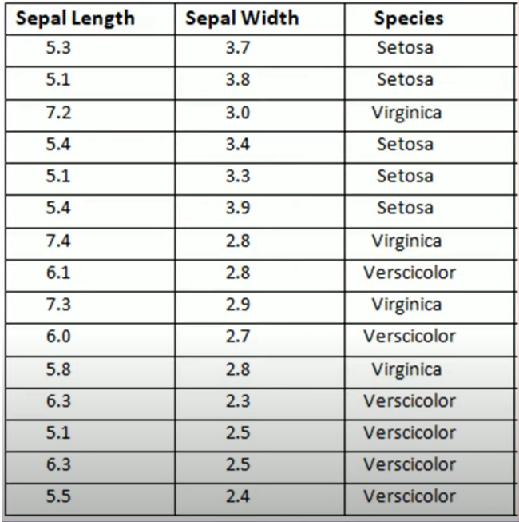

Slide 5
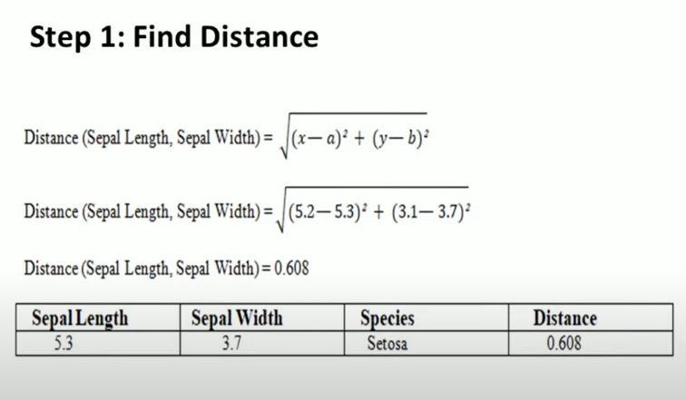

Slide 6
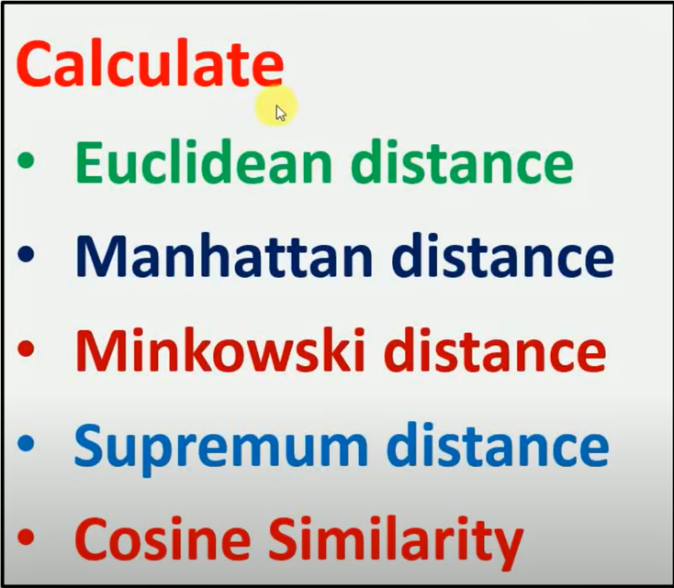

Slide 7
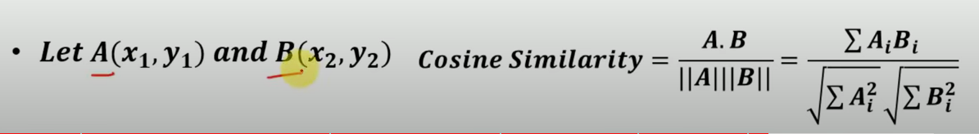

Slide 8
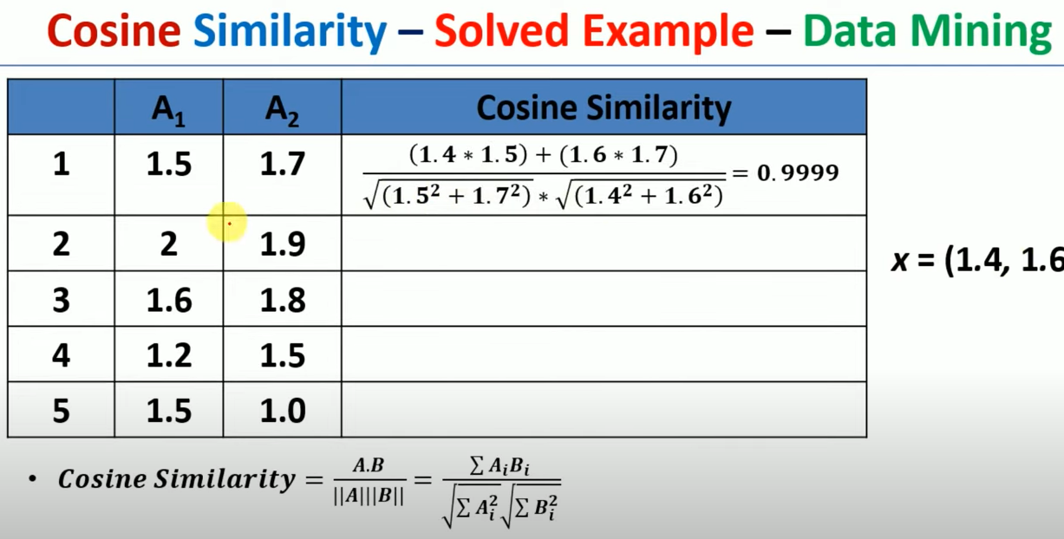

Slide 9
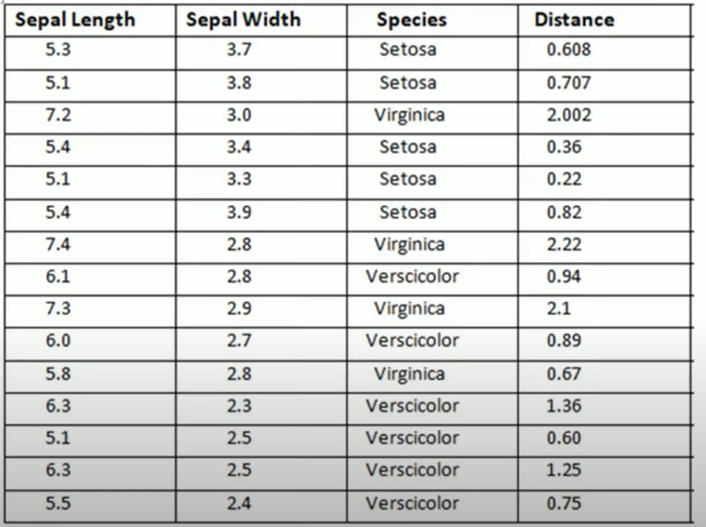
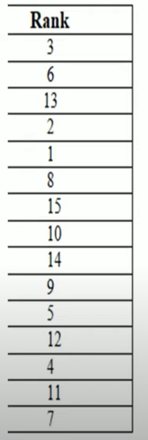

Slide 10
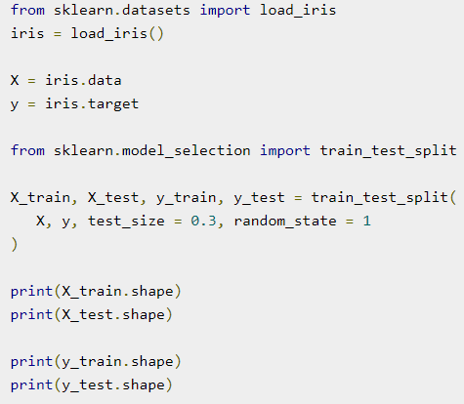

Splitting the dataset

Slide 11
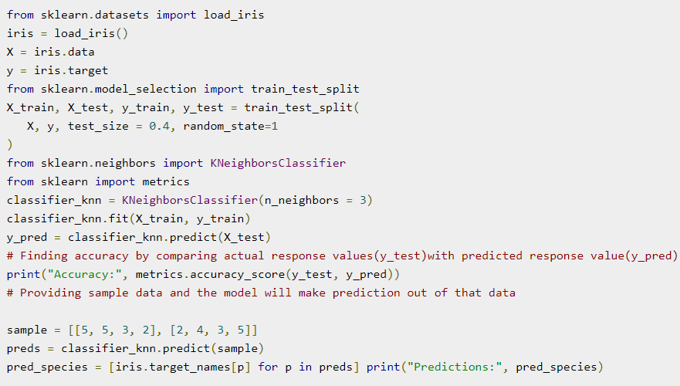

Train the Model

Slide 12


Model Persistence
from sklearn.datasets import load_iris
from sklearn.neighbors import KNeighborsClassifier
from sklearn.externals import joblib
# Load the Iris dataset
iris = load_iris()
X, y = iris.data, iris.target
# Train a KNN classifier
classifier_knn = KNeighborsClassifier()
classifier_knn.fit(X, y)
# Save the trained classifier to a file
joblib.dump(classifier_knn, 'iris_classifier_knn.joblib')
# Later, load the classifier from the file
loaded_classifier = joblib.load('iris_classifier_knn.joblib')
# Use the loaded classifier to make predictions
new_data = [[5.1, 3.5, 1.4, 0.2], [6.2, 2.9, 4.3, 1.3]]
predictions = loaded_classifier.predict(new_data)
print(predictions)

Slide 13
Time calculation
from sklearn.model_selection import train_test_split
from sklearn.svm import SVC
import time
# Assuming you have your data X and y
X_train, X_test, y_train, y_test = train_test_split(X, y, test_size=0.2, random_state=42)
# Initialize the classifier
clf = SVC()
# Measure the start time
start_time = time.time()
# Train the model
clf.fit(X_train, y_train)
# Measure the end time
end_time = time.time()
# Calculate the training time
training_time = end_time - start_time
# Print the training time
print("Training time: {:.2f} seconds".format(training_time))

Slide 14
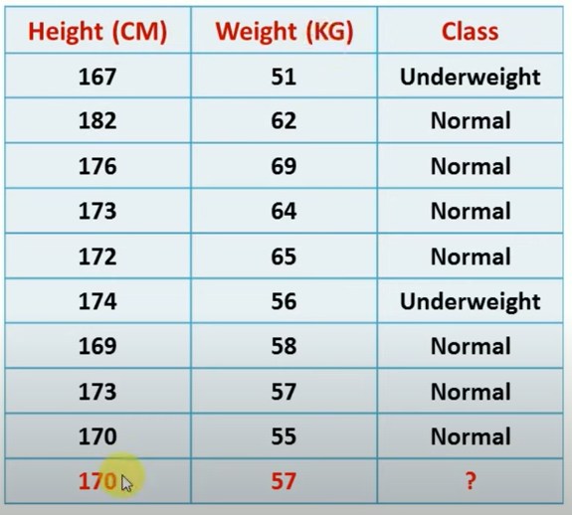

Slide 15
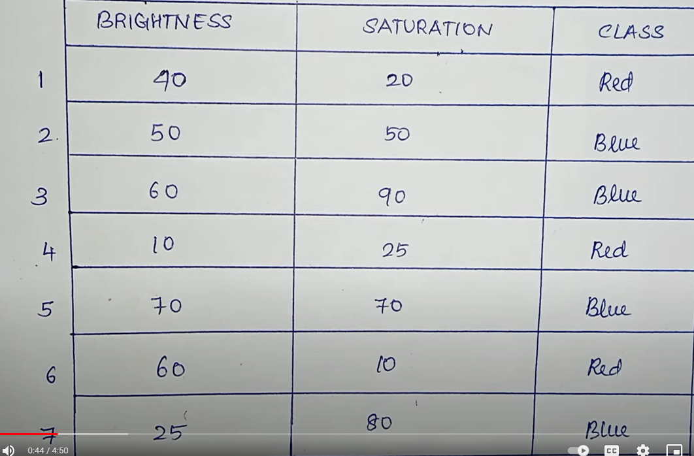

Slide 16
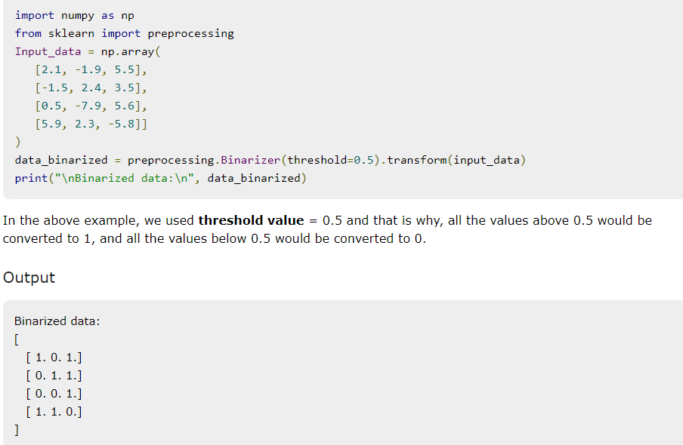
Preprocessing the Data
Before inputting that data to machine learning algorithms, we need to convert it into meaningful data.
Binarisation

Slide 17
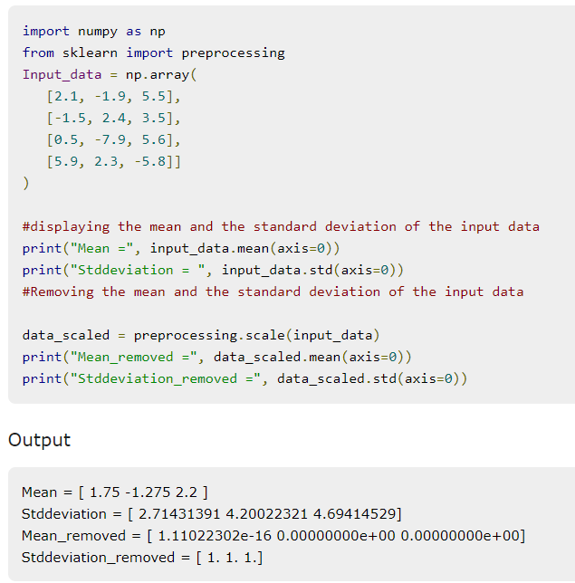
Mean Removal
To eliminate the mean from feature vector so that every feature centered on zero.

Slide 18
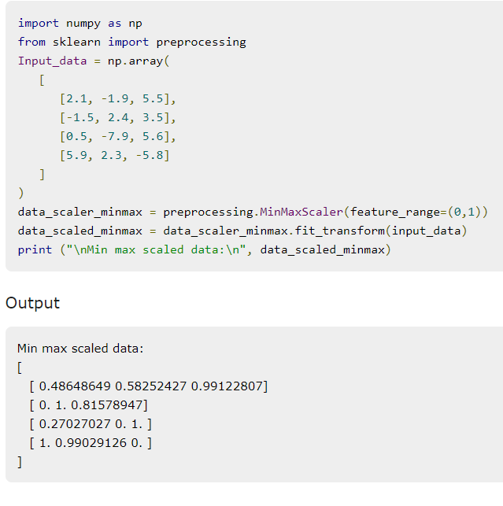
Scaling
We use this preprocessing technique for scaling the feature vectors.

Slide 19
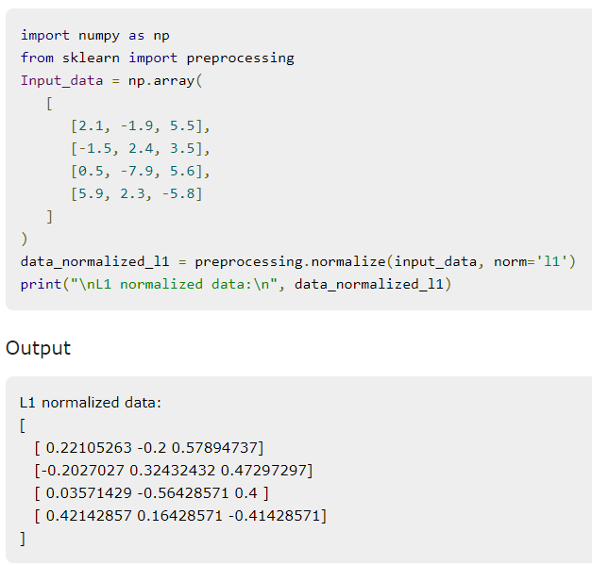
Normalisation
preprocessing technique for modifying the feature vectors
L1 Normalisation
It modifies the value in such a manner that the sum of the absolute values remains always up to 1 in each row.

Slide 20
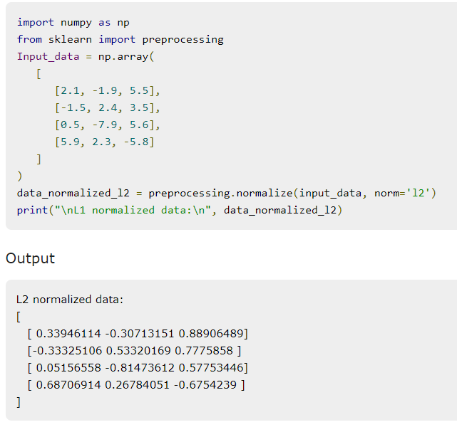
L2 Normalisation
It modifies the value in such a manner that the sum of the squares remains always up to 1 in each row.

