Slide 1
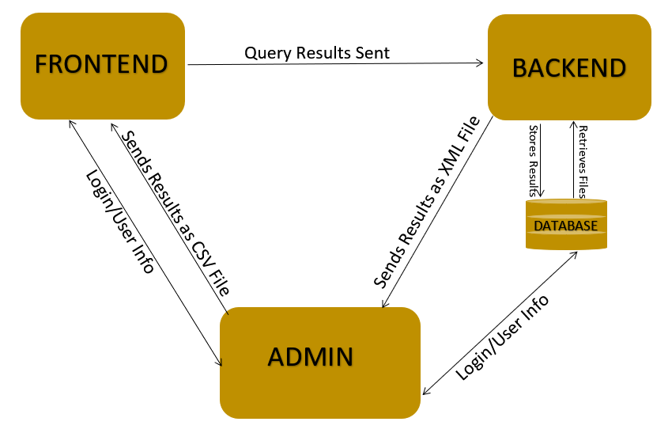
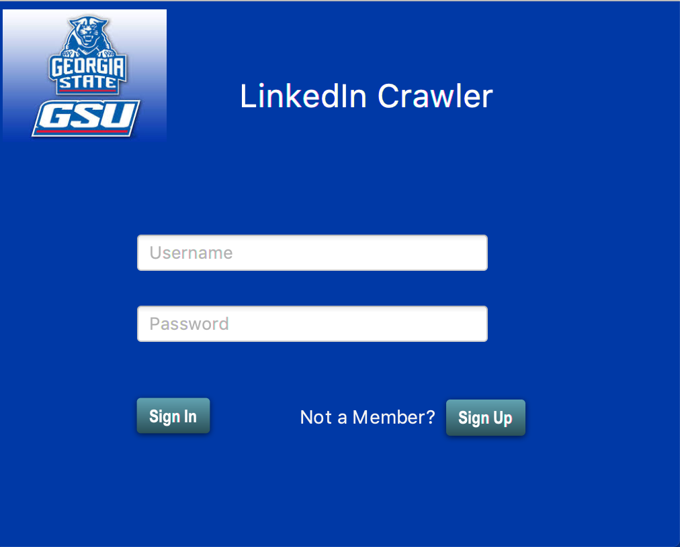
LinkedIn API Team Name
LOGO
LOGO
The Problem
Conceptual Model
LinkedIn is a social networking site which allows its users to create connections with employers, co-workers and classmates. A LinkedIn user page generally contains their skills, employment history and education. The purpose of this project was to create a program in which GSU faculty and staff could use to search previous alumni matching certain criterias such as graduation year and/or major.
Requirements
The Linkedin API program should:
Allow users to register for an account and login using a registered account.
Allow users to create specific search requests based on criterias such as degree title and/or graduation year.
Provide the user with his/her search results in a CSV file.
Implementation
Screenshots
The program has three components and each component was divided among separate teams .All three teams used Java Remote Method Invocation (RMI) since it was easier for each team to work on their own computer.
The front-end component was created using JavaFx. The administration and backend modules used Java. The backend component used Linkedin’s API to gather the user request search results. Amazon RDS served as the database to store user credentials as well as search requests.
Summary
The LinkedIn program allows users to search for GSU alumni using LinkedIn’s API. Users will be able to register and login to the application to create search requests. The results will be available to the user in CSV format.
Acknowledgement
We would like to thank William Gregory Johnson for his support during the course of the project.

