Slide 1

DQuick
Modern GUI Library for D
Inspired by QML (QtQuick)

Slide 2
Goals
Reflect D philosophy
Multiplatform
Performances
Easy (Simple to learn)
Rich (Really easy to customize)
Target most usages
Modern applications (Rich in visual effects and animations)
Industrial tools (Advanced 3D editors, IDEs,…)

Slide 3
Be Multiplatform
D is multiplatform
OpenGL/ES is well adopted (Angle for Windows?)
Use only non D dependencies that are portable (Desktops and Mobiles)

Slide 4
Have Great Performances
OpenGL/ES for complexes transformations
D will help a lot
Some parts can be multithreaded
Renderer (Qt blog)
Asynchronous resource loading (Images,…)
Prediction
Animations (for responsiveness) (Qt Blog , look Animation Driver section)

Slide 5
Easy to use
Simple declarative language
Lua is a great declarative language
Lua is the most accessible for a prototype
A frontend can be created to simplified Lua’s syntax in some cases
Editor to abstract complexity
Will allow fast prototyping like with flash
Remote connection on target application (Real result instead of a preview)
Real-time error detection of code declarations

Slide 6
Customize Everything
No default behaviors
Not all applications want the same button so it’s not a basic Item
Classic Items (checkbox, buttons, status bar,…) will come in an additional module
Create your own Items like you want
Property bindings and other features will help you
Basics containers will be provide
Binding a D Item is so simple (addItemType!(ImageItem, "Image")();)

Slide 7
Rendering Quality (Fixing 3D Renderer issues)
Runtime
Pixel perfect
DPI Aware
Text Kerning
Sub-pixel hint for font with shaders? (Qt Blog - Inspired by a Valve's Sigraph paper)
Tools
Textures borders generation
Color Bleeding in Alpha textures

Slide 8
DPI Issues
High DPI == High memory consuming
Downscale by tool (application startup?) for lower devices (quality conservation)
Compressed textures for pictures (ETC, PVRTC,…)

Slide 9
Language - Item
One of basic types
Referenced by ID
Not necessary graphic (sound, … bindings of D objects)
Draw in the cascading order (last declaration on top)
User defined properties
Notes:
Insert code screenshots

Slide 10
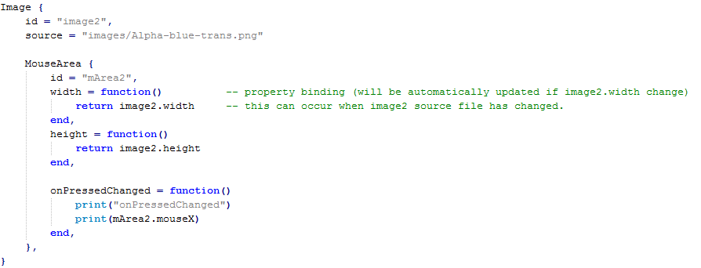
Language - Property Bindings

Slide 11
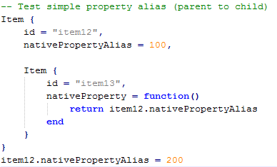
Language – Property Alias
Alias are normal properties
Binding works in both ways
Useful for some components

Slide 12
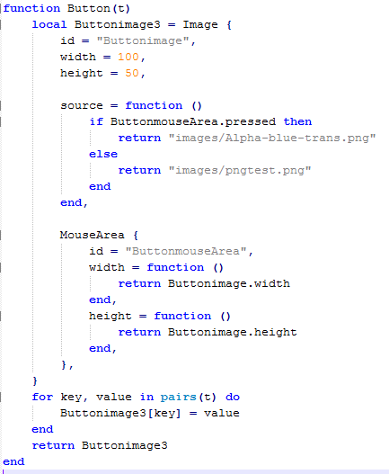
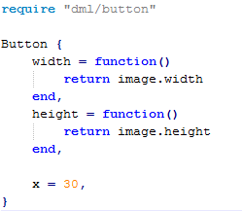
Language – Components
Component Item created in Lua
Property binding of components can be improved

Slide 13
Language – Animation
In development

Slide 14
Utilities – Translation
Follow the Qt Way?

Slide 15
Utilities – Backup
Provide a simple API
Multiplatform access to a writable user space (best in phobos?)
User GUI preferences (Window size, dock positions,…)

Slide 16
Utilities – Resources Management
A simple way to adapt some part of GUI to specifics criteria
Tag system to filter resources
Target (OS, devices,…)
Languages
Resolution (Orientation, DPI,…)
User defined Tags

Slide 17
Editor – WHY
Fix library development line
Best sample of DQuick quality
Easier to use than direct Lua edition
Prototyping accessible to artist

Slide 18
Editor – Features
Update GUI files
Insertion in a user modified file
On runtime edition (ORE)
Can be connected to the targeted application
Direct GUI modifications (positions, sizes,… complete item’s edition)
Let application runs normally (user interactions not broken, items edition done on editor side)

Slide 19
Editor – ORE Details
Application side
Build in listen mode (like remote debugging with JVM)
GUI modified in memory (prefer load GUI file in memory instead of file system)
Run with some exception/crash protection (bad item references,…)
Editor side
Network connection to an application or the default viewer
Update GUI files in the application bundle possible
Send modifications only when generated files are valid
Values modifications (changing a position,…) use reflection

