Slide 1
Project: IronKAggle
Dylan Rodríguez Flores

Slide 2
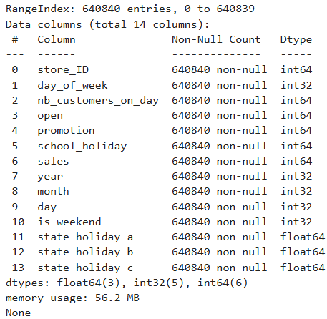
Exploratory Data Analisys
Checked the types of the data columns and found that only 2 would need to be modified (date and state_holiday).
Checked for missing values, none found.
Used a correlation matrix to see if any variables had a relation higher than 0.90
Dropped Unnamed: 0 (index) and state_holiday
Split the data into training and test sets.

Slide 3
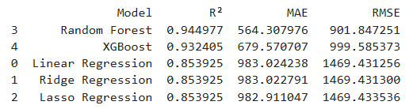
Model Evaluation

Slide 4
Model training: XGBOost
Tuning:
xgb_model = XGBRegressor()
random_state = 42
n_estimators = 100
learning_rate = 0.5
max_depth = 6
Results:
R^2 = 0.9370
Mean Absolute Error: 653.6943
Root Mean Squared Error: 964.6445

Slide 5
Thank You!

