Slide 1
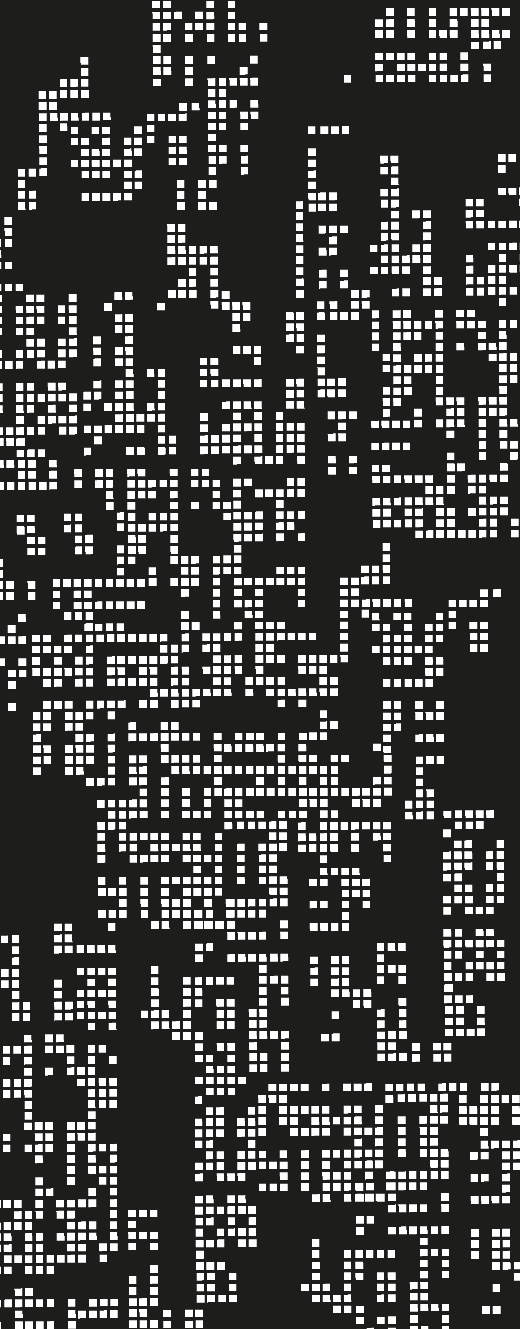
Deep Learning: Image classification with CNN
Project Overview and Results
Dylan Rodríguez Flores
Dara Guadalupe Carrasquillo

Slide 2
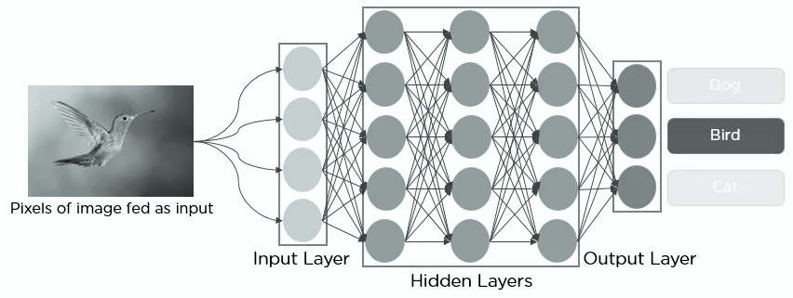
Goal:
Classify images from two datasets using CNNs and transfer learning.

Slide 3
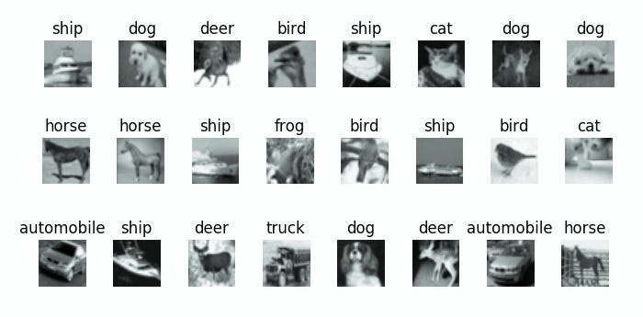
Choosing dataset:
We chose CIFAR-10 for its abundant resources, community support, and suitability for learning, benchmarking, and exploring computer vision tasks.
Works well for CNNs, VGG, or ResNet.

Slide 4
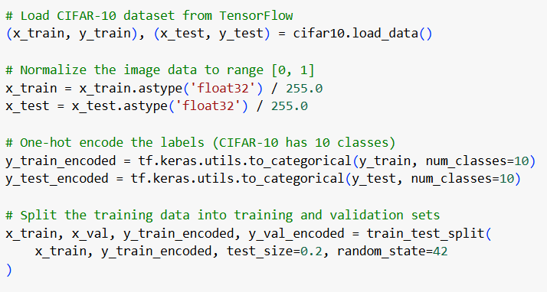
Preparing our data for CNN and Transfer Learning:
Load data from tensorflow.
Normalize the pixel values to a range of [0, 1].
Convert the labels into one-hot encoding.
Split data into training and validation set.

Slide 5
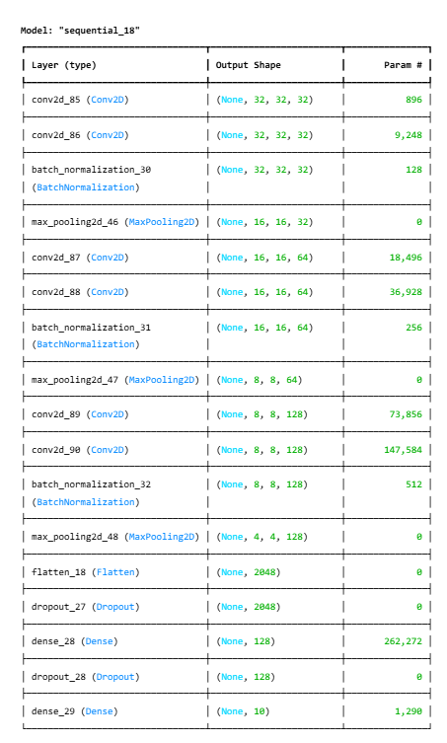
Our model:
We each made a model from scratch, but we used the one with best results for this project.
Parameters:
Total params: 551,466 (2.10 MB)
Trainable params: 551,018 (2.10 MB)
Non-trainable params: 448 (1.75 KB)

Slide 6
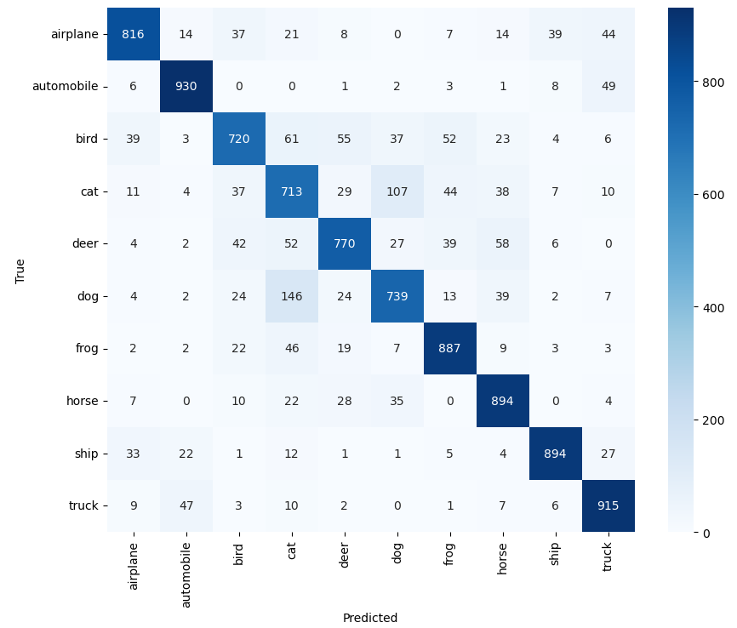
Our model parameters:
Epochs: 20
Batch Size: 64
Early Stopping:
Monitor: val_loss
Patience: 3
Learning Rate Scheduler:
Monitor = val_loss
Factor: 0.5
Patience: 2
Min_lr = 0.000006

Slide 7
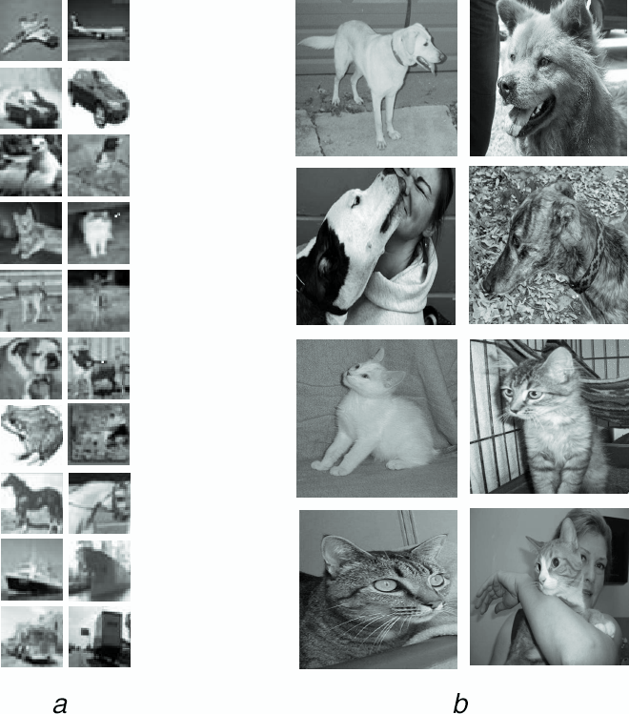
Our model results:
After analyzing the confusion matrix, we concluded that the pictures depicting animals seem to be giving the model much more trouble than any other category. Cats were most frequently incorrectly labeled as dogs and vice versa.
Test accuracy: 83%
Test loss: 0.58

Slide 8
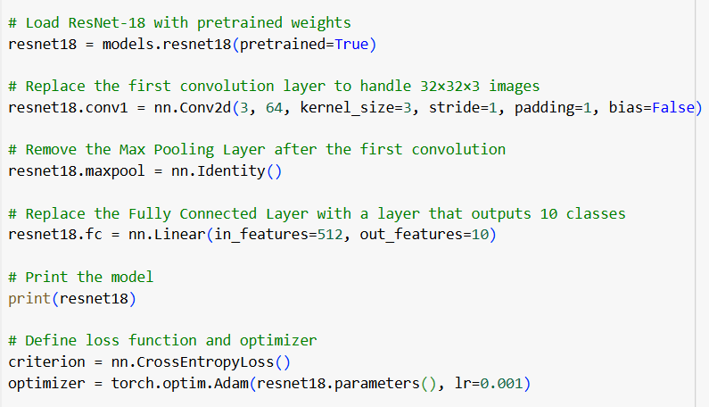
Adjusted ResNet18:.
-Replaced first convolution layer
-Removed Max Pooling after first
Convolution layer
-Replaced the Fully connected
layer
-Parameters:
Total params: 11173962
Trainable params: 11173962
Non-trainable params: 0

Slide 9
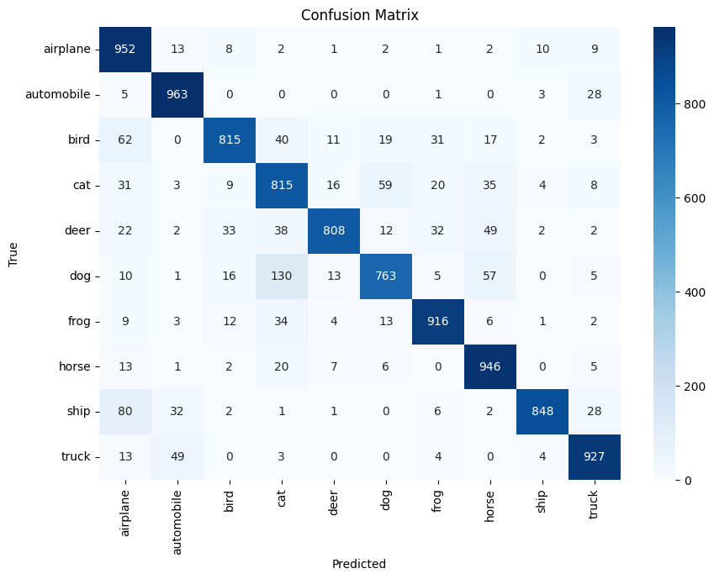
Adjusted ResNet18 parameters:
Epochs: 10
Batch Size: 64
Learning Rate: 0.001
Early Stopping:
Monitor: val_loss
Patience: 3

Slide 10
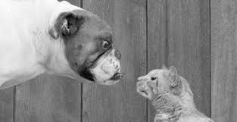
ResNet18 results:
After analyzing the confusion metrix, we concluded that the pictures depicting cats and dogs as well as ships and airplanes seem to be giving the model more trouble than other categories. Dogs were most frequently incorrectly labeled as cats (130). Next ships as airplanes (80).
Test accuracy: 88%
Test loss: 0.38
Again cats and dogs!

Slide 11
Project insight:
The most important insight gained from the experimentation was the importance of the architecture of the model and how the layers interact. Removing or adding a single element to one of the layers can yield dramatically different results on the testing.
Furthermore, there are many ways in which the models can be fine tuned and optimized for better performance. Sometimes the most complex model is not necessarily the best one, this showed in both our models.

Slide 12
Thanks!

