Slide 1


Cohort Analysis for IronHack Payments
by:
Jarian N. Del Valle
Diego Rosa Paz
Natalia Torres
Dylan Rodriguez
Javier A. Dastas
Notes:
Photo by rawpixel on Unsplash

Slide 2



Exploration Data Analysis
EXPLORATION
DATA CLEAN & QUALITY
VISUALIZATION
Examine the structure, data types, and relationships between datasets.
Correct inconsistent or missing values.
Document results, observed patterns, and interpretations.
Analyze distributions and key descriptive statistics.
Secure standardize formats (e.g., dates, types, status).
Create visualizations to explore trends and patterns (e.g., histogram of amounts, usage frequency by month).
Identify missing values, duplicates, and inconsistent formats.
Create new columns derived from existing data (e.g., cohorts based on creation month).
Create charts to showcase the monthly evolution of metrics.

Slide 3
Challenges and Solutions
Remove rows with nulls and empty values.
Data Cleaning
Validate relational integrity between data sets.
Data Inconsistency
Data Integration
Merge datasets, Single Source of Truth (SSOT).
Need of Standardized Data
Standardize dates and discrete values.
Raw data difficult to understand
Create graphs for easier visualization.

Slide 4
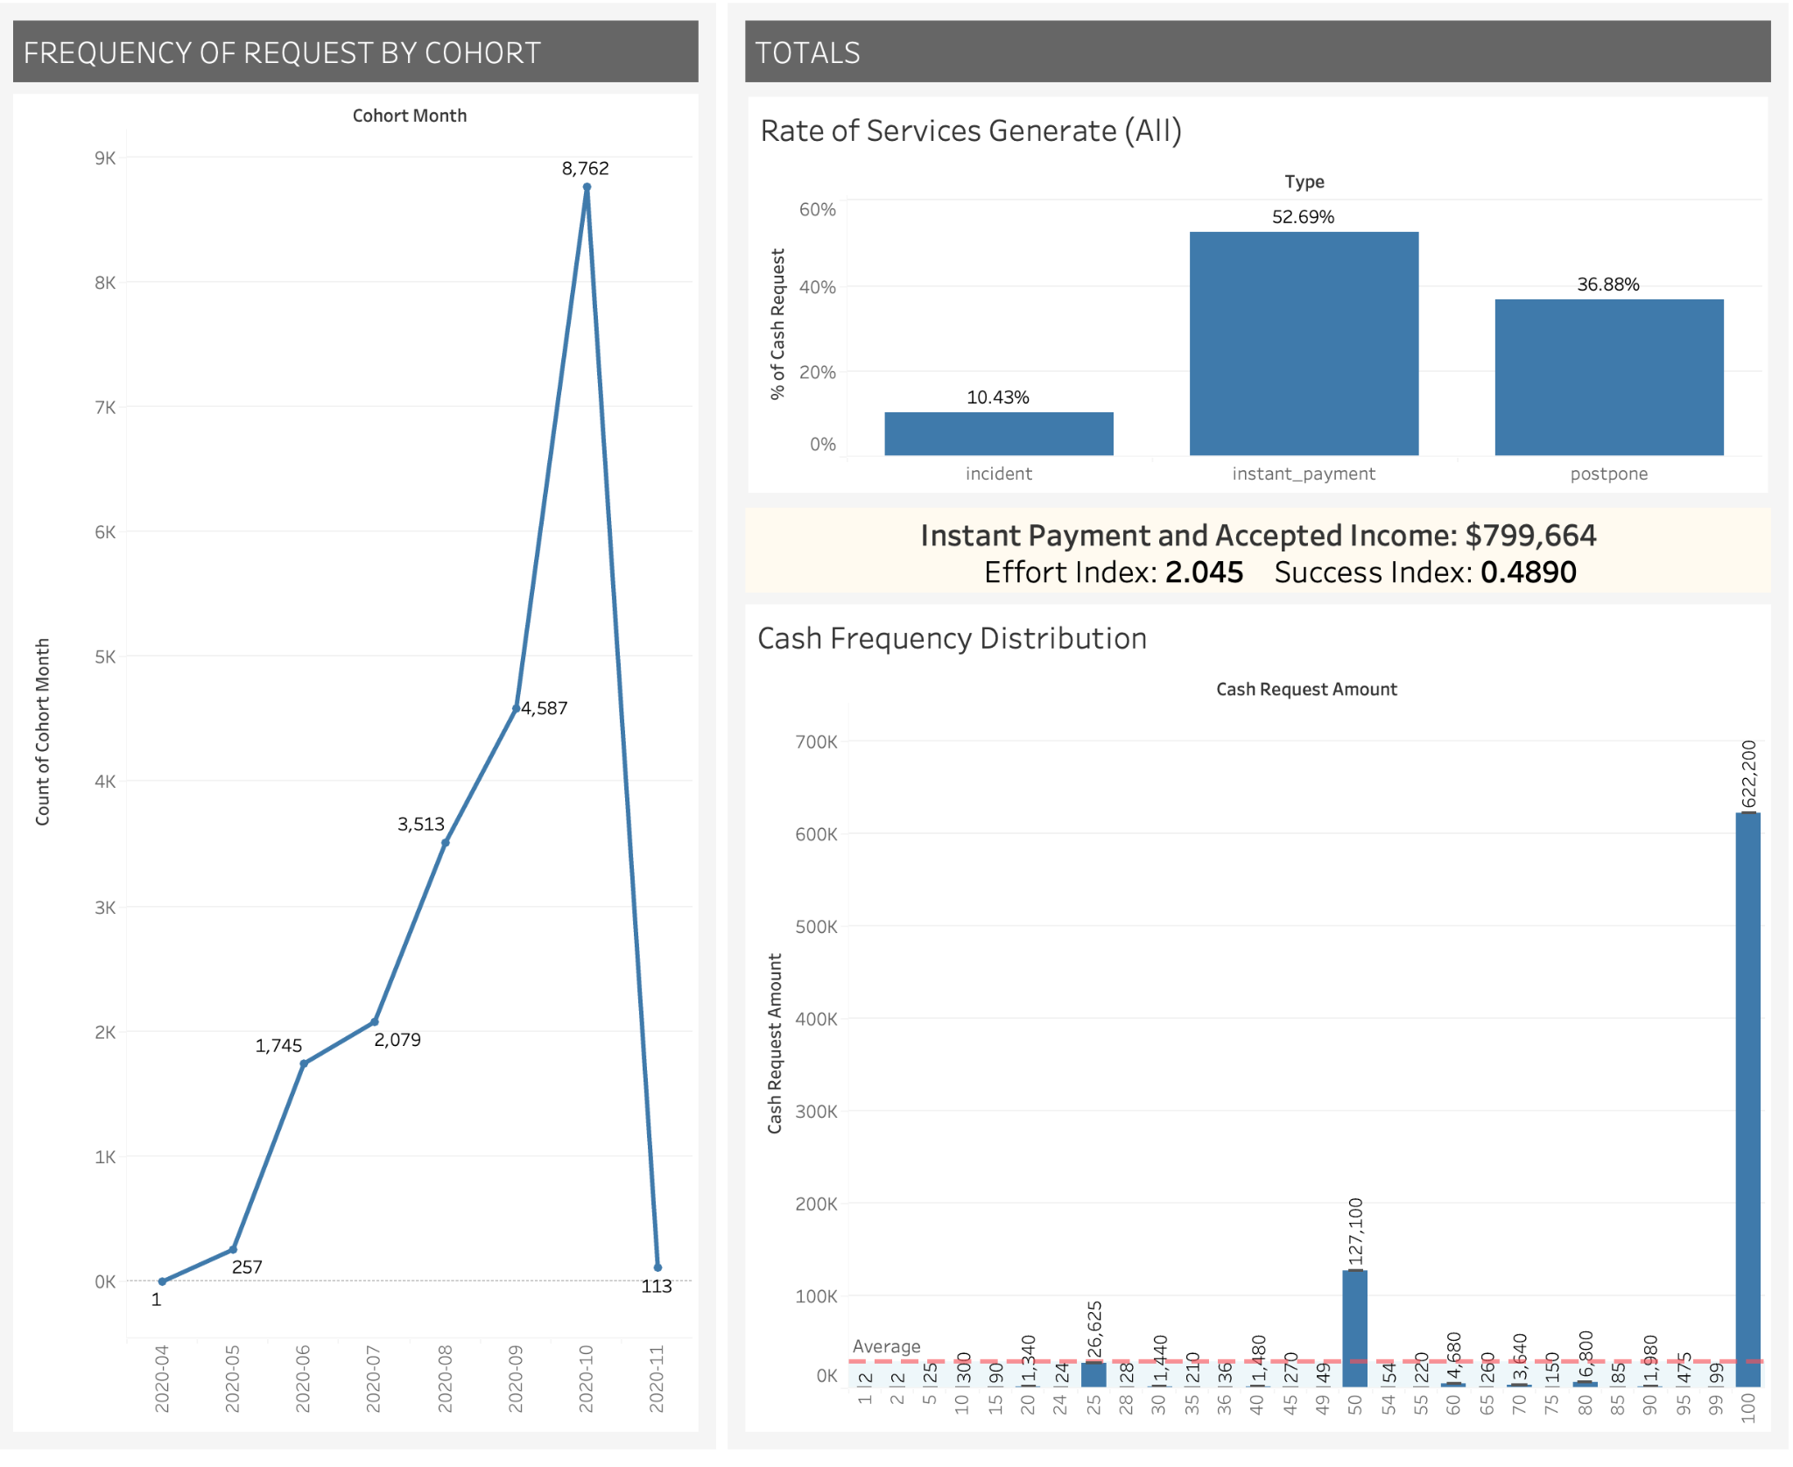
Success vs Effort Index
More effort than necessary is being invested in transactions, but an adequate completion rate is not being achieved.
Future Analysis: check the cost per transaction, possible bad data, problems with the fees request system, bad process...

Slide 5
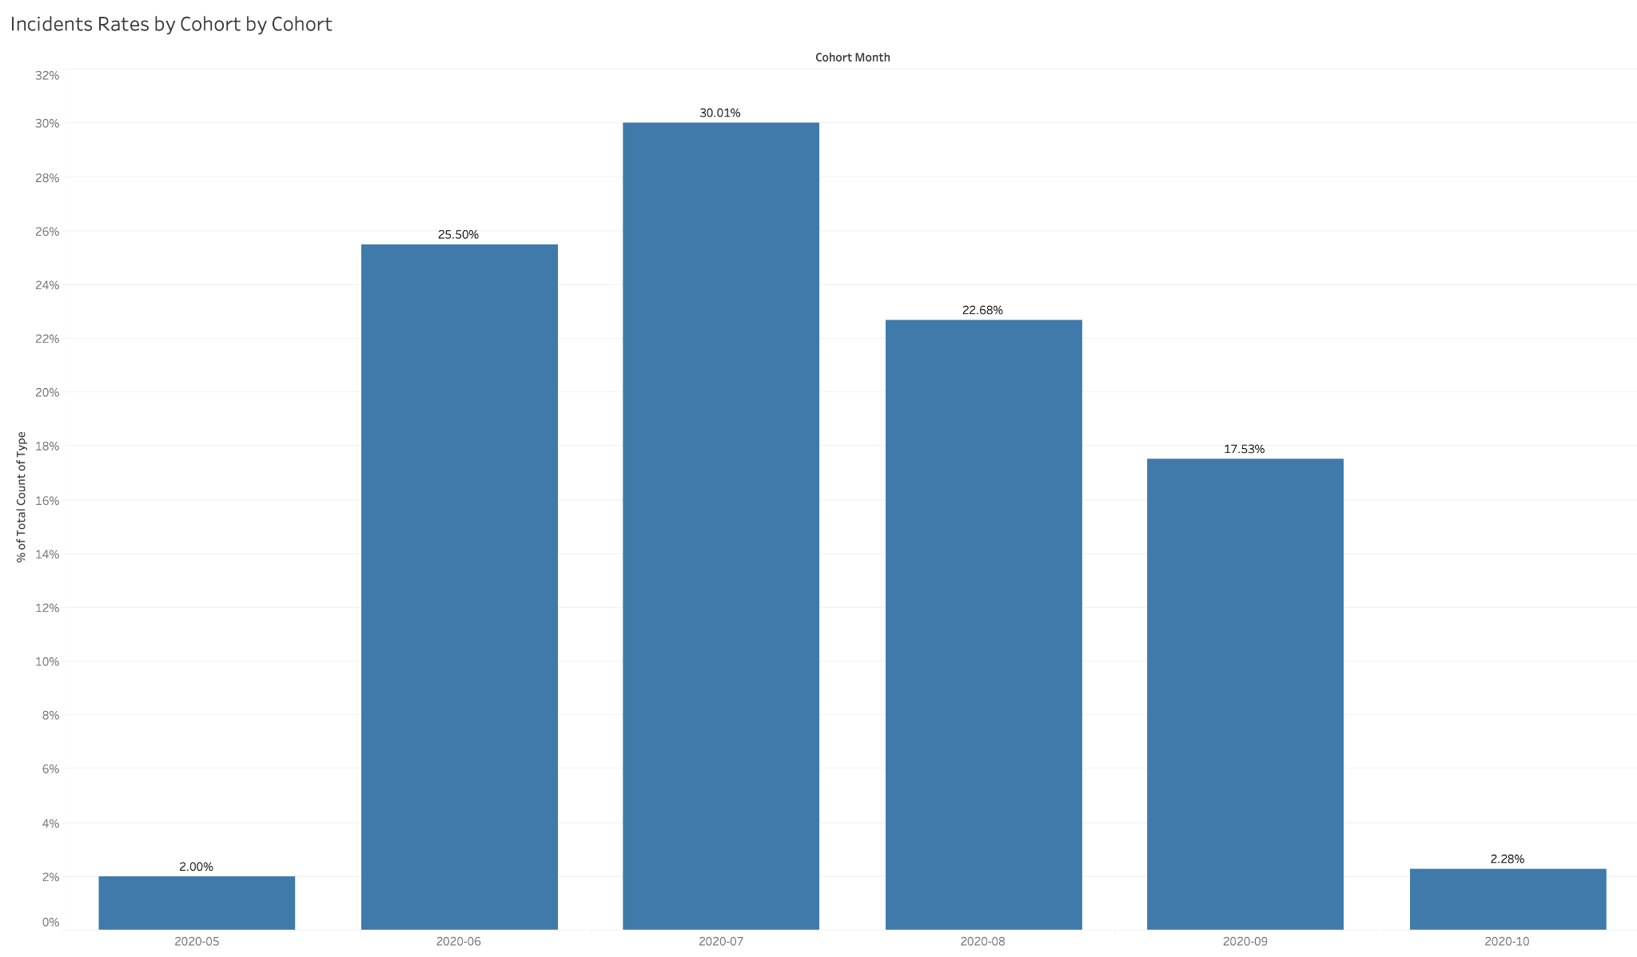
Incidence rate
The month with the highest notable incident rate is July.
As the incident rate diminished, there was an increment in the total of services and clients.
There is a direct correlation between the increment of incidents and the reduced revenue generated in the cohort month.

Slide 6
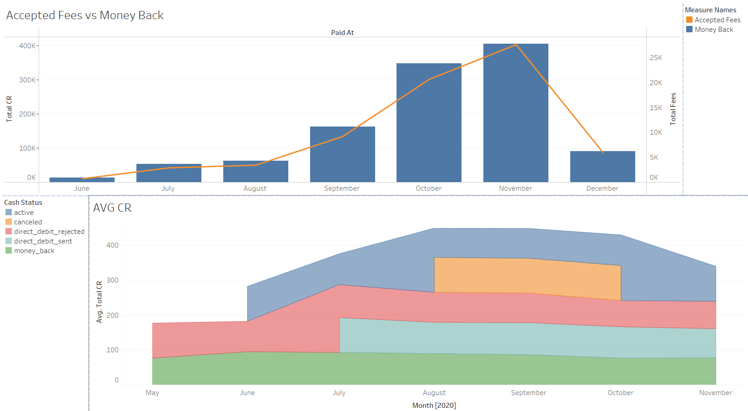
Highly Seasonal Pattern
Most CRs are grouped nearest to end of year holidays, peaking significantly in October and November.
The yearly average on CRs of all status does peak nearer to August, suggesting a prognosis of the peak months may be possible if some external factors come into consideration.

Slide 7
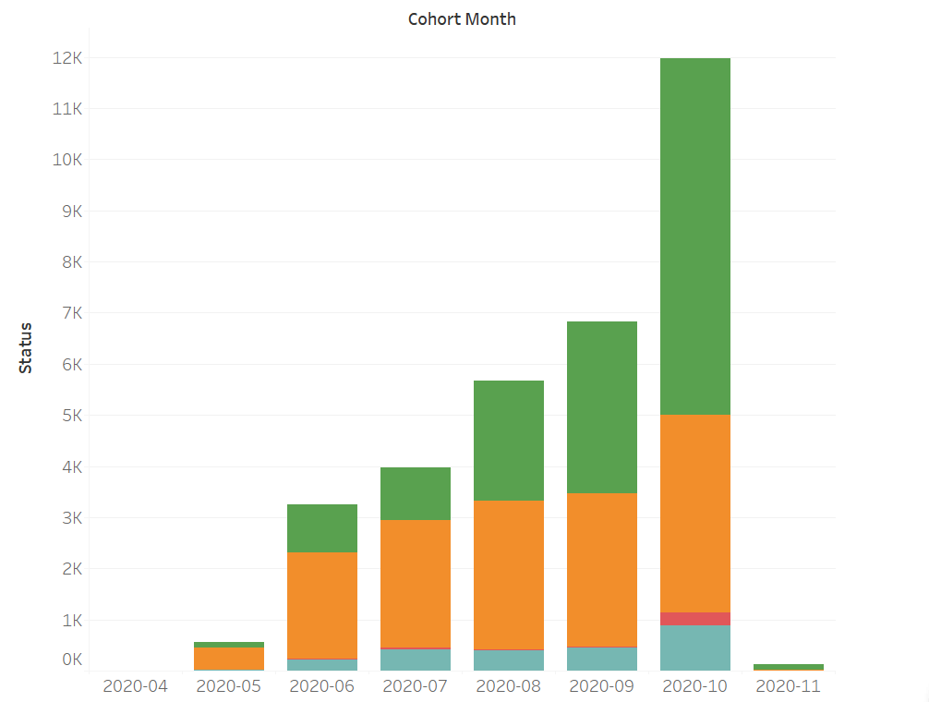
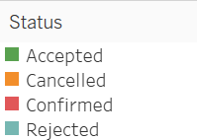
Acceptance rate
There is an increment in the acceptance rate throughout the months during the cohort.
Observable difference in the rate of acceptance and cancellation.

Slide 8
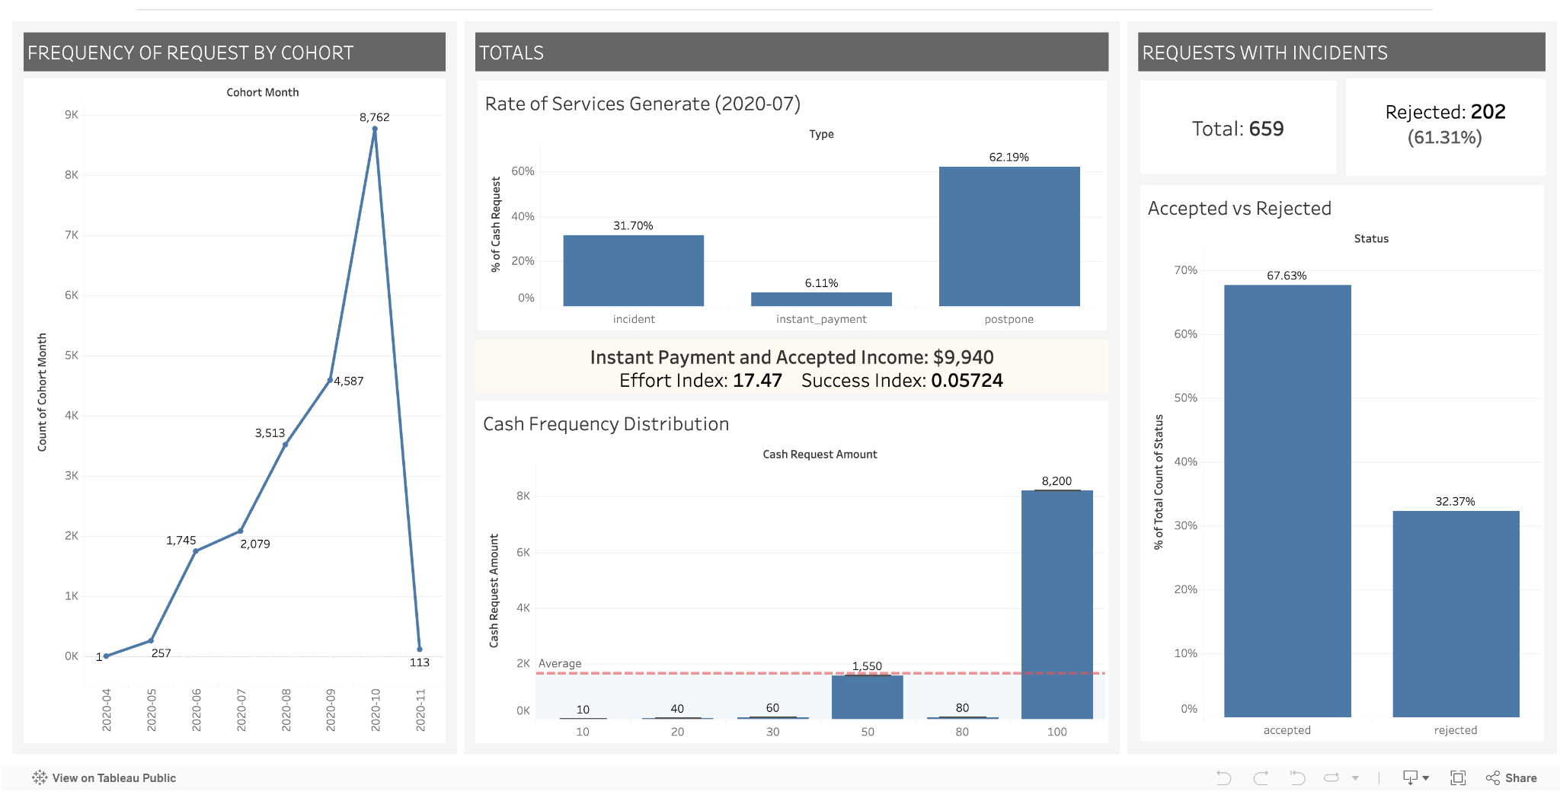
Dashboard Publication in Tableau Public
https://public.tableau.com/views/DSMLBootcampProjectI-DemoData/Dashboard1?:language=en-US&publish=yes&:sid=&:redirect=auth&:display_count=n&:origin=viz_share_link

Slide 9
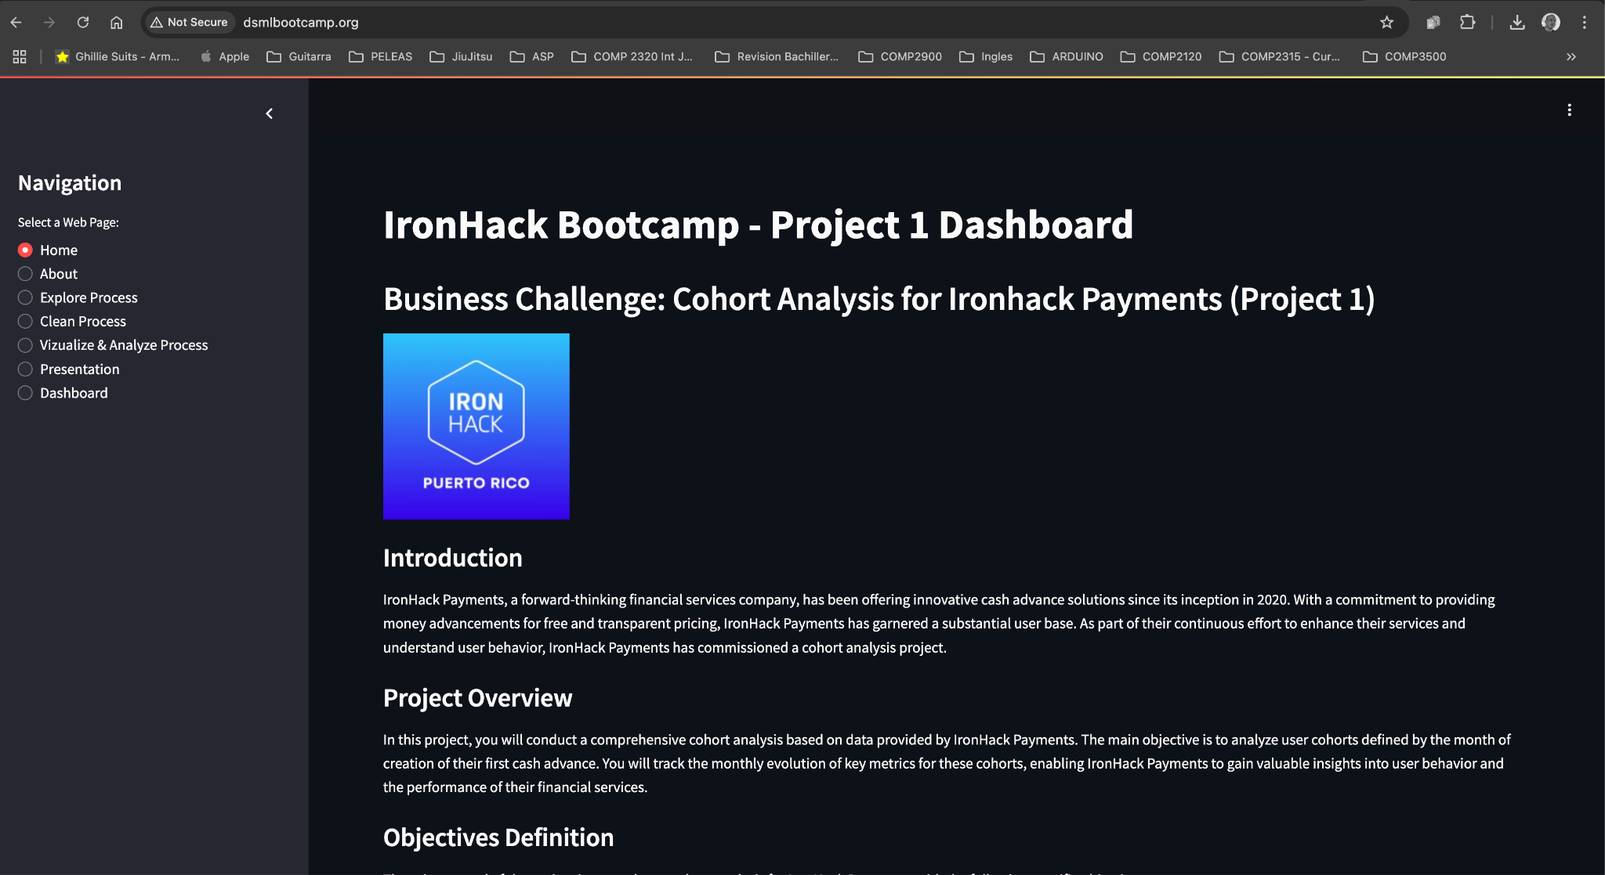
Streamlit - Analysis Dashboard
http://dsmlbootcamp.org/

Slide 10
Conclusion
Cleaned and merged datasets for a comprehensive analysis.
Identified patterns in service usage, incident rates, and revenue generation.
Developed a new metric focused on instant payment efficiency and monthly cohorts.
Observed a rise in instant payment acceptance, correlating with client growth.
Detected seasonal peaks in service usage during late-year holidays.
Detected more effort than necessary is being invested in transaction.
Recommended prioritizing holiday marketing or incentive programs for instant payments to boost profitability.
Suggested extracting client location data to identify top-performing regions and demographics.

Slide 11
Cohort Analysis for IronHack Payments
THANK YOU
by:
Jarian N. Del Valle
Diego Rosa Paz
Natalia Torres
Dylan Rodriguez
Javier A. Dastas
Notes:
Photo by rawpixel on Unsplash

