Slide 1
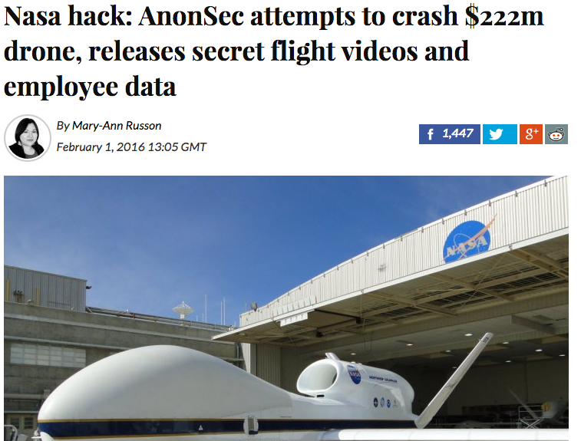

Slide 2
Logistics
HW0 up on github
“Due” next Tuesday
Not graded
First real homework HW1 will be assigned Tuesday. Homework teams should be pairs or if needed singletons
Thursday Feb 11: in-class studio session to get over hurdles on homework. Bring your questions, Rahul will be there to help groups.
Piazza “homeworks” are going to count towards participation credit
For this Thursday: Finish descriptions from last semester
Come to class prepared to discuss distillation of critical crypto problems seen across all the posts

Slide 3
Today in Cryptography (5830)
One time pad review
Block ciphers
Ideal ciphers / functions
Computational OTP-like security
Pseudorandom functions & permutations
DES, AES
Notes:
We develop pioneering leaders for the digital age.

Slide 4
One-time pads
Fix some message length n bits
Key generation: output random n-bit string K
E(K,M) = M K
D(K,C) = C K

Slide 5
Shannon’s security notion
(1949)
Def. A symmetric encryption scheme is perfectly secure if
for all messages M,M’ and ciphertexts C
Pr[ E(K,M) = C ] = Pr[ E(K,M’) = C ]
where probabilities are over choice of K
Thm. OTP is perfectly secure
For any C and M of length L bits
Pr[ K M = C ] =
1 / 2^{n}
Pr[ K M = C ] =
Pr[ K M’ = C ]

Slide 6
Shannon’s security notion
(1949)
Def. A symmetric encryption scheme is perfectly secure if
for all messages M,M’ and ciphertexts C
Pr[ E(K,M) = C ] = Pr[ E(K,M’) = C ]
where probabilities are over choice of K
Thm. OTP is perfectly secure
Thm. Perfectly secure encryption requires |K| ≥ |M|
Notes:
Road map:
Let’s build OTP-like encryption using short keys. We’ll do this using block ciphers
But first we will abstract away details of block ciphers and assume they act in an idealized model where they act like truly random functions.
Then we’ll build block ciphers that behave as much as possible like their idealized counterpart

Slide 7
Block ciphers
Family of permutations, one permutation for each key
E : {0,1}^{k} x {0,1}^{n} --> {0,1}^{n}
E(K,X) = Y D(K,Y) = X
functions
function
Ignore this for now. In fact, assume we can’t invert.

Slide 8
Ideal block cipher
Imagine Alice and Bob share an idealized version of block cipher: random look-up table function that is (magically) efficient to evaluate (unit cost)
We can encrypt using this idealized cipher. How?
Notes:
n-bit messages, k-bit keys, n-bit counter.
What is this random function model: Unit cost to evaluate function on a point. Values are random – have to evaluate to learn the point.
How many n bit to n bit random functions are there? 2^(n2^n)
Using shared random function and counter value. Use each range point as pad, iteratively.

Slide 9
Adversary knows the cipher
Adversary can compute by making unit cost evaluations of cipher as well.
Does scheme achieve perfect security? No. Why?
What is best attack you can think of?
Notes:
n-bit messages, k-bit keys, n-bit counter
Using shared random function and counter value. Use each range point as pad, iteratively.

Slide 10
Brute-force attacks
Get one or more input-output examples of encryption
Try decrypting with each possible key
Each decryption = 1 unit cost
Expected run time: 2^{k-1} (for key size k)
Worst-case run time: 2^{k}
Notes:
n-bit messages, k-bit keys, n-bit counter
Using shared random function and counter value. Use each range point as pad, iteratively.

Slide 11
Computational security
We aim for encryption schemes secure only against computationally limited adversaries.
In fact, our little scheme provably leaks nothing about plaintexts for computationally bound adversaries.
Referred to as semantic security
Notes:
Give some intuition about how one would argue a proof. If key is long enough, no way for attacker to try evaluating random function on any input associated to the key

Slide 12
Random IV instead of counter
The counter reveals how many messages encrypted. Let’s get rid of it
Pick a random value each time we encrypt
Security before: counters always unique
Now no guarantee of uniqueness. How many messages can we encrypt before security fails?

Slide 13
The birthday bound
Throw q balls in 2^{n} bins uniformly. What is probability that no bin has two balls?
Pr[Coll] ≤ q² / 2^{n}
Implication:
Security holds up to q a bit less than 2^{n/2}
Notes:
Let coll_i be collision after throw i.
Pr[coll] = Pr[coll_2 or … or coll_q] <= Pr[ coll_2 ] +…+ Pr[coll_q] = 1/2^n + 2/2^n + … + q-1/2^n = q(q-1)/2^(n+1)

Slide 14
Variable length messages
We have been assuming each message is n bits
How can we do variable length messages?

Slide 15
Still relying on idealization
Idea: instantiate keyed random function with computationally efficient block cipher
Design block cipher to “behave like” random function
Random oracle: function is random for every key
Pseudorandom function (PRF): function indistinguishable from a random function for a uniform, secret key

Slide 16
Block ciphers
Family of permutations, one permutation for each key
E : {0,1}^{k} x {0,1}^{n} --> {0,1}^{n}
E(K,X) = Y D(K,Y) = X

Slide 17
Random permutations
Like random functions but respect permutivity
Keyed random permutation (ideal cipher):
Each key selects random permutation
Pseudorandom permutation
Indistinguishable from random permutation under uniform, secret key

Slide 18
How do we build efficient block ciphers that are close to ideal?

Slide 19
Data encryption standard (DES)
L0 R0
Originally called Lucifer
team at IBM
input from NSA
standardized by NIST in 1976
F_{K1}
+
n = 64
k = 56
L1 R1
Number of keys:
72,057,594,037,927,936
F_{K2}
Split 64-bit input into L0,R0 of 32 bits each
Repeat Feistel round 16 times
+
Each round applies function F using
separate round key
L2 R2
…
…

Slide 20
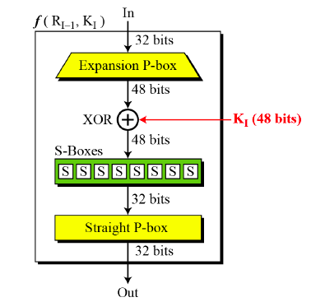
Round functions
X
F(Ki,X)

Slide 21
Best attacks against DES
Attack | Attack type | Complexity | Year
Biham, Shamir | Chosen plaintexts, recovers key | 2⁴⁷ plaintext, ciphertext pairs | 1992
DESCHALL | Unknown plaintext, recovers key | 2^{56/4} DES computations 41 days | 1997
EFF Deepcrack | Unknown plaintext, recovers key | ~4.5 days | 1998
Deepcrack + DESCHALL | Unknown plaintext, recovers key | 22 hours | 1999
- DES is still used in some places
- 3DES (use DES 3 times in a row with more keys) expands
keyspace and still used widely in practice

Slide 22
Advanced Encryption Standard (AES)
Rijndael (Rijmen and Daemen)
M
n = 128
k = 128, 192, 256
Permute
Number of keys for k=128:
340,282,366,920,938,463,463,374,607,431,768,211,456
S1
+
K1
Substitution-permutation design.
For k=128 uses 10 rounds of:
Permute
1) Permute:
SubBytes (non-linear S-boxes)
ShiftRows + MixCols (invertible linear transform)
S2
+
K2
Permute
2) XOR in a round key derived from K
(Actually last round skips MixCols)
…

Slide 23
Best attacks against AES
Attack | Attack type | Complexity | Year
Bogdanov, Khovratovich, Rechberger | chosen ciphertext, recovers key | 2^{126.1} time + some data overheads | 2011
Brute force requires time 2¹²⁸
Approximately factor 4 speedup

Slide 24
Summary
Use block ciphers to build stream cipher
Secure block cipher means we get OTP-like security against computionally bounded adversaries
Brute-force attacks
A good blockcipher is family of permutations, one permutation per key
Ideally behaves like random permutation for all keys
PRF and PRP security hold for uniform, secret keys
We have good blockciphers: 3DES, AES
Design of good blockciphers is topic of a whole other class

