Slide 1
Today in Cryptography (5830)
Review of modes of operation & active attacks
Message authentication
CBC-MAC
Attacks against bad CBC-MAC implementations
Variable-length secure CBC-MAC
Notes:
We develop pioneering leaders for the digital age.

Slide 2
Review
Goal: secure (length-extending) encryption
What we have so far:
Block cipher modes of operation (CBC, CTR)
Insecurity against active attacks
Bit flip “mauling” attacks against CTR
Padding oracle attacks against CBC
We need another tool:
authenticity mechanisms

Slide 3
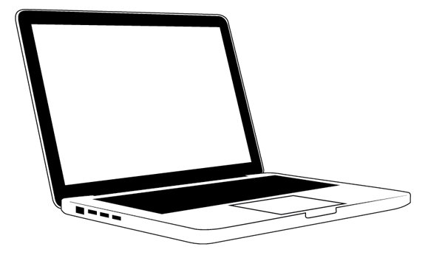
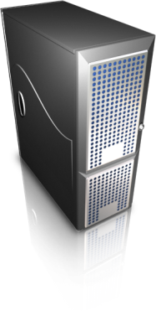
Malleability example: Encrypted cookies
http://startup.com
GET /index.html HTTP/1.1
HTTP/1.1 200 OK
Content-type: text/html
Set-cookie: sessionToken=ab35h013490...
Has secret key K
GET /info.html HTTP/1.1
Cookie: sessionToken=ab35h013490…
abc35h013490… = CTR-Mode(K, “admin=0”)
Malicious client can simply flip a few bits to change admin=1

Slide 4

More generally:
CTR-Mode(K,M)
K
K
Sender
Receiver
Attacker has read/write access to communications channel
The strategy:
Arrange so that that all bits received can be validated as
having come from sender (the person with key K)

Slide 5
The tool: Message authentication
Msg, T
K
K
Sender
Receiver
Two algorithms:
Tag(K,Msg) outputs a tag T
Verify(K,Msg,T) outputs 0/1 (invalid / valid)
Correctness: Verify(K,Msg,Tag(K,Msg)) = 1 always
Security: No computationally efficient attacker can forge tags for a new message even when attacker gets
(Msg₁ , T₁ ) , (Msg₂ , T₂ ), … , (Msg_{q} , T_{q})
for messages of his choosing and reasonably large q.

Slide 6
Composing encryption and authentication
CTR-Mode(K₁,M), Tag(K₂,C)
K
K
Sender
Receiver
Encrypt(K,M):
Use secret keys K₁ and K₂ . These can be derived from K if needed
K₁ = AES(K,0^{n}) K₂ = AES(K,1^{n})
C = CTR-Mode(K₁, M)
T = Tag(K₂,C)
Output C||T
Decrypt(K,C||T)
If Tag(K₂,C,T) ≠ 1 then Return error
Return CTR-Mode(K₁,C)
Notes:
This is probably too boring. Focus on a new, cool application. Something people aren’t expecting. On-line shopping is circa 2000. Let’s get something more hip. (Defer to later.)
Actually perhaps this is okay spin: this is a pretty pedestrian application, but in fact it’s quite difficult to render secure!

Slide 7
Message authentication using pseudorandom functions
(PRFs)
Msg, T = F(K,Msg)
K
K
Sender
Receiver
If F behaves like random function (to those
w/o K, this will be secure.
Tag(K,M) = F(K,Msg)
What was example of a good PRF?

Slide 8
Message authentication using pseudorandom functions
(PRFs)
Msg, T = F(K,Msg)
K
K
Sender
Receiver
If F behaves like random function (to those
w/o K, this will be secure.
Tag(K,M) = F(K,Msg)
Deterministic message authentication scheme is often called message authentication code (MAC) and tag called MAC
What was example of a good PRF?

Slide 9
Recall CBC mode
Ciphertext block chaining (CBC)
Pad message M to M1,M2,M3,... where each block Mi is n bits
Choose random n-bit string IV
Then:
M1
M2
M3
IV
E_{K}
E_{K}
E_{K}
C0
C1
C2
C3
Can we convert this into variable-message-length PRF?

Slide 10
CBC-MAC
Message authentication code (MAC)
M1
M2
M3
IV
E_{K}
E_{K}
E_{K}
Fix IV to constant
value, e.g., IV = 0^{n}
T
Turns out this is (provably) a good PRF
if only K used only on same-length messages
Notes:
http://blog.cryptographyengineering.com/2013/02/why-i-hate-cbc-mac.html

Slide 11
CBC-MAC
Message authentication code (MAC)
M1
M2
M3
IV
E_{K}
E_{K}
E_{K}
Fix IV to constant
value, e.g., IV = 0^{n}
T
Turns out this is (provably) a good PRF
if K used only on same-length messages
Notes:
http://blog.cryptographyengineering.com/2013/02/why-i-hate-cbc-mac.html
Show attacks on board for length-extension and for using random IV

Slide 12
Variable-message-length CBC-MAC
Prepend message length
Encrypted CBC-MAC
|M|
M1
M2
E_{K}
E_{K}
E_{K}
T
M1
M2
M3
E_{K}
E_{K}
E_{K}
E_{K’}
T

Slide 13
Discussion exercise
We used hazmat interface for CBC mode in HW1 to implement Feistel round function.
Does this realize a secure implementation of CBC-MAC?

