Slide 1
Today in Cryptography (5830)
Hash functions
HMAC
Passwords and password-based key derivation
Notes:
We develop pioneering leaders for the digital age.

Slide 2
Cryptographic hash functions
A cryptographich hash function H maps arbitrary bit string to
fixed length string of size m
MD5: m = 128 bits
SHA-1: m = 160 bits
SHA-256: m = 256 bits
M
H
H(M)
Some security goals:
collision resistance: can’t find M != M’ such that H(M) = H(M’)
preimage resistance: given H(M), can’t find M
second-preimage resistance: given H(M), can’t find M’ s.t.
H(M’) = H(M)
Behave like a public, random function. Sometimes called random oracle model (ROM)

Slide 3
Pseudorandom functions vs. random oracles
 | Inputs | Security | Examples
PRF | Secret key, message | Indistinguishable from random function to any party without key | CBC-MAC HMAC
Random oracle (RO) | Message | Is a random function, but one that everyone can compute | SHA-256 SHA-512 SHA-3

Slide 4
Two-step design for hash functions
Compression
Function
Hash Function
d
*
n
Domain
extension
transform
n
n
f
f
H
E.g., H = “Merkle-Damgard with strengthening”
M1
M2
M3||10^{r} || <|M|>
Used in
MD-x, SHA-1,
SHA-256, …
f
f
f
f
IV
H (M)

Slide 5
Building compression functions
Can build compression functions from suitable block ciphers
f(z,m) = E(m,z) z
Can use AES, but security too low. Why?
Notes:
Examples of broken uses of block cipher. Simple m + z. E(m,z) or E(z,m).

Slide 6
Building PRFs with hash functions: HMAC
Use a hash function H to build a MAC. K is a secret key
ipad != opad are constants
K ipad || M
H
K opad || h
H
T
This is slight simplification, assuming |K| < d
(recall d is underlying message block length)

Slide 7
What’s wrong with this PRF construction?
K || M
H

Slide 8


Passwords
Internet
http://amazon.com
login: tom password: princess
tom | princess
alice | 123456
bob | p@ssword!

Slide 9
Passwords
Internet
https://amazon.com
login: tom password: princess
tom | princess
alice | 123456
bob | p@ssword!
TLS encrypted

Slide 10
Password hashing
Password hashing. Choose random salt and store (salt,h) where:
salt || pw
H
h
The idea: Attacker, given (salt,h), should not be able to recover pw
Or can they?
Rainbow tables speed this
up in practice by way of
precompution. Large salts
make rainbow tables impractical
For each guess pw’:
If H(salt||pw’) = h then
Ret pw’

Slide 11
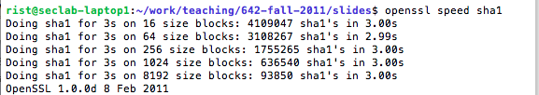
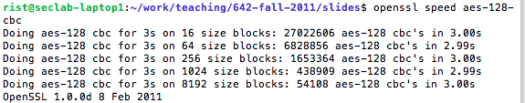
Say c = 4096. Generous back of envelope* suggests that in 1 second,
can test 252 passwords and so a naïve brute-force:
6 numerical digits | 10⁶ = 1,000,000 | ~ 3968 seconds
6 lower case alphanumeric digits | 36⁶ = 2,176,782,336 | ~ 99 days
8 alphanumeric + 10 special symbols | 72⁸ = 722,204,136,308,736 | ~ 33million days
* I did the arithmetic…

Slide 12
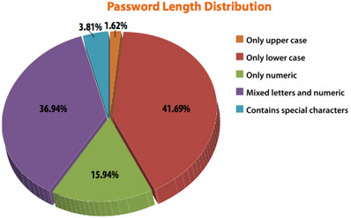
From an Imperva study of
released RockMe.com
password database
2010

Slide 13
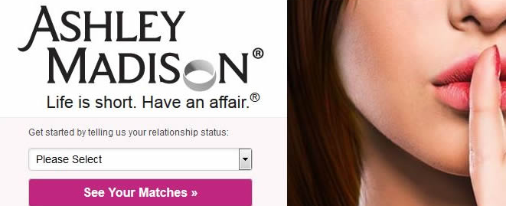
AshleyMadison hack: 36 million user hashes
Salts + Passwords hashed using bcrypt with c = 2¹² = 4096
4,007 cracked directly with trivial approach
CynoSure analysis: 11 million hashes cracked
>630,000 people used usernames as passwords
MD5 hashes left lying around accidentally
http://cynosureprime.blogspot.com/2015/09/csp-our-take-on-cracked-am-passwords.html

Slide 14




Ashley Madison in good company
…
32.6 million leaked (2012)
32.6 million recovered (plaintext!)
6.5 million leaked (2012)
5.85 million recovered in 2 weeks
442,832 leaked (2012)
442,832 recovered
36 million accounts leaked (2013)
Encrypted, but with ECB mode
…

Slide 15
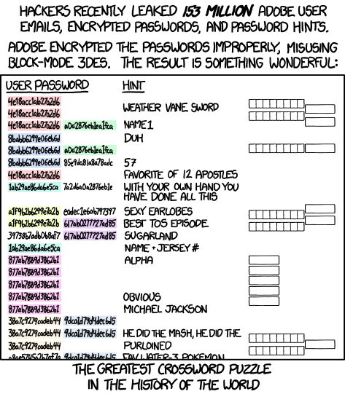

Slide 16
Password-based Key Deriviation (PBKDF)
PBKDF(pw,salt):
Truncate if
needed
salt || pw
H
H
…
H
h
repeat c times
PKCS#5 standardizes PBKDF1 and PBKDF2, which are both hash-chain based.
Only slows down by a factor of c
scrypt, argon2: memory-hard hashing functions

Slide 17

Facebook password onion
$cur = ‘password’
$cur = md5($cur)
$salt = randbytes(20)
$cur = hmac_sha1($cur, $salt)
$cur = remote_hmac_sha256($cur, $secret)
$cur = scrypt($cur, $salt)
$cur = hmac_sha256($cur, $salt)
Evolution of their password hashing over time
Limitations:
Can’t rotate secret
Can’t do cryptographic erasure for compromise clean-up

Slide 18



The Pythia PRF Service
Login: tom
Pw: princess
id, blinded h
K
f = F(K, h)
Back-end
Pythia
service
salt, F(K, H^{c}(princess|| salt) )
Stronger password privacy properties via blinding of values derived from password
Prototype and paper:
http://pages.cs.wisc.edu/~ace/pythia.html

Slide 19
Another application of PBKDFs: PW-based encryption
Enc(pw,M):
salt
K = PBKDF(pw,salt)
C’ = AEnc(K,M)
Return (salt,C’)
Here En is a normal
symmetric encryption
scheme (CBC+HMAC)
Dec(pw,salt||C):
K = PBKDF(pw,salt)
M = ADec(K,C)
Return M
Attacks?

Slide 20
Summary
Hash functions
Merkle-Damgard domain extension
Compression functions from block ciphers
Length-extension attacks & HMAC
Passwords
Brute-force attacks
PBKDFs slow down attacks
Split-state architectures help (Facebook & Pythia)
PW-based encryption (PBKDF + AEnc)

