Slide 1
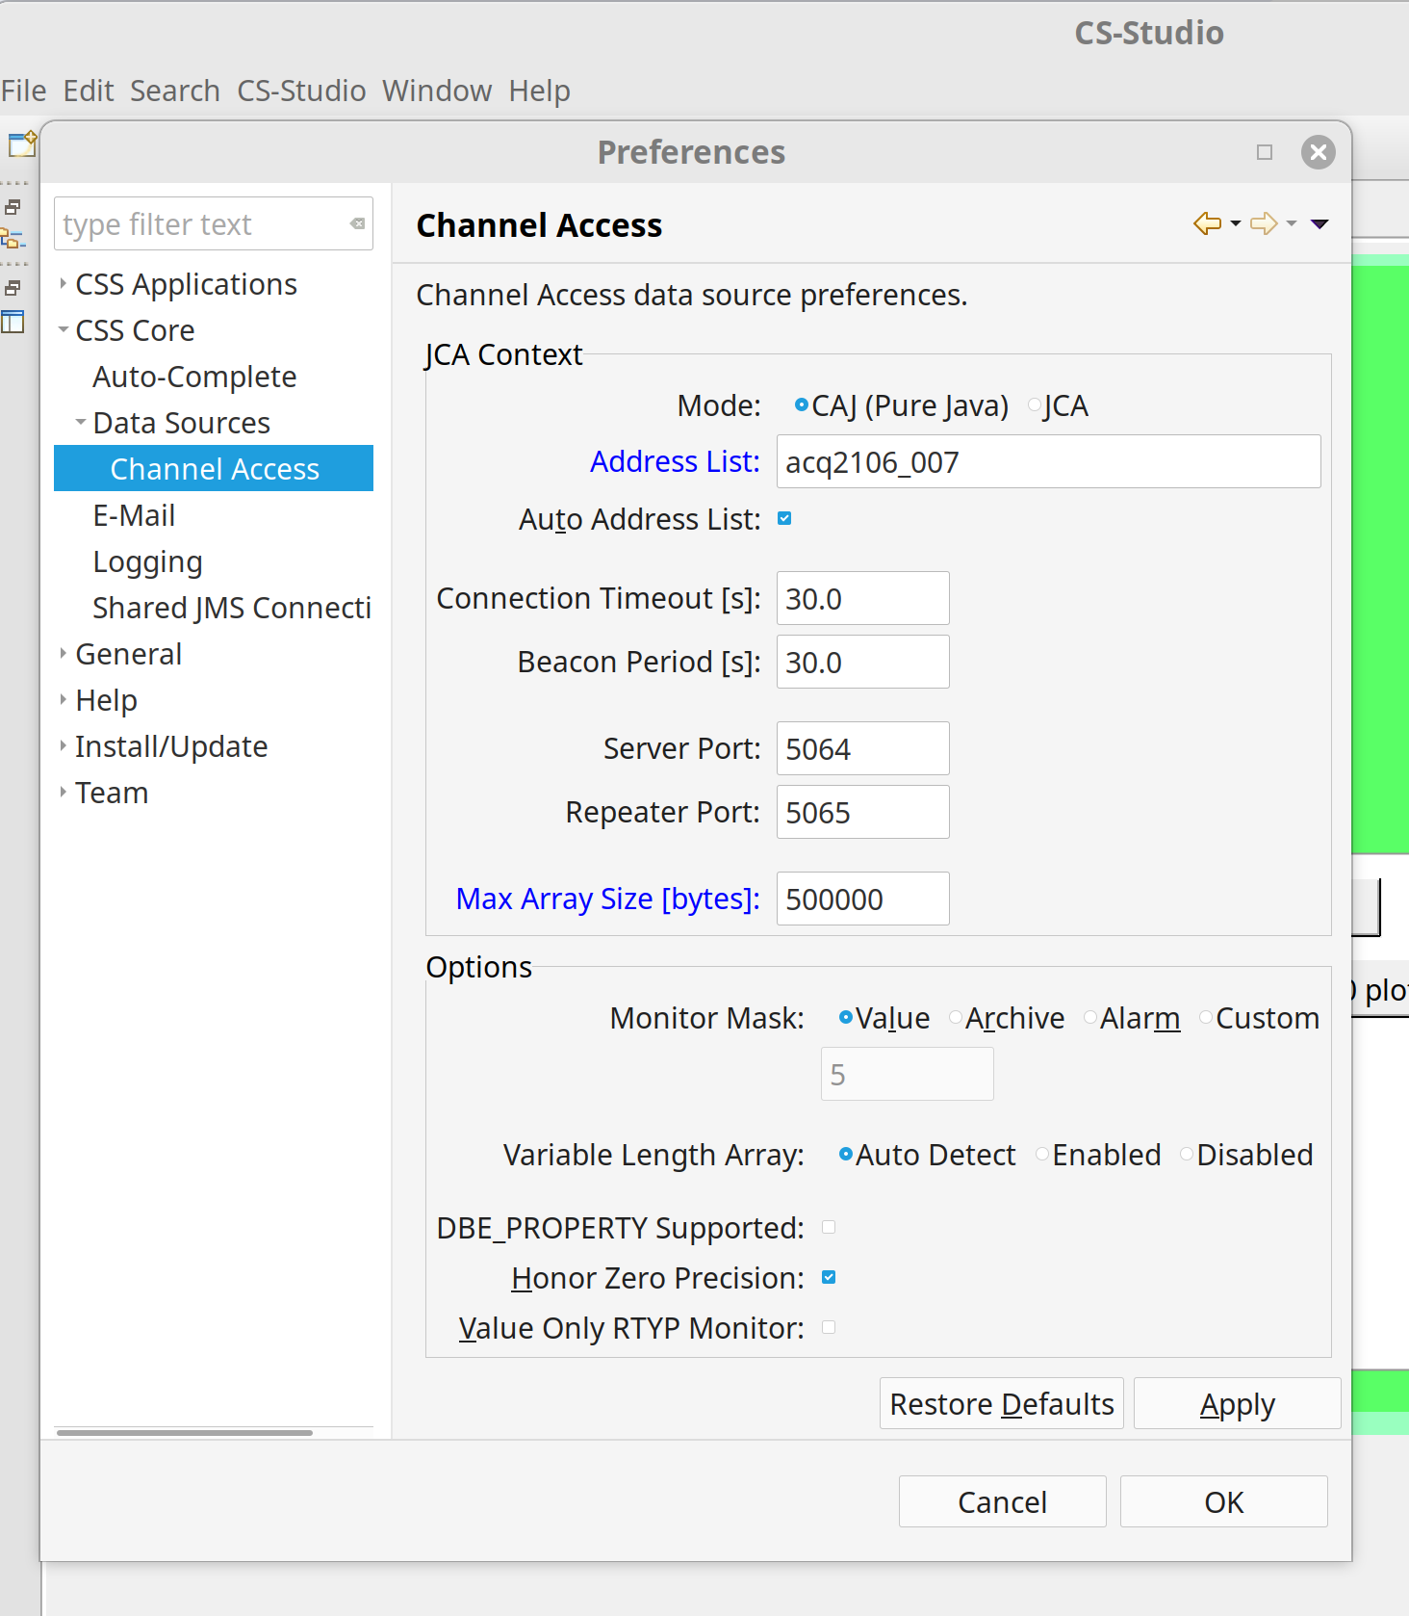
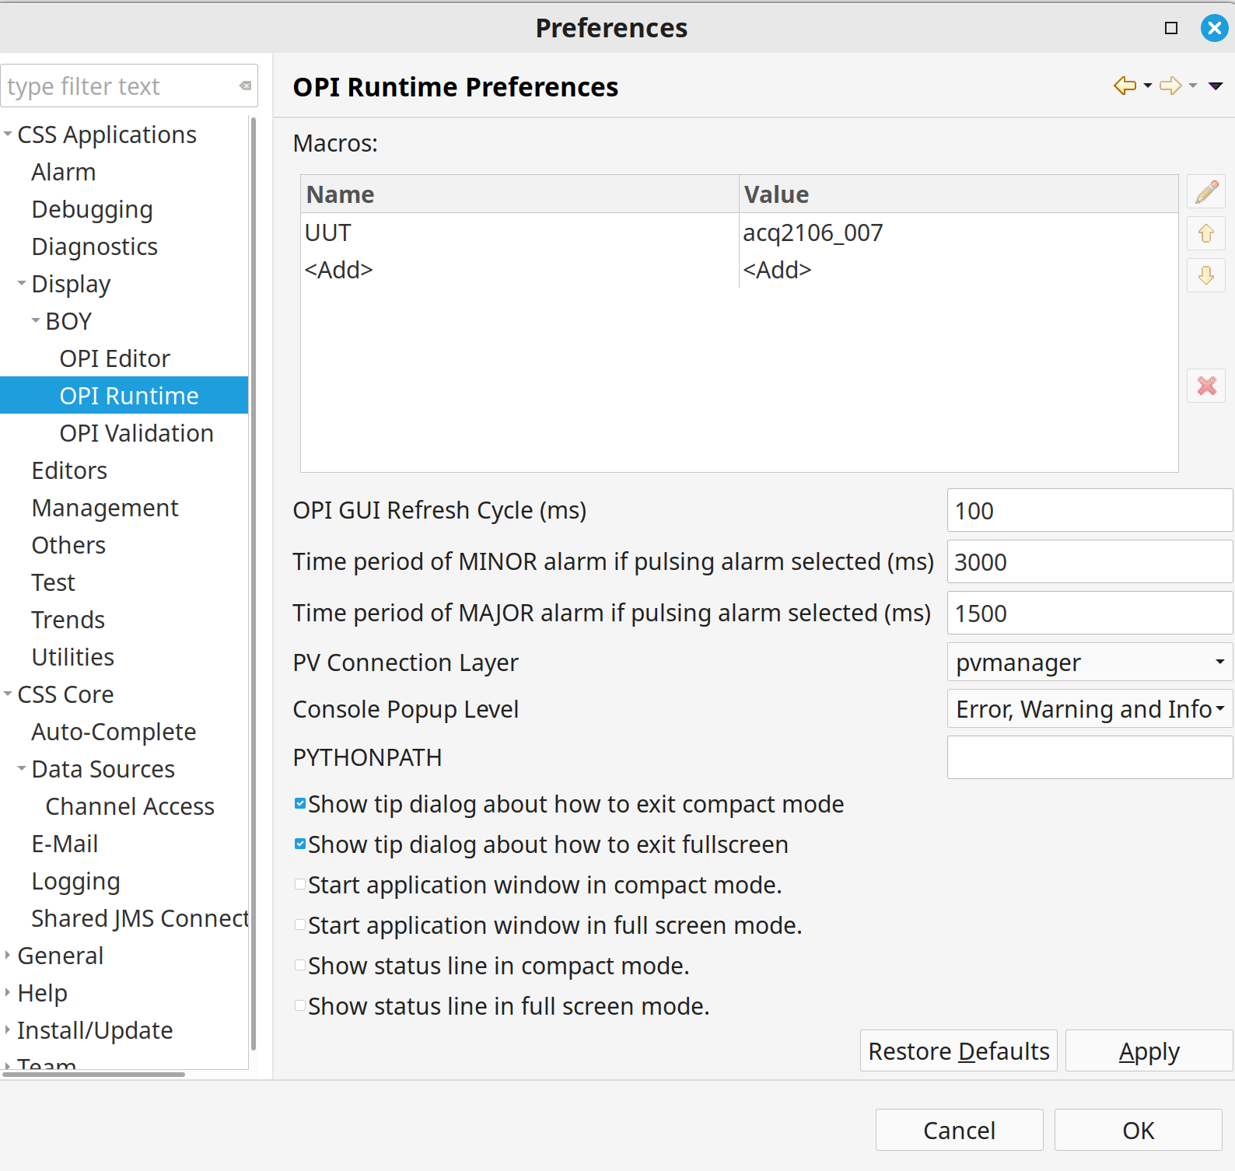
Cs-studio Environment Settings
(1) Edit|Preferences
(2) Set UUT, NAME
Essential. NAME, not IP
(3) Set Max Ar Size 500000
Essential.
(4) Option: needed only if “Network is not Well Behaved”
Eg blocked broadcast, VPN
Here we set the DNS name, ip-address if you have to

