Slide 1
Python Variables

Slide 2
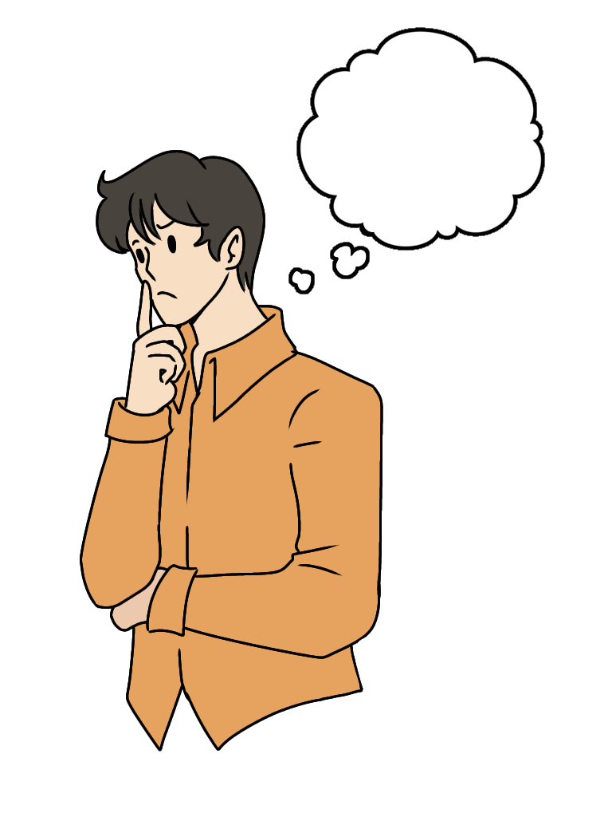
What is a variable?
Notes:
Image: FreyaSyauqila, CC BY 4.0 <https://creativecommons.org/licenses/by/4.0>, via Wikimedia Commons

Slide 3
Let’s try to answer this question!
If we put it simply, variable is our way to tell the computer to remember some data.
Let’s compare it to the real world!

Slide 4

The closest concept to the variable in real life is a word
Each word in our language have the form (combination of letters) and the meaning:
Table
Word “form”
Word meaning (what we are imagining when saying it)
Notes:
Image: Smart Servier, CC BY-SA 3.0 <https://creativecommons.org/licenses/by-sa/3.0>, via Wikimedia Commons

Slide 5
In Python same concept can be applied!
Here is how we create variable:
variableName
variableValue
Assignment Operator

Slide 6
Real Python example:
Variable value. In this case we define it ourselves. Because Python assigning the type automatically intVar will have int type. Because it’s a number without decimal point
intVar = 23
Variable name. Defined by the user.
There are some rules for defining variable names, such as:
A variable name must start with a letter or the underscore character
A variable name cannot start with a number
A variable name can only contain alpha-numeric characters and underscores (A-z, 0-9, and _ )
Variable names are case-sensitive (age, Age and AGE are three different variables)

Slide 7
Types of variables in Python:
Numeric (int, float, complex)
Boolean (contains only 2 values - True or False) (bool)
Text type (sequence of characters or single character) (str)
NoneType (basically absence of value) (None)
Sequence (sequence of variables) (list, tuple, range)
Mapping (dict)
Binary (bytes, bytearray, memoryview)
The list of types is retrieved from: https://www.w3schools.com/python/python_datatypes.asp

Slide 8
If the value have an exact type, that does not mean that it can’t be converted
Syntaxis for the conversion:
variableName = newType(valueToConvert)
For example:
intVar = str(1) - converting integer 1 to string
However, you need to be careful with conversion!
strToInt = int(“123xyz”) - will produce error, because xyz is not numeric, hence, can’t be converted to number

Slide 9

IMPORTANT!!!
The variable exists until we don’t need it anymore. If we are reaching the point in our program where this variable will never be used anymore – its erased from the RAM by garbage collector.
Notes:
Image: Painter06, CC0, via Wikimedia Commons

Slide 10
What is garbage collector?
Garbage collector (also known as gc) is essential part of Python.
It’s a process that manages PC resources to achieve the best performance for our program.
If the variable is no longer used – the gc will erase it from

